Slide 1
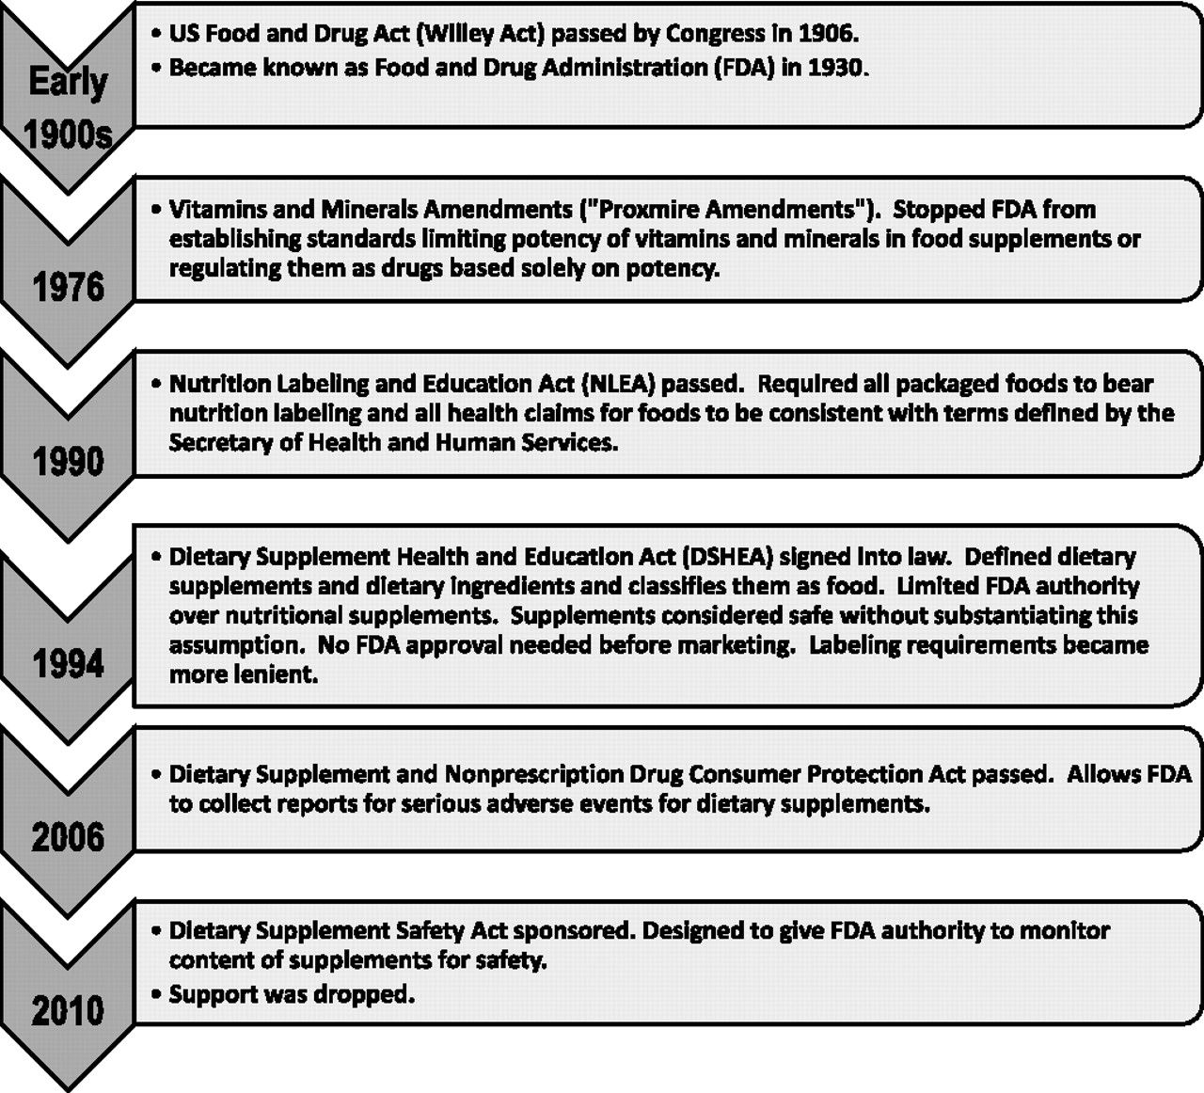
Figure 1 Regulatory history of dietary supplements in the United States.
Notes:
Figure 1 Regulatory history of dietary supplements in the United States.
Unless provided in the caption above, the following copyright applies to the content of this slide: © The Author 2012. Published by Oxford University Press.

