Slide 1
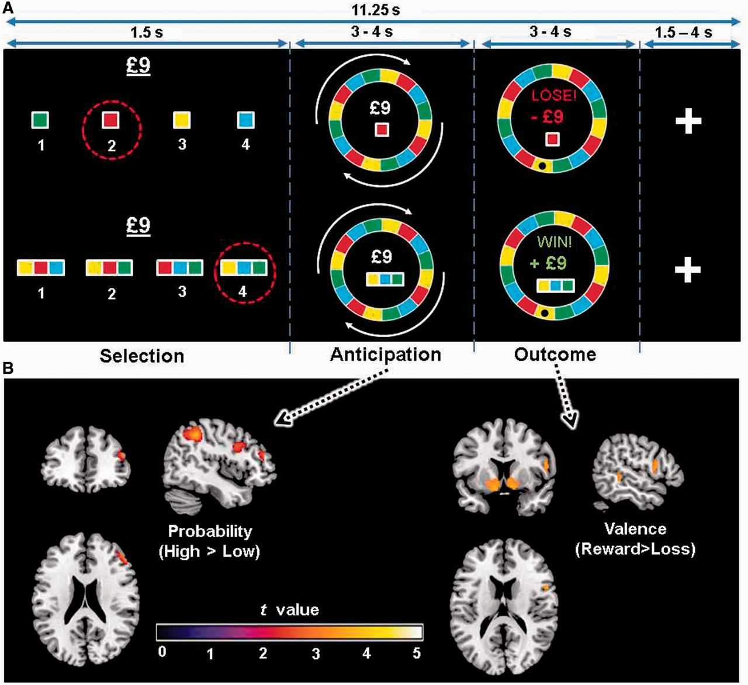
Figure 1 Trial schematic and associated neural activity. (A) Participants made bets on which colour would win in a ...
Notes:
Figure 1 Trial schematic and associated neural activity. (A) Participants made bets on which colour would win in a Roulette gamble. The trial sequence comprised three phases: selection; anticipation while the wheel spun; and outcome evaluation when the ball stopped on one of the colours, signifying the delivery of the reward or loss. (B) Whole-brain analysis of probability and valence during anticipation and outcome, respectively. Dorsolateral prefrontal cortex activated more during anticipation of high compared to low reward probability (cluster threshold P = 0.011 uncorrected, see Supplementary Table 1). At outcome, the nucleus accumbens was more active for rewards than losses (left and right cluster threshold P < 0.05 familywise error corrected).
Unless provided in the caption above, the following copyright applies to the content of this slide: © The Author (2014). Published by Oxford University Press on behalf of the Guarantors of Brain.This is an Open Access article distributed under the terms of the Creative Commons Attribution License (http://creativecommons.org/licenses/by/3.0/), which permits unrestricted reuse, distribution, and reproduction in any medium, provided the original work is properly cited.

Slide 2
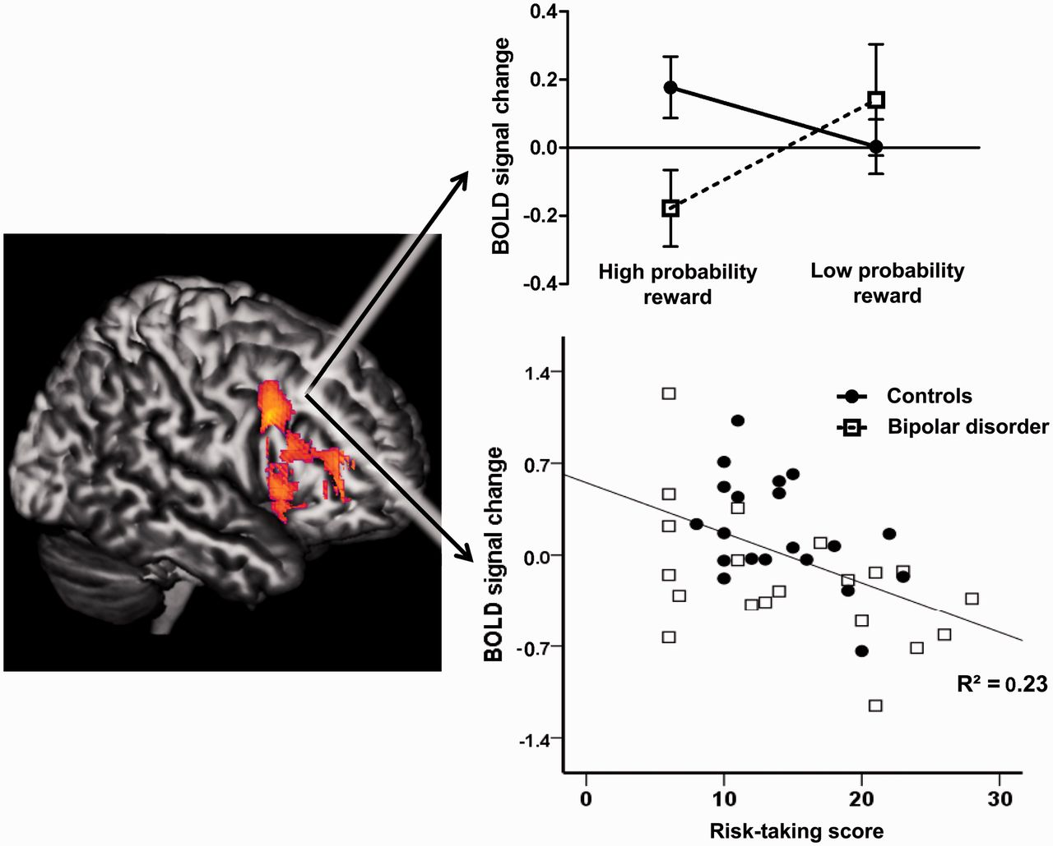
Figure 2 Abnormal dorsolateral prefrontal cortex (PFC) activity in bipolar disorder correlates with risk-taking. Left: ...
Notes:
Figure 2 Abnormal dorsolateral prefrontal cortex (PFC) activity in bipolar disorder correlates with risk-taking. Left: Effect of probability (High > Low) in whole-brain analysis of gamble outcomes. Right: Blood oxygen level-dependent signal from a priori region of interest analysis. Top right: Whereas controls preferentially activate dorsolateral PFC for high-probability (safe) reward outcomes, the bipolar disorder group show the opposite pattern, activating this region more for low-probability (risky) rewards. Bottom right: Greater real-life risk-taking in bipolar disorder group is associated with a reduced response to safe reward outcomes in right dorsolateral prefrontal cortex [r = −0.629, P = 0.005].
Unless provided in the caption above, the following copyright applies to the content of this slide: © The Author (2014). Published by Oxford University Press on behalf of the Guarantors of Brain.This is an Open Access article distributed under the terms of the Creative Commons Attribution License (http://creativecommons.org/licenses/by/3.0/), which permits unrestricted reuse, distribution, and reproduction in any medium, provided the original work is properly cited.

Slide 3
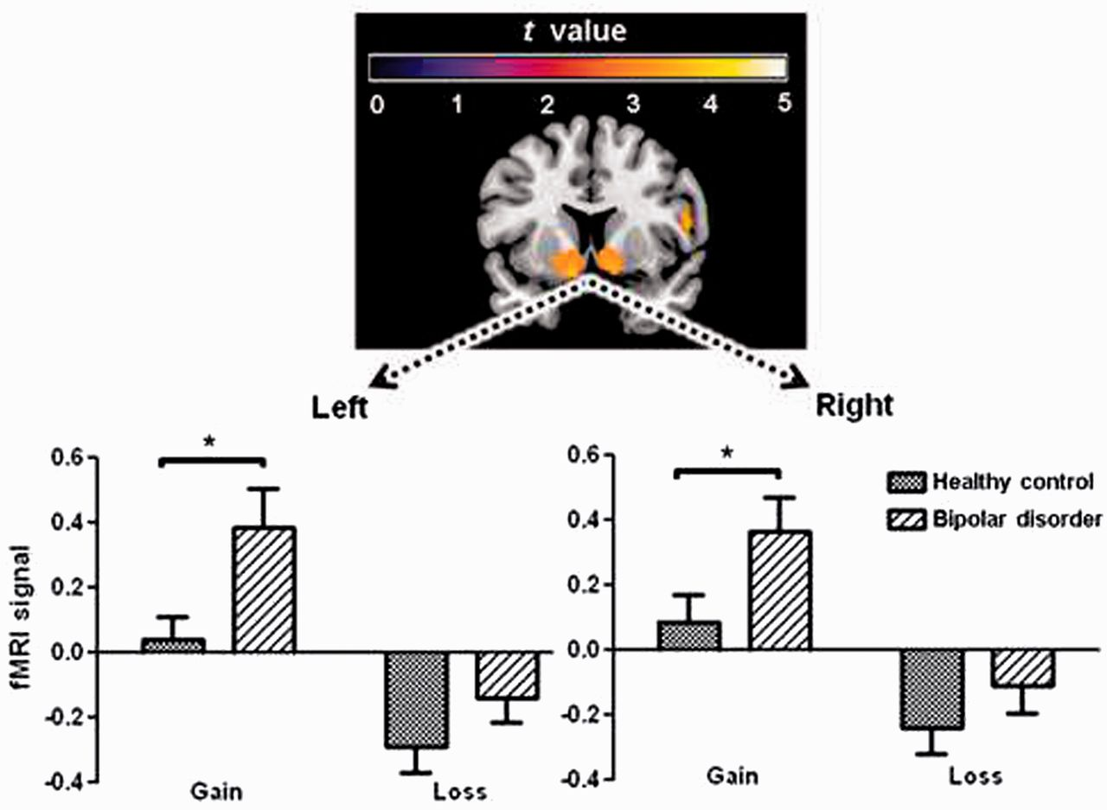
Figure 3 Hyper-hedonic response to reward in bipolar disorder. Top: Activity in ventral striatum and the ventromedial ...
Notes:
Figure 3 Hyper-hedonic response to reward in bipolar disorder. Top: Activity in ventral striatum and the ventromedial prefrontal cortex in response to gains [Gain > Loss contrast across all subjects (whole-brain analysis; P < 0.05, familywise error corrected)]. Bottom: blood oxygen level-dependent signal from a priori region of interest analysis of left and right ventral striatum for gain and loss outcomes. After a Roulette gamble, patients with euthymic bipolar disorder show a hyper-hedonic response to winning, and a smaller response to losing. This may result in greater swaying by the ‘feel-good’ highs and less influence of the potential hazards of risky choices. Asterisk indicates significant group difference (P ≤ 0.05).
Unless provided in the caption above, the following copyright applies to the content of this slide: © The Author (2014). Published by Oxford University Press on behalf of the Guarantors of Brain.This is an Open Access article distributed under the terms of the Creative Commons Attribution License (http://creativecommons.org/licenses/by/3.0/), which permits unrestricted reuse, distribution, and reproduction in any medium, provided the original work is properly cited.

Slide 4
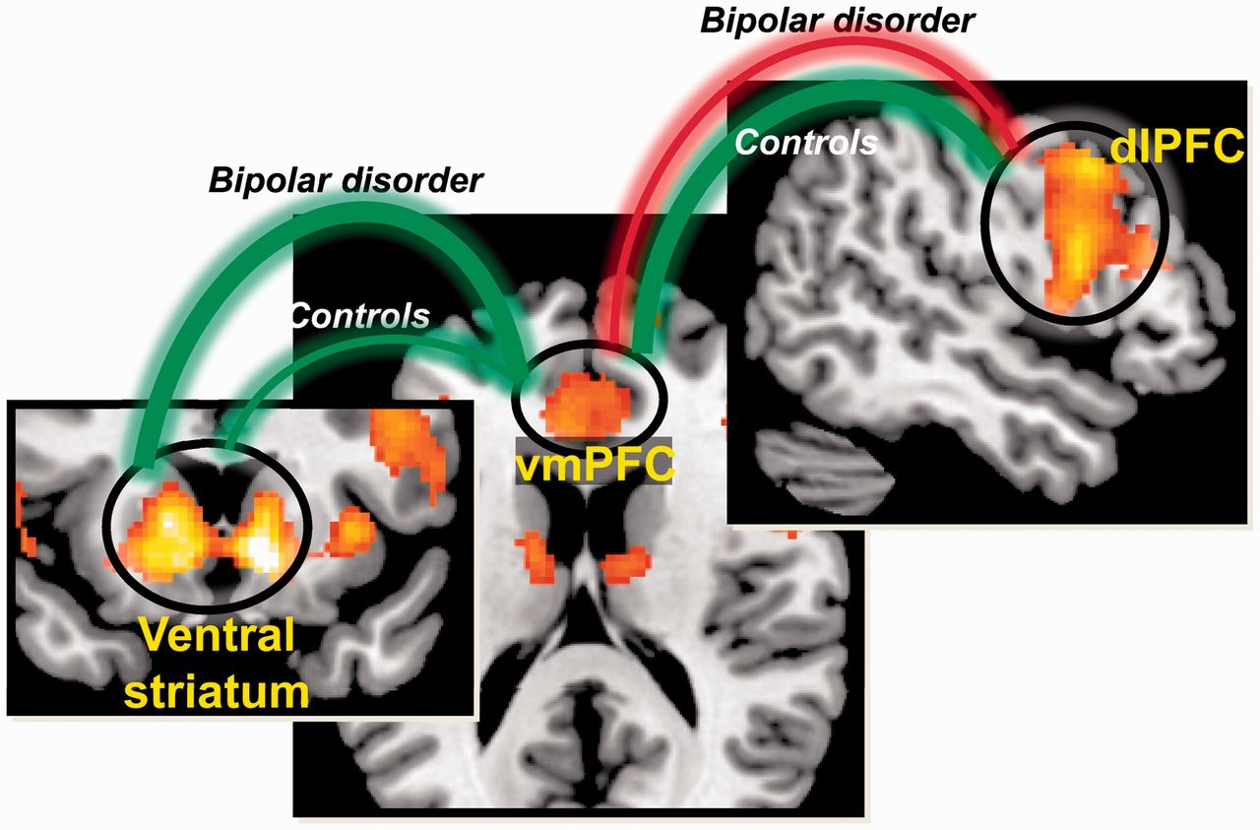
Figure 4 Outcome valuation in bipolar disorder is driven more by ventral striatal than dorsal prefrontal cortical ...
Notes:
Figure 4 Outcome valuation in bipolar disorder is driven more by ventral striatal than dorsal prefrontal cortical signals. In controls, ventromedial prefrontal cortical (vmPFC) activity showed moderate positive associations with both ventral striatum and with dorsolateral prefrontal cortex (dlPFC), consistent with comparable influences of both lower-order (ventral pathway) and higher-order (dorsal pathway) goals. In contrast, the bipolar disorder group showed a strong positive association in the ventral pathway (between ventral striatum and ventromedial PFC), and an inverse association in the dorsal pathway (between dorsolateral PFC and ventromedial PFC), suggesting that decision-making is influenced more by lower-order rather than higher-order aspects. Green and red lines denote positive and negative correlation, respectively. Thickness of connecting line denotes the strength of correlation coefficients.
Unless provided in the caption above, the following copyright applies to the content of this slide: © The Author (2014). Published by Oxford University Press on behalf of the Guarantors of Brain.This is an Open Access article distributed under the terms of the Creative Commons Attribution License (http://creativecommons.org/licenses/by/3.0/), which permits unrestricted reuse, distribution, and reproduction in any medium, provided the original work is properly cited.

