Slide 1
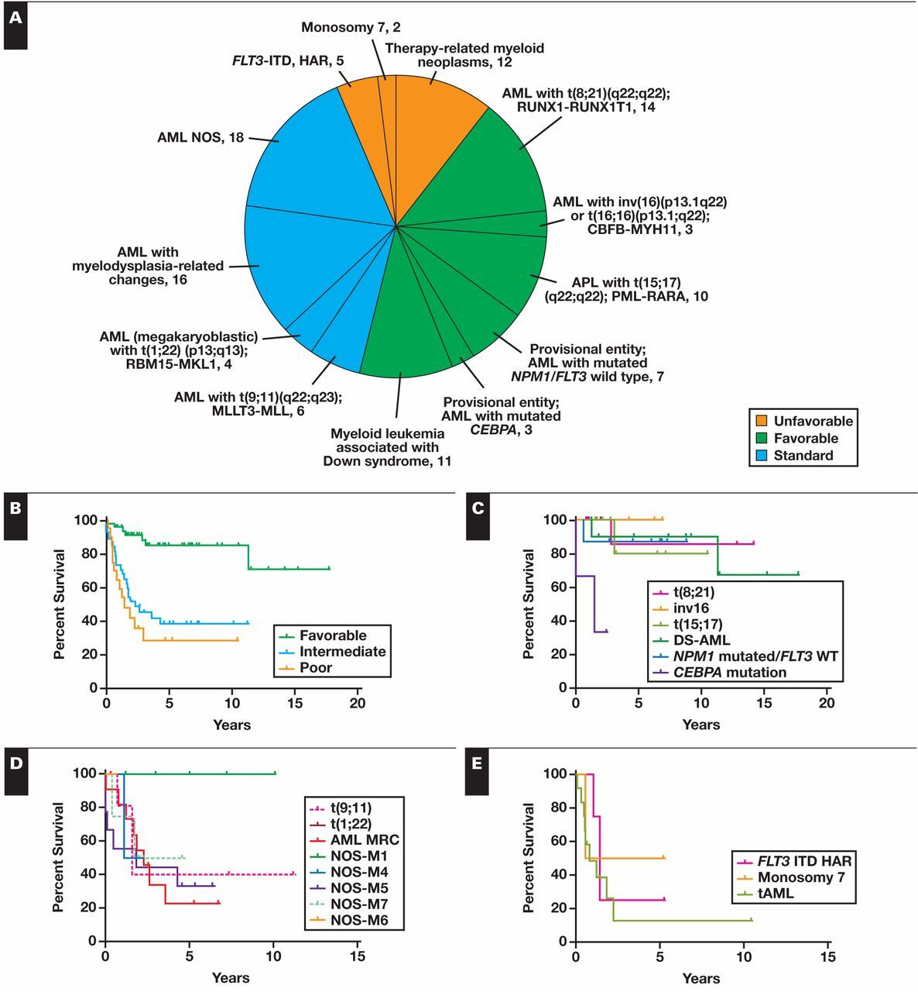
Figure 3 A, Distribution of our pediatric acute myeloid leukemia (AML) cases based on risk category. B, Overall ...
Notes:
Figure 3 A, Distribution of our pediatric acute myeloid leukemia (AML) cases based on risk category. B, Overall survival proportions based on risk group assignment. Only those with favorable risk had a statistically significant difference in survival. Individual Kaplan-Meier curves for each risk group are shown: favorable (C), intermediate (D), and unfavorable (E). APL, acute promyelocytic leukemia; DS, Down syndrome; HAR, high allelic ratio; ITD, internal tandem duplication; MRC, myelodysplasia-related changes; NOS, not otherwise specified; tAML, treatment-related AML; WT, wild type.
Unless provided in the caption above, the following copyright applies to the content of this slide: © American Society for Clinical Pathology

Slide 2
Figure 2 A, Overall survival of patients with treatment-related acute myeloid leukemia (tAML). B, Overall survival ...
Notes:
Figure 2 A, Overall survival of patients with treatment-related acute myeloid leukemia (tAML). B, Overall survival based on therapy received—chemotherapy alone vs chemotherapy and stem cell transplantation (P = .9461).
Unless provided in the caption above, the following copyright applies to the content of this slide: © American Society for Clinical Pathology

Slide 3
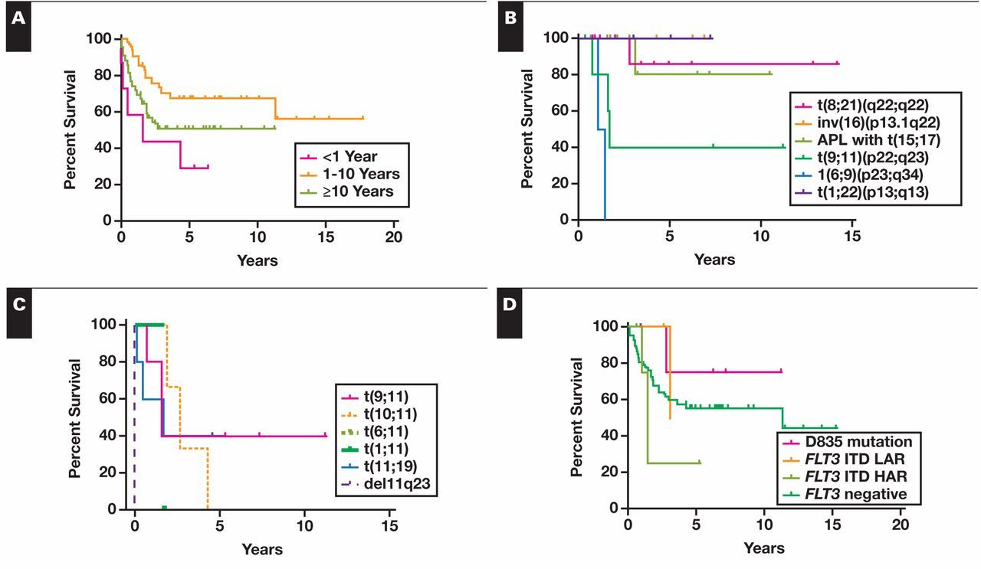
Figure 1 A, Overall survival based on age at diagnosis (P = .0214). B, Overall survival proportions based on recurrent ...
Notes:
Figure 1 A, Overall survival based on age at diagnosis (P = .0214). B, Overall survival proportions based on recurrent genetic abnormality subcategories according to the 2008 World Health Organization (WHO) classification. C, Overall survival proportions based on abnormalities of 11q23, of which the only prognostically recognized category in the WHO 2008 is t(9;11). D, Overall survival proportions based on abnormalities of FLT3. APL, acute promyelocytic leukemia; HAR, high allelic ratio; ITD, internal tandem duplication; LAR, low allelic ratio.
Unless provided in the caption above, the following copyright applies to the content of this slide: © American Society for Clinical Pathology

