Slide 1
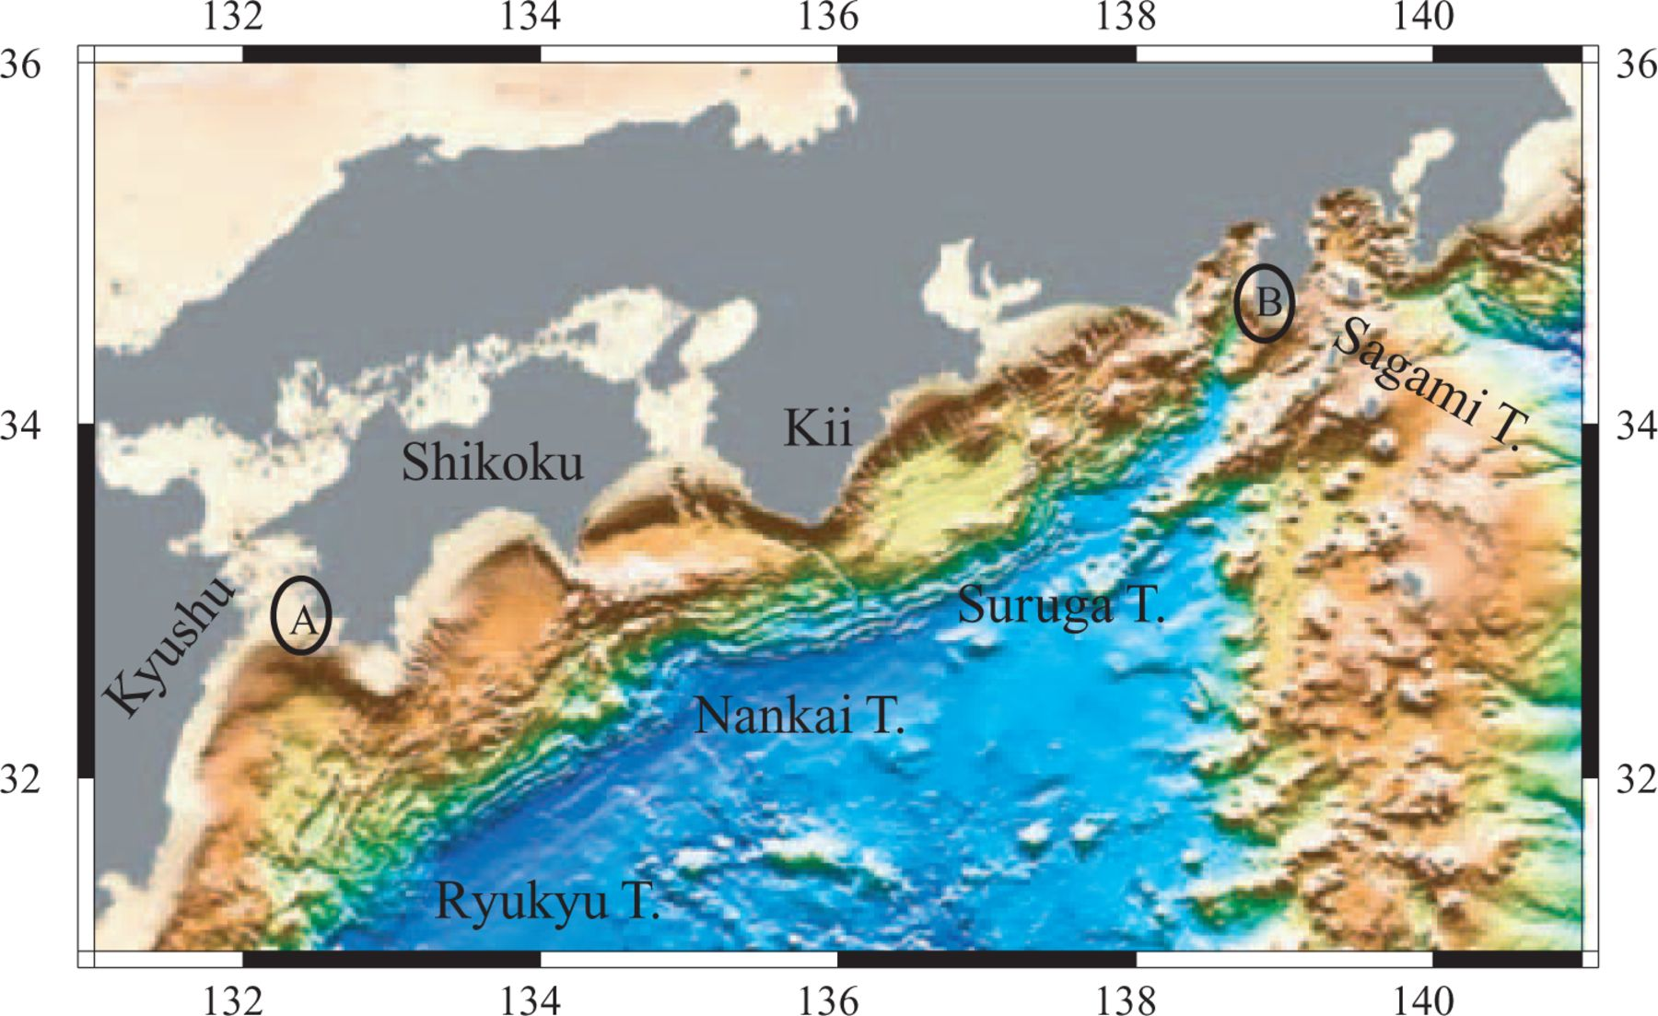
Figure 1 Regional study area. Points A and B indicate arc–arc joints of segments between the Ryukyu and Nankai ...
Notes:
Figure 1 Regional study area. Points A and B indicate arc–arc joints of segments between the Ryukyu and Nankai Troughs, and the Suruga and Sagami Troughs, respectively.
Unless provided in the caption above, the following copyright applies to the content of this slide: © 2005 RAS

Slide 2
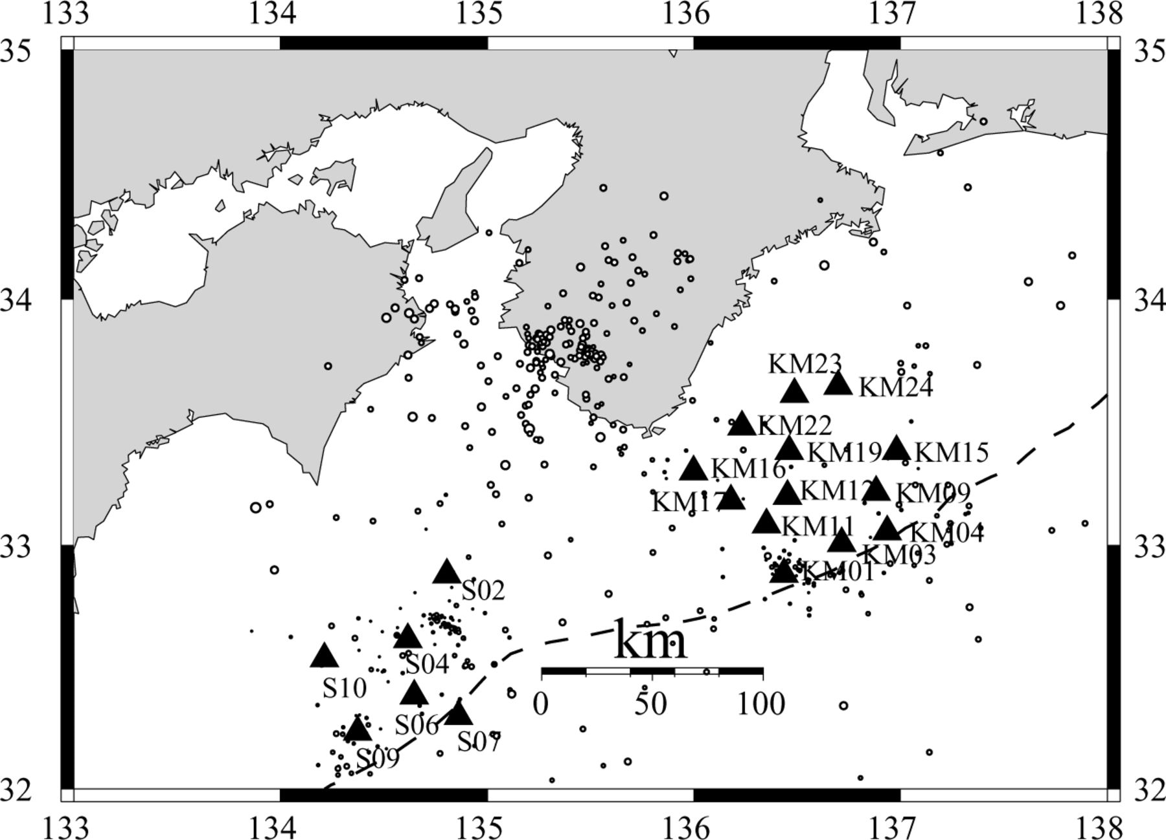
Figure 2 Shikoku Islands and Kii peninsula. Events recorded from OBS during 2000 June to August (off Muroto) and 2001 ...
Notes:
Figure 2 Shikoku Islands and Kii peninsula. Events recorded from OBS during 2000 June to August (off Muroto) and 2001 November to 2002 January (off Kii). Triangles: positions of OBS stations.
Unless provided in the caption above, the following copyright applies to the content of this slide: © 2005 RAS

Slide 3
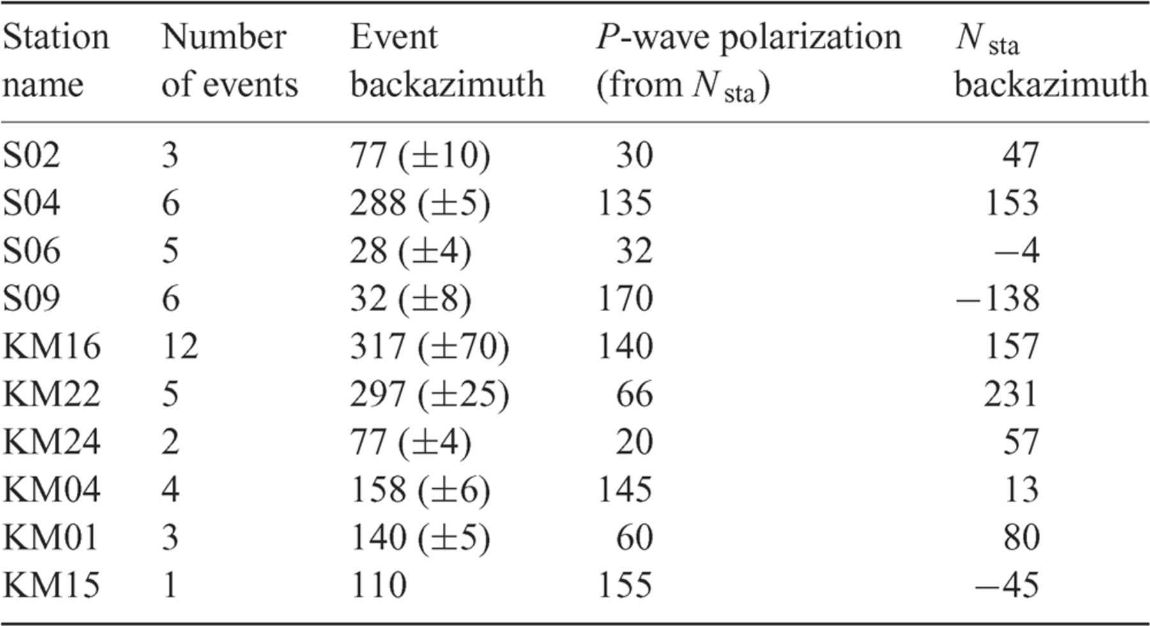
Table 1 Determination of OBS orientation based on event backazimuth and P-onset polarization.
Notes:
Table 1 Determination of OBS orientation based on event backazimuth and P-onset polarization.
Unless provided in the caption above, the following copyright applies to the content of this slide: © 2005 RAS

Slide 4
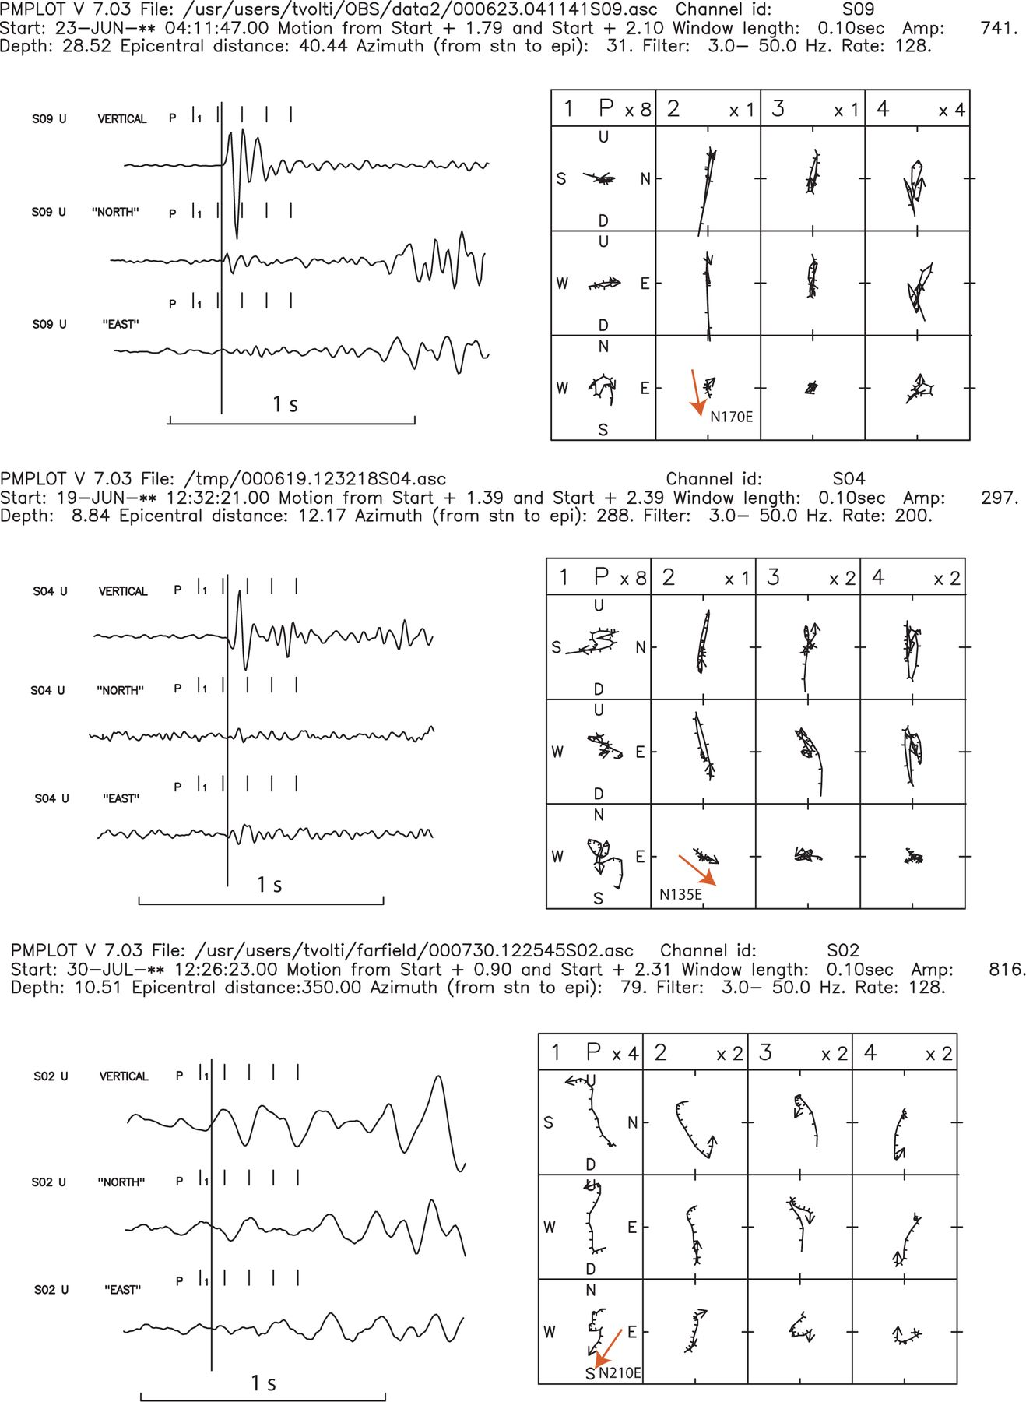
Figure 3 (a) and (b): two examples of seismograms where the P motion on the horizontal plane was used in order to ...
Notes:
Figure 3 (a) and (b): two examples of seismograms where the P motion on the horizontal plane was used in order to determine the true N and E orientations of the OBS stations.
Unless provided in the caption above, the following copyright applies to the content of this slide: © 2005 RAS

Slide 5
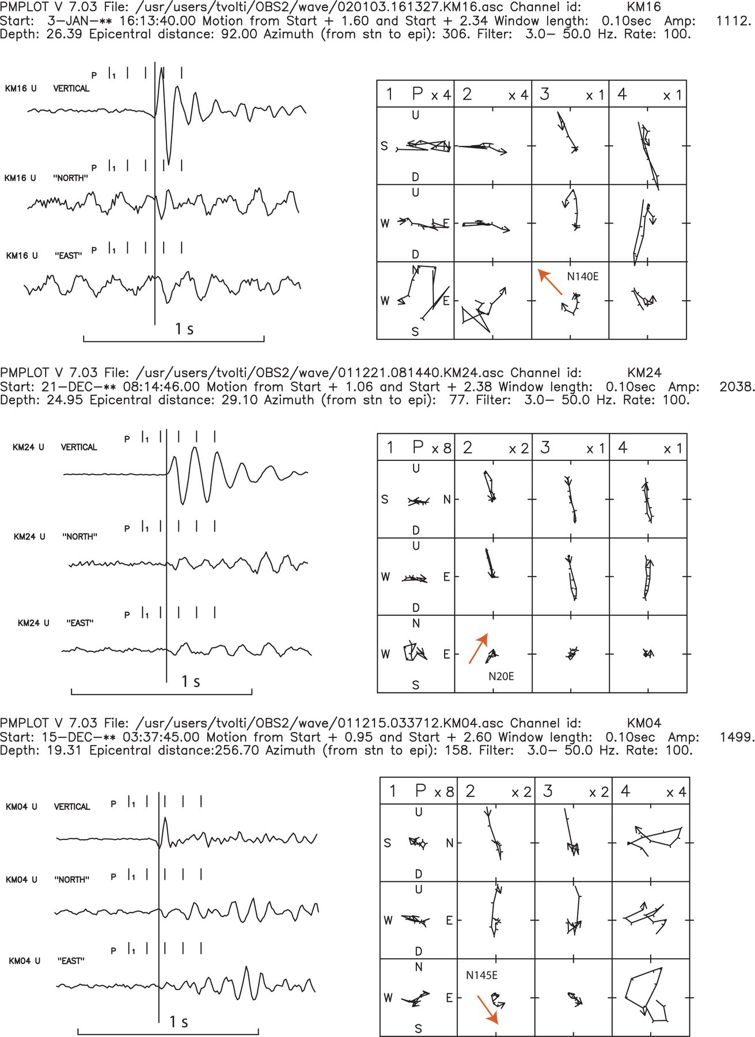
Figure 3 (a) and (b): two examples of seismograms where the P motion on the horizontal plane was used in order to ...
Notes:
Figure 3 (a) and (b): two examples of seismograms where the P motion on the horizontal plane was used in order to determine the true N and E orientations of the OBS stations.
Unless provided in the caption above, the following copyright applies to the content of this slide: © 2005 RAS

Slide 6
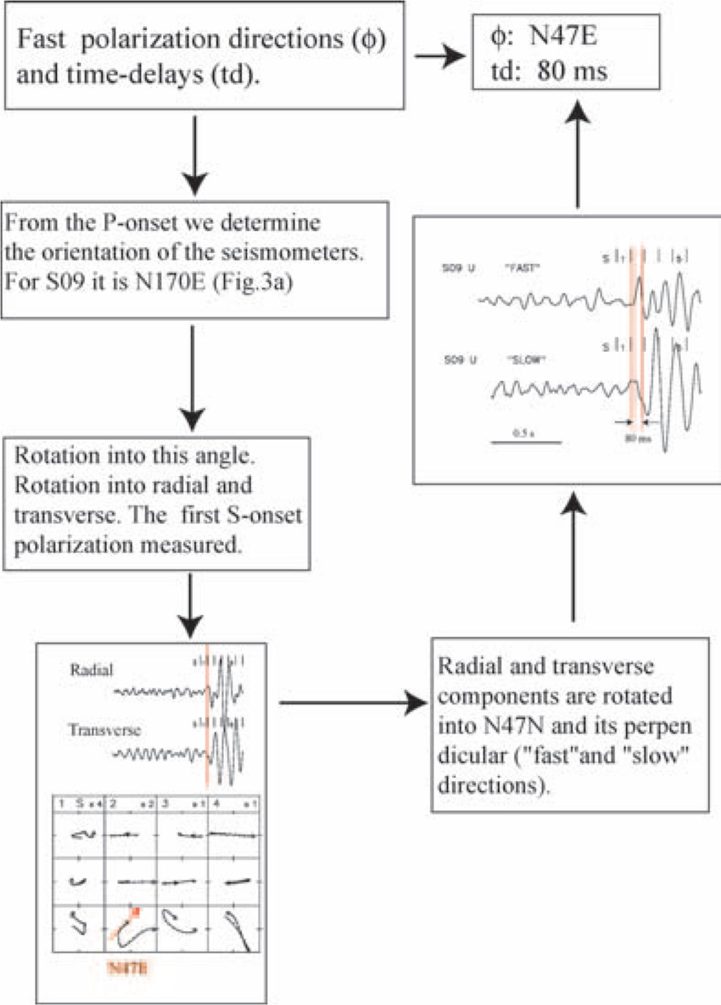
Figure 4 Flowchart showing the measurement procedure of SWS parameters (fast polarizations, time delays).
Notes:
Figure 4 Flowchart showing the measurement procedure of SWS parameters (fast polarizations, time delays).
Unless provided in the caption above, the following copyright applies to the content of this slide: © 2005 RAS

Slide 7
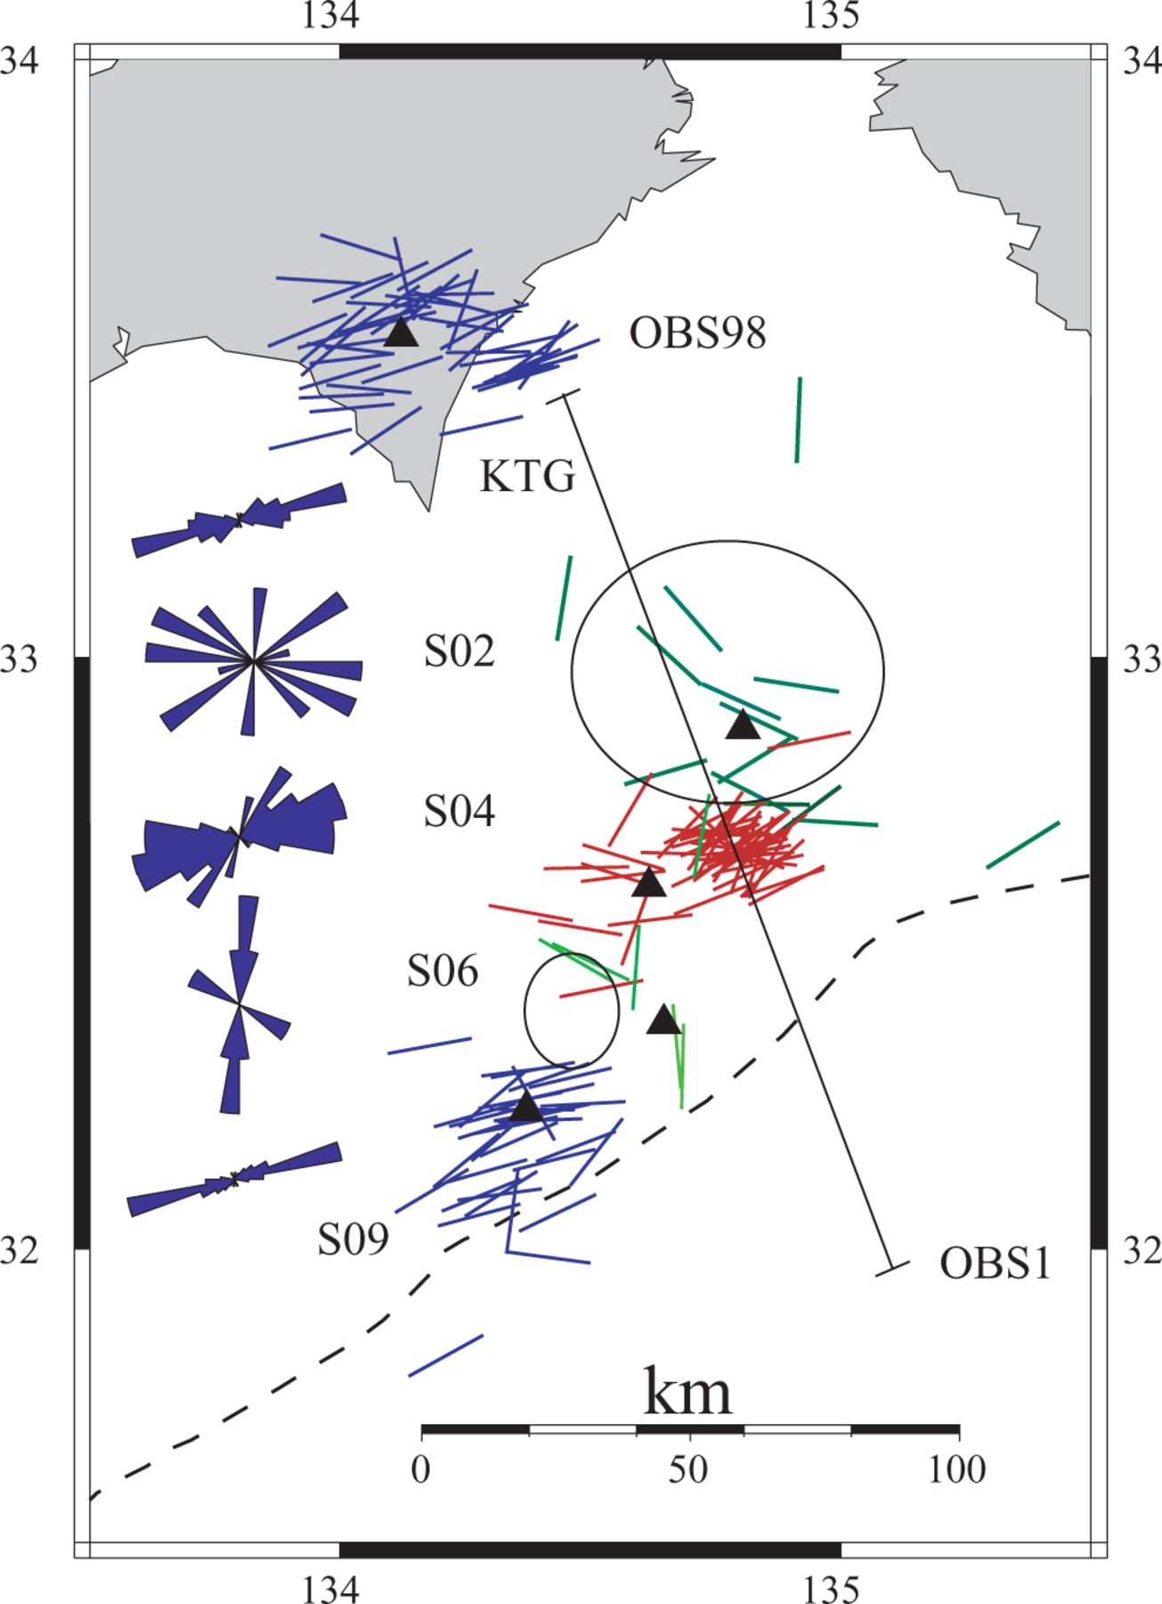
Figure 5 Fast shear-wave polarizations at stations S09 and KTG (blue), S06 and S02 (light and dark green, ...
Notes:
Figure 5 Fast shear-wave polarizations at stations S09 and KTG (blue), S06 and S02 (light and dark green, respectively) and S04 (red). Corresponding rose diagrams are on the left of the figure. Trench boundary shown with dashed line. OBS1–OBS98: seismic profile perpendicular to the trench. Location of seamounts shown with ellipses.
Unless provided in the caption above, the following copyright applies to the content of this slide: © 2005 RAS

Slide 8
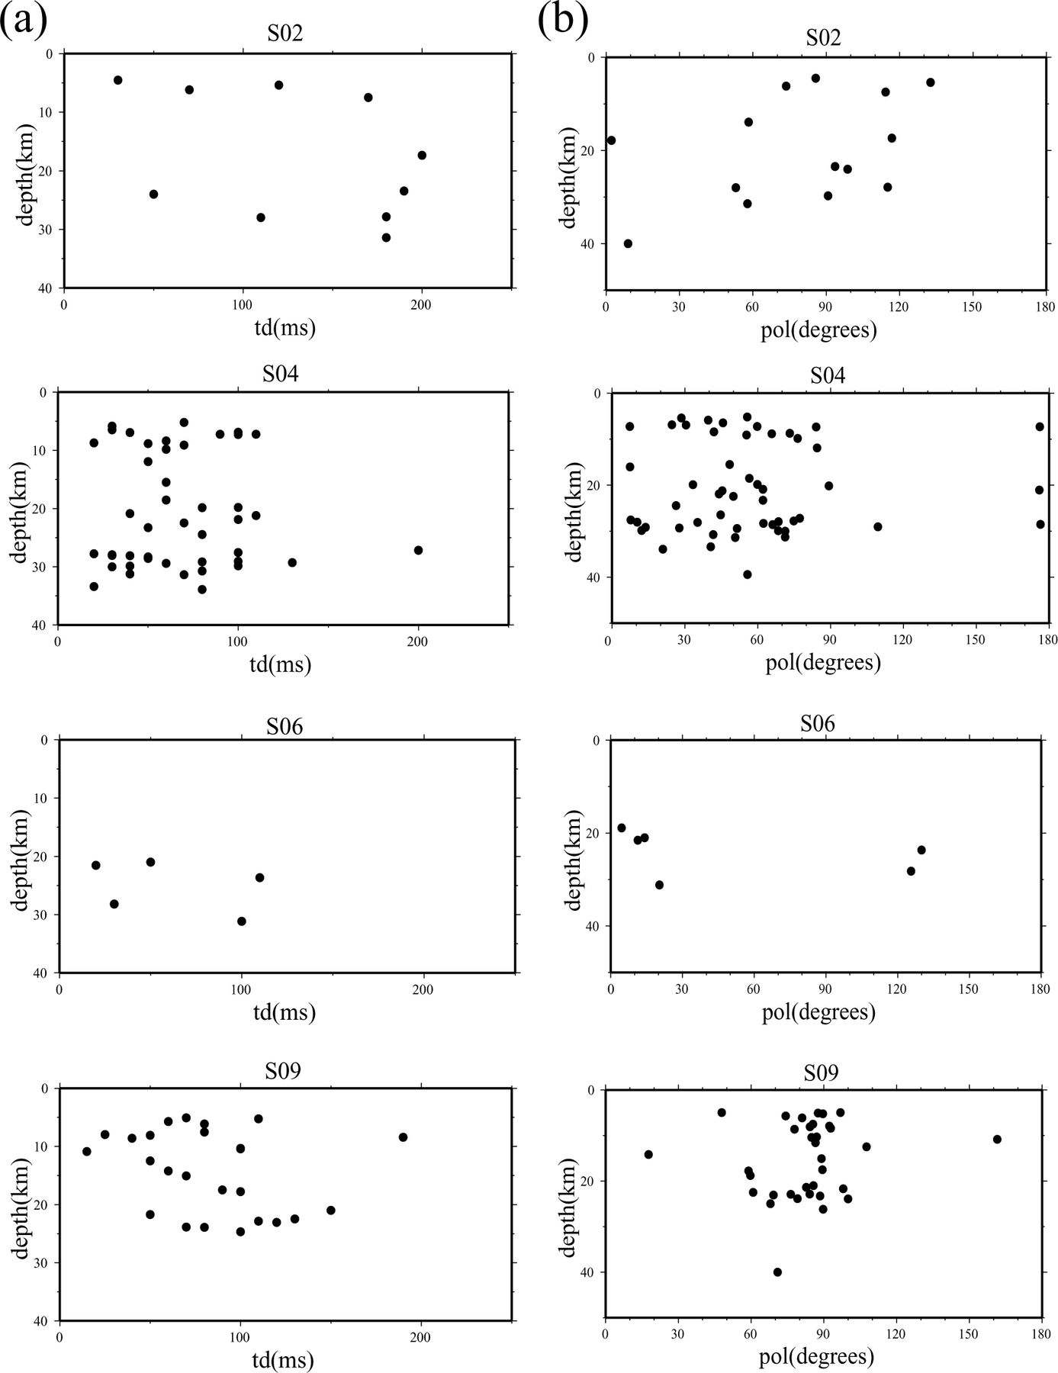
Figure 6 (a) Time delays and (b) polarizations versus depth.
Notes:
Figure 6 (a) Time delays and (b) polarizations versus depth.
Unless provided in the caption above, the following copyright applies to the content of this slide: © 2005 RAS

Slide 9
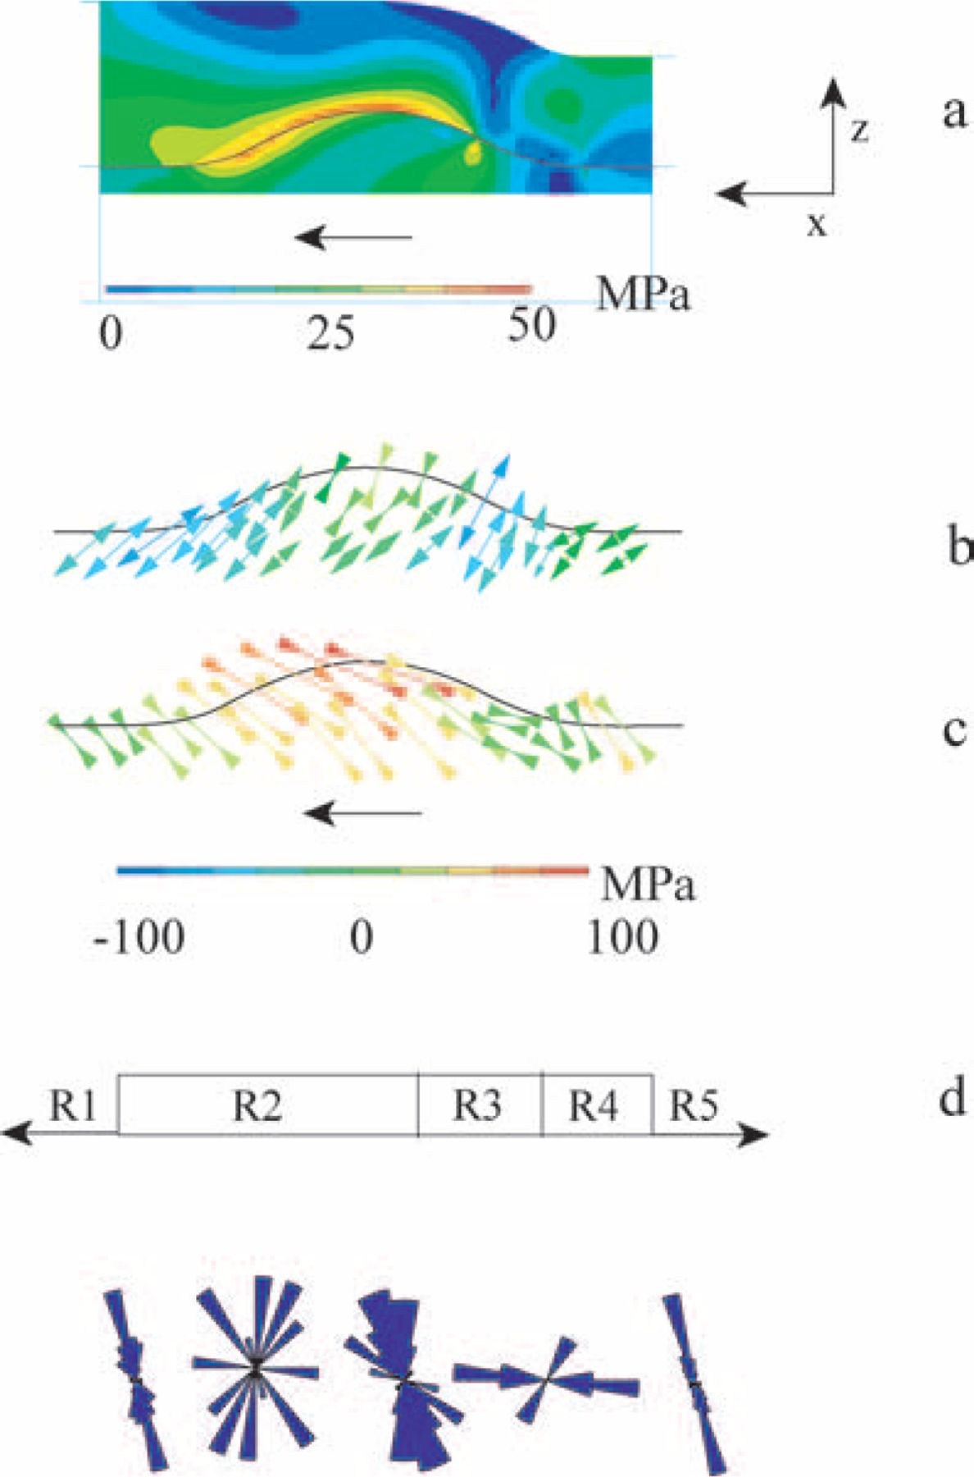
Figure 7 (a), (b) and (c) Results of 2-D finite element model (after Baba et al. 2001) The dimensions of seamount are ...
Notes:
Figure 7 (a), (b) and (c) Results of 2-D finite element model (after Baba et al. 2001) The dimensions of seamount are 2 km tall by 15 km wide. The thickness of accretionary sediments on landward flank is 6 km and on seaward flank 4 km.(a) Distribution of maximum incremental shear stress (b) and (c) minimum and maximum principal stress, respectively. (d) Regions with qualitatively different stress-field characteristics.
Unless provided in the caption above, the following copyright applies to the content of this slide: © 2005 RAS

Slide 10
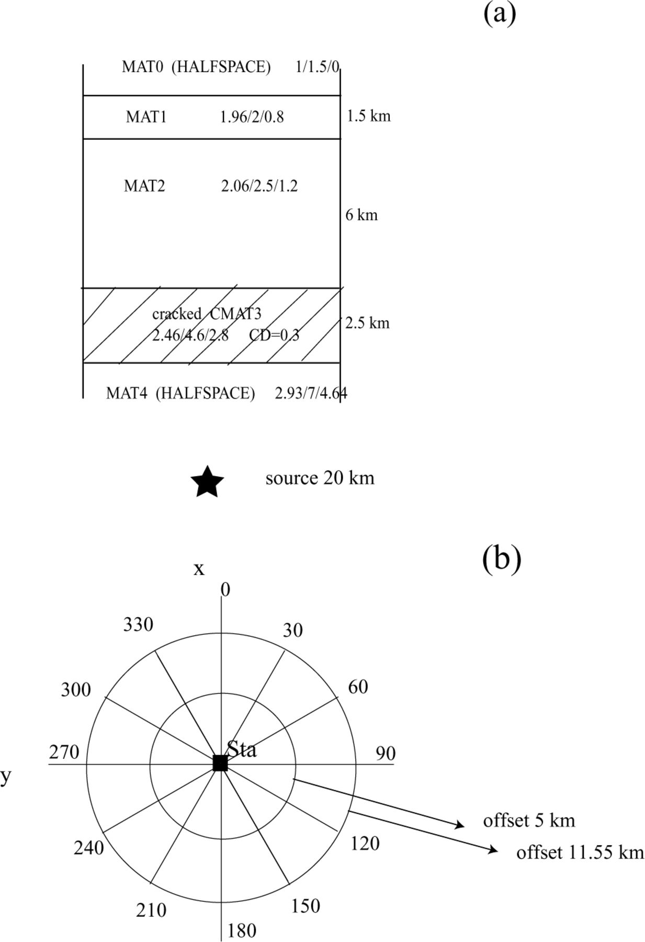
Figure 8 (a) Layered model for Nankai (after Kodaira et al. 2002; Park et al. 1999). The layer above the seamount is ...
Notes:
Figure 8 (a) Layered model for Nankai (after Kodaira et al. 2002; Park et al. 1999). The layer above the seamount is cracked. Numbers denote density, Vp and Vs. CD: crack density. (b) Horizontal view of modelling. The 30° azimuth step for two offsets 5 and 11.55 km, respectively.
Unless provided in the caption above, the following copyright applies to the content of this slide: © 2005 RAS

Slide 11
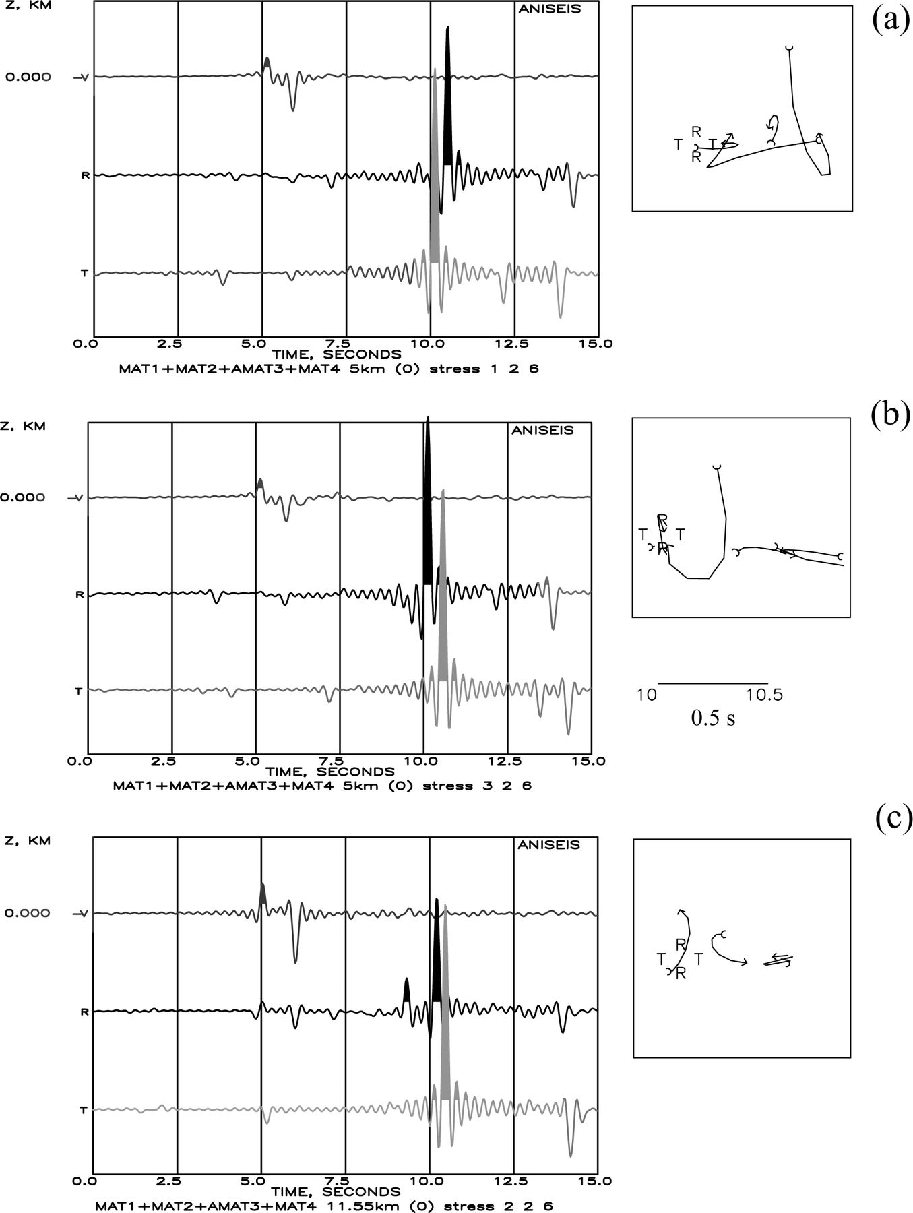
Figure 9 Synthetic seismograms calculated for the model of Fig. 8, using ANISEIS. Anisotropic poro-elasticity (APE) ...
Notes:
Figure 9 Synthetic seismograms calculated for the model of Fig. 8, using ANISEIS. Anisotropic poro-elasticity (APE) applied for three sets of differential stress. Source depth: 20 km. y: direction of regional field. Effect of shear-wave polarizations for azimuth 0° (a) 1 2 6 for offset 5 km; (b) 3 2 6 for offset 5 km and (c) 2 2 6 for offset 11.55 km. Notice the larger offset (11.55 km) in (c) needed for time-delays to be noticed.
Unless provided in the caption above, the following copyright applies to the content of this slide: © 2005 RAS

Slide 12
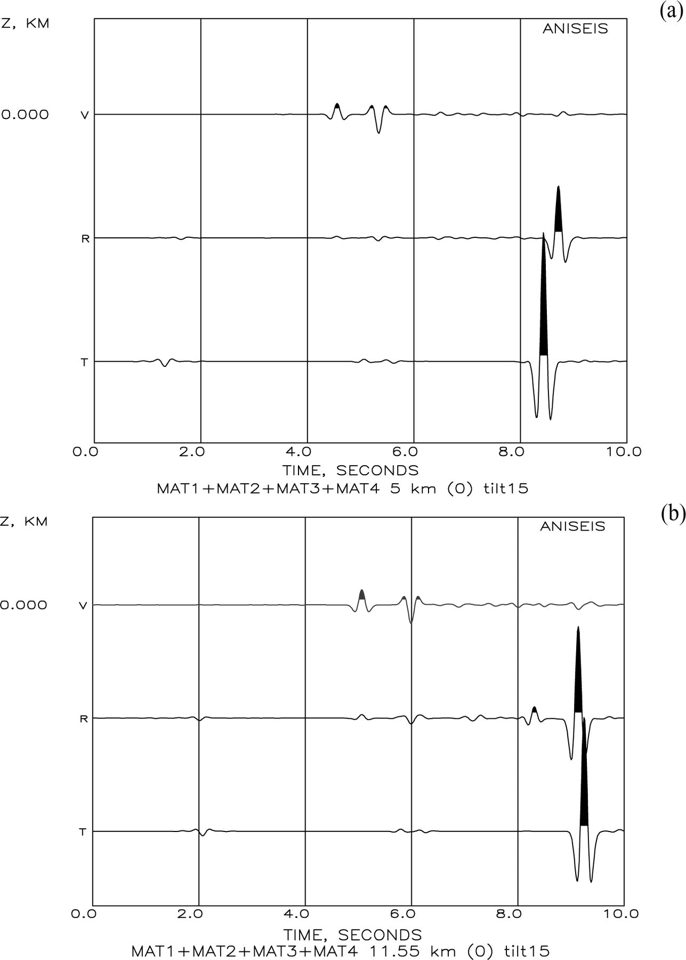
Figure 10 Effect of tilting the X–Z plane of cracks on synthetic shear-wave polarizations. (a) tilt 15° offset 5 km (b) ...
Notes:
Figure 10 Effect of tilting the X–Z plane of cracks on synthetic shear-wave polarizations. (a) tilt 15° offset 5 km (b) tilt 15° offset 11.55 km.
Unless provided in the caption above, the following copyright applies to the content of this slide: © 2005 RAS

Slide 13
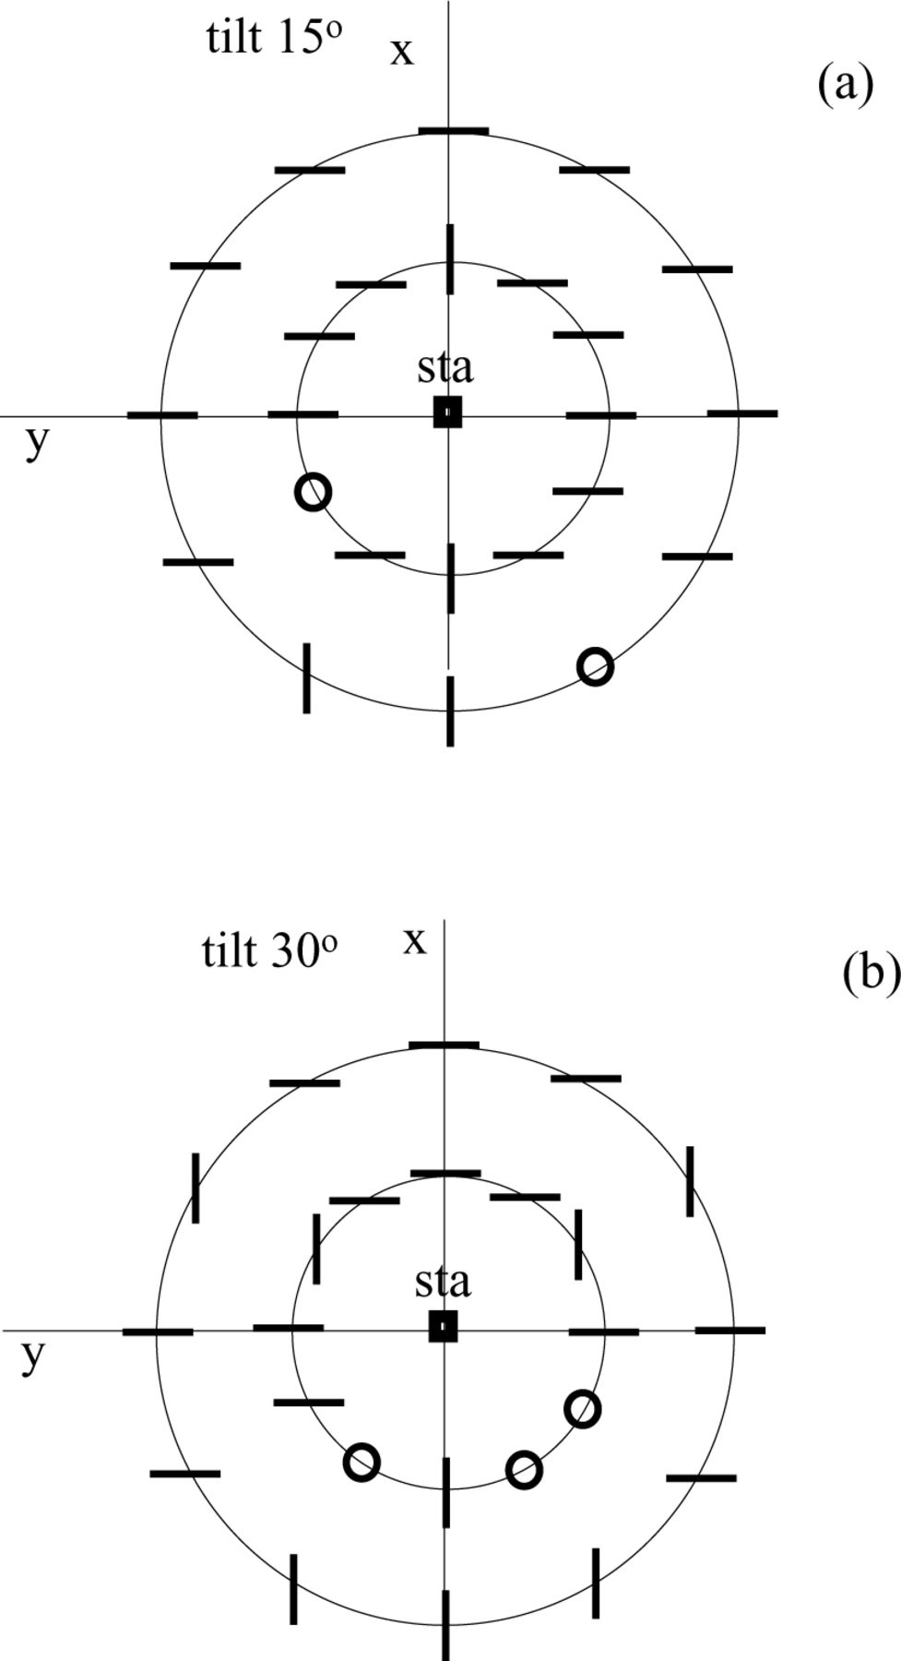
Figure 11 Summary of results for tilts 15° and 30°. Inner circle radius 5 km. Outer circle radius 11.55 km. Source ...
Notes:
Figure 11 Summary of results for tilts 15° and 30°. Inner circle radius 5 km. Outer circle radius 11.55 km. Source depth 20 km. Open circle: elliptical motion.
Unless provided in the caption above, the following copyright applies to the content of this slide: © 2005 RAS

Slide 14
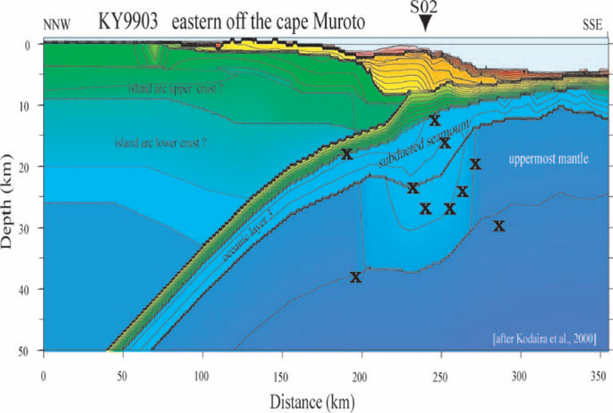
Figure 12 Model based on the reflection profile (after Kodaira et al. 2002), and location of events from the lower ...
Notes:
Figure 12 Model based on the reflection profile (after Kodaira et al. 2002), and location of events from the lower oceanic crust and the uppermost mantle, as recorded by station S02.
Unless provided in the caption above, the following copyright applies to the content of this slide: © 2005 RAS

Slide 15
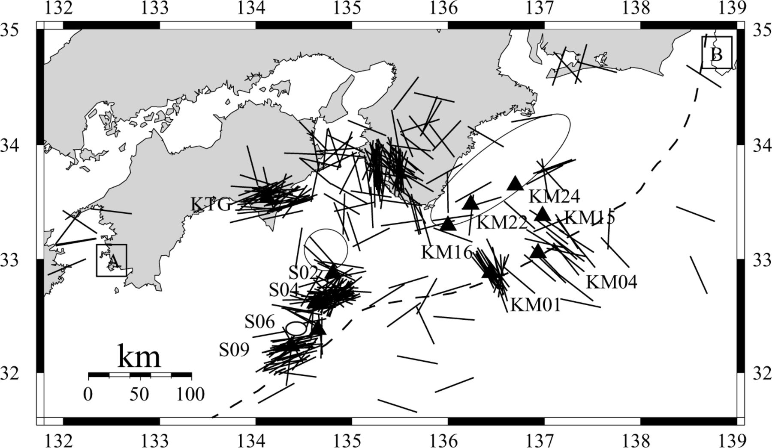
Figure 13 Map of fast polarizations for crustal and underplate earthquakes (off Mmuroto, off Kii regions). Positions of ...
Notes:
Figure 13 Map of fast polarizations for crustal and underplate earthquakes (off Mmuroto, off Kii regions). Positions of seamounts and asperities are marked with ellipses. For points A and B, see Fig. 1.
Unless provided in the caption above, the following copyright applies to the content of this slide: © 2005 RAS

