Slide 1
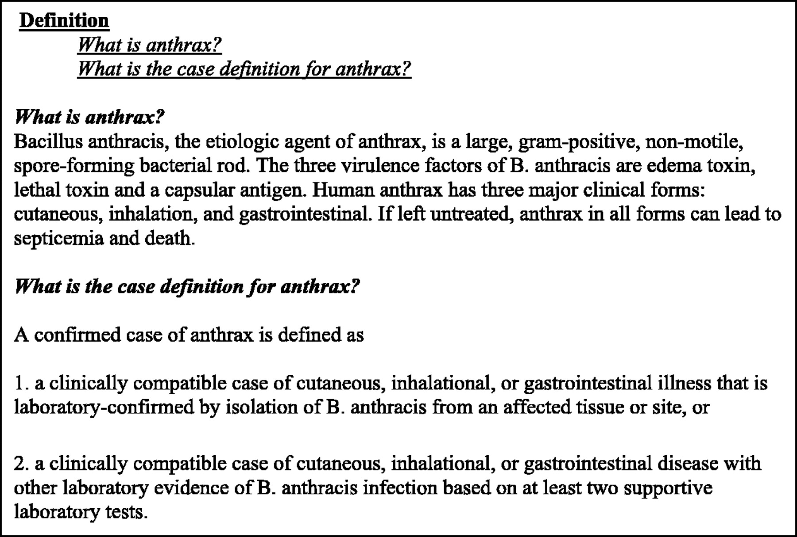
Fig. 1: CDC web site definition of anthrax (CDC, 2002).
Notes:
Fig. 1: CDC web site definition of anthrax (CDC, 2002).
Unless provided in the caption above, the following copyright applies to the content of this slide: © The Author 2005. Published by Oxford University Press. All rights reserved. For Permissions, please email: journals.permissions@oupjournals.org

Slide 2
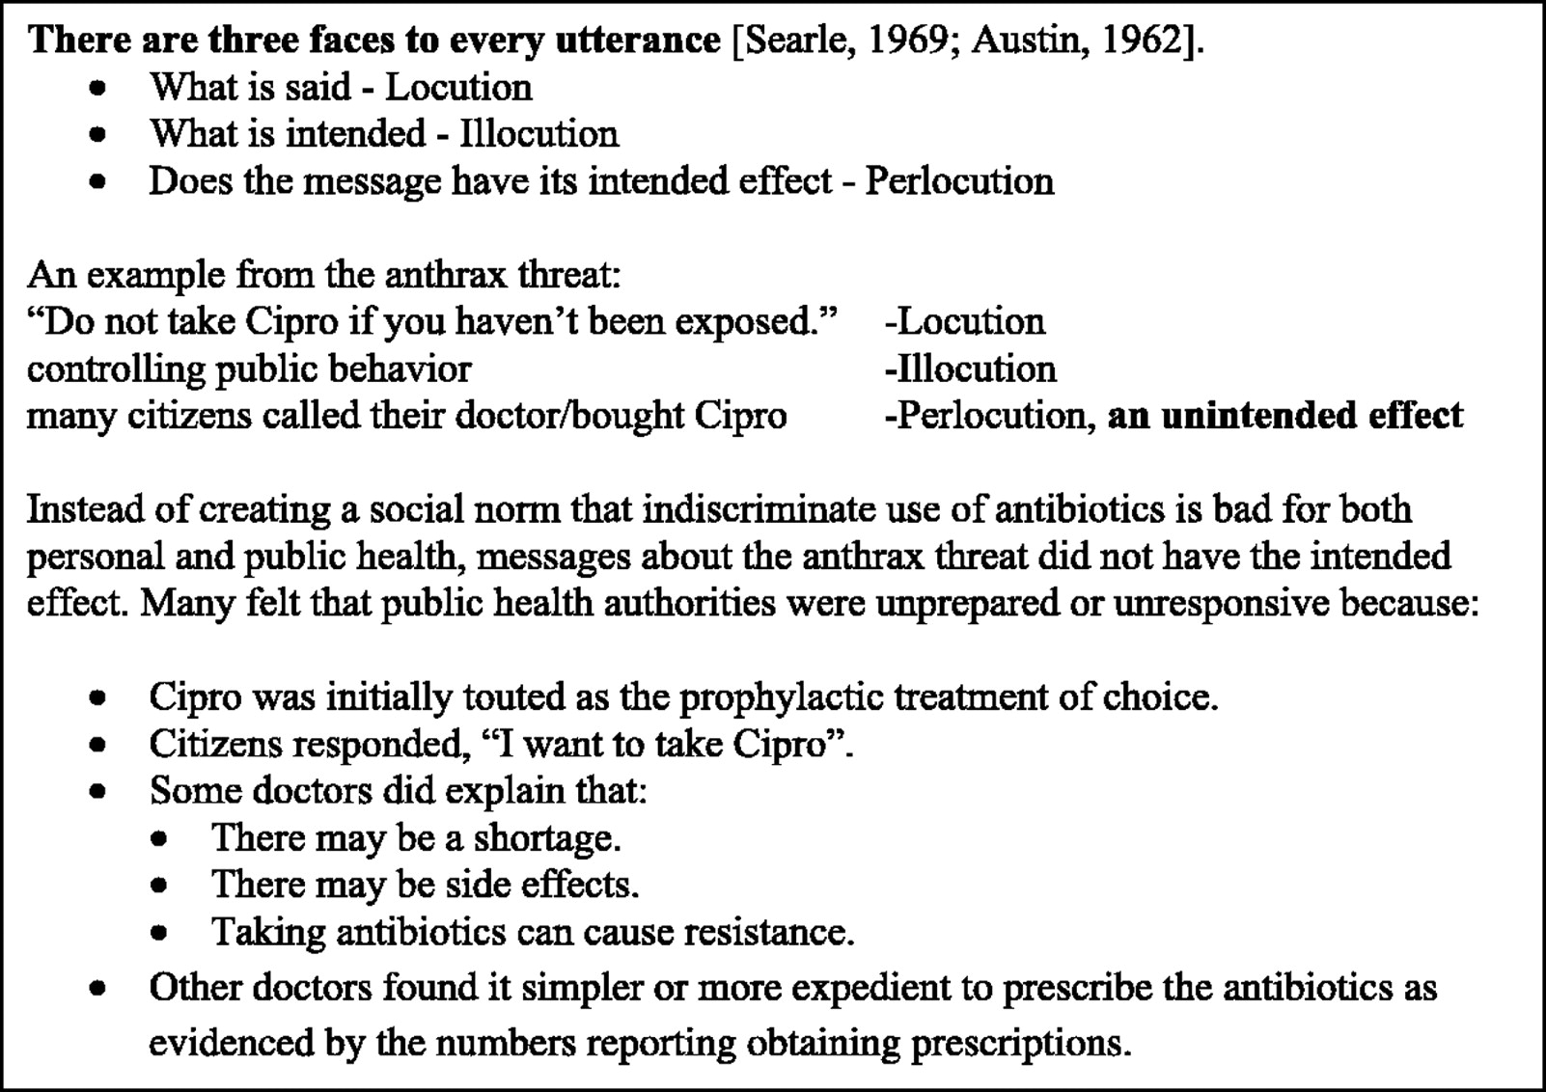
Fig. 2: A mini-case: Messages about Cipro not leading to the desired outcome.
Notes:
Fig. 2: A mini-case: Messages about Cipro not leading to the desired outcome.
Unless provided in the caption above, the following copyright applies to the content of this slide: © The Author 2005. Published by Oxford University Press. All rights reserved. For Permissions, please email: journals.permissions@oupjournals.org

