Slide 1
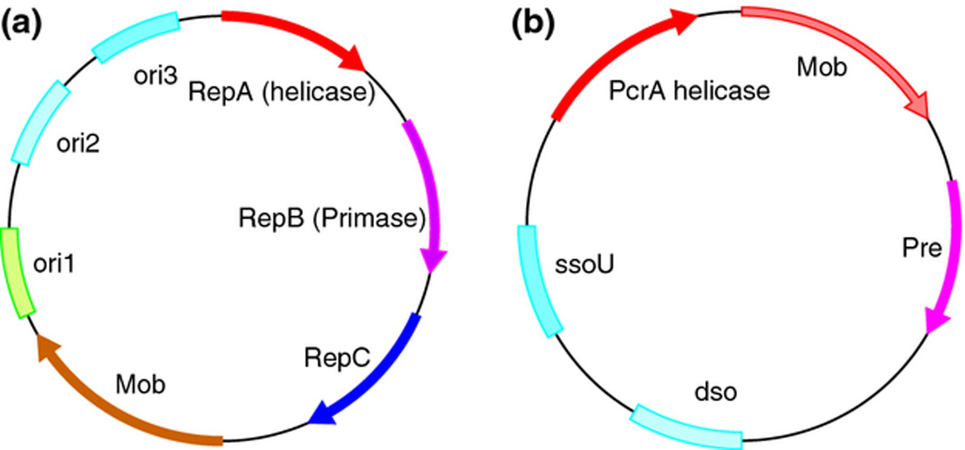
Idealized depiction of a broad host range plasmid originating from a Gram-negative bacteria (a) and ...
Notes:
Idealized depiction of a broad host range plasmid originating from a Gram-negative bacteria (a) and Gram-positive bacteria (b). The genes repA, repB, and repC encode for the helicase, primase. and initiator protein. The single-stranded origin ssoU and the PcrA helicase is highlighted, which confers broad host range to Gram-positive bacteria.
Unless provided in the caption above, the following copyright applies to the content of this slide: © 2013 Federation of European Microbiological Societies. Published by John Wiley & Sons Ltd. All rights reserved

