Slide 1
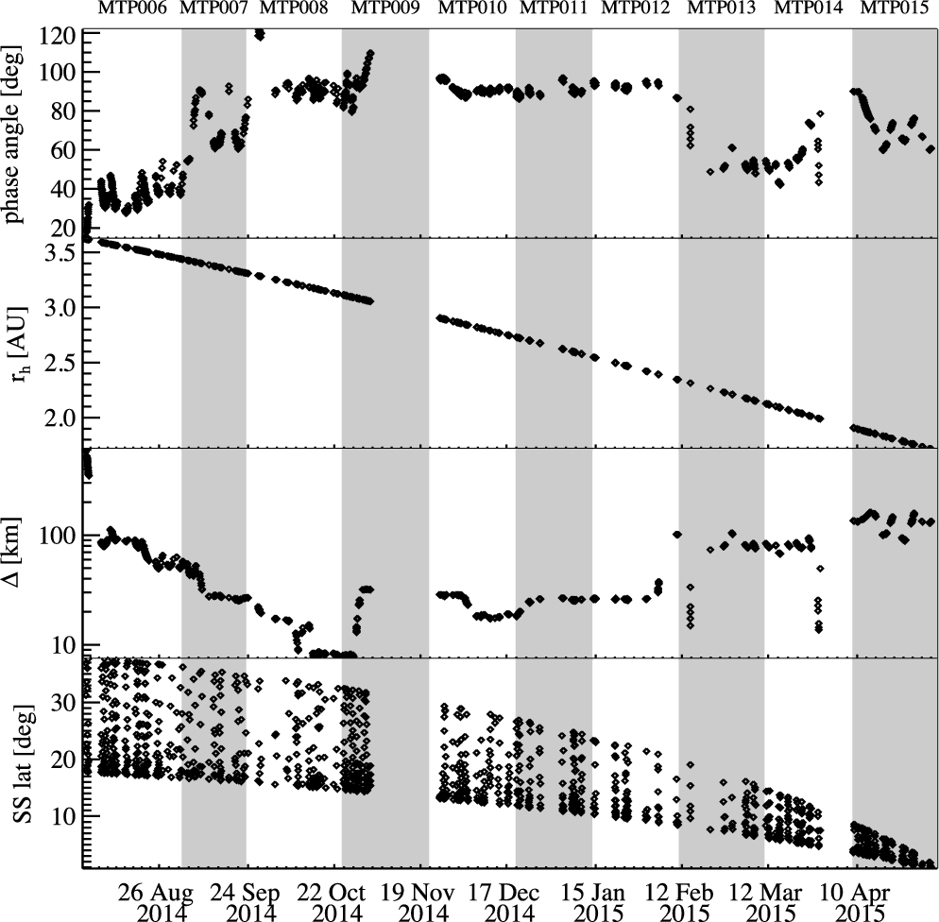
Figure 1. VIRTIS-M observations data set properties as a function of time. From top to bottom: solar phase angle, ...
Notes:
Figure 1. VIRTIS-M observations data set properties as a function of time. From top to bottom: solar phase angle, heliocentric distance rh, comet–spacecraft distance Δ and subsolar latitude, SS lat. Oscillations of the subsolar latitude with diurnal frequency are due to the irregular shape of the nucleus.
Unless provided in the caption above, the following copyright applies to the content of this slide: © 2016 The Authors Published by Oxford University Press on behalf of the Royal Astronomical Society

Slide 2
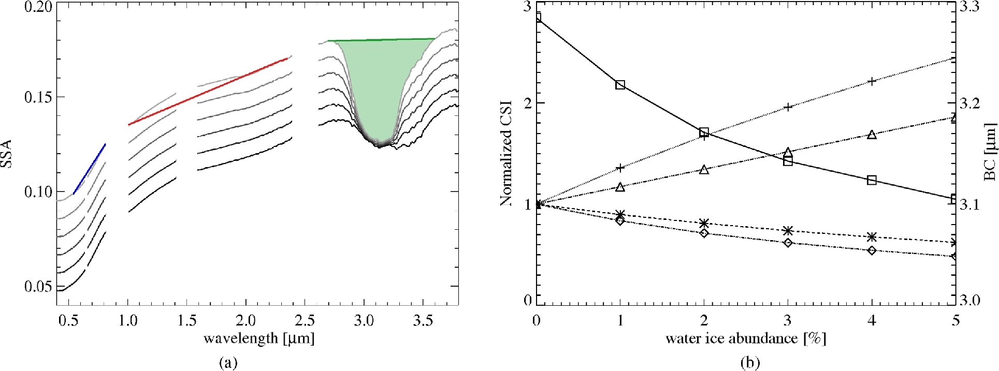
Figure 2. (a) Simulated SSA of 67P dark terrain intimately mixed with various amounts of water ice from 0 to 5 per cent ...
Notes:
Figure 2. (a) Simulated SSA of 67P dark terrain intimately mixed with various amounts of water ice from 0 to 5 per cent (black to grey). Spectral models are computed by means of Hapke theory (Ciarniello et al. 2011; Hapke 2012; Raponi et al. 2016) assuming 2 μm grain size water ice particles (De Sanctis et al. 2015). SSA of 67P's dark terrain is given in Ciarniello et al. (2015), while for H2O ice it is computed from optical constants by Warren (1984), Mastrapa et al. (2008, 2009) and Clark et al. (2012). The blue and red lines across the spectrum indicate how the spectral slope in the VIS (SVIS) and in the IR (SIR) are computed, respectively. Similarly, the green area in correspondence of the 3.2 μm band evidences the interval selected to compute the band area (BA) and the band centre (BC), which, we recall here, are computed after continuum removal. (b) CSI (comet spectral indicators) normalized at their value computed on 67P dark terrain as a function of water ice abundance: SVIS (diamonds), SIR (asterisks), BA (crosses) and SSA (triangles). BC (squares) is not normalized and its scale is reported on the right axis.
Unless provided in the caption above, the following copyright applies to the content of this slide: © 2016 The Authors Published by Oxford University Press on behalf of the Royal Astronomical Society

Slide 3
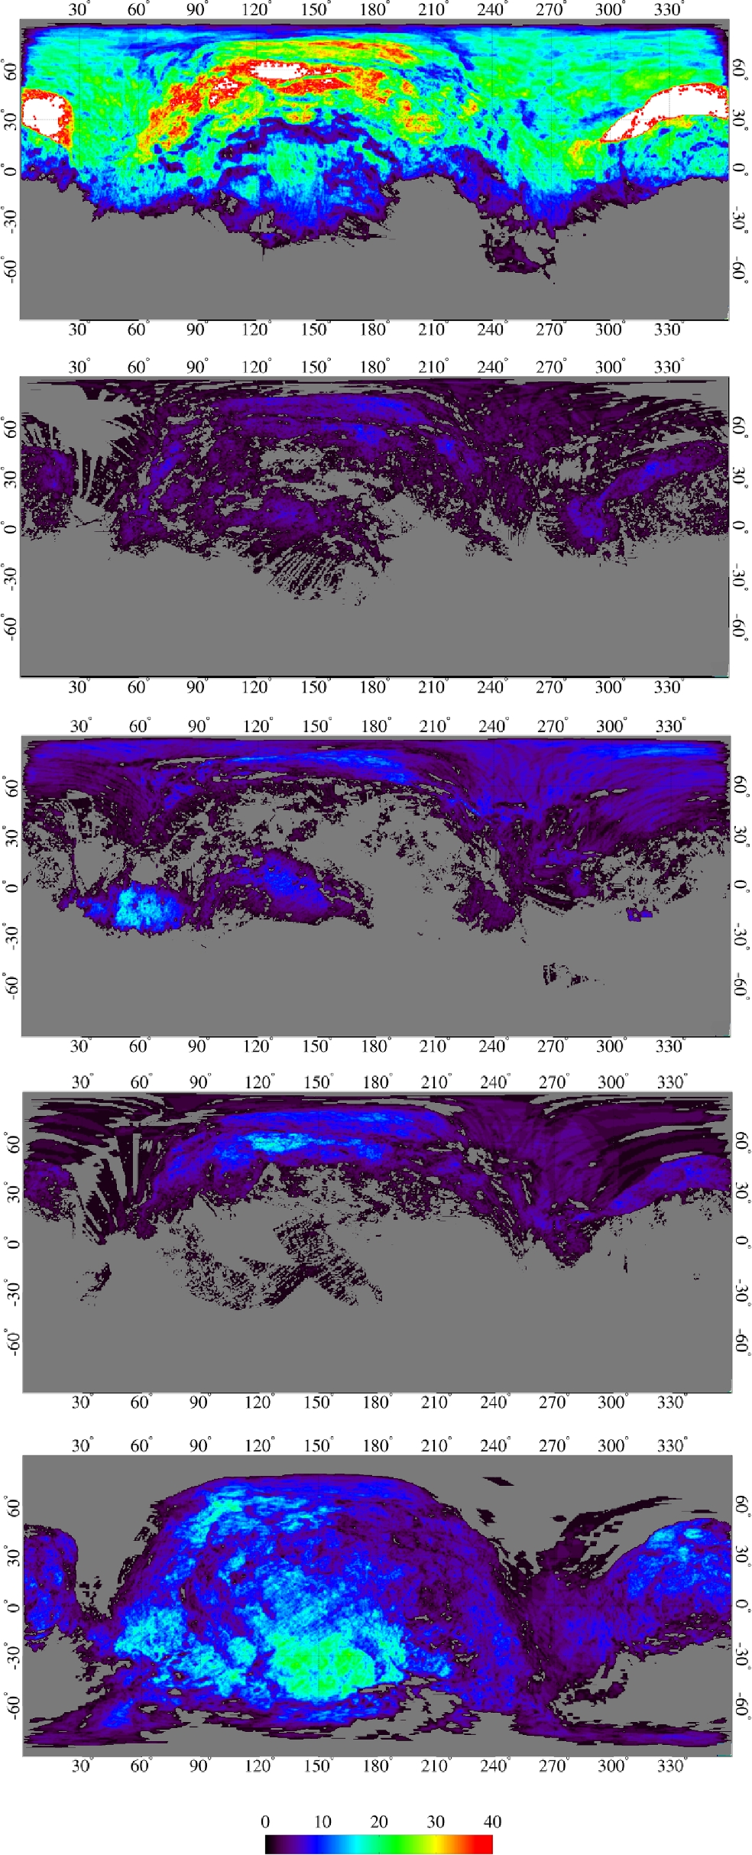
Figure 3. Redundancy (number of available VIRTIS observations for a given position) maps for the different observation ...
Notes:
Figure 3. Redundancy (number of available VIRTIS observations for a given position) maps for the different observation phases. From top to bottom: MTP006, MTP007-MTP008, MTP009-MTP010, MTP011-MTP012 and MTP014-MTP015. See Figs 4 and 5 for 67P's morphological regions.
Unless provided in the caption above, the following copyright applies to the content of this slide: © 2016 The Authors Published by Oxford University Press on behalf of the Royal Astronomical Society

Slide 4
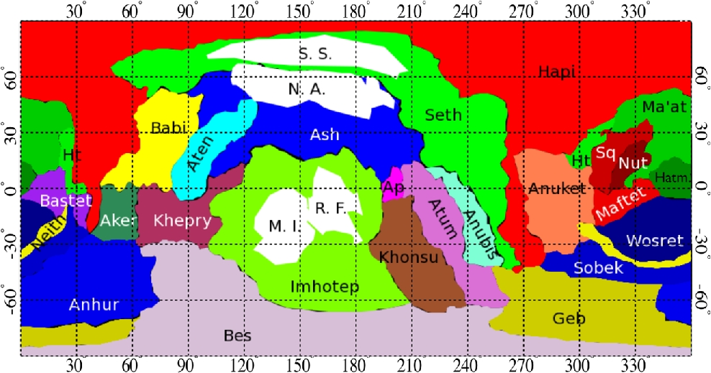
Figure 4. Morphological regions for the nucleus of 67P adapted from El-Maarry et al. (2016). White areas are the ...
Notes:
Figure 4. Morphological regions for the nucleus of 67P adapted from El-Maarry et al. (2016). White areas are the subregions investigated in Section 4.4 along with Hapi: roundish features (R.F.), mid-Imhotep (M.I.), north Ash (N.A.) and smooth Seth (S.S.). The reference system is the same as used for the maps in Fig. 3.
Unless provided in the caption above, the following copyright applies to the content of this slide: © 2016 The Authors Published by Oxford University Press on behalf of the Royal Astronomical Society

Slide 5
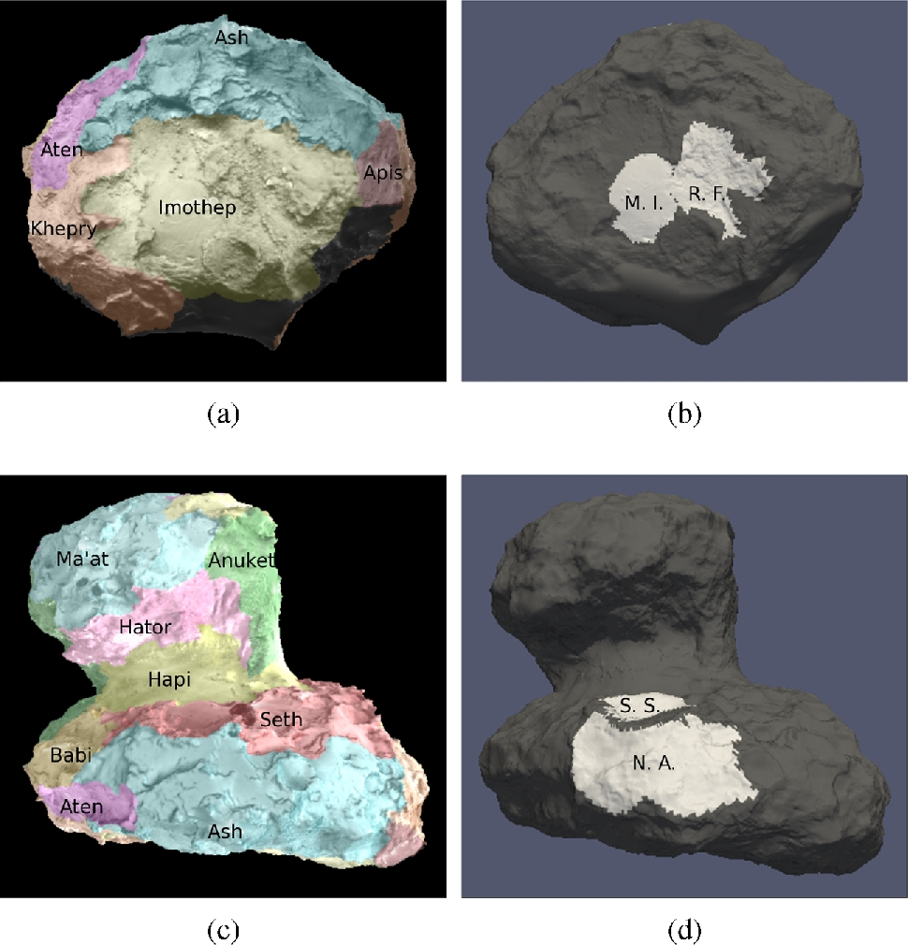
Figure 5. Two different views of the morphological regions of 67P projected on the nucleus shape model (a and c) and of ...
Notes:
Figure 5. Two different views of the morphological regions of 67P projected on the nucleus shape model (a and c) and of the subregions investigated in Section 4.3 (white areas in b and d panels) along with Hapi: roundish features (R.F.), mid-Imhotep (M.I.), north Ash (N.A.) and smooth Seth (S.S.).
Unless provided in the caption above, the following copyright applies to the content of this slide: © 2016 The Authors Published by Oxford University Press on behalf of the Royal Astronomical Society

Slide 6
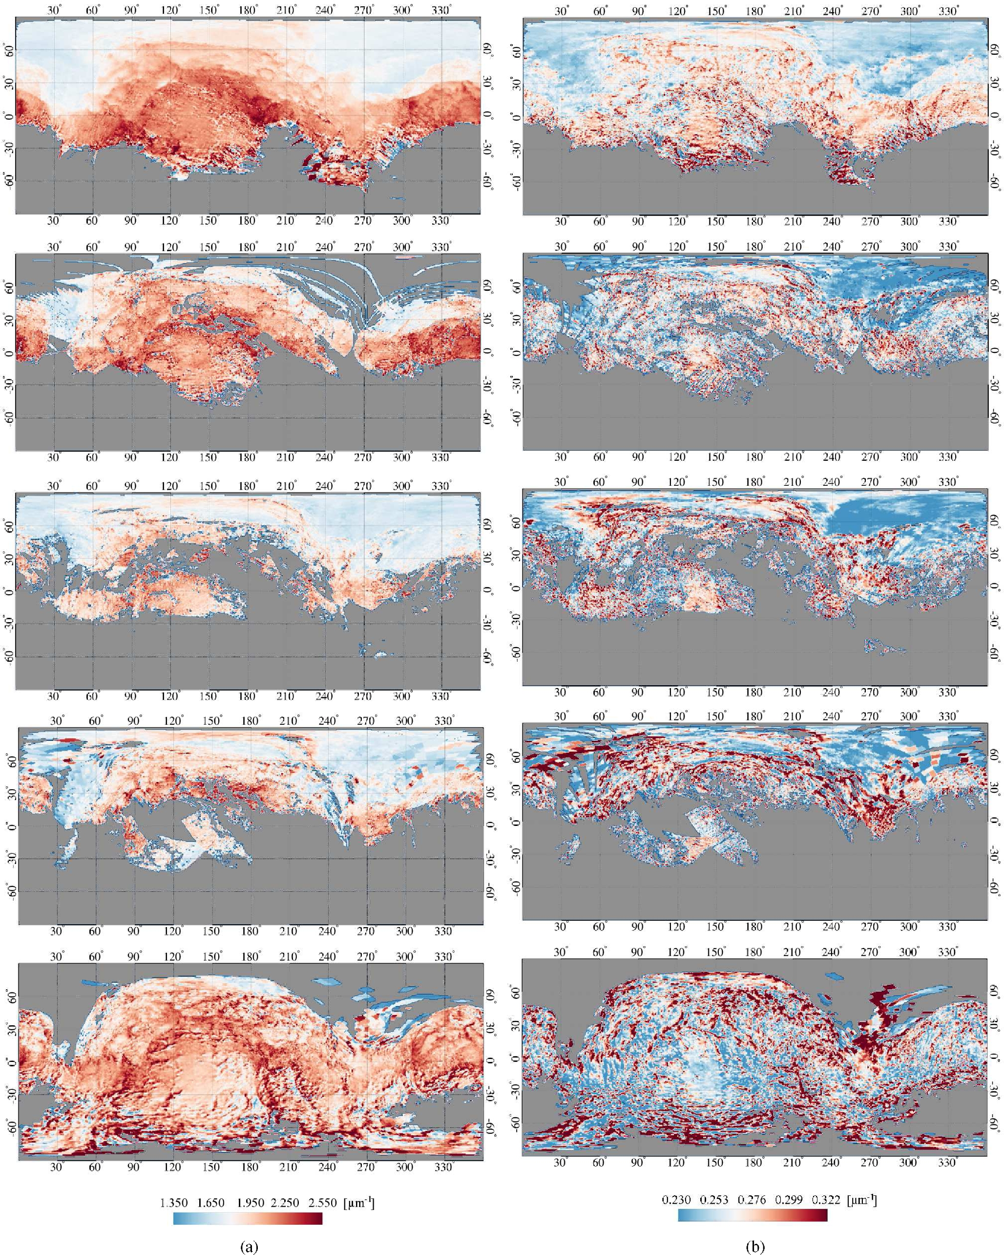
Figure 6. S_{VIS} (left-hand column, a) and S_{IR} (right-hand column, b) maps. From top to bottom: ...
Notes:
Figure 6. SVIS (left-hand column, a) and SIR (right-hand column, b) maps. From top to bottom: MTP006, MTP007-MTP008, MTP009-MTP010, MTP011-MTP012 and MTP014-MTP015.
Unless provided in the caption above, the following copyright applies to the content of this slide: © 2016 The Authors Published by Oxford University Press on behalf of the Royal Astronomical Society

Slide 7
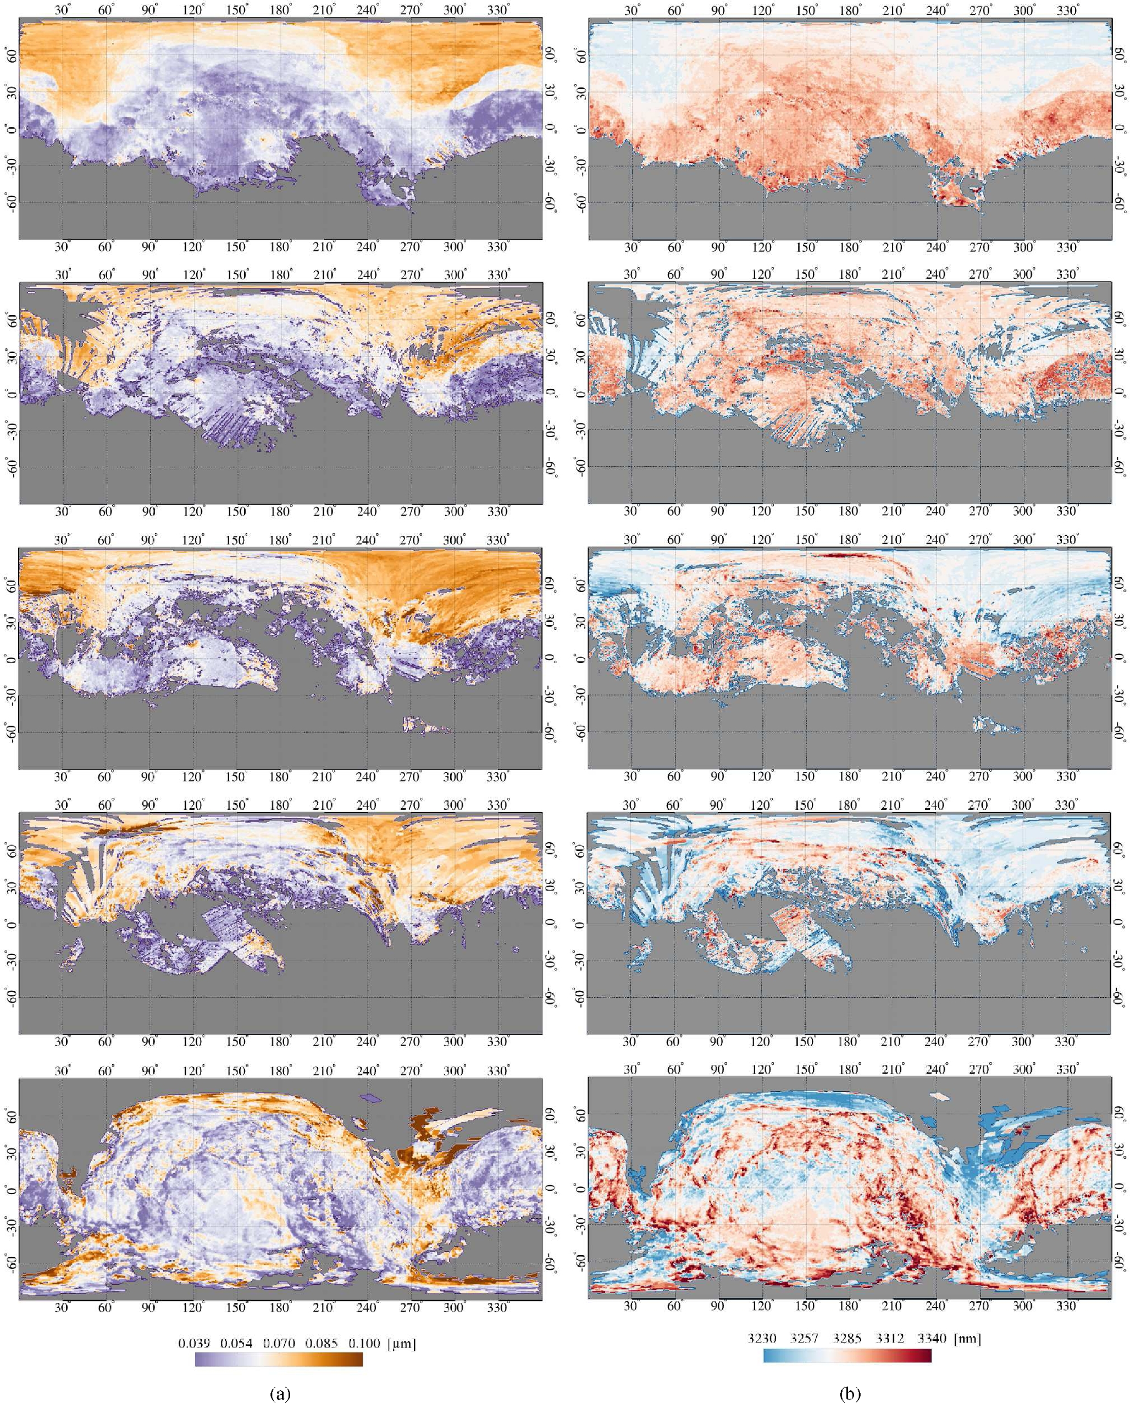
Figure 7. BA (left-hand column, a) and BC (right-hand column, b) maps. From top to bottom: MTP006, MTP007-MTP008, ...
Notes:
Figure 7. BA (left-hand column, a) and BC (right-hand column, b) maps. From top to bottom: MTP006, MTP007-MTP008, MTP009-MTP010, MTP011-MTP012 and MTP014-MTP015.
Unless provided in the caption above, the following copyright applies to the content of this slide: © 2016 The Authors Published by Oxford University Press on behalf of the Royal Astronomical Society

Slide 8
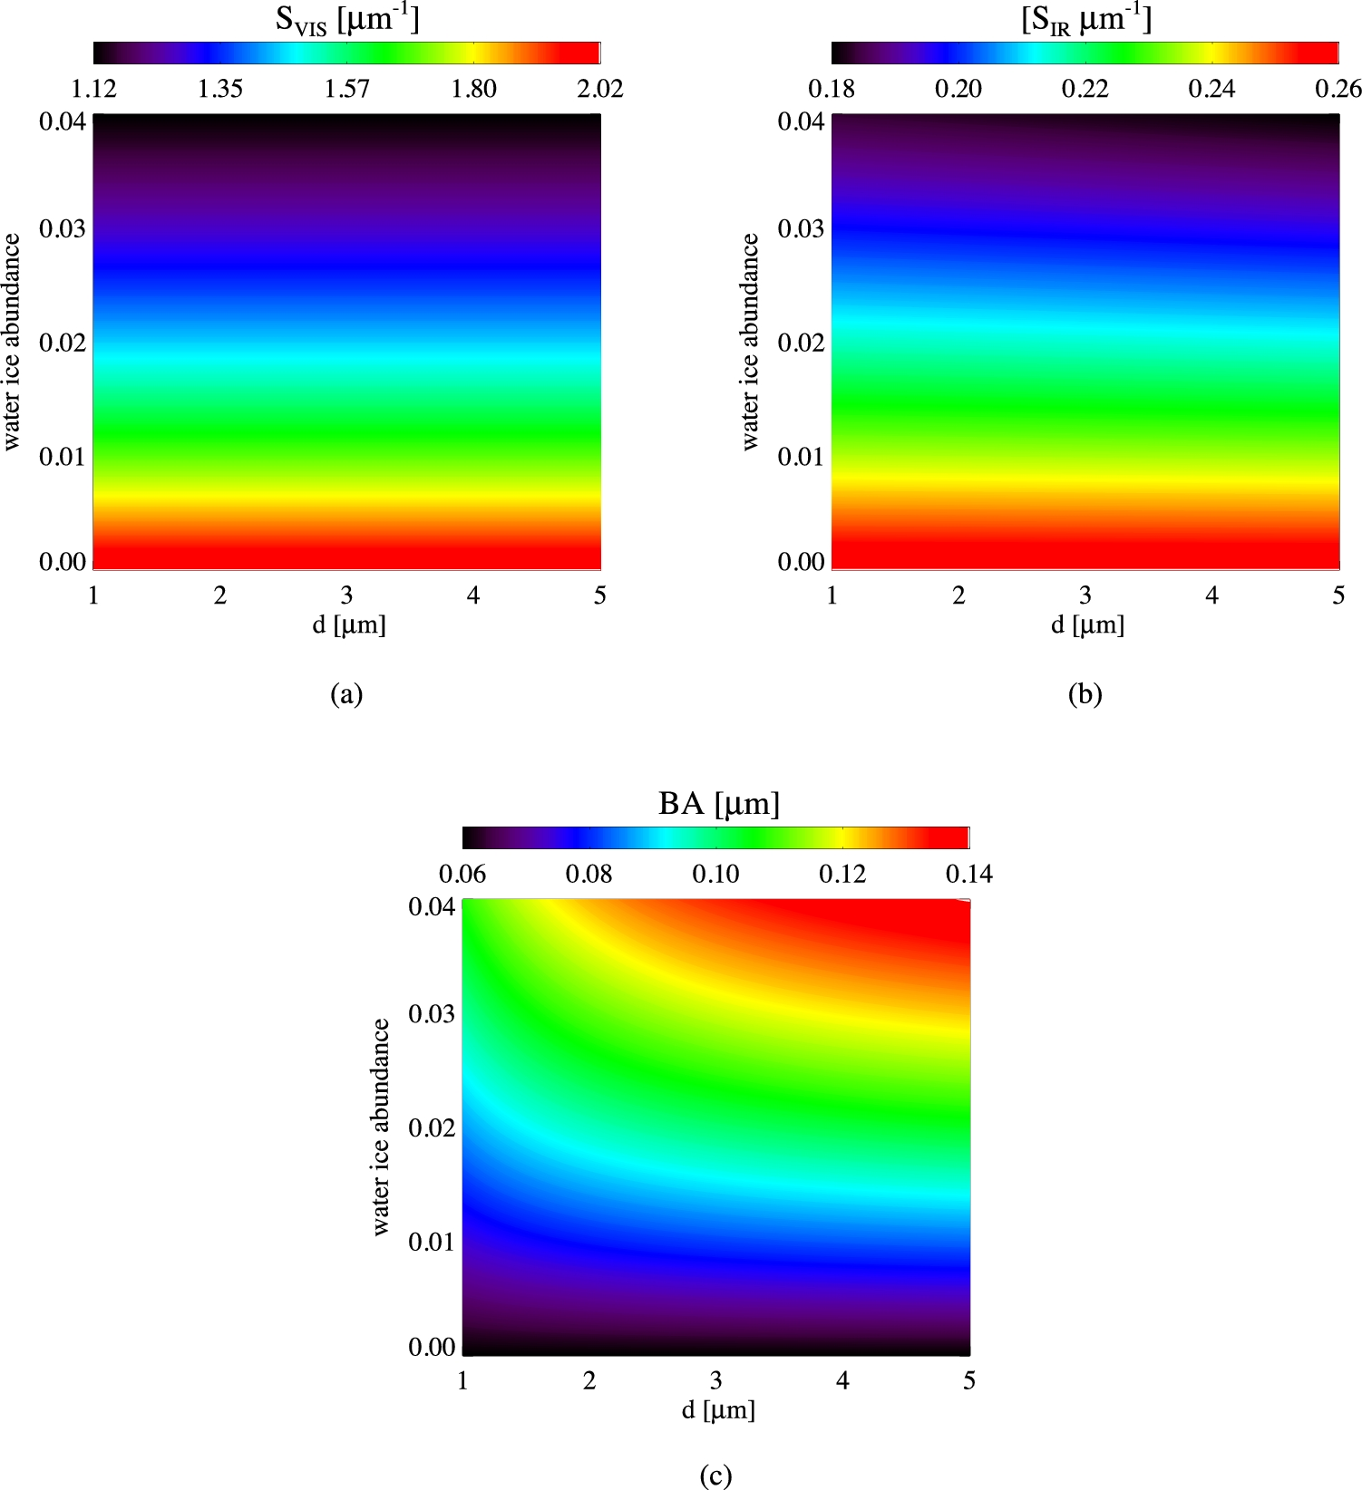
Figure 8. Plots of lookup tables depicting the simulated CSI as functions of grain size d (1–5 μm) and water ice ...
Notes:
Figure 8. Plots of lookup tables depicting the simulated CSI as functions of grain size d (1–5 μm) and water ice abundance (0–4 per cent): SVIS (a), SIR (b) and BA (c). CSI are computed from synthetic spectra of dark terrain–water ice intimate mixtures as derived from Hapke's theory.
Unless provided in the caption above, the following copyright applies to the content of this slide: © 2016 The Authors Published by Oxford University Press on behalf of the Royal Astronomical Society

Slide 9
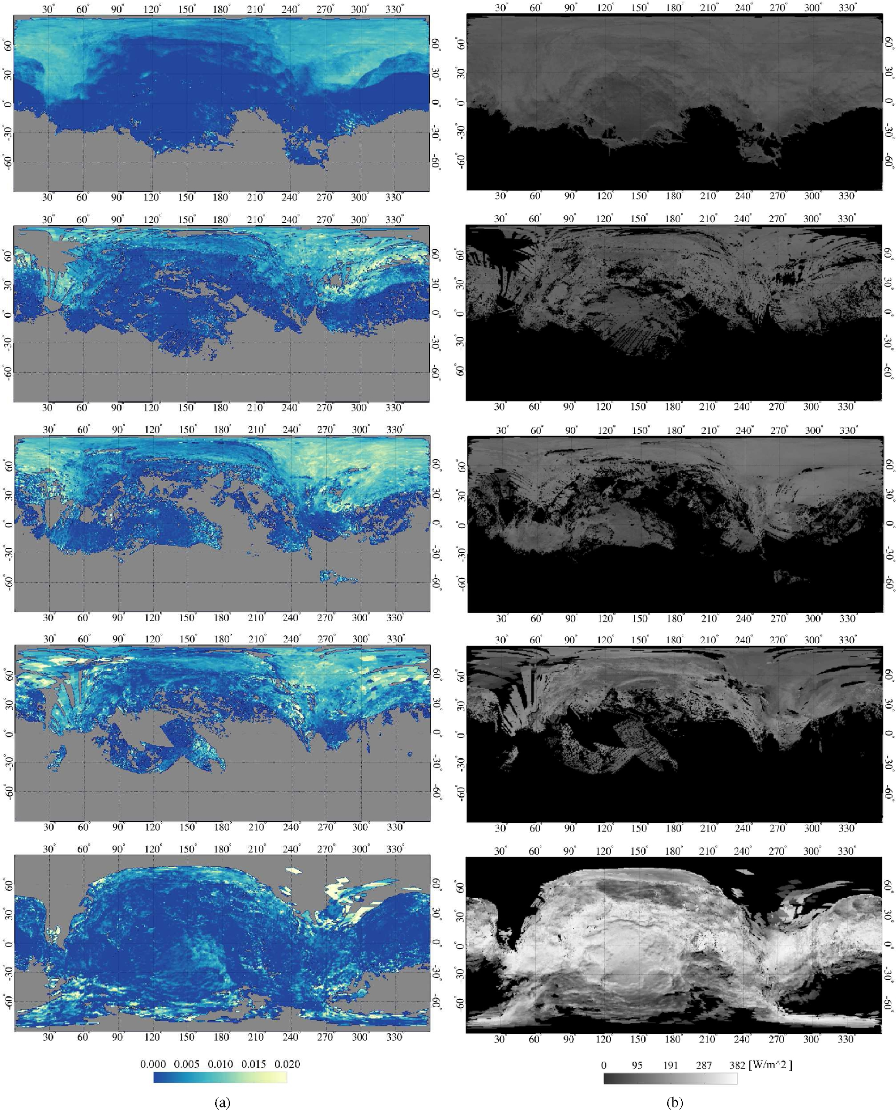
Figure 9. Water ice abundance maps (a) and solar flux maps (b).
Notes:
Figure 9. Water ice abundance maps (a) and solar flux maps (b).
Unless provided in the caption above, the following copyright applies to the content of this slide: © 2016 The Authors Published by Oxford University Press on behalf of the Royal Astronomical Society

Slide 10
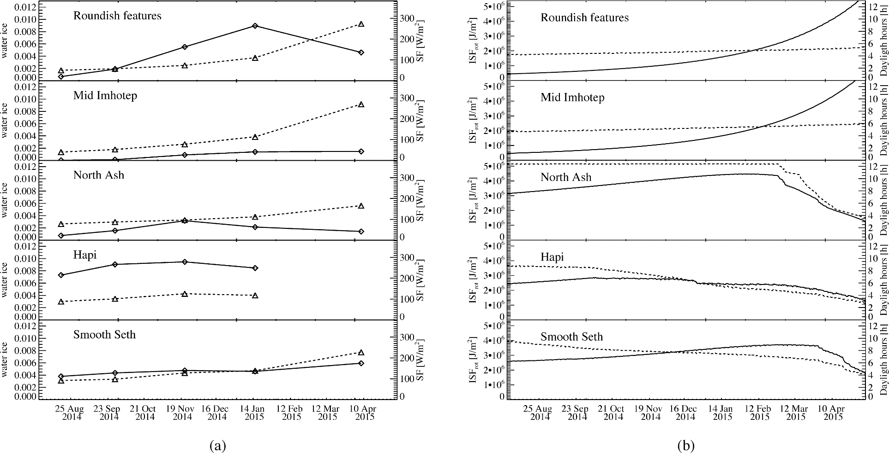
Figure 10. (a) Water ice abundance (diamonds and solid lines) and SF (triangles and dashed lines) as functions of time ...
Notes:
Figure 10. (a) Water ice abundance (diamonds and solid lines) and SF (triangles and dashed lines) as functions of time for the five selected regions. (b) ISFrot (solid lines) and daylight hours (dashed lines) as derived from spice simulations as functions of time for the five selected regions. Smooth Seth: Water ice abundance varies in the ≈0.4–0.5 per cent range from 2014 August to 2015 January–February, with a significant increase during 2015 April–May at ≈0.6 per cent, corresponding to the maximum value of the SF (225 W m−2). Mid-Imhotep: This area has the lowest abundance of water ice among the five investigated across the whole analysed time interval, being null in 2014 August and growing to ≈0.15 per cent in 2015 February–January until 2015 April–May, while showing a positive trend in SF (from 45 to 270 W m−2). Along with the local enrichment in water ice in the selected zone, the water ice distribution in Imhotep broadens with time, thus resulting in an increase of the total ice content. Roundish features: This area is not evenly covered during all the observation sequences, none the less a significant increase of the water ice abundance can be measured from 2014 August to 2015 January–February, with average contents going from ≈0.1 to 0.9 per cent, showing the largest increase rate with respect to the other selected regions. In the 2015 April–May observations, a reduction of the average water ice content is measured down to 0.5 per cent. Conversely, SF increases monotonically within the whole investigated time frame across this area. We want to mention that because of the limited spatial coverage and redundancy of the observations taken through 2014 November–December and 2015 January–February, the derived values of the water ice abundance must be considered with care and could possibly be overestimated. Conversely, the good observation conditions in 2015 April–May provide a more robust determination of the real water ice content and indicate also an enlargement of the ice-enriched area with respect to the previous observations during MTP006 and MTP007-MTP008, similar to what is observed in the rest of the Imhotep region. North Ash: The selected area within Ash corresponds to the portion of this region that, because of its orientation, receives the lowest amount of instantaneous solar flux across all the analysed observation phases (Fig. 9b). After the mid-Imhotep, area it is the least enriched in water ice. Its abundance increases from ≈0.1 per cent in 2014 August to 0.3 per cent in 2015 November–December, and then decreases to ≈0.2 per cent in 2015 January–February and to ≈0.15 per cent 2015 April–May. SF at the time of the observations doubles from MTP006 (80 W m−2) to MTP014-MTP015 (165 W m−2) with an increment that is the lowest among the different selected regions, except Hapi.
Unless provided in the caption above, the following copyright applies to the content of this slide: © 2016 The Authors Published by Oxford University Press on behalf of the Royal Astronomical Society

Slide 11
Figure 11. BA orthographic maps centred at the North pole of 67P. The rotational phase increases by ≈ 1 h/step from top ...
Notes:
Figure 11. BA orthographic maps centred at the North pole of 67P. The rotational phase increases by ≈ 1 h/step from top to bottom and left to right. Grey areas represent missing data and regions not mapped, while black represent shadows as derived from spice calculations (Acton 1996). Shadows move counterclockwise because of the comet's rotation. The red, green and yellow arrows indicate three fronts showing an increased BA at places exposed by receding shadows, which is interpreted as an increased water ice abundance.
Unless provided in the caption above, the following copyright applies to the content of this slide: © 2016 The Authors Published by Oxford University Press on behalf of the Royal Astronomical Society

Slide 12
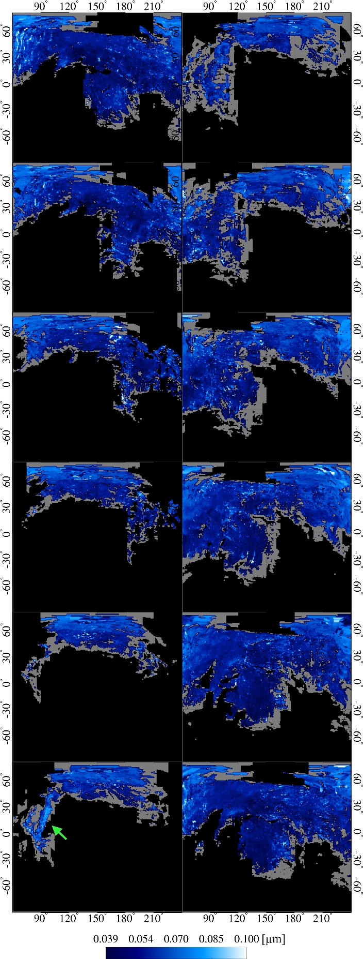
Figure 12. BA cylindrical maps centred in Imhotep at 0° lat–180° lon. The rotational phase increases by ≈1 h/step from ...
Notes:
Figure 12. BA cylindrical maps centred in Imhotep at 0° lat–180° lon. The rotational phase increases by ≈1 h/step from top to bottom and left to right. Grey areas represent missing data and regions not mapped, while black represents shadows as derived from spice calculations (Acton 1996). The shadow pattern proceeds from left to right. The green arrow indicates the Aten region showing an increase of BA.
Unless provided in the caption above, the following copyright applies to the content of this slide: © 2016 The Authors Published by Oxford University Press on behalf of the Royal Astronomical Society

Slide 13
Figure 13. BA cylindrical maps centred in Hatmehit region at 15° lat–345° lon. The rotational phase increases by ...
Notes:
Figure 13. BA cylindrical maps centred in Hatmehit region at 15° lat–345° lon. The rotational phase increases by ≈1h/step from top to bottom and left to right. Grey areas represent missing data and regions not mapped, while black represents shadows as derived from spice calculations (Acton 1996). The shadow front moves from positive to negative latitudes and backward.
Unless provided in the caption above, the following copyright applies to the content of this slide: © 2016 The Authors Published by Oxford University Press on behalf of the Royal Astronomical Society

