Slide 1
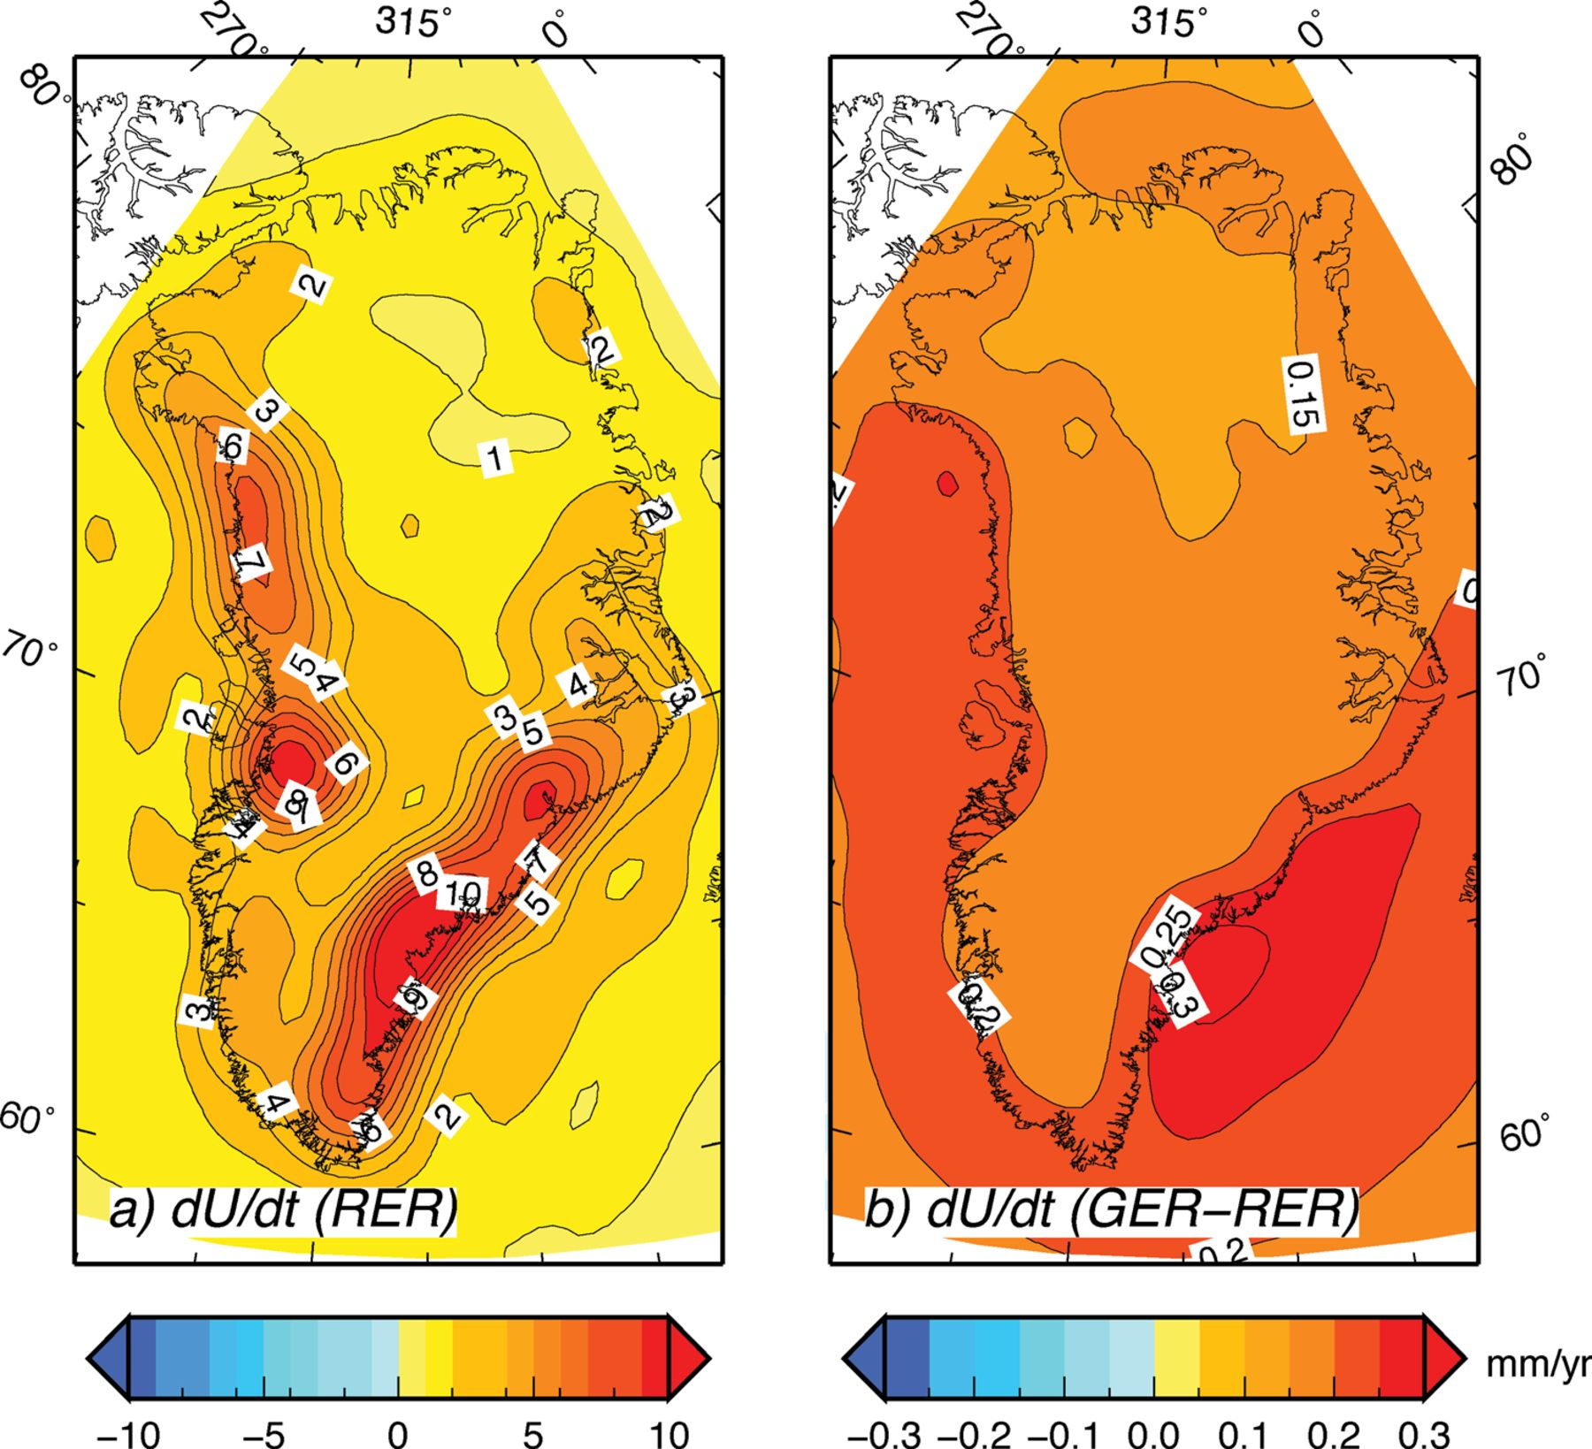
Figure 7 (a) Elastic vertical velocity across Greenland according to the RER approach to degree ℓ_{max}= 128. ...
Notes:
Figure 7 (a) Elastic vertical velocity across Greenland according to the RER approach to degree ℓmax= 128. (b) Difference between the GER results in Figs 3(a) and 7(a), respectively (note the different ranges of colour tables). The GER velocity only slightly exceeds the RER solution.
Unless provided in the caption above, the following copyright applies to the content of this slide: © The Authors Geophysical Journal International © 2012 RAS

Slide 2
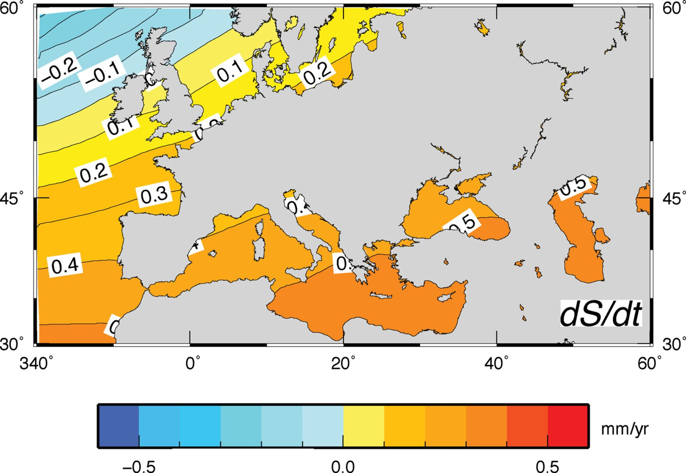
Figure 6 Present-day rate of sea level change (dS/dt) across the Mediterranean and southern Europe associated with the ...
Notes:
Figure 6 Present-day rate of sea level change (dS/dt) across the Mediterranean and southern Europe associated with the M3 melting scenario of Fig. 1(a). Maximum rates (∼0.6 mm yr-’1, i.e. close to the eustatic value) are predicted along the levant coasts. In consideration of the distance from the source of melt water, using the M3U scenario employed in Fig. 5(b) would not change the details of this map.
Unless provided in the caption above, the following copyright applies to the content of this slide: © The Authors Geophysical Journal International © 2012 RAS

Slide 3
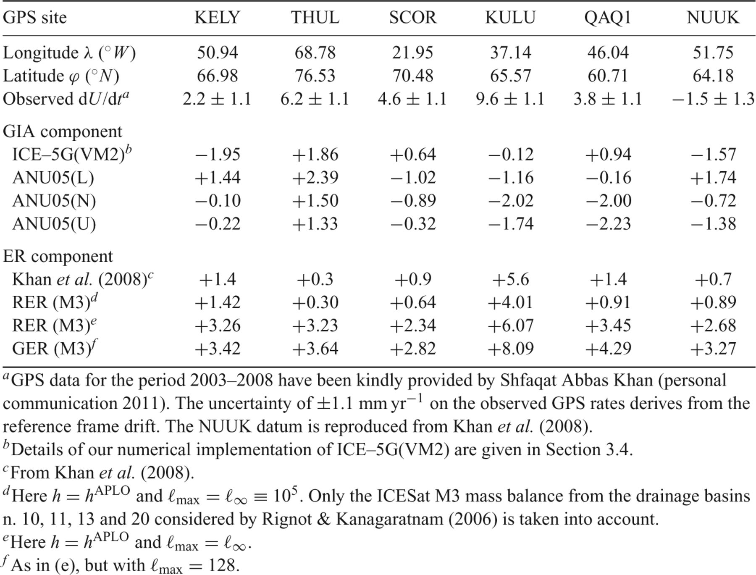
Table 3
Notes:
Table 3
Unless provided in the caption above, the following copyright applies to the content of this slide: © The Authors Geophysical Journal International © 2012 RAS

Slide 4
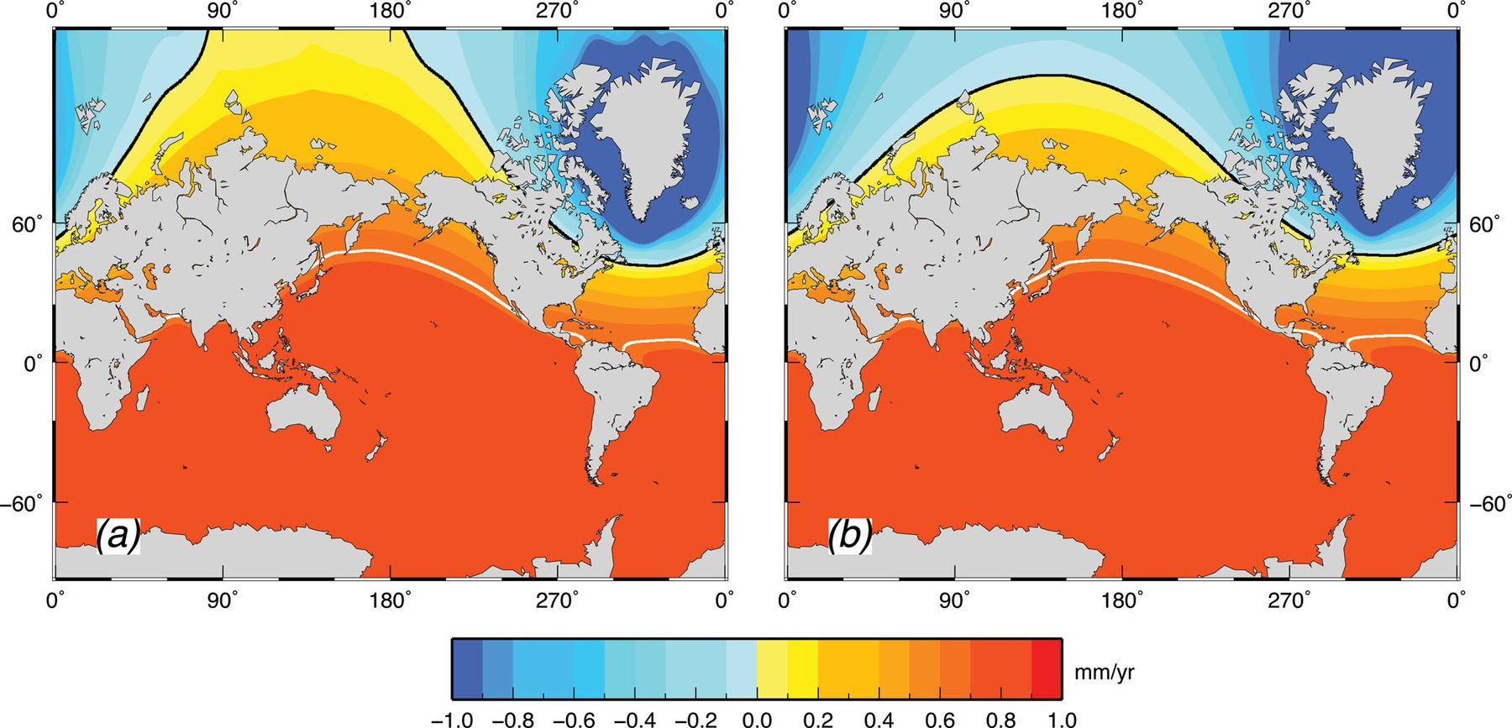
Figure 5 (a) Rate of global sea level variation associated with the mass balance M3 of Fig. 1(a). In (b), the total ...
Notes:
Figure 5 (a) Rate of global sea level variation associated with the mass balance M3 of Fig. 1(a). In (b), the total volume of ice loss is the same, but uniformly distributed over all the GrIS pixels (note that in both frames the colour table is limited to ±1 mm yr-’1). White contours mark the place where sea level change corresponds to the eustatic change induced by the GrIS meltwater budget ( mm yr-’1). The black contour represents the nodal line (). The jagged shape of the contour lines in (a) reflects the larger energy of short-wavelength harmonics in the GrIS mass budget relative to (b).
Unless provided in the caption above, the following copyright applies to the content of this slide: © The Authors Geophysical Journal International © 2012 RAS

Slide 5
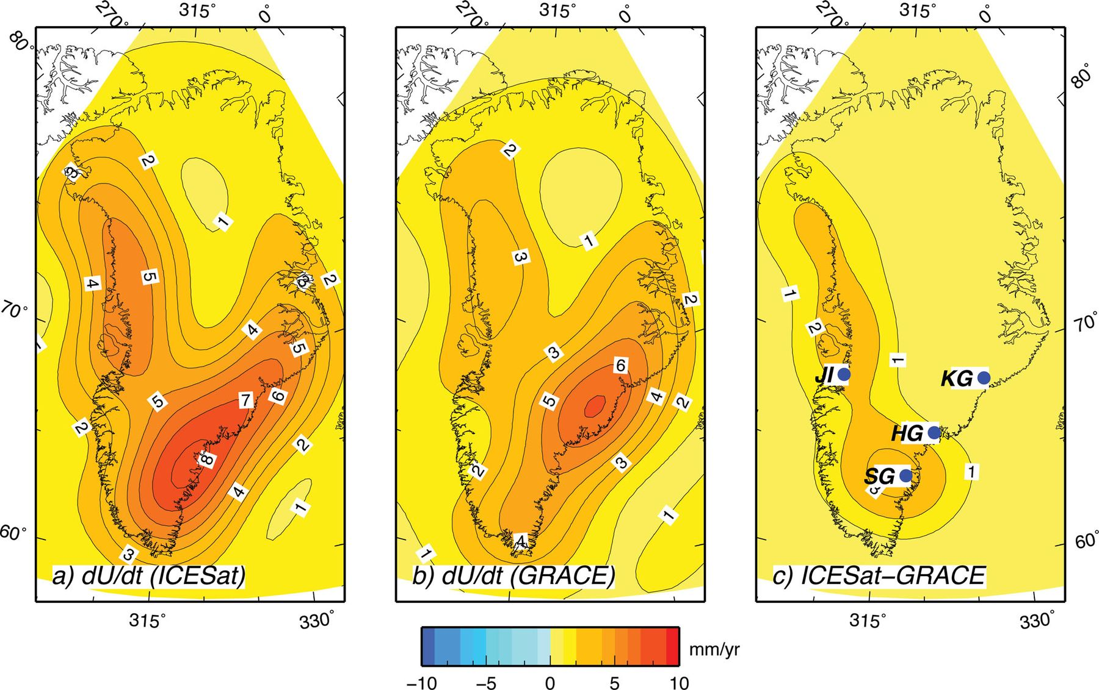
Figure 4 (a) Regional rate of elastic uplift across Greenland according to the ICESat model M3, using the GER method ...
Notes:
Figure 4 (a) Regional rate of elastic uplift across Greenland according to the ICESat model M3, using the GER method of solution with ℓmax= 60. (b) As in (a), but using the GRACE mass balance by Wouters et al. (2008) at the same harmonic degree. The difference between the two solutions, shown in (c), is largest around the Southeast Glaciers (SG) and in the vicinity of Jakobshavn Isbræ (JI).
Unless provided in the caption above, the following copyright applies to the content of this slide: © The Authors Geophysical Journal International © 2012 RAS

Slide 6
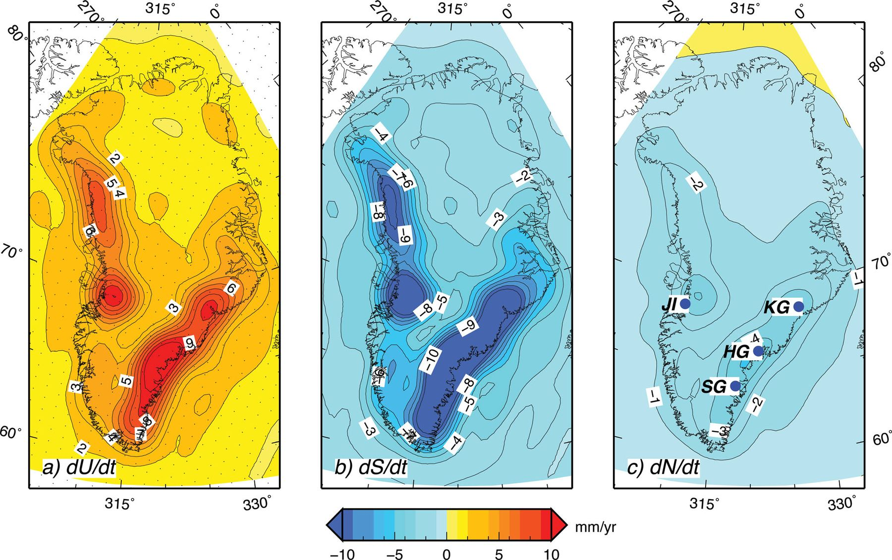
Figure 3 (a) Elastic vertical velocity () across Greenland, computed by the GER method to degree ℓ_{max}= 128, ...
Notes:
Figure 3 (a) Elastic vertical velocity () across Greenland, computed by the GER method to degree ℓmax= 128, according to the M3 ICESat mass balance in Fig. 1(a). Dots in (a) show the grid pixels. Frames (b) and (c) show the rates of sea level change () and of sea surface variation (), respectively. In all frames, contour lines are spaced by 1 mm yr-’1.
Unless provided in the caption above, the following copyright applies to the content of this slide: © The Authors Geophysical Journal International © 2012 RAS

Slide 7
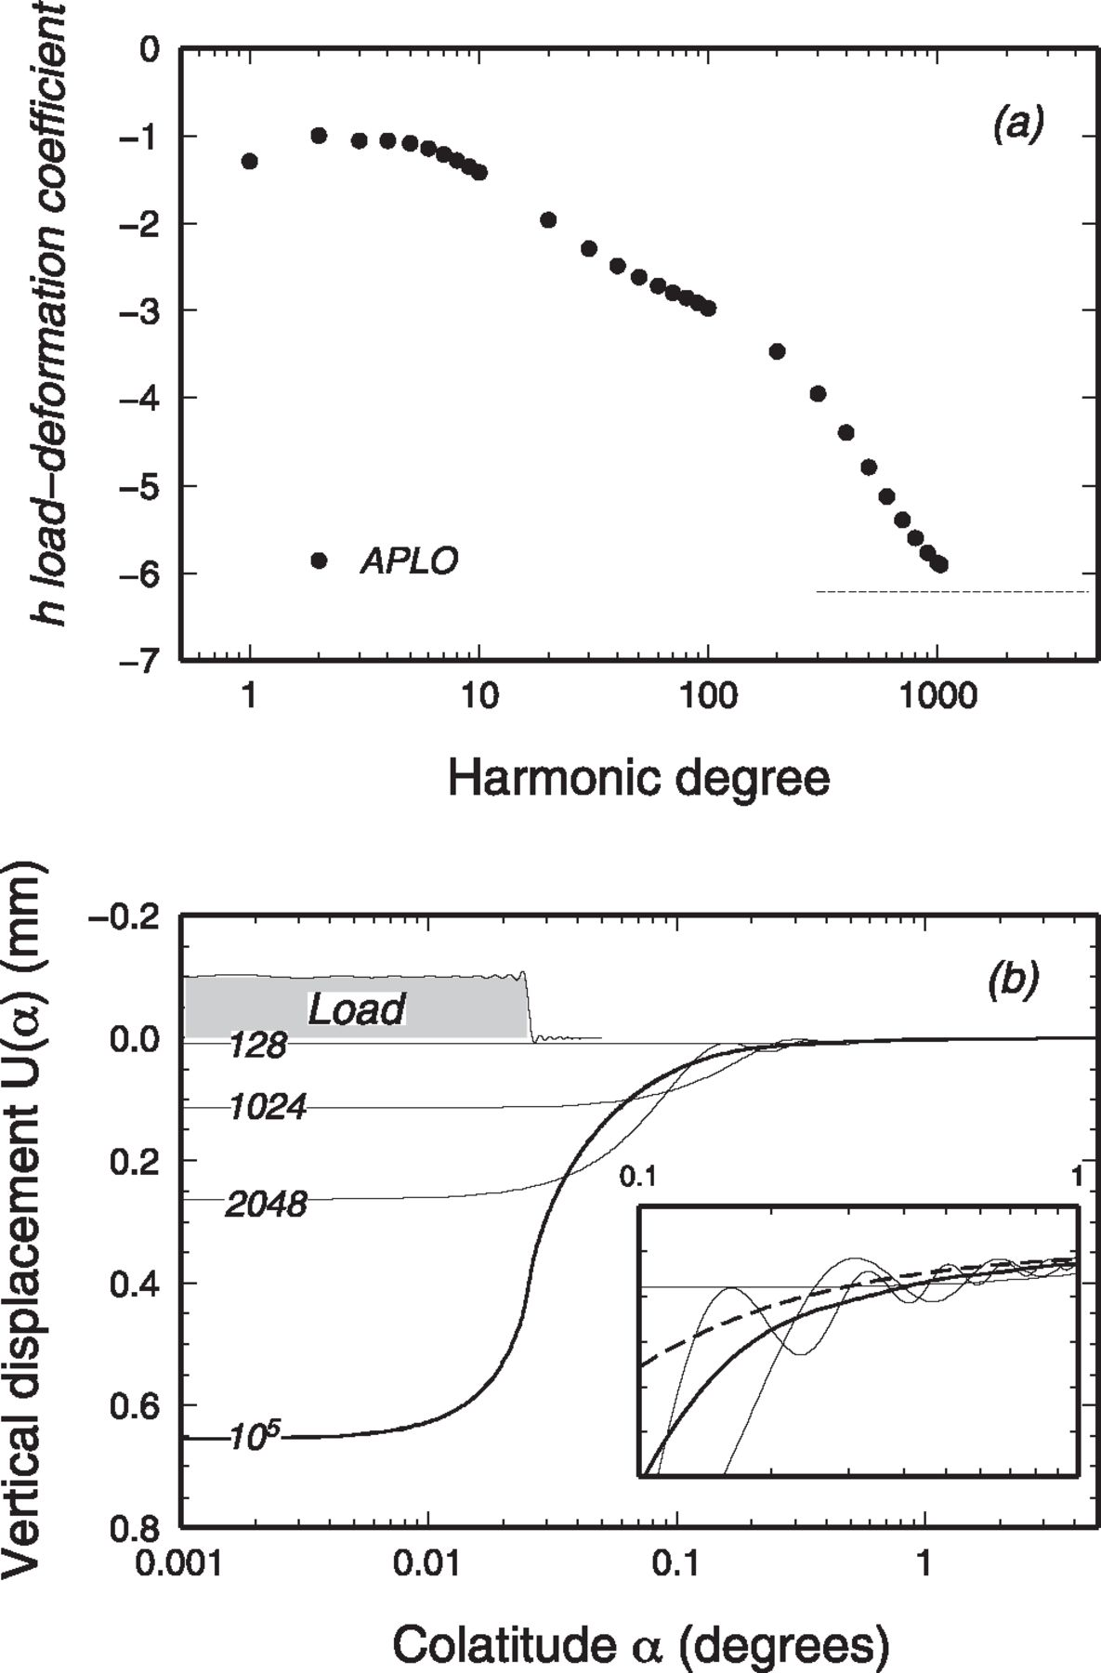
Figure 2 (a) Vertical LDCs h^{ALPO} (circles). The curve is comparable to that in Fig. 1 of Farrell (1972), ...
Notes:
Figure 2 (a) Vertical LDCs hALPO (circles). The curve is comparable to that in Fig. 1 of Farrell (1972), pertaining to the Gutemberg-Bullen A earth model and used by Khan et al. (2008). The dashed line shows the asymptote . (b) Vertical displacement in response to the thickness variation of ΔH=-’1 m for a disc load with β= 0.025° (the disc profile is shown by the grey hatched area along with its spherical harmonic reconstruction). Note that the α-axis is logarithmic and that the y-axis is positive downward. Solid curves are obtained using h=hAPLO and varying ℓmax (an asymptotic value is obtained for ℓmax=ℓ∞≡ 105). The inset shows the details of U(α) in the range of colatitudes 0.1°≤α≤ 1°.
Unless provided in the caption above, the following copyright applies to the content of this slide: © The Authors Geophysical Journal International © 2012 RAS

Slide 8
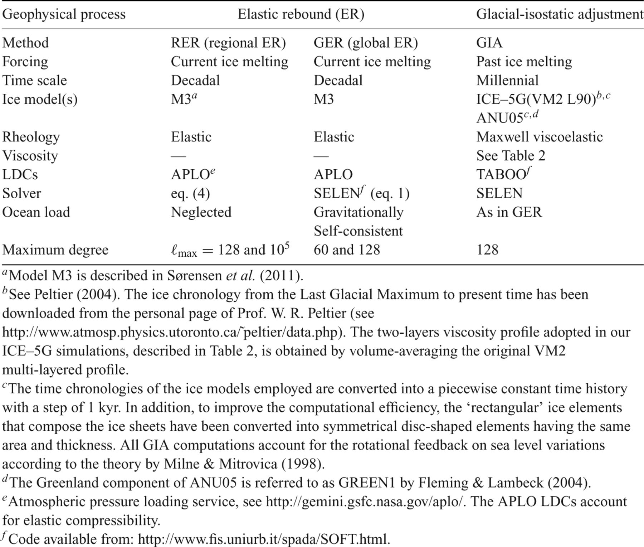
Table 1 Synoptic presentation of the geophysical processes considered in this study and of the settings of the ...
Notes:
Table 1 Synoptic presentation of the geophysical processes considered in this study and of the settings of the numerical methods employed.
Unless provided in the caption above, the following copyright applies to the content of this slide: © The Authors Geophysical Journal International © 2012 RAS

Slide 9
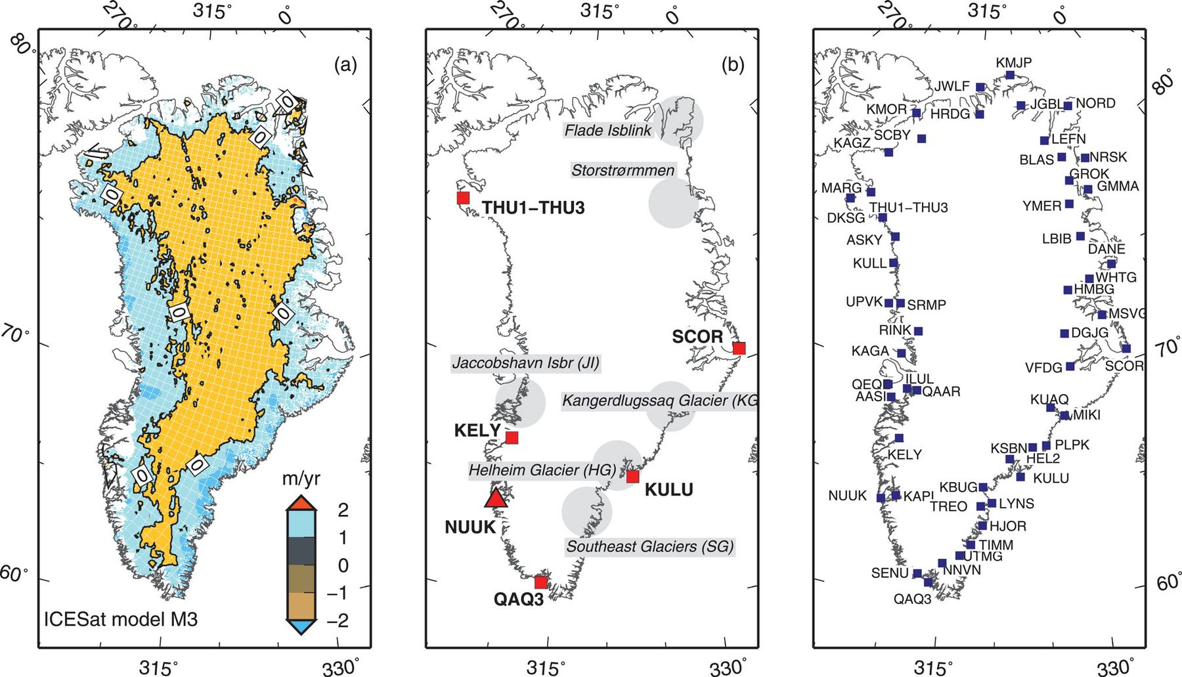
Figure 1 (a) Mass balance of the GrIS (expressed in units of m yr ^{-’1}) according to solution M3 of Sørensen ...
Notes:
Figure 1 (a) Mass balance of the GrIS (expressed in units of m yr -’1) according to solution M3 of Sørensen et al. (2011), retrieved from ICESat data for the period between 2003 October and 2008 March. The whole GrIS is discretized into ∼71000 equal disc-shaped elements with angular radius β≈ 0.025°, corresponding to an area of 25 km2). The total mass balance of M3 is -’240 ± 28 Gt yr-’1. Frame (b) shows the GPS and tide-gauge (NUUK) sites for which a reliable estimate of vertical uplift is nowadays available (red symbols) and the approximate location of the glaciers mostly contributing to mass loss (with names abbreviations JI, SG, HG and KG). Also shown are the locations of Flade Isblink and Storstrømmen glaciers. (c) Sites of the Greenland GPS Network (GNET) (coordinates are obtained from the UNAVCO database, see http://www.unavco.org/unavco.html).
Unless provided in the caption above, the following copyright applies to the content of this slide: © The Authors Geophysical Journal International © 2012 RAS

Slide 10
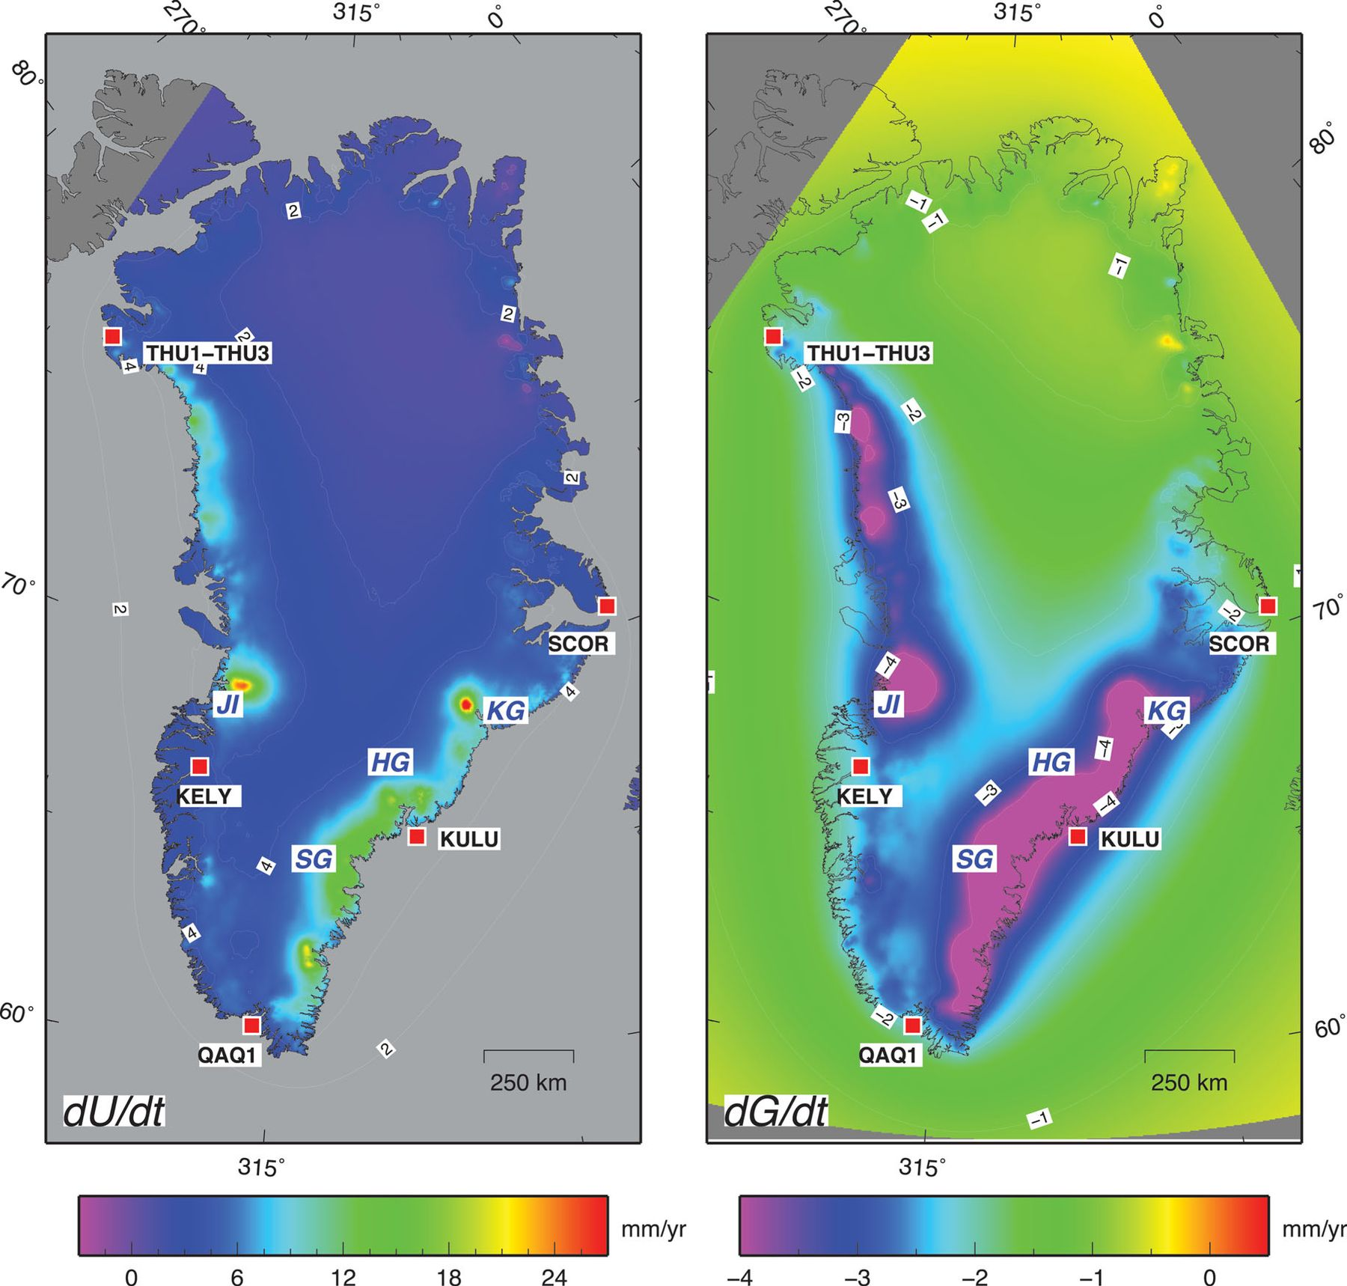
Figure 8 Rate of vertical uplift (a) and of geoid height variation (b) across Greenland, according to RER computations ...
Notes:
Figure 8 Rate of vertical uplift (a) and of geoid height variation (b) across Greenland, according to RER computations to degree ℓ∞. The maximum rates ( and mm yr-’1, respectively) are predicted in the vicinity of the Kangerdlugssuaq Glacier (KG). Here, the horizontal resolution is ∼2.8 km.
Unless provided in the caption above, the following copyright applies to the content of this slide: © The Authors Geophysical Journal International © 2012 RAS

Slide 11
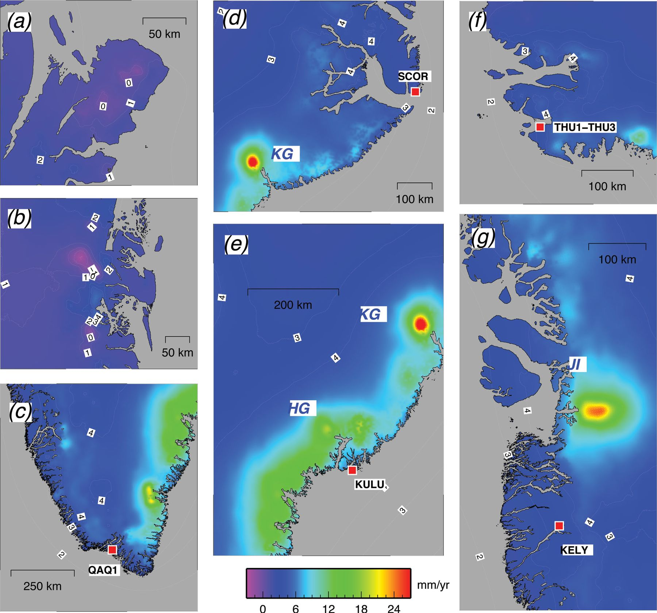
Figure 9 Details of the elastic uplift patterns associated with the mass balance M3, obtained by the RER method to ...
Notes:
Figure 9 Details of the elastic uplift patterns associated with the mass balance M3, obtained by the RER method to harmonic degree ℓmax=ℓ∞. Contours lines are 1 mm yr-’1 apart. Frames (a) and (b) show areas of subsidence in the regions of the Flade Isblink and Storstrømmen glaciers, respectively. The other frames show detailed uplift maps in areas surrounding the GPS stations of QAQ1 (c), SCOR (d), KULU (e), THUL (f) and KELY (g). In these maps, the horizontal resolution is ∼550 m in the NS direction and varies from 90 to 270 m in the EW direction. Contour lines show vertical velocity in units of mmyr-’1.
Unless provided in the caption above, the following copyright applies to the content of this slide: © The Authors Geophysical Journal International © 2012 RAS

Slide 12
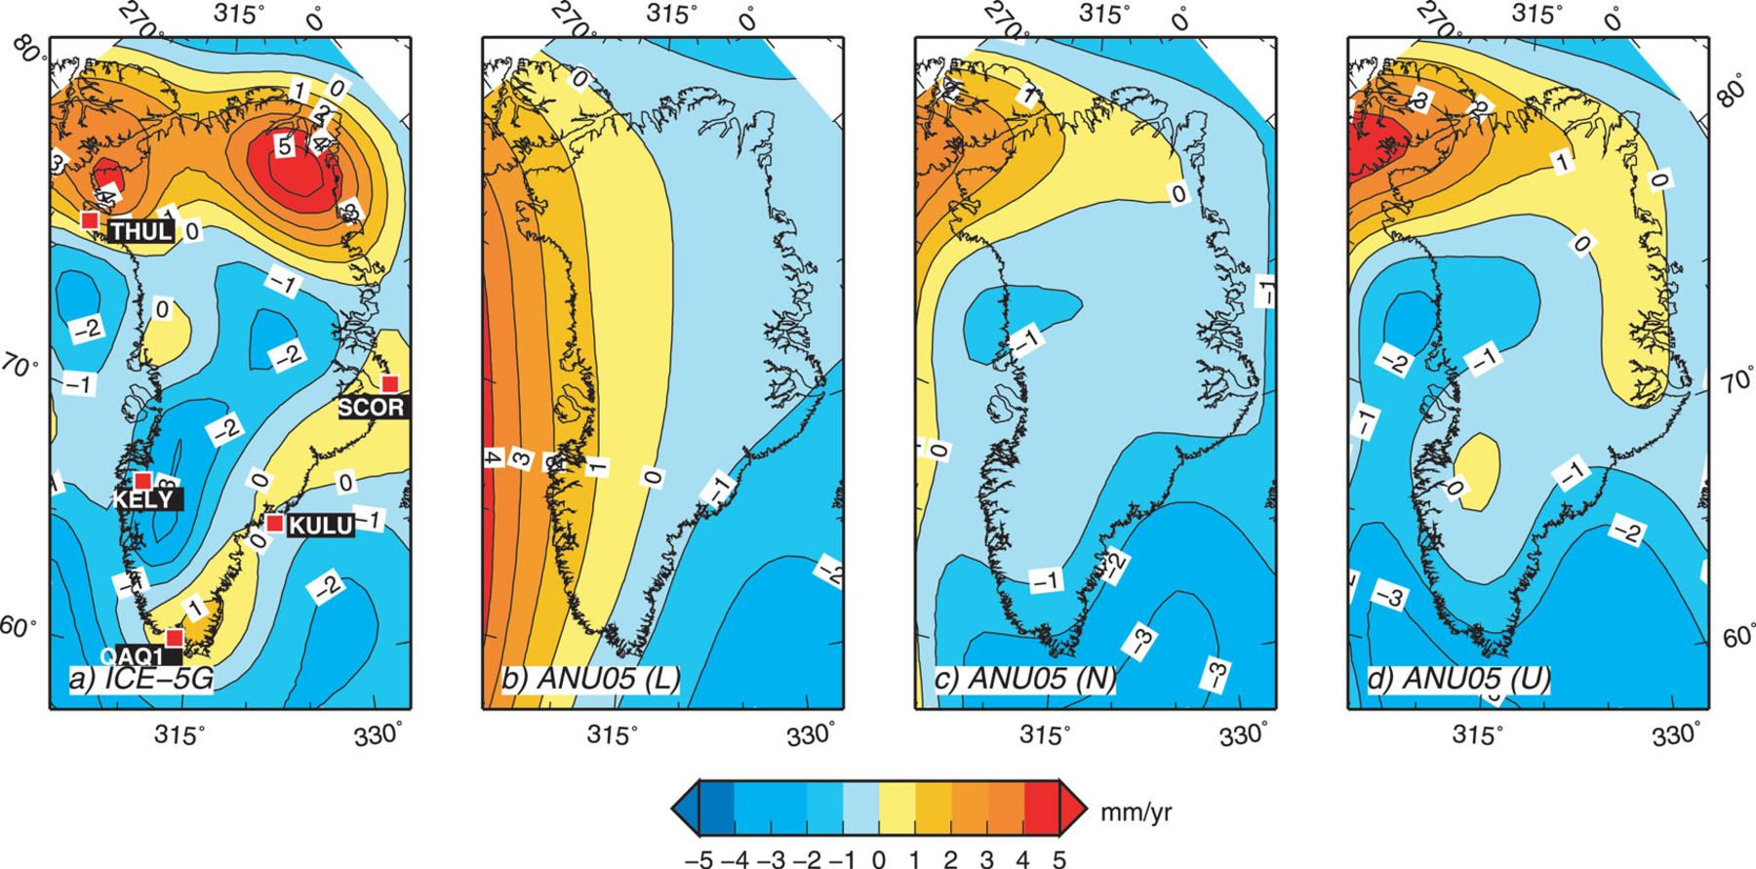
Figure 10 Present-day GIA uplift rates computed according to our implementation of the sea level equation, and using ...
Notes:
Figure 10 Present-day GIA uplift rates computed according to our implementation of the sea level equation, and using the four models described in the body of the paper and in Table 2. Frame (a) also shows the locations of the main GPS sites. In all these GIA computations, ℓmax= 128.
Unless provided in the caption above, the following copyright applies to the content of this slide: © The Authors Geophysical Journal International © 2012 RAS

Slide 13
Table 2
Notes:
Table 2
Unless provided in the caption above, the following copyright applies to the content of this slide: © The Authors Geophysical Journal International © 2012 RAS

Slide 14
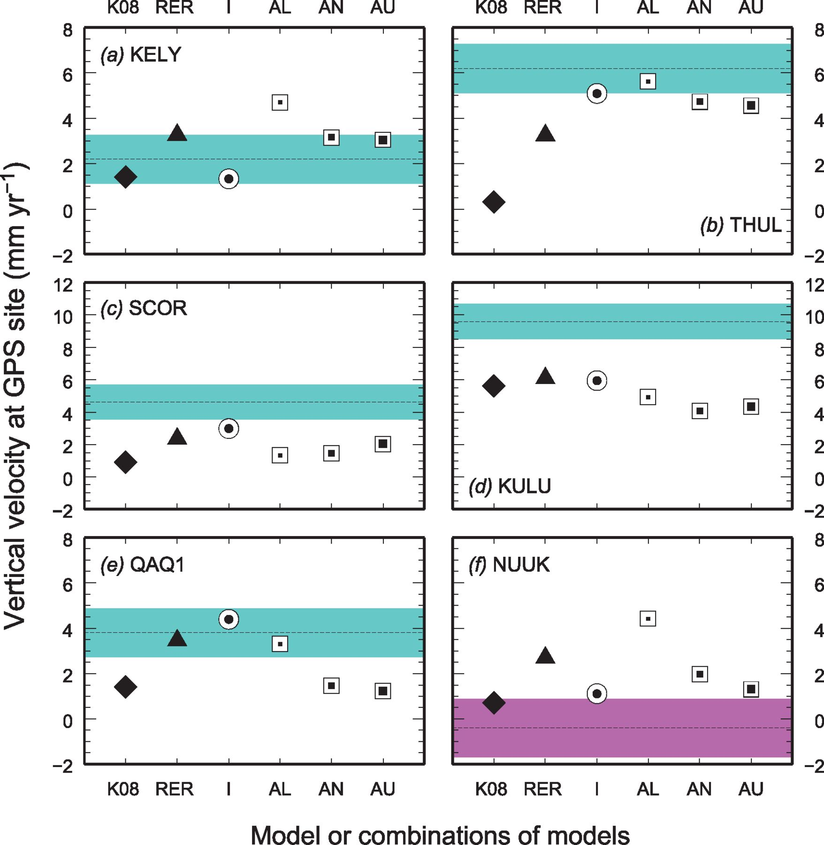
Figure 11 Rates of vertical uplift observed at relevant GPS sites (a-e) and at the NUUK tide gauge (f) (shaded, from ...
Notes:
Figure 11 Rates of vertical uplift observed at relevant GPS sites (a-e) and at the NUUK tide gauge (f) (shaded, from Khan et al. 2008). Model predictions are as follows. K08 and RER: Elastic rebound uplift rate according to Khan et al. (2008) and this work, respectively; I: combination of RER with our GIA computations based on ICE–5G; AL, AN and AU: combination of RER with the lower, nominal and upper ANU05 solutions.
Unless provided in the caption above, the following copyright applies to the content of this slide: © The Authors Geophysical Journal International © 2012 RAS

Slide 15
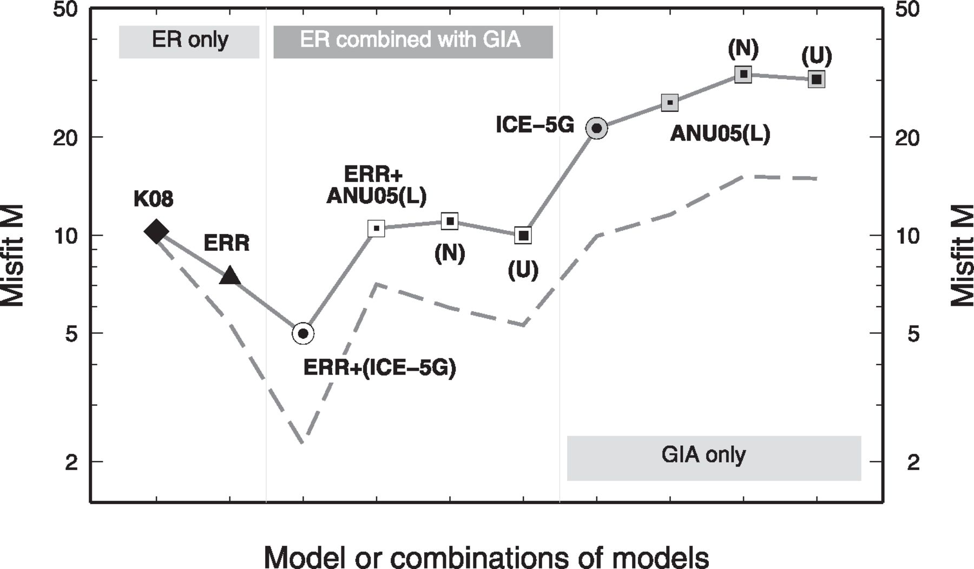
Figure 12 Misfit between model predictions and the GPS observations of Fig. 11. Misfit for purely ER (‘Elastic ...
Notes:
Figure 12 Misfit between model predictions and the GPS observations of Fig. 11. Misfit for purely ER (‘Elastic Rebound’) models, for combinations of ER and GIA models and for GIA models only, is computed as ((modi-’ obsi)/σi)2 where N is the number of sites considered (N= 6), obsi is an observed GPS uplift rate, σi its uncertainty (see Table 3) and modi is a modelled rate. Note that the M-axis is logarithmic. The symbols are connected by segments only for showing qualitatively the misfit trend with varying combination of models. The dashed curve shows the misfit when the GPS site of KULU is excluded from the computations.
Unless provided in the caption above, the following copyright applies to the content of this slide: © The Authors Geophysical Journal International © 2012 RAS

Slide 16
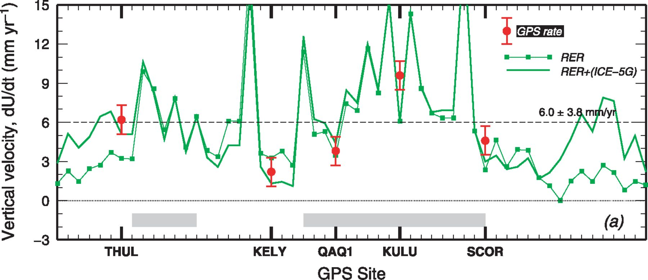
Figure 13 Vertical uplift rates expected at all the GPS sites shown in Fig. 1 according to several model predictions. ...
Notes:
Figure 13 Vertical uplift rates expected at all the GPS sites shown in Fig. 1 according to several model predictions. The elastic component (RER) of total uplift is computed to harmonic degree ℓmax= 105 using the LDCs h=hAPLO. The RER results are combined with GIA predictions obtained by model ICE–5G using ℓmax= 128. Dashed lines show the average trend of the total predicted vertical uplift and its standard deviation. Shaded rectangles indicate the range of GPS sites where vertical GIA movements are small compared to ER movements. These sites range between DKSG and QAAR and between UTMG and SCOR, respectively (see Fig. 1b).
Unless provided in the caption above, the following copyright applies to the content of this slide: © The Authors Geophysical Journal International © 2012 RAS

