Slide 1
Table 1 Clinical features in patients with strongyloidiasis
Notes:
Table 1 Clinical features in patients with strongyloidiasis
Unless provided in the caption above, the following copyright applies to the content of this slide: © Royal Society of Tropical Medicine and Hygiene 2008

Slide 2
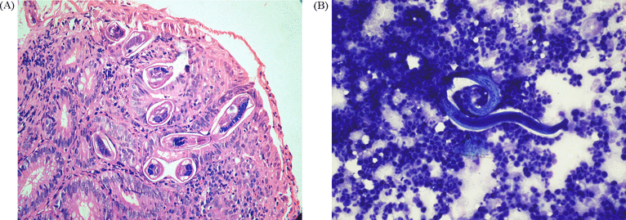
Figure 1 (A) Duodenal biopsy showing villous blunting and presence of larvae of Strongyloides embedded in the mucosa ...
Notes:
Figure 1 (A) Duodenal biopsy showing villous blunting and presence of larvae of Strongyloides embedded in the mucosa (haematoxylin–eosin, 400×). (B) Smear of ascitic fluid. Coiled filariform larva with internal structures associated with a dense neutrophilic infiltrate (May–Grünwald–Giemsa, 400×).
Unless provided in the caption above, the following copyright applies to the content of this slide: © Royal Society of Tropical Medicine and Hygiene 2008

