Slide 1
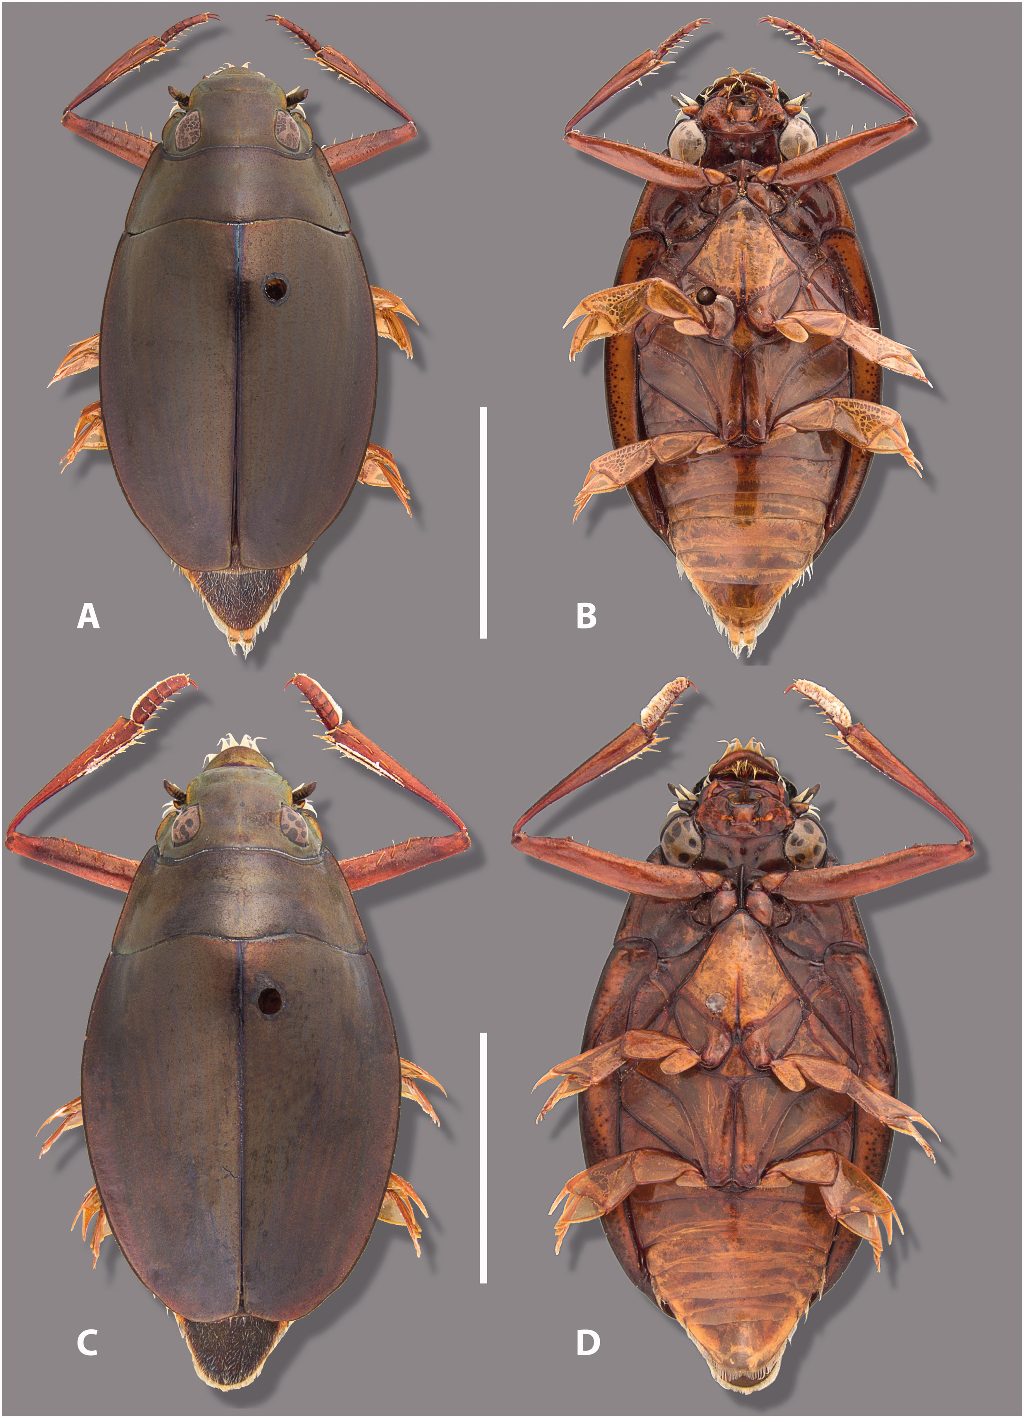
Fig. 1. Habitus of Dineutus shorti n. sp. (A) Dorsal habitus ♀ paratype. (B) Ventral habitus ♀ paratype. (C) Dorsal ...
Notes:
Fig. 1. Habitus of Dineutus shorti n. sp. (A) Dorsal habitus ♀ paratype. (B) Ventral habitus ♀ paratype. (C) Dorsal habitus ♂ holotype. (D) Ventral habitus ♂ holotype. Scale bars = 5 mm.
Unless provided in the caption above, the following copyright applies to the content of this slide: © The Authors 2015. Published by Oxford University Press on behalf of Entomological Society of America. All rights reserved. For Permissions, please email: journals.permissions@oup.com

Slide 2
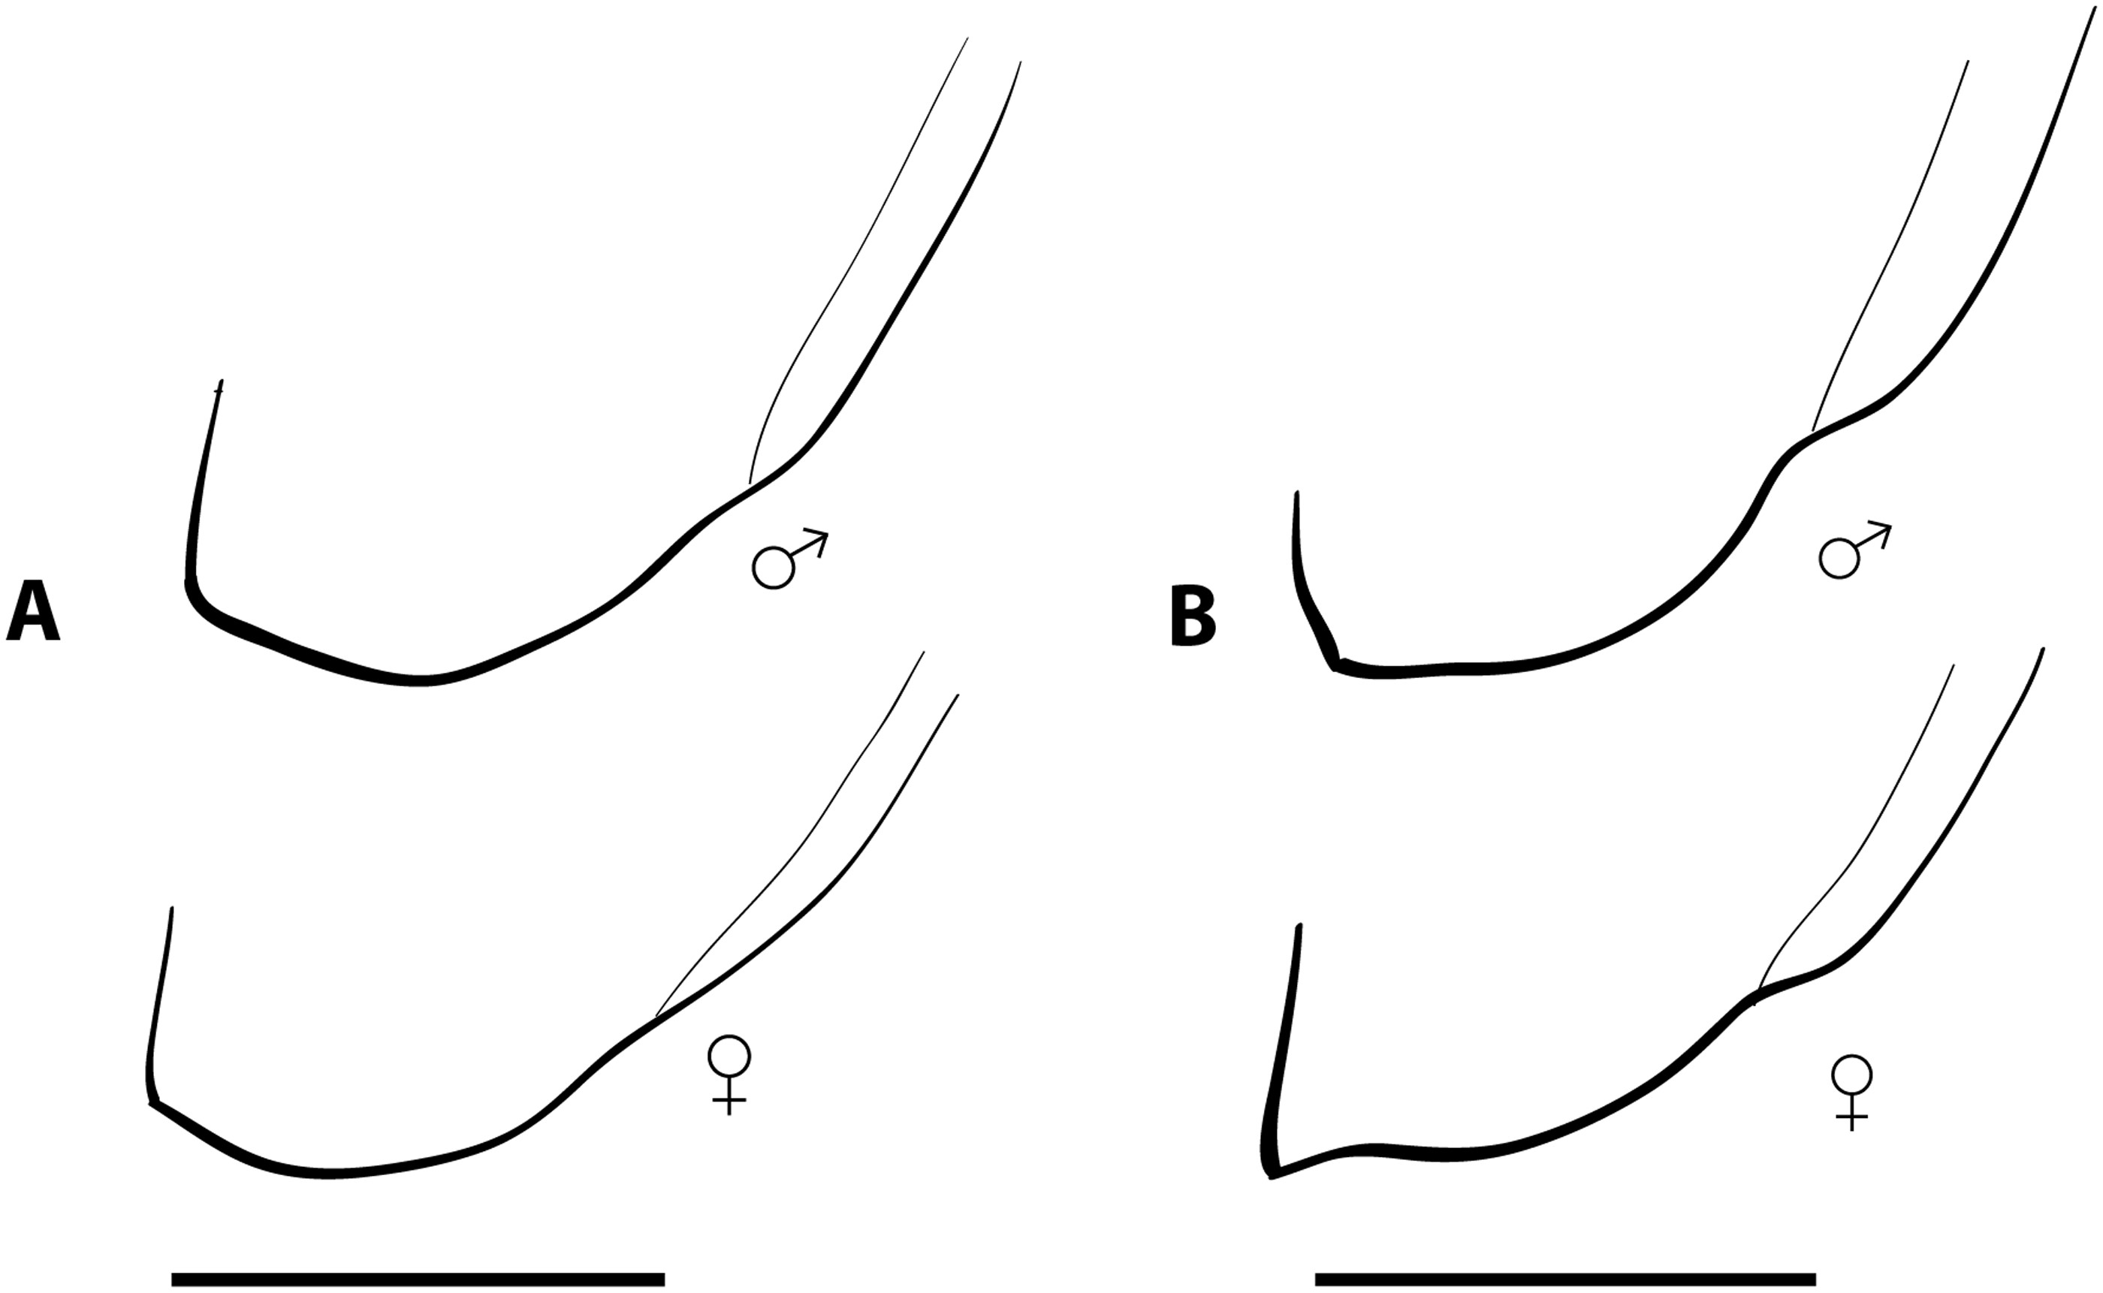
Fig. 2. Right elytral apex of both sexes. (A) Dineutus shorti n. sp. (B) Dineutus discolor . Scale bars = 2 mm.
Notes:
Fig. 2. Right elytral apex of both sexes. (A) Dineutus shorti n. sp. (B) Dineutus discolor . Scale bars = 2 mm.
Unless provided in the caption above, the following copyright applies to the content of this slide: © The Authors 2015. Published by Oxford University Press on behalf of Entomological Society of America. All rights reserved. For Permissions, please email: journals.permissions@oup.com

Slide 3
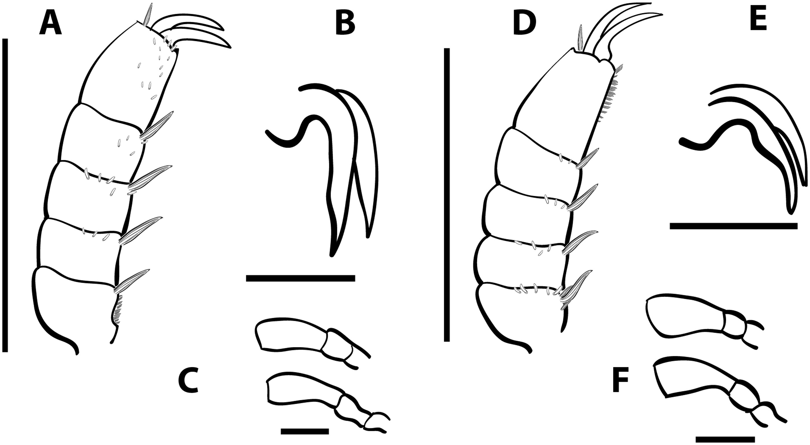
Fig. 3. Appendages of Dineutus shorti n. sp. (A–C) and of Dineutus discolor (D–F). (A) Protarsus, scale ...
Notes:
Fig. 3. Appendages of Dineutus shorti n. sp. (A–C) and of Dineutus discolor (D–F). (A) Protarsus, scale bar = 1.4 mm. (B) ♂ mesotarsal claw, scale bar = 0.2 mm. (C) Maxillary palp above, labial palp below, scale bar = 0.2 mm. (D) Protarsus, scale bar = 1.3 mm. (E) ♂ mesotarsal claw, scale bar = 0.2 mm. (F) Maxillary palp above, labial palp below, scale bar = 0.2 mm.
Unless provided in the caption above, the following copyright applies to the content of this slide: © The Authors 2015. Published by Oxford University Press on behalf of Entomological Society of America. All rights reserved. For Permissions, please email: journals.permissions@oup.com

Slide 4
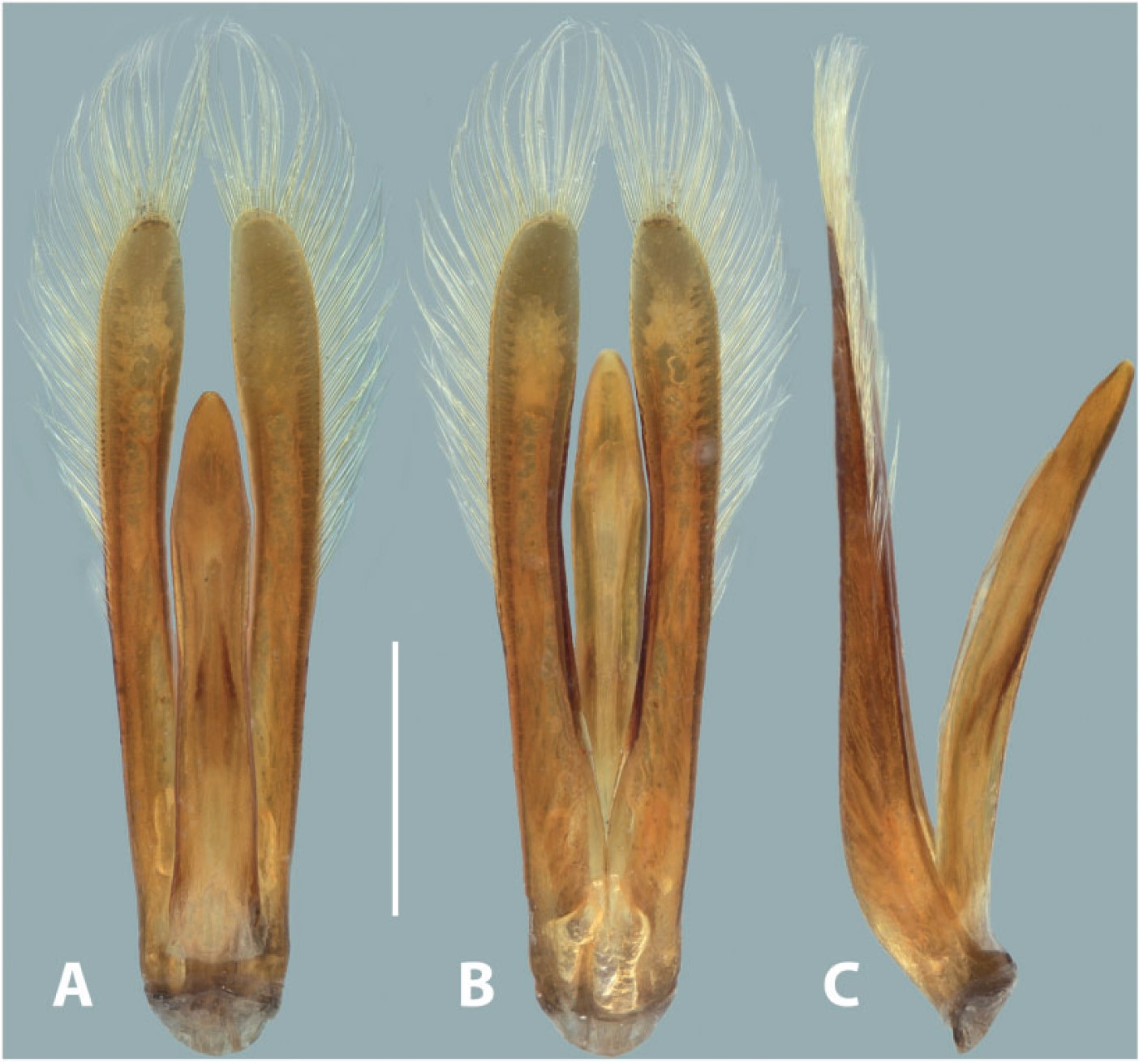
Fig. 4. Aedeagus of Dineutus shorti n. sp. holotype. (A) Dorsal view. (B) Ventral view. ( C ) Lateral view. Scale ...
Notes:
Fig. 4. Aedeagus of Dineutus shorti n. sp. holotype. (A) Dorsal view. (B) Ventral view. ( C ) Lateral view. Scale bar = 1 mm.
Unless provided in the caption above, the following copyright applies to the content of this slide: © The Authors 2015. Published by Oxford University Press on behalf of Entomological Society of America. All rights reserved. For Permissions, please email: journals.permissions@oup.com

Slide 5
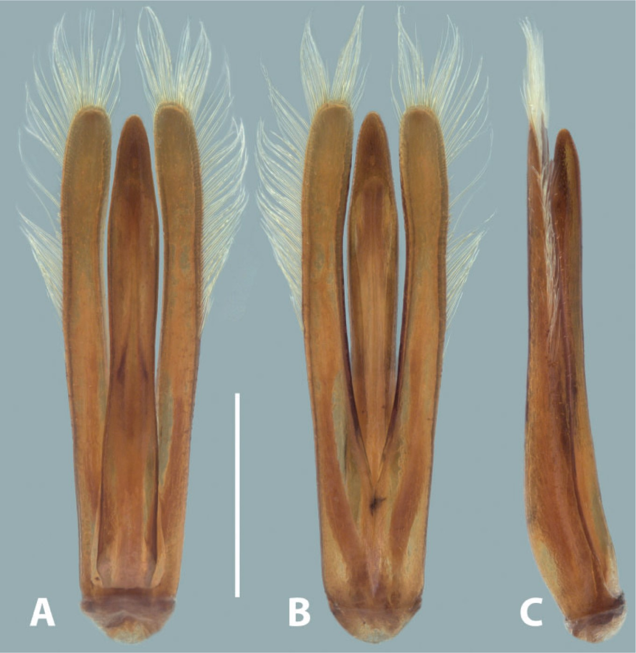
Fig. 5. Aedeagus of Dineutus discolor . (A) Dorsal view. (B) Ventral view. (C) Lateral view. Scale bar = 1 mm.
Notes:
Fig. 5. Aedeagus of Dineutus discolor . (A) Dorsal view. (B) Ventral view. (C) Lateral view. Scale bar = 1 mm.
Unless provided in the caption above, the following copyright applies to the content of this slide: © The Authors 2015. Published by Oxford University Press on behalf of Entomological Society of America. All rights reserved. For Permissions, please email: journals.permissions@oup.com

Slide 6
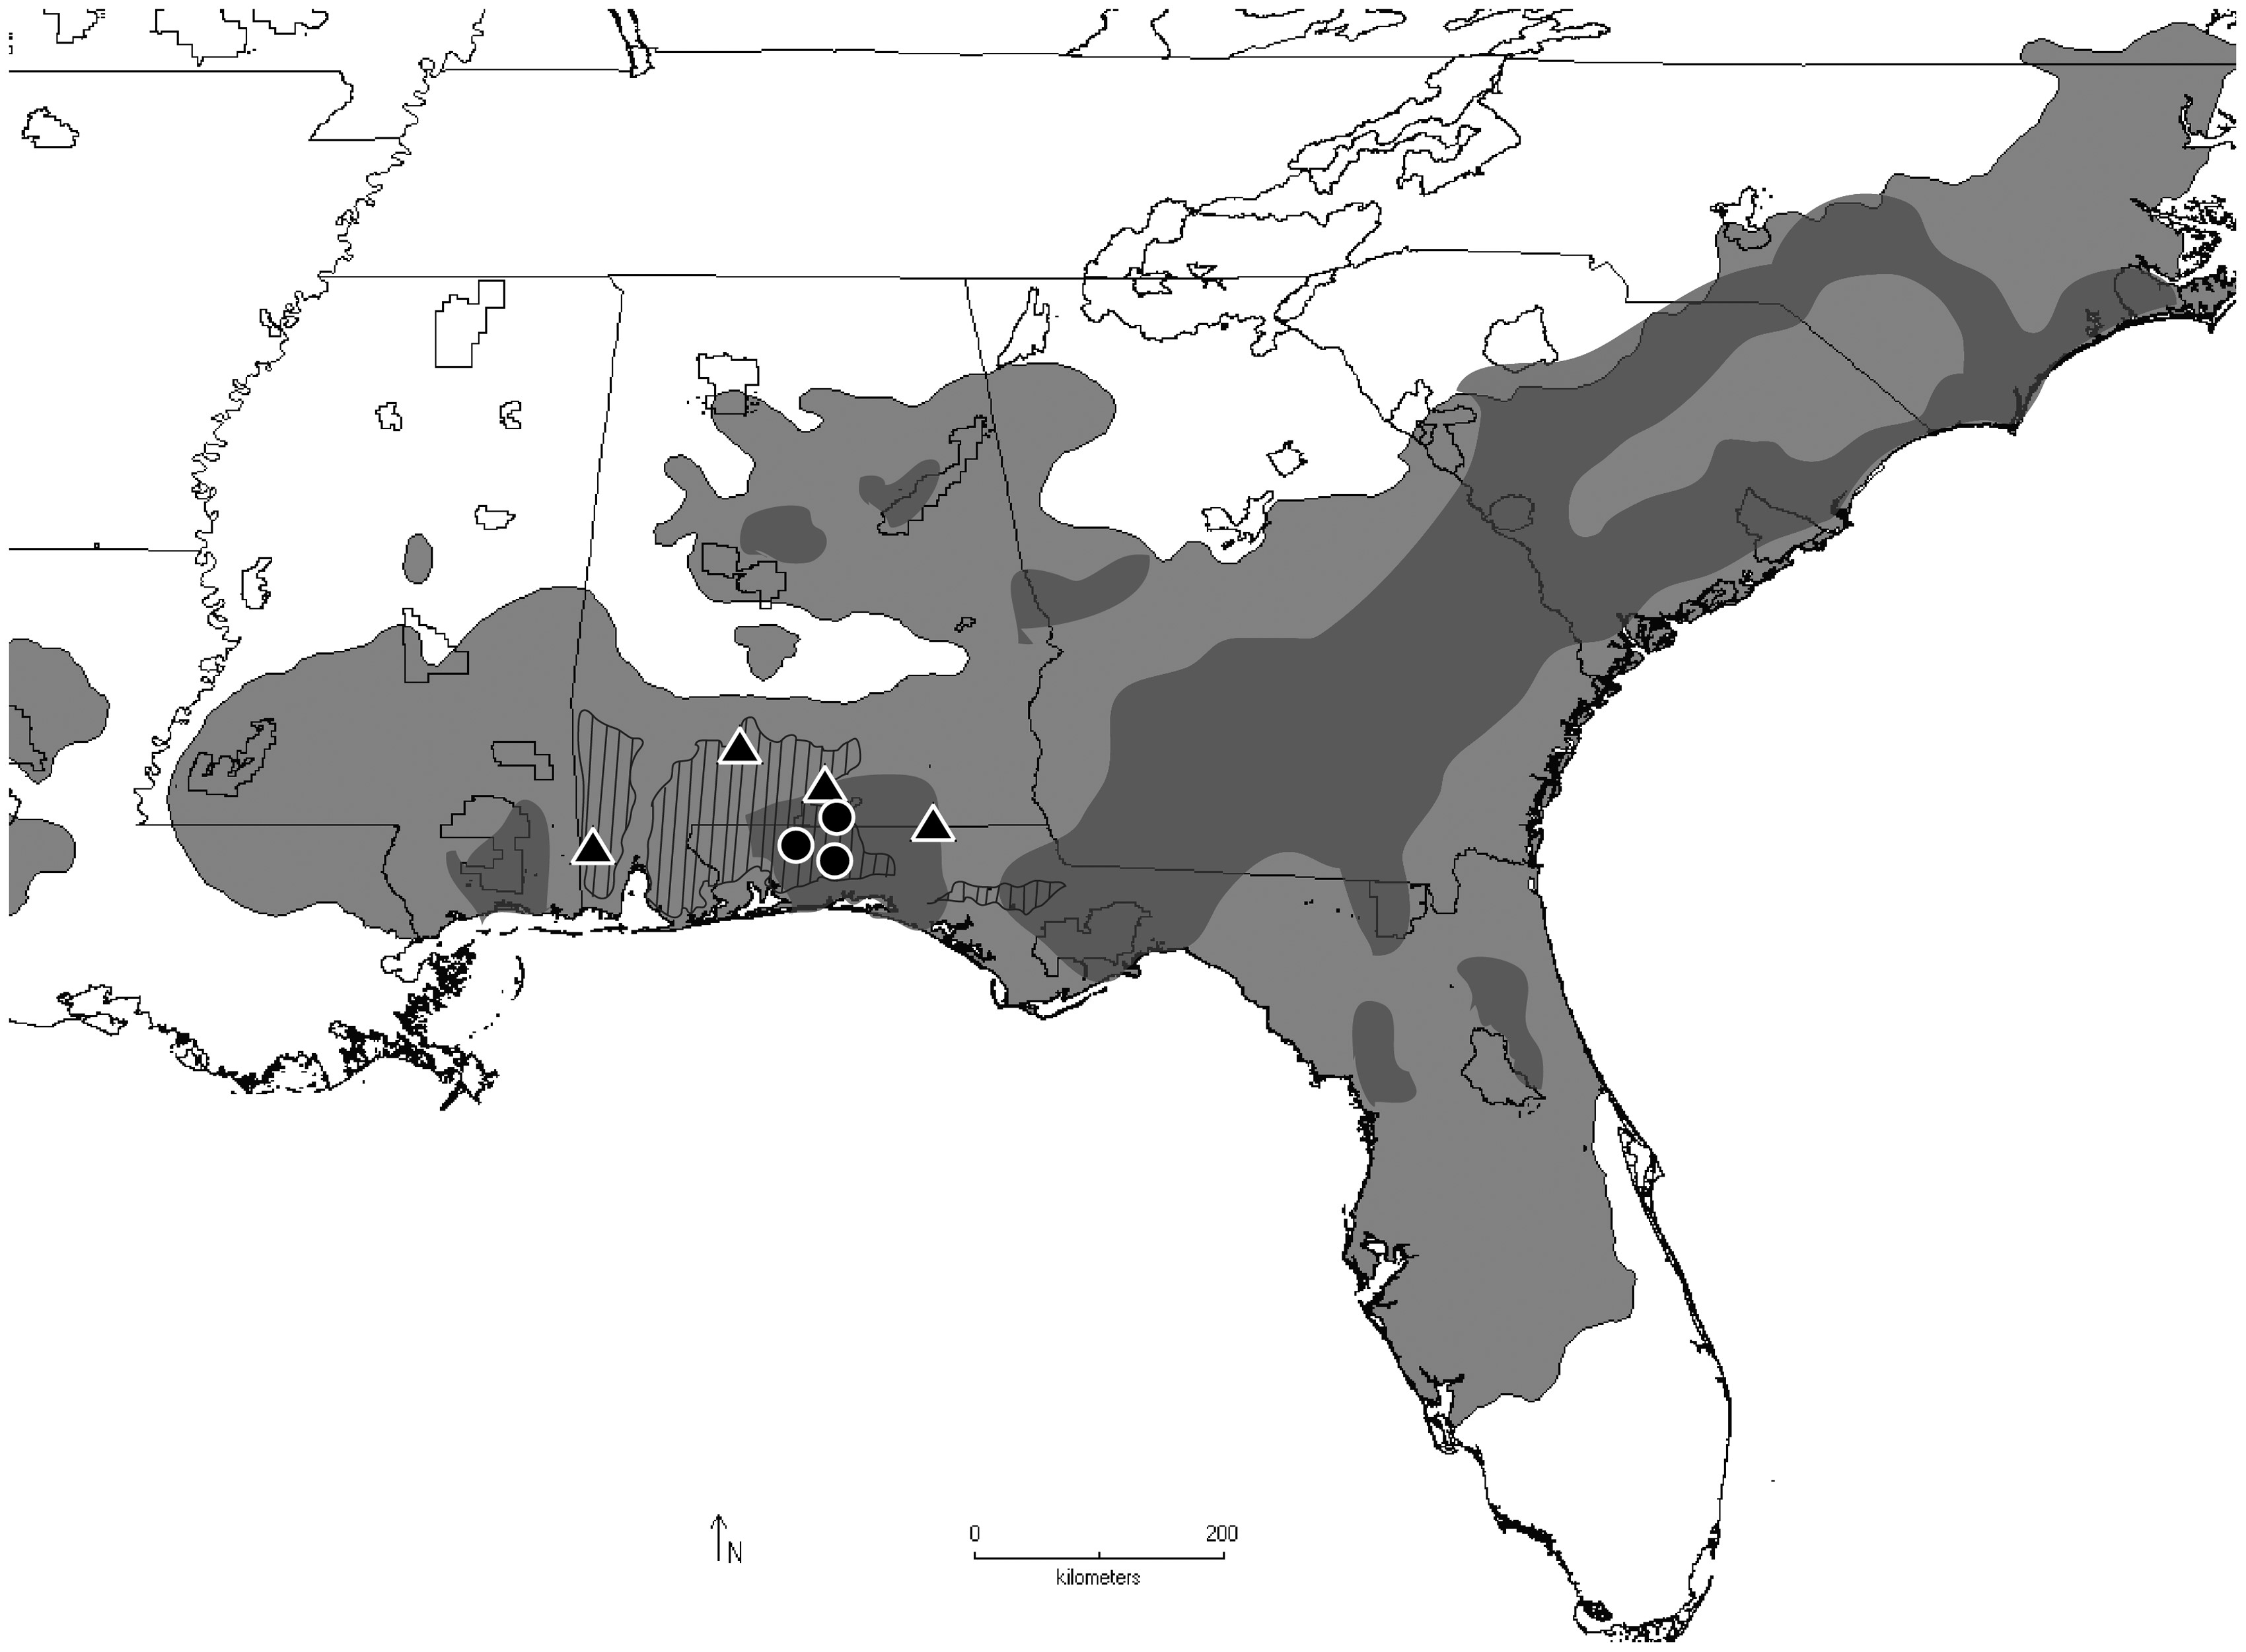
Fig. 6. Southeastern habitats and specimen collection. Circles— Dineutus shorti n. sp., triangles— Dineutus discolor ...
Notes:
Fig. 6. Southeastern habitats and specimen collection. Circles— Dineutus shorti n. sp., triangles— Dineutus discolor , both collected by G.T.G. in April 2015; hatched region represents Southern Pine Plains Region as designated by Griffith et al. ( 2012 , 2015 ), lighter gray region is natural range of longleaf pine ( Pinus palustris ), darker gray is natural stands older than 40 yr after Trani (2002) .
Unless provided in the caption above, the following copyright applies to the content of this slide: © The Authors 2015. Published by Oxford University Press on behalf of Entomological Society of America. All rights reserved. For Permissions, please email: journals.permissions@oup.com

