Slide 1
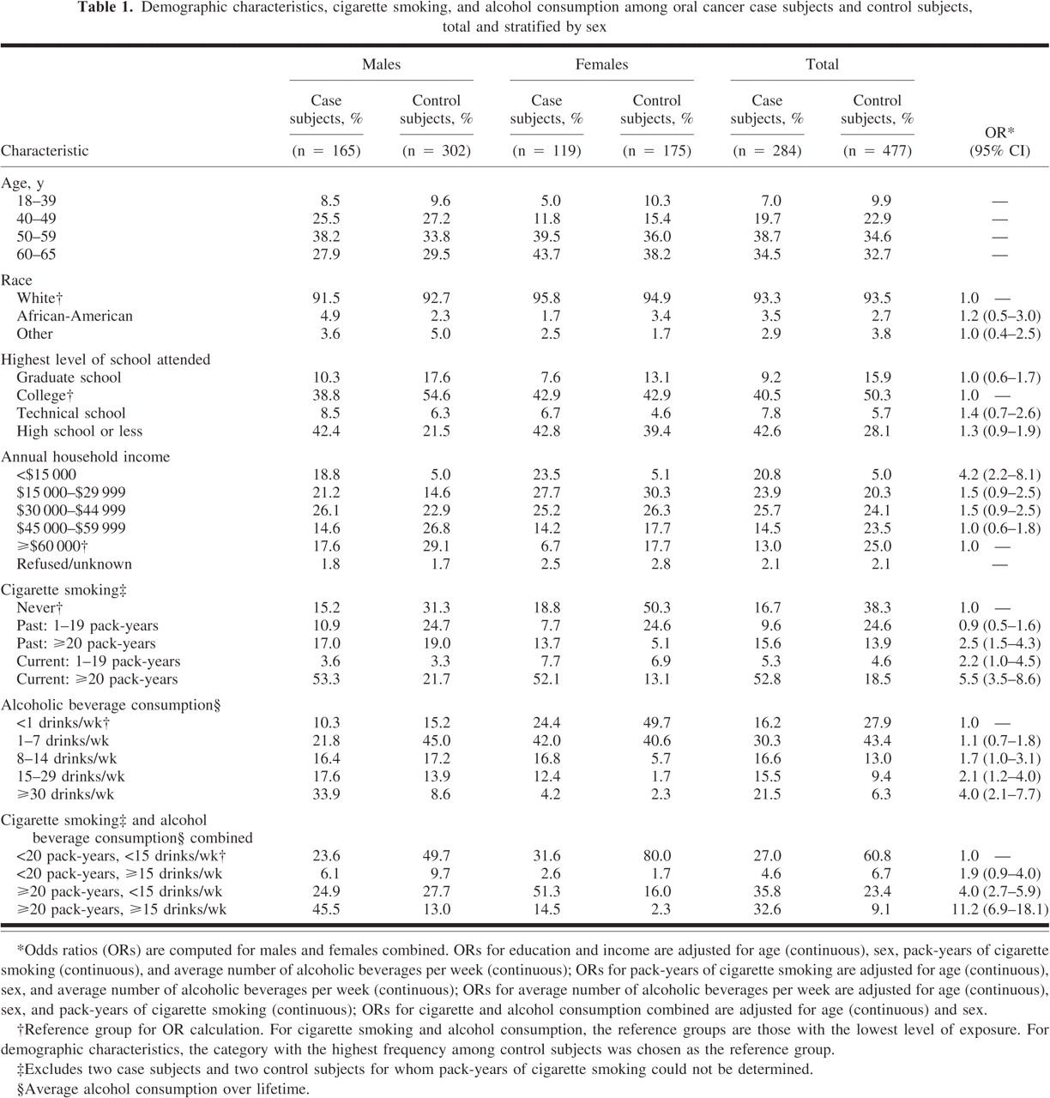
Notes:
Unless provided in the caption above, the following copyright applies to the content of this slide: © Oxford University Press

Slide 2
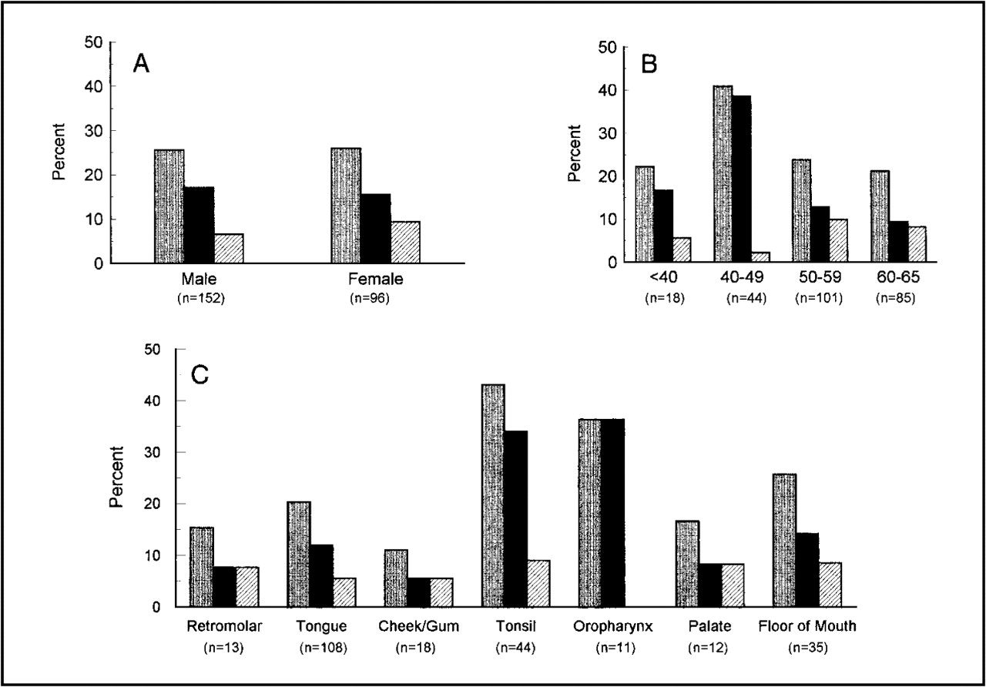
Fig. 1 Prevalence of human papillomavirus (HPV) DNA in tumor tissue of oral cancer case subjects. A) By sex; B) by ...
Notes:
Fig. 1 Prevalence of human papillomavirus (HPV) DNA in tumor tissue of oral cancer case subjects. A) By sex; B) by age at diagnosis; and C) by tumor site. Gray bars 4 total HPV DNA; black bars 4 HPV type 16 DNA; and hatched bars 4 HPV type 6 or type 11 DNA. Includes interviewed and noninterviewed case subjects. HPV type 16 DNA tumors (n 4 41) included 31 tumors with only HPV type 16 DNA and 10 tumors with HPV type 16 DNA and one or more other HPV types (seven with HPV type 6 or type 11 DNA, one with HPV type 11 and HPV type 31/33/35 DNA, one with HPV type 6 DNA and an unknown HPV DNA type, and one with unknown HPV DNA type). Two tumors contained only HPV DNA that could not be classified as to a specific type. Not included in C are two tumors arising in the uvula and two tumors for which the site was unknown
Unless provided in the caption above, the following copyright applies to the content of this slide: © Oxford University Press

Slide 3
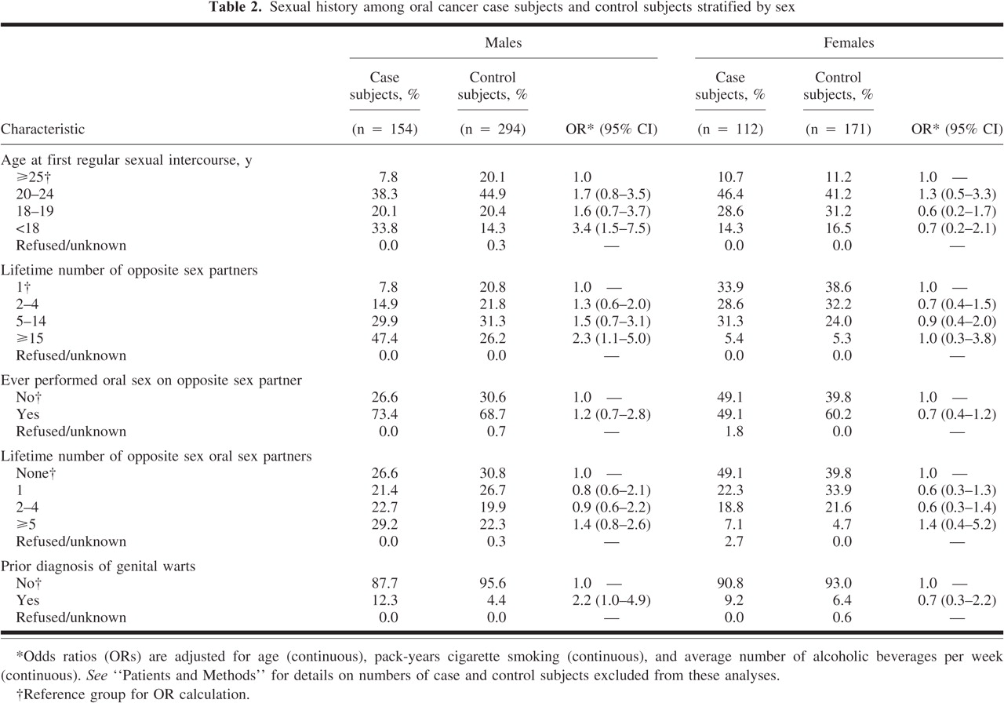
Notes:
Unless provided in the caption above, the following copyright applies to the content of this slide: © Oxford University Press

Slide 4
Notes:
Unless provided in the caption above, the following copyright applies to the content of this slide: © Oxford University Press

Slide 5
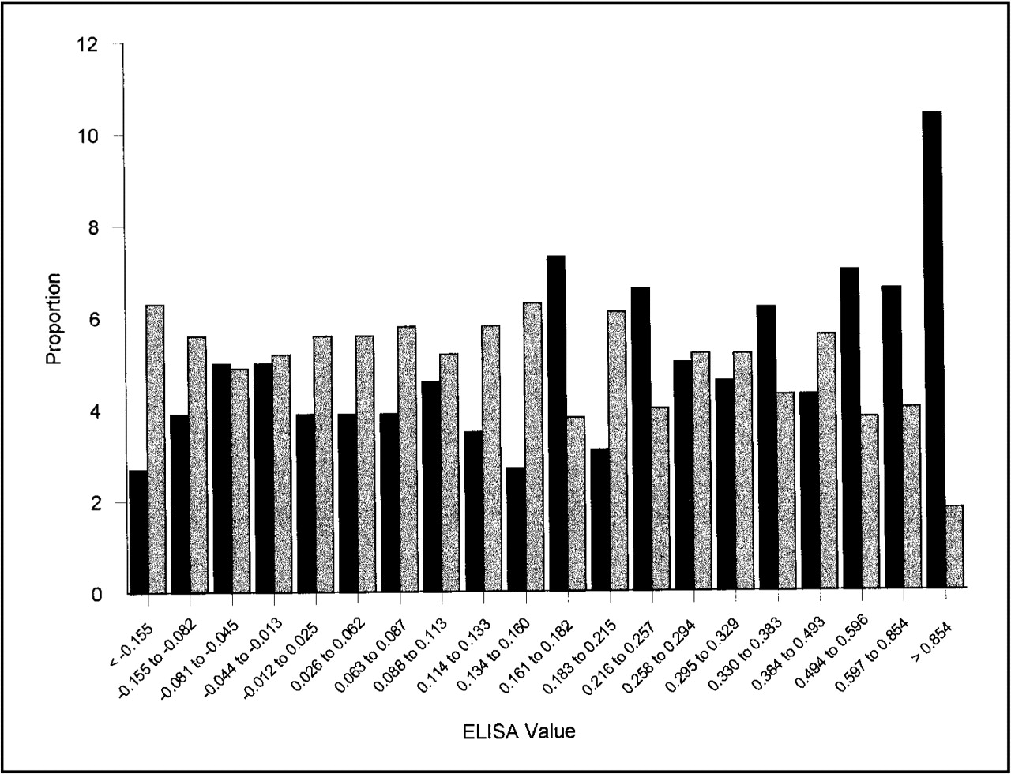
Fig. 2 Distribution of oral cancer case and control subjects by enzyme-linked immunosorbent assay (ELISA) value from ...
Notes:
Fig. 2 Distribution of oral cancer case and control subjects by enzyme-linked immunosorbent assay (ELISA) value from the HPV type 16 capsid ELISA. Black bars 4 case subjects; gray bars 4 control subjects. ELISA value categories are based on quantiles among case and control subjects combined. The proportion within each category is computed separately for case and control subjects. The ELISA value that defined the cutoff point for seropositivity was 0.209. See “Patients and Methods” for the definition of ELISA value and determination of cutoff for seropositivity.
Unless provided in the caption above, the following copyright applies to the content of this slide: © Oxford University Press

Slide 6
Notes:
Unless provided in the caption above, the following copyright applies to the content of this slide: © Oxford University Press

Slide 7
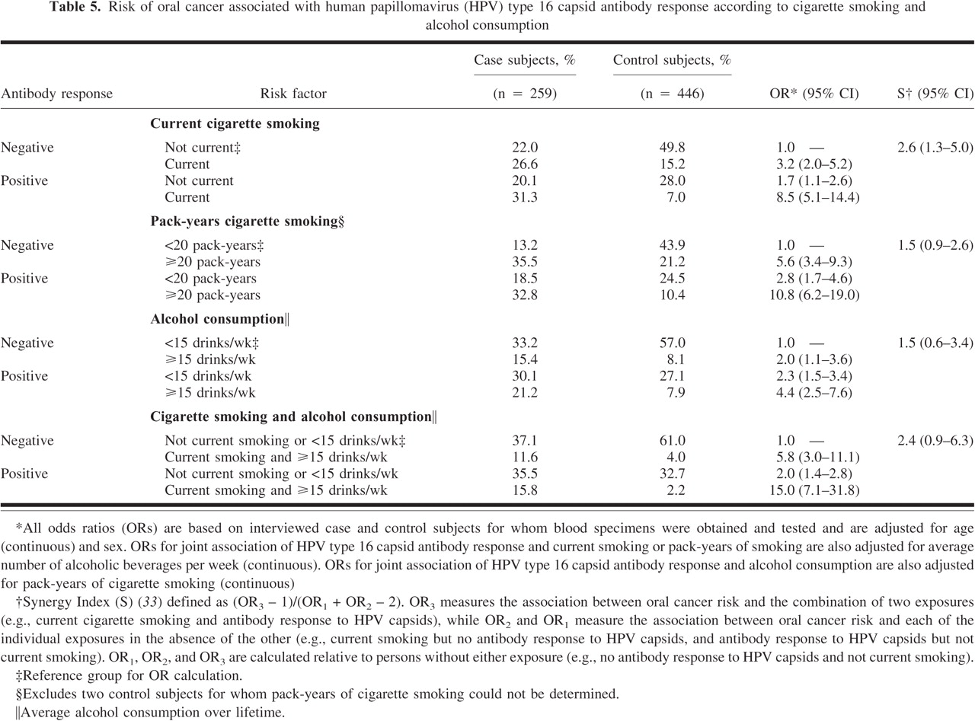
Notes:
Unless provided in the caption above, the following copyright applies to the content of this slide: © Oxford University Press

