Slide 1
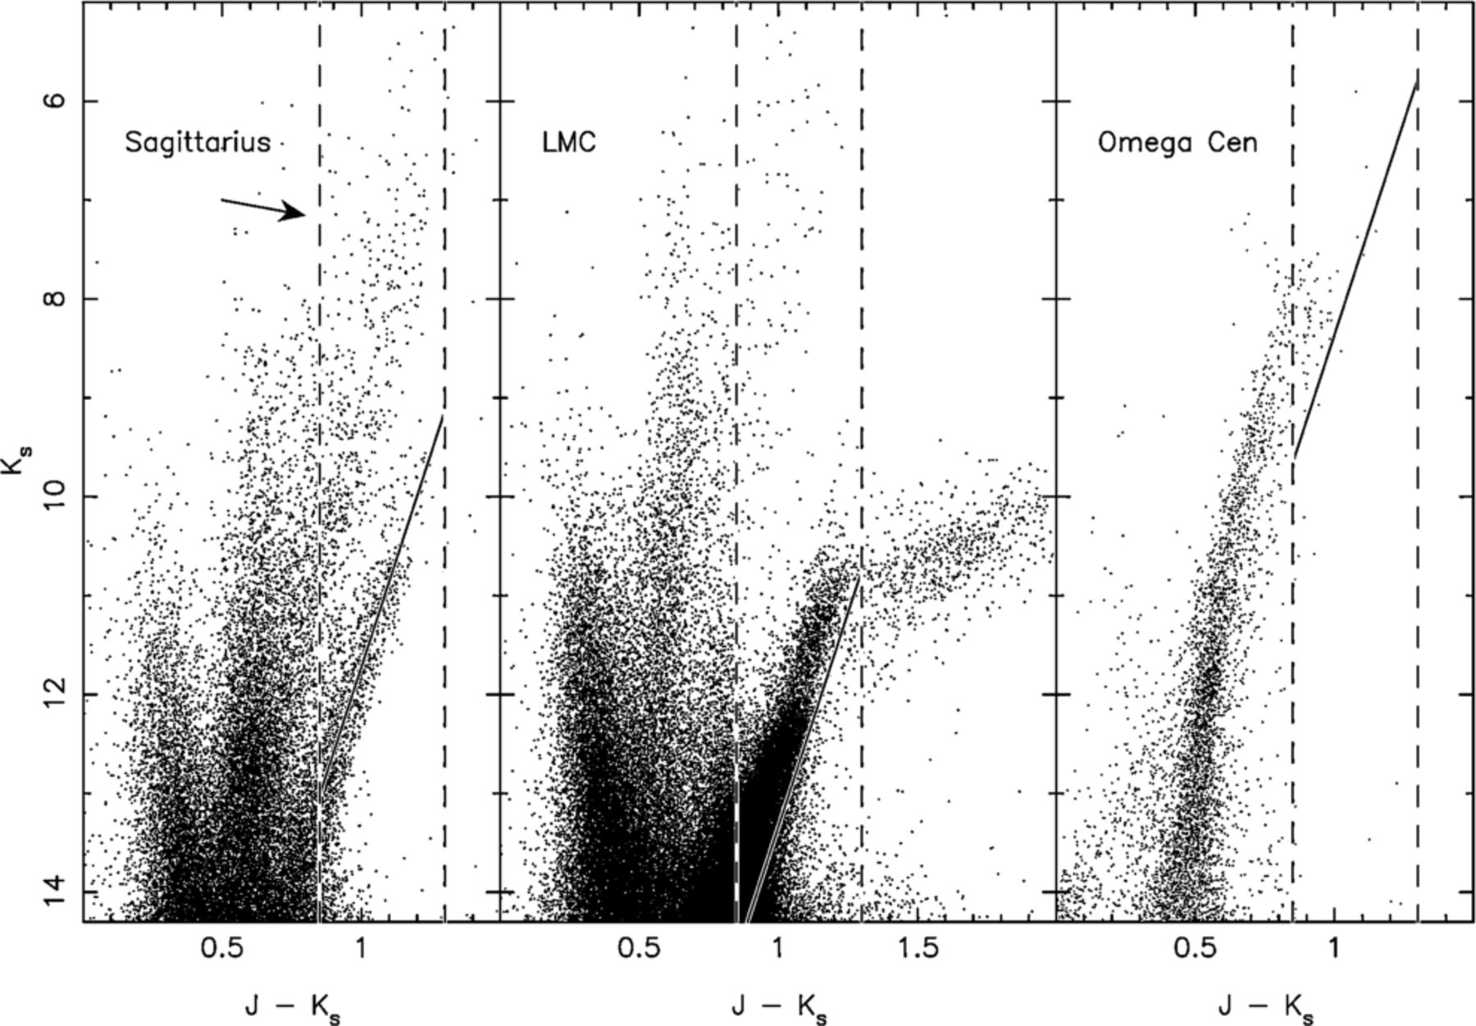
Figure 1. Comparison of colour–magnitude diagrams of our M-giant distance calibrator, the Sagittarius dwarf galaxy ...
Notes:
Figure 1. Comparison of colour–magnitude diagrams of our M-giant distance calibrator, the Sagittarius dwarf galaxy (left-hand panel), with the LMC (middle panel) and Omega Centauri (right-hand panel). The proper-motion cleaned catalogue (sample B) is used here. The Sgr CMD is derived from a 1° circle, centred on the core of the galaxy, the LMC CMD comes from an annulus between 5° and 6°, while the Omega Cen CMD is from data within 20′ of the core of the cluster. The J−Ks, Ks colour–magnitude selection window is shown between the dashed vertical lines (though note the additional selection in J-H colour is not displayed here). The arrow shows the reddening vector, with a length corresponding to the chosen reddening limit of E(B−V) < 0.555. In the left-hand panel, the solid line shows the Majewski et al. (2003) RGB calibration for the Sgr dwarf (m−M= 16.9; Ibata et al. 1997). The parallel sequence approximately two magnitudes brighter than the Sgr RGB is the RGB of the bulge. The solid line in the middle and right-hand panels show the corresponding ridge line assuming a distance modulus of 18.515 for the LMC (Clementini et al. 2003) and 13.53 for Omega Cen (Harris 1996). Using the Sgr fiducial to determine the distance to the LMC or Omega Cen would lead to a ∼ 30 per cent underestimate of their distances. The substantial population red-ward of J−Ks= 1.3 in the LMC are AGB carbon stars, which highlights the need for the upper J−Ks colour limit.
Unless provided in the caption above, the following copyright applies to the content of this slide: © 2004 RAS

Slide 2
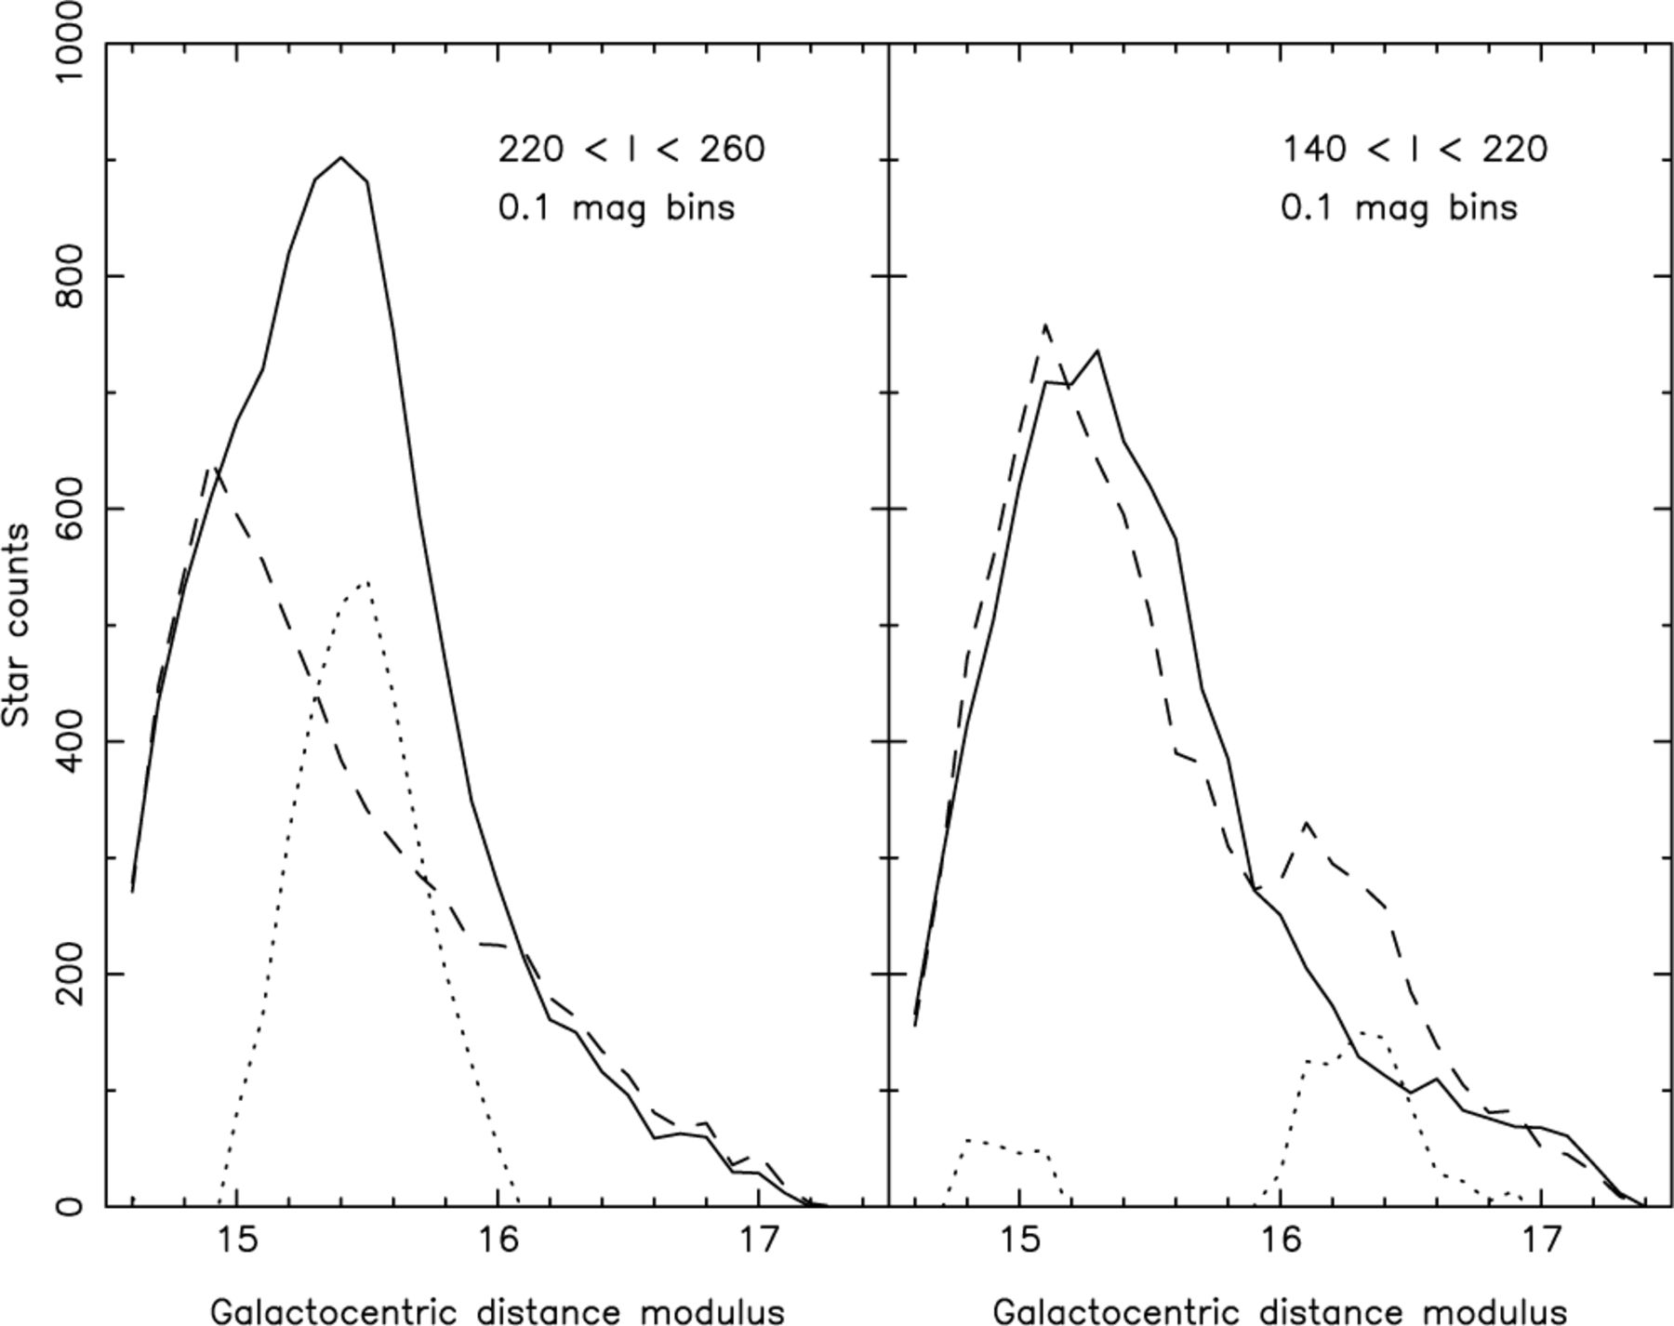
Figure 2. The Galactocentric distance modulus (m−M)_{GC} distribution for M-giant stars in sample A with |b| < ...
Notes:
Figure 2. The Galactocentric distance modulus (m−M)GC distribution for M-giant stars in sample A with |b| < 40°, E(B−V) < 0.555 and for different ranges in ℓ. Note that in this, and all subsequent figures, those regions removed by the extinction cut have their corresponding symmetric region about the Galactic plane removed as well. The star distribution in the southern hemisphere (full line) is compared to the northern hemisphere distribution (dashed line); the difference between these distributions is also plotted (dotted line). The 220° < ℓ < 260° region (left-hand panel) shows an overdensity in the southern hemisphere, ranging over 15.0 < (m−M)GC < 16.0 with a maximum at (m−M)GC= 15.5 (the signal to noise ratio of this peak is S/N = 30). The 140° < ℓ < 220° region (right-hand panel) shows an overdensity in the northern hemisphere, ranging over 16.0 < (m−M)GC < 16.6 with a maximum between (m−M)GC= 16.1 and (m−M)GC= 16.4 (this peak has S/N = 13).
Unless provided in the caption above, the following copyright applies to the content of this slide: © 2004 RAS

Slide 3
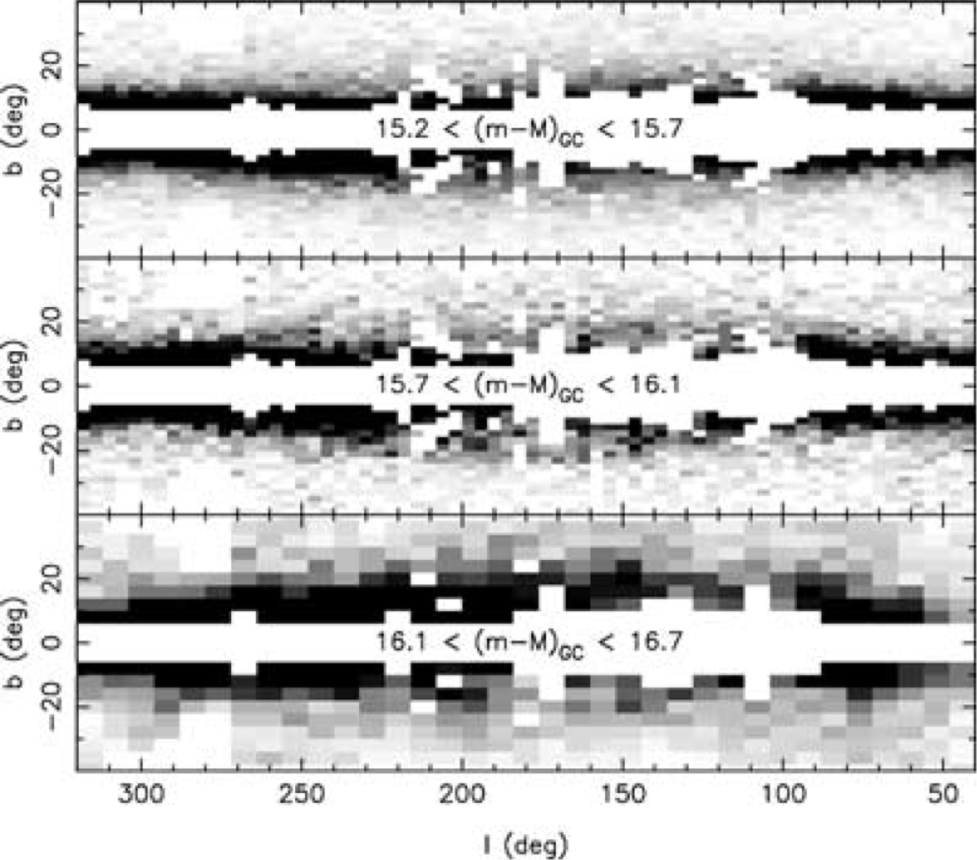
Figure 3. The distribution of M-giant stars (from sample A) for different ranges in Galactocentric distance modulus ...
Notes:
Figure 3. The distribution of M-giant stars (from sample A) for different ranges in Galactocentric distance modulus (m−M)GC. (We choose to display these distributions in Galactocentric coordinates because the overdensities are more peaked than in heliocentric coordinates, whereas the use of the distance modulus makes it easier to visualize the effects of extinction and population differences). In the upper two panels a pixel corresponds to a 4°× 2° rectangle, while in the bottom panel a pixel covers 8°× 4°; the scale colour is different for each panel to emphasize the structures. The circular hole at ℓ∼ 280° and b∼− 35° comes from the removal of the Large Magellanic Cloud; due to the symmetry imposed on the map, this hole is reflected in the North as well. The top panel contains the sources of our sample with 15.2 < (m−M)GC < 15.7. The most significant overdensity in this distance range is created by a dense object at 220°≲ℓ≲ 260° and b≳− 20°, towards Canis Major. The middle panel shows the distribution of sources with 15.7 < (m−M)GC < 16.1, while the bottom panel shows 16.1 < (m−M)GC < 16.7. In the top, middle and bottom panels, a black pixel corresponds to 40, 16 and 16 counts, respectively.
Unless provided in the caption above, the following copyright applies to the content of this slide: © 2004 RAS

Slide 4
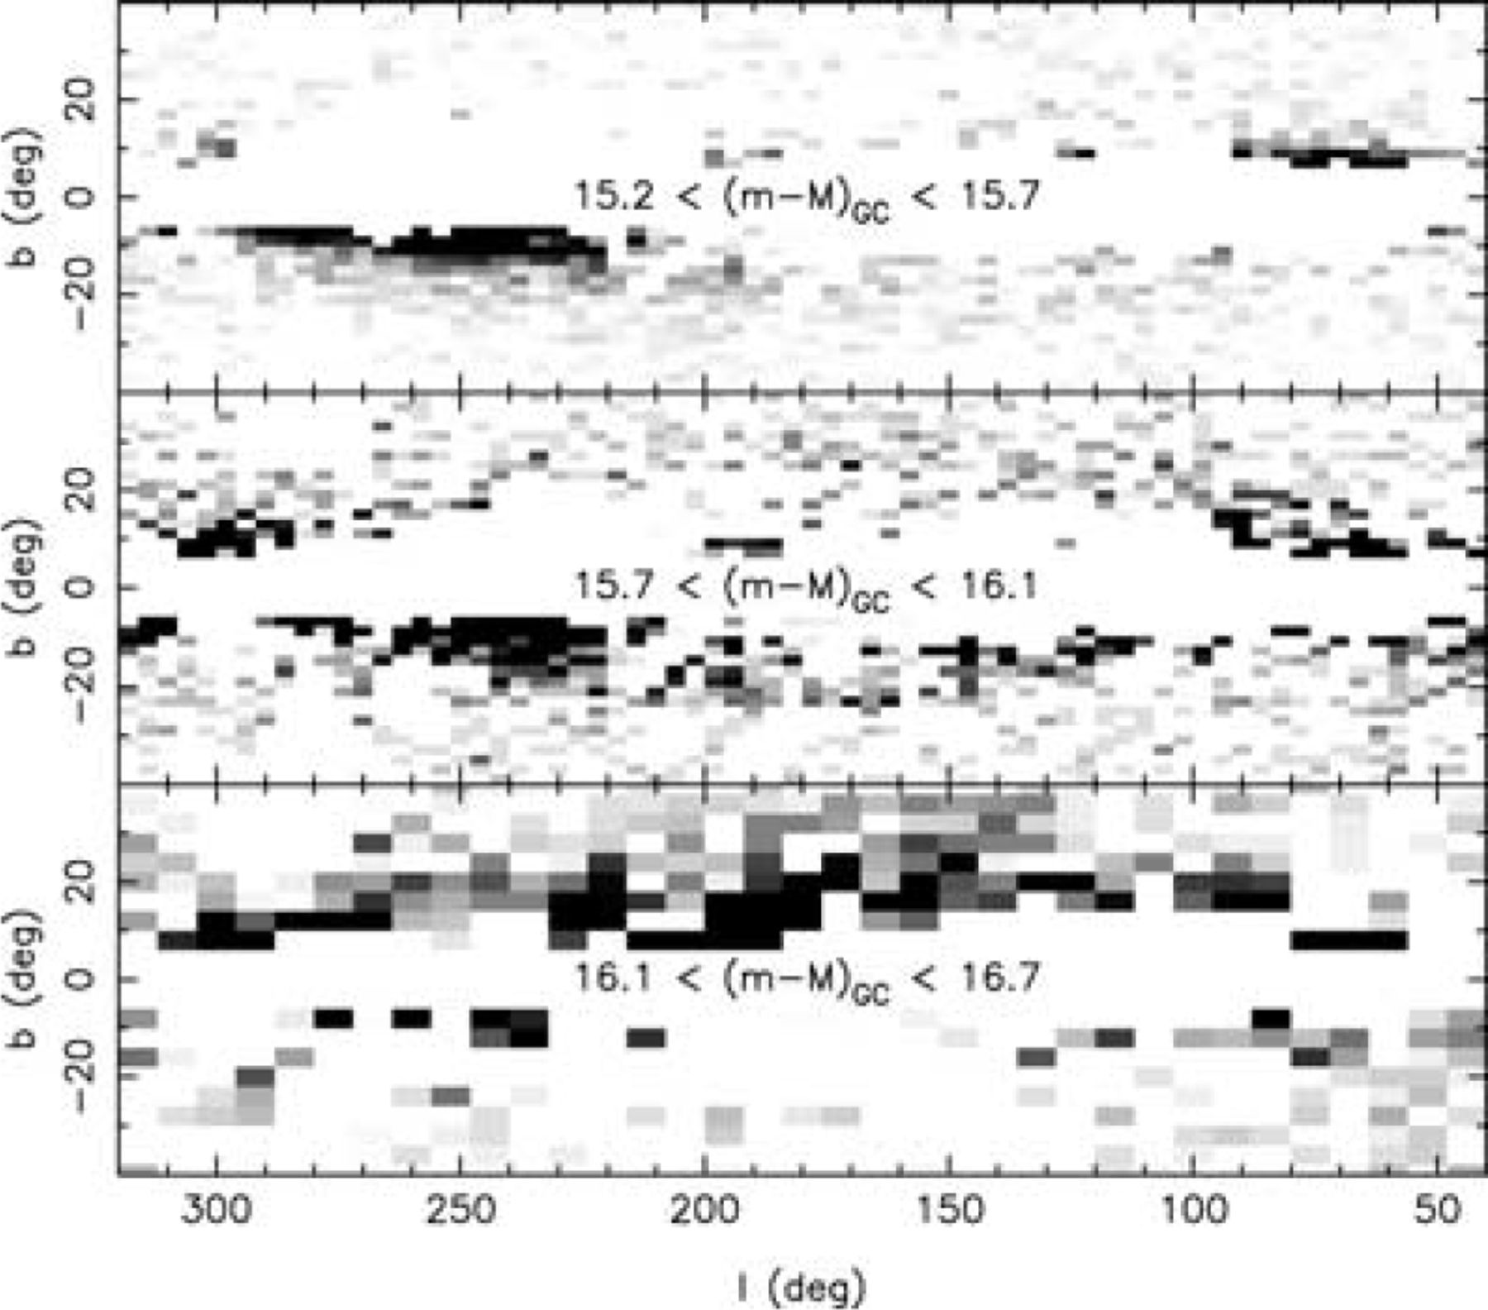
Figure 4. As Fig. 3, but showing the difference in M-giant starcounts between the two hemispheres. The Canis Major ...
Notes:
Figure 4. As Fig. 3, but showing the difference in M-giant starcounts between the two hemispheres. The Canis Major overdensity at (ℓ∼ 240°, b∼− 10°) is clearly visible on the upper two panels. The middle panel also shows a fainter population arcing over the sky between 110°≲ℓ≲ 210° in the southern hemisphere. Another huge arc-like structure is present in the northern hemisphere in the bottom panel ranging from ℓ∼ 140° to ℓ∼ 220°. In the top, middle and bottom panels, a black pixel corresponds to 40, 8 and 8 counts, respectively.
Unless provided in the caption above, the following copyright applies to the content of this slide: © 2004 RAS

Slide 5
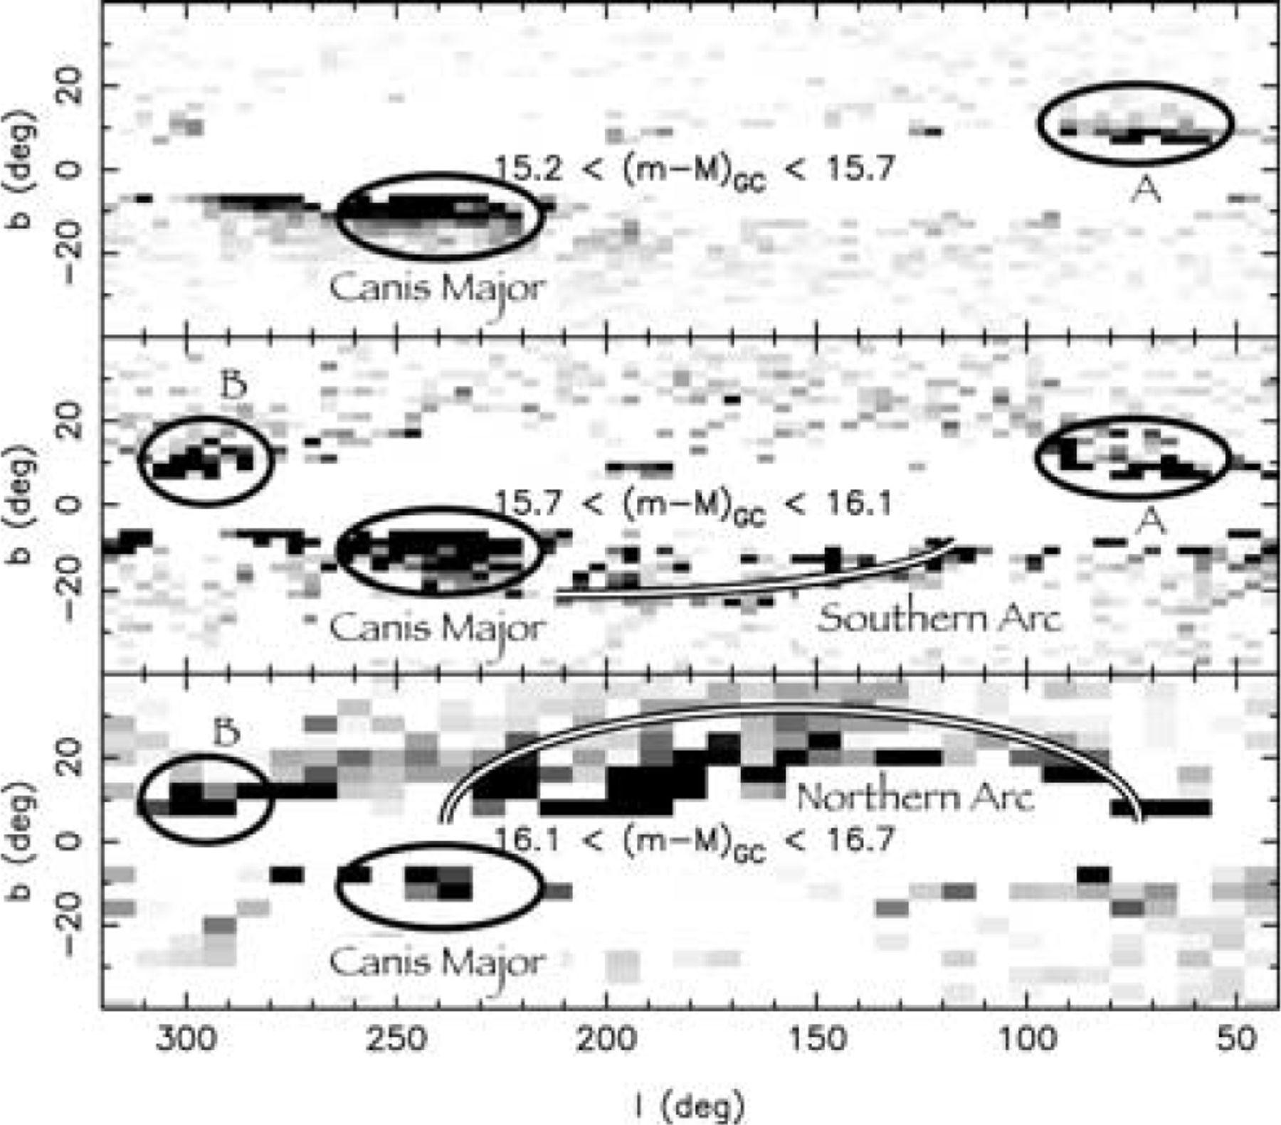
Figure 5. As Fig. 4, with an overlay of the main asymmetries in the Galactic M-giant distribution detected in Figs 3 ...
Notes:
Figure 5. As Fig. 4, with an overlay of the main asymmetries in the Galactic M-giant distribution detected in Figs 3 and 4. The strongest of these is the Canis Major overdensity, followed by the Northern Arc. A fainter Southern Arc is also visible, as are two structures at ℓ= 70°, and ℓ= 300°, which we label structures A and B respectively.
Unless provided in the caption above, the following copyright applies to the content of this slide: © 2004 RAS

Slide 6
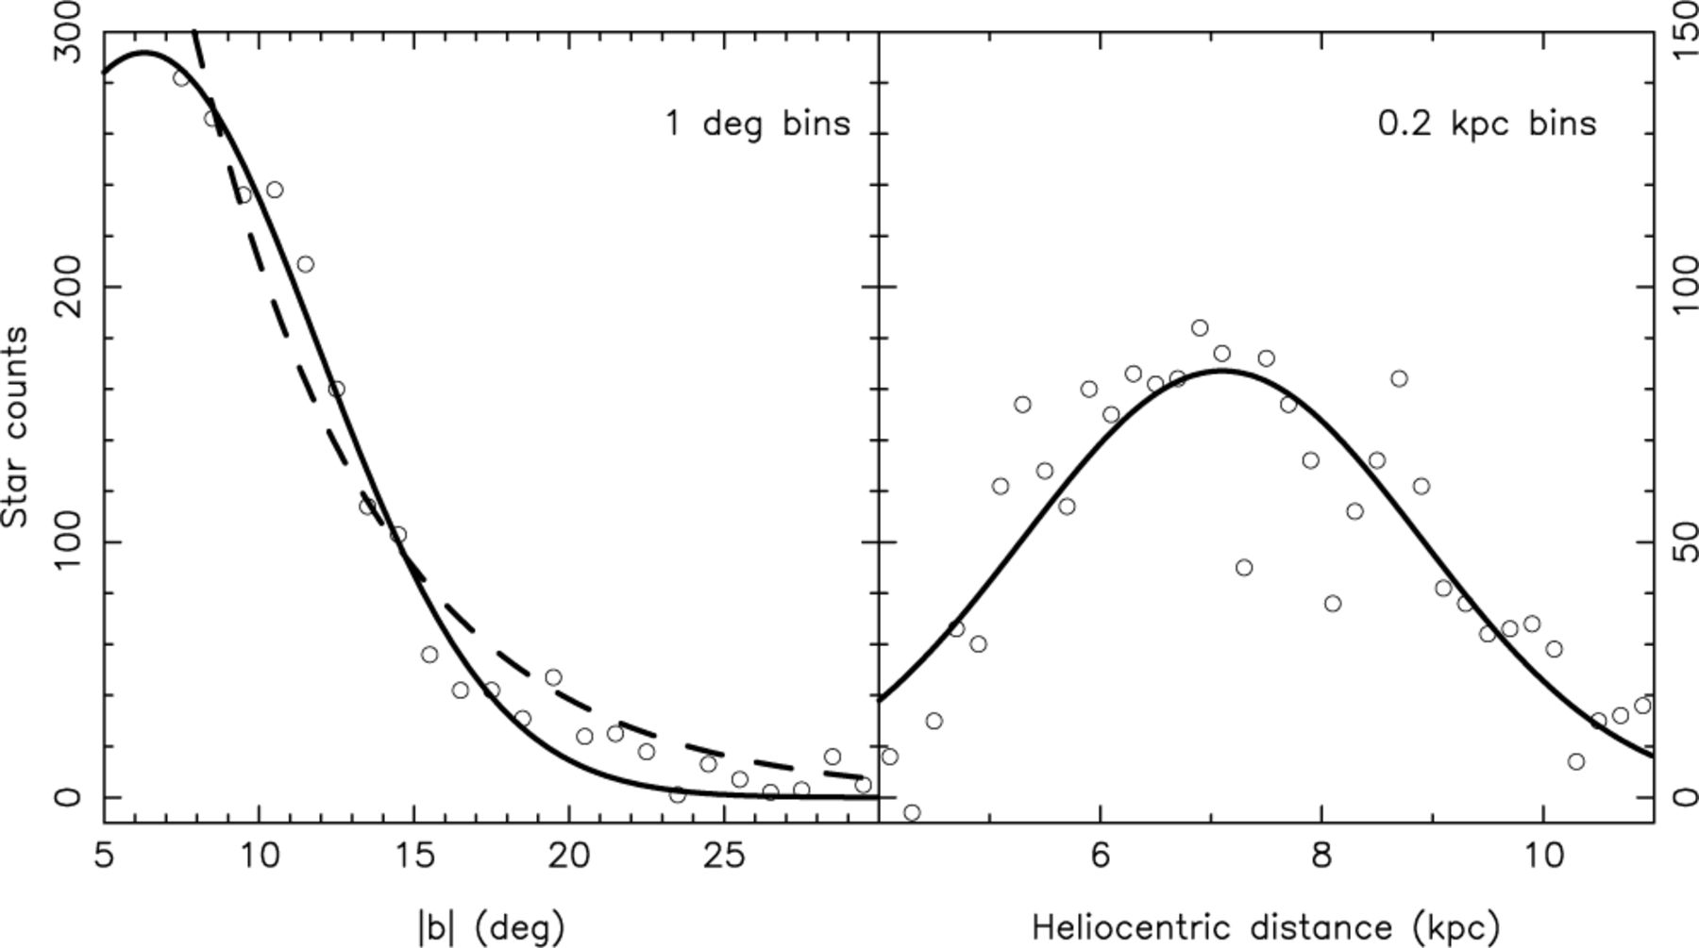
Figure 6. Vertical and radial profiles of the Canis Major object, derived from sample A. The northern hemisphere is ...
Notes:
Figure 6. Vertical and radial profiles of the Canis Major object, derived from sample A. The northern hemisphere is used as a reference and its star counts are subtracted from those of the southern hemisphere. The left-hand panel shows the latitude distribution of stars with 15.2 < (m−M)GC < 15.7 and 220° < ℓ < 260°. The lack of data for |b| < 7° puts a high degree of uncertainty on the fits, but the best Gaussian fit (full line) is centred on with a FWHM of , corresponding to a latitude width of 1.6 ± 0.2 kpc. We also calculated the best exponential fit of the population (dashed line): it has a scaleheight of 0.73 ± 0.05 kpc. The right-hand panel shows the radial distribution of stars for the region of the centre of the object (230° < ℓ < 250° and −12° < b < −7°). The best Gaussian fit has been superposed on the star counts: it corresponds to a Gaussian centred on D⊙= 7.1 ± 1.3 kpc, with a 4.2 ± 0.3 kpc FWHM. We used the heliocentric distance distribution here because our angle selection was made in heliocentric coordinates, more suited for observations along these lines of sight.
Unless provided in the caption above, the following copyright applies to the content of this slide: © 2004 RAS

Slide 7
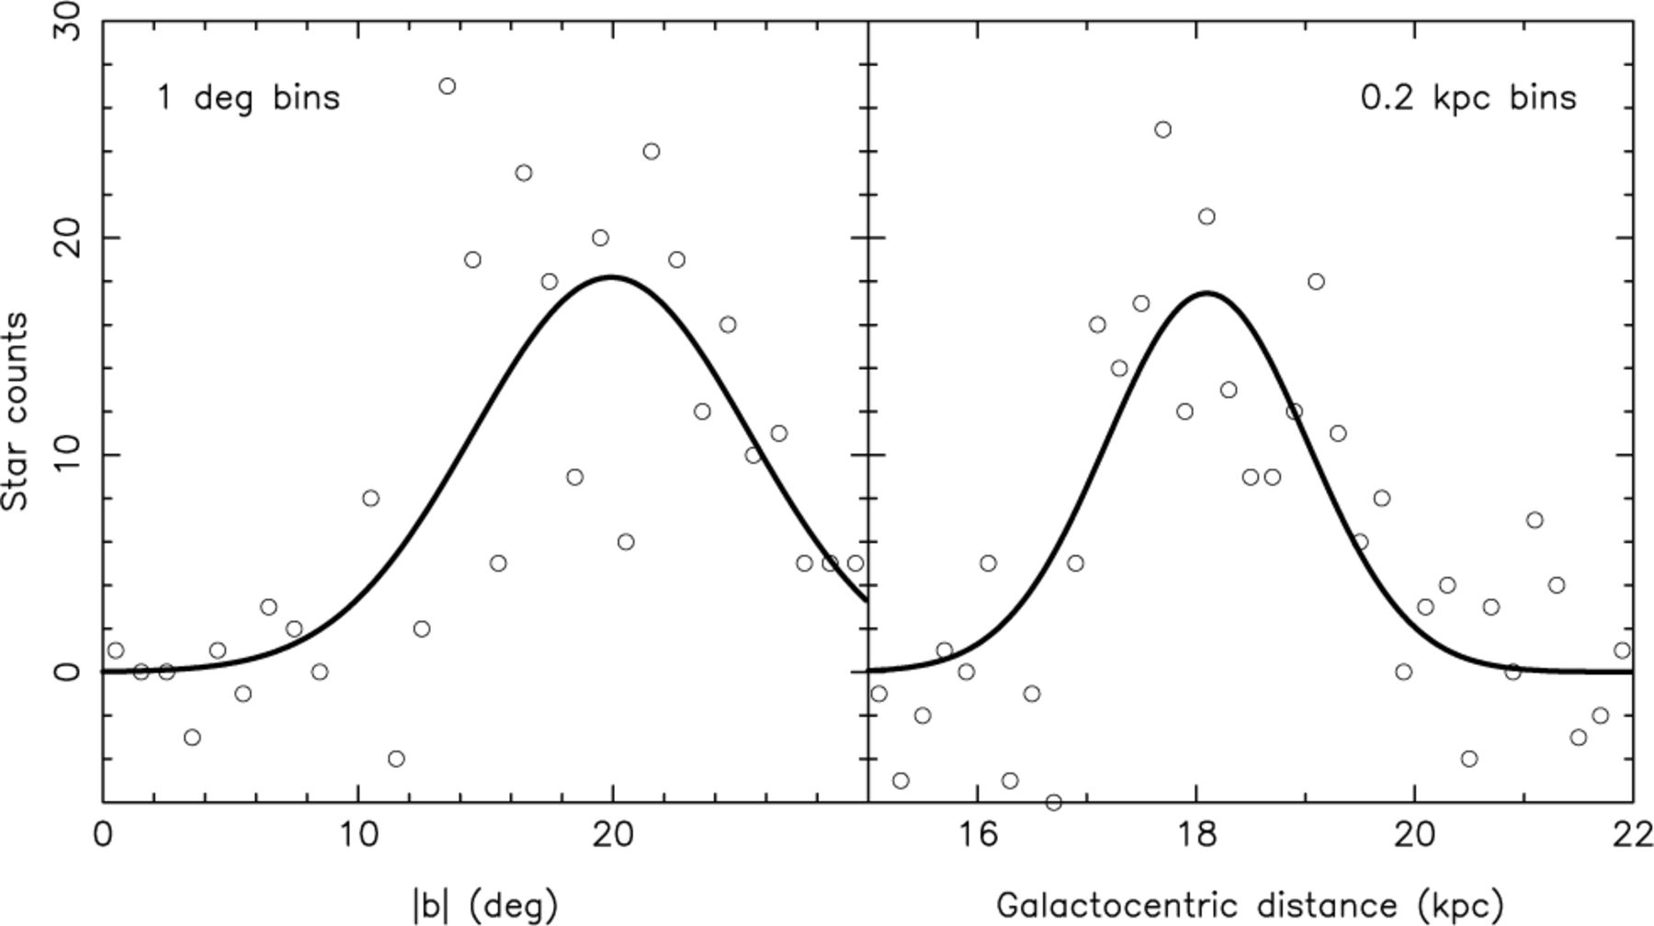
Figure 7. Profiles of the Northern Arc structure. The southern hemisphere is used as a reference and its star counts ...
Notes:
Figure 7. Profiles of the Northern Arc structure. The southern hemisphere is used as a reference and its star counts are subtracted from those of the northern hemisphere. The left-hand panel shows the latitude profile of the structure for 140° < ℓ < 180° and 16.1 < (m−M)GC < 16.7, and the best Gaussian fit of the star counts. The distribution has a mean value of and a FWHM of . At the heliocentric distance of the object (∼10 kpc), it corresponds to a vertical width of 2.2 ± 0.4 kpc. The right-hand panel shows the radial profile of the structure for 140° < ℓ < 180° and +10° < b < +25°. The distribution is centred on DGC= 18.1 ± 0.1 kpc with a 2.2 ± 0.3 kpc thickness. Because here the observations are in the direction of the anticentre, we were able to use Galactocentric distances.
Unless provided in the caption above, the following copyright applies to the content of this slide: © 2004 RAS

Slide 8
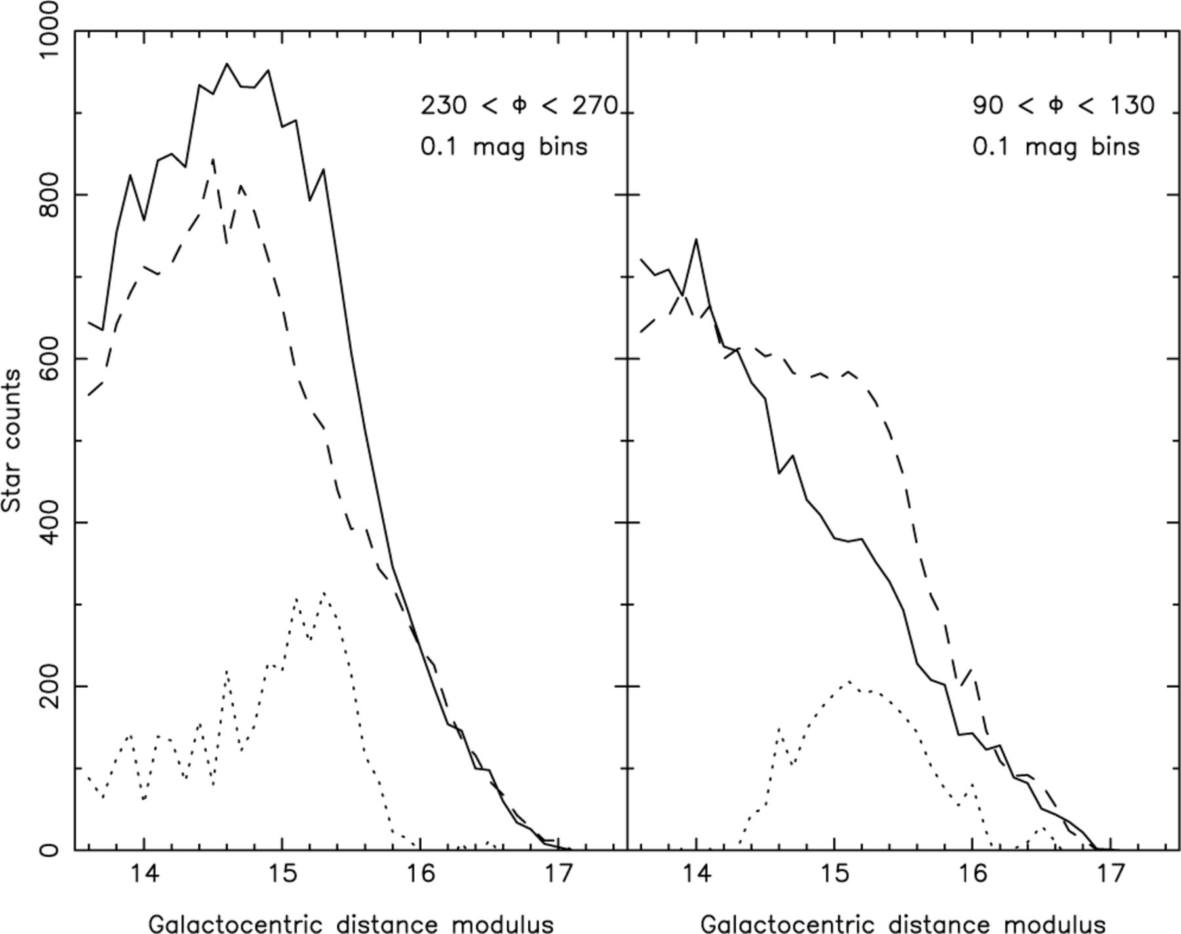
Figure 8. The Galactocentric distance modulus (m−M)_{GC} distribution for M-giant stars with |b| < 30°, E(B−V) ...
Notes:
Figure 8. The Galactocentric distance modulus (m−M)GC distribution for M-giant stars with |b| < 30°, E(B−V) < 0.555 and for different ranges of the Galactocentric cylindrical coordinate Φ. The star distribution in the southern hemisphere (full line) is compared to the northern hemisphere distribution (dashed line); the overdensities are also plotted (dotted line). The 230° < Φ < 270° region (left-hand panel), which corresponds to ℓ≳ 270°, shows the prolongation of the Canis Major overdensity. With a Galactocentric distance modulus of (m−M)GC < 15.8, it is closer to the Galactic centre than the overdensity we presented on Fig. 2; the (m−M)GC= 13.5 lower limit is due to the presence of the bulge. The overdensity has a maximum star count of ∼300 (per interval of 0.1 in distance modulus) at (m−M)GC= 15.1 and slowly decreases with decreasing distance from the Galactic centre. The 90° < Φ < 130° region (right-hand panel), which corresponds to ℓ≲ 90°, shows the feature labelled as structure ‘A’ in Fig. 5, which may be the prolongation of the Northern Arc. It is also nearer, ranging over 14.3 < (m−M)GC < 16.1 centred around (m−M)GC= 15.1, with a profile that is approximately symmetric.
Unless provided in the caption above, the following copyright applies to the content of this slide: © 2004 RAS

Slide 9
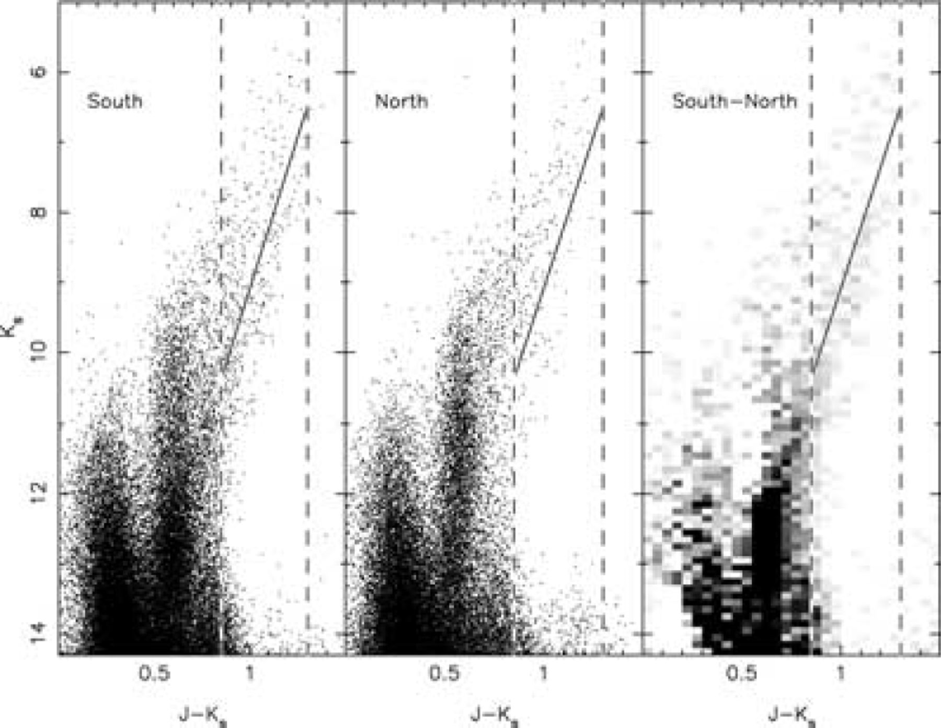
Figure 9. Near-infrared CMDs (from the proper-motion cleaned sample B) of the centre of the Canis Major object (239° < ...
Notes:
Figure 9. Near-infrared CMDs (from the proper-motion cleaned sample B) of the centre of the Canis Major object (239° < ℓ < 244° and −10° < b < −8°) and its symmetric region in the northern hemisphere (239° < ℓ < 244° and 8° < b < 10°). The Canis Major object CMD shows two features which are not in the reference CMD, and that are clearly seen in the subtracted Hess diagram shown on the right-hand panel (a black pixel corresponds to a count of 25 stars). A red-giant branch is present from (J−Ks∼ 0.7, Ks∼ 12) to (J−Ks∼ 1.2, Ks∼ 8), while the dense feature at (0.55 < J−Ks < 0.65, Ks∼ 12.5) is the red clump. As in Figure 1, the dashed lines show part of the colour–magnitude selection region. The solid lines show the RGB fiducial of the Sgr dwarf galaxy (left-hand panel of Fig. 1), adjusted to a distance of 7.1 kpc (the distance to the structure determined from the analysis presented in Fig. 6).
Unless provided in the caption above, the following copyright applies to the content of this slide: © 2004 RAS

Slide 10
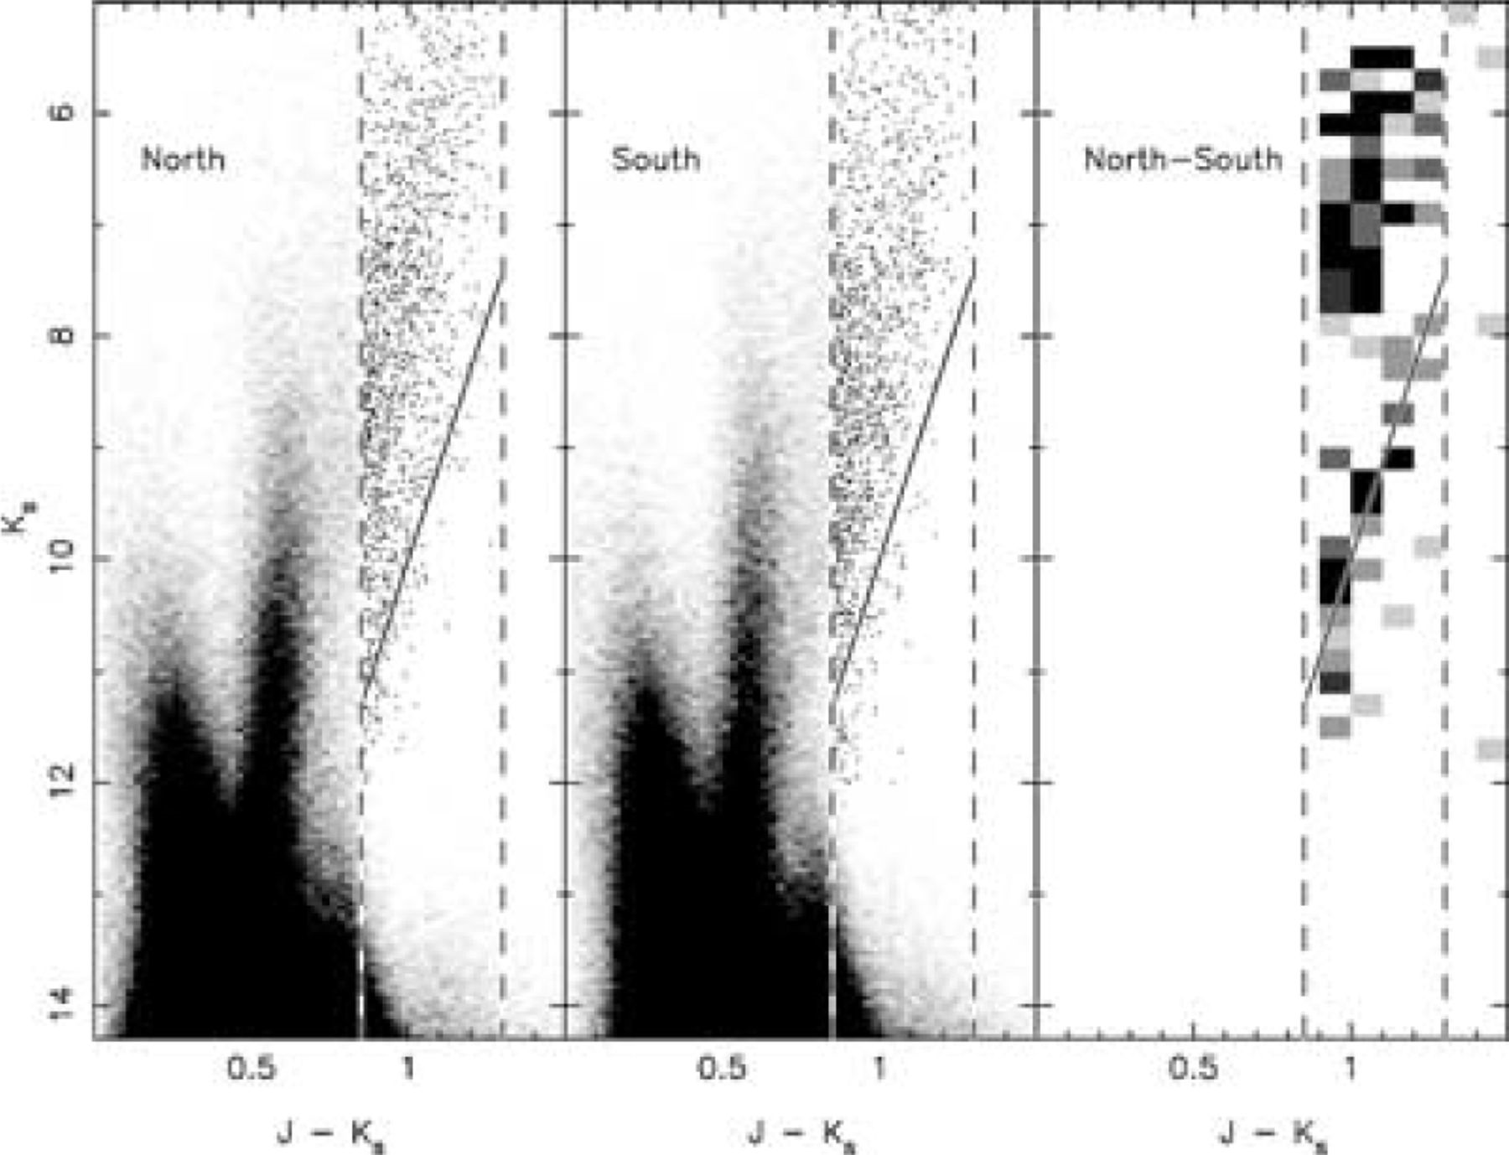
Figure 10. The left-hand panel shows the near-infrared CMD (from the proper-motion cleaned sample B) of a 15°× 15° ...
Notes:
Figure 10. The left-hand panel shows the near-infrared CMD (from the proper-motion cleaned sample B) of a 15°× 15° region in the Northern Arc overdensity (140° < ℓ < 155° and 10° < b < 25°). Since the Northern Arc is fainter than the Canis Major structure, it is necessary to gather sources over a wider area to obtain sufficient signal to render the excess M-giant population visible. For clarity, we use a Hess diagram, except in the colour–magnitude region J−Ks > 0.85, Ks < 12.0. The solid line shows the position of the fiducial Sgr dwarf RGB, shifted to an equivalent Galactocentric distance of 18.1 kpc, as indicated by the analysis presented in Fig. 7. A population of stars is clumped around this line, indicating the presence of an RGB at this distance. A gap between the RGB of the Northern Arc overdensity and the RGBs of the disc can also be perceived, indicating that the structure is separated from the disc in this direction. The middle panel shows the Hess diagram and CMD of the symmetric region about the Galactic plane (140° < ℓ < 155° and −25° < b < − 10°). A hint of the same RGB is also present, though the population is much less numerous; it probably corresponds to the Southern Arc identified in Fig. 5. Due to the low contrast of the population over the numerous foreground, it proved hard to construct a clear subtracted Hess diagram. Our best attempt, shown on the right-hand panel, reveals the presence of an RGB-like population beneath the solid line; here a black pixel corresponds to five stars. The red clump population, however, is lost in the noise of the local disc red dwarf sequence.
Unless provided in the caption above, the following copyright applies to the content of this slide: © 2004 RAS

Slide 11
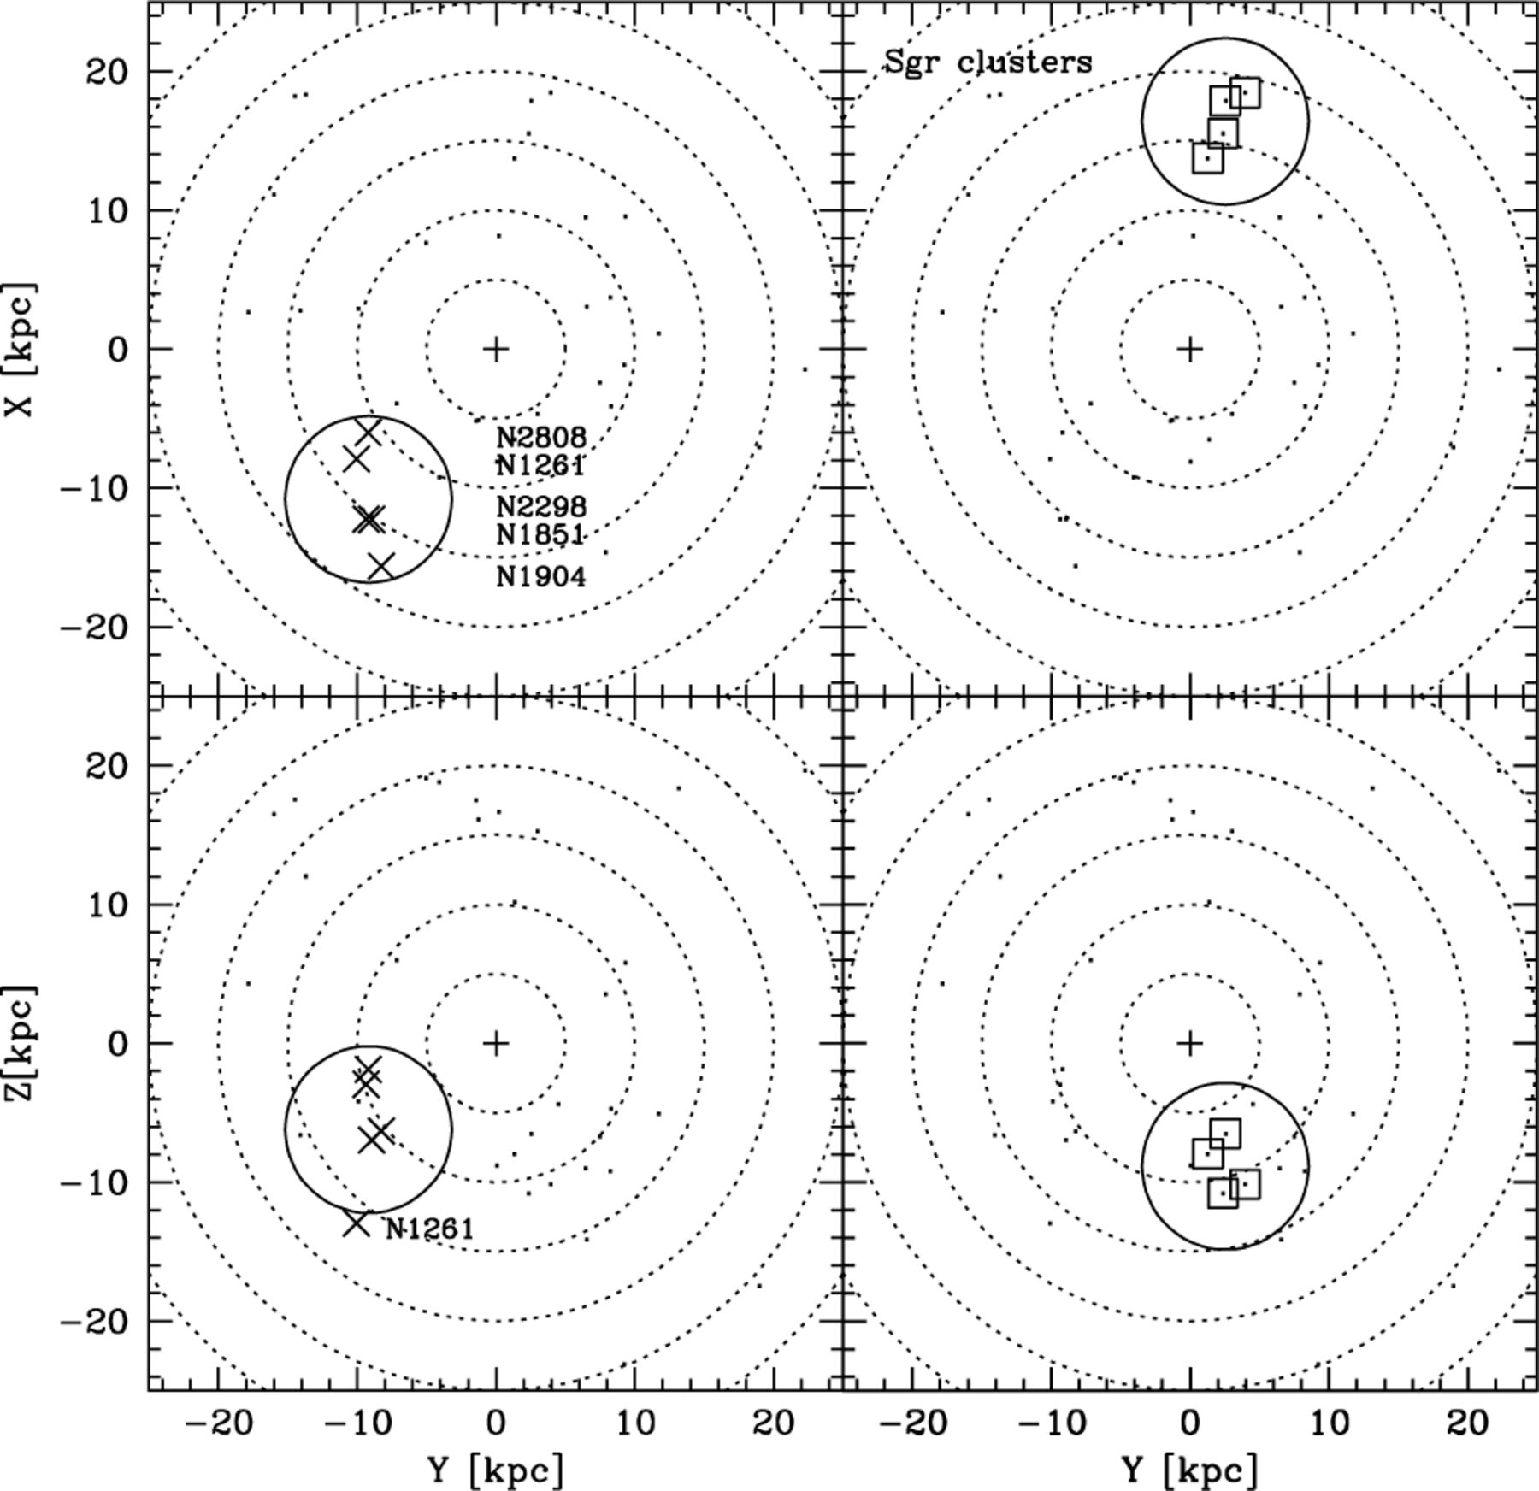
Figure 11. Comparison of the clustering properties in space of the group of globulars NGC 1851, 1904, 2298, 2808 and ...
Notes:
Figure 11. Comparison of the clustering properties in space of the group of globulars NGC 1851, 1904, 2298, 2808 and 1261 (left-hand panels) and of the globular clusters associated with the main body of the Sgr galaxy; M 54, Ter 7, Ter 8, and Arp 2 (right-hand panels). The clusters are plotted in Cartesian Galactocentric projections (upper panels: YX; lower panels: YZ). In this coordinate system the Galactic Centre is at (X, Y, Z) = (0, 0, 0) kpc and the Sun is at (X, Y, Z) = (−8, 0, 0) kpc. The small cross indicates the Galactic Centre and the dotted circles have Galactocentric radius from R= 5 kpc to R= 30 kpc, in steps of 5 kpc. Both groups are enclosed in a (continuous) circle having radius r= 6 kpc.
Unless provided in the caption above, the following copyright applies to the content of this slide: © 2004 RAS

Slide 12
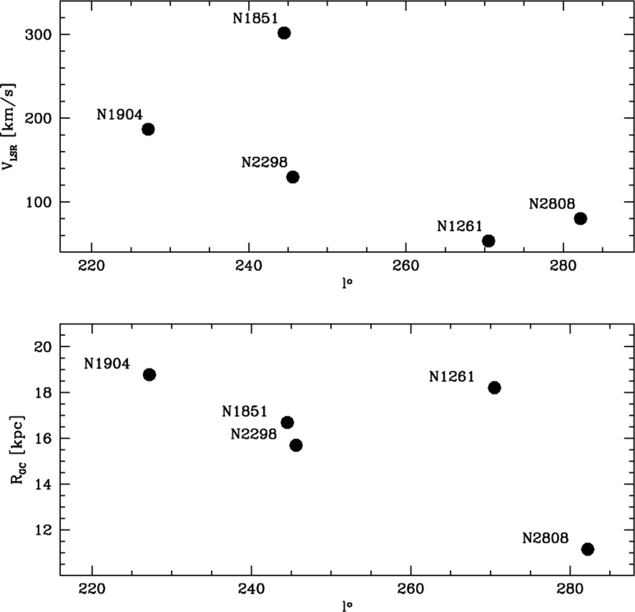
Figure 12. The upper panel shows the correlation between Galactic longitude and the radial velocity (corrected for the ...
Notes:
Figure 12. The upper panel shows the correlation between Galactic longitude and the radial velocity (corrected for the motion of the LSR) for the clusters associated with the Canis Major object. The lower panel presents the correlation between Galactic longitude and Galactocentric distance.
Unless provided in the caption above, the following copyright applies to the content of this slide: © 2004 RAS

Slide 13
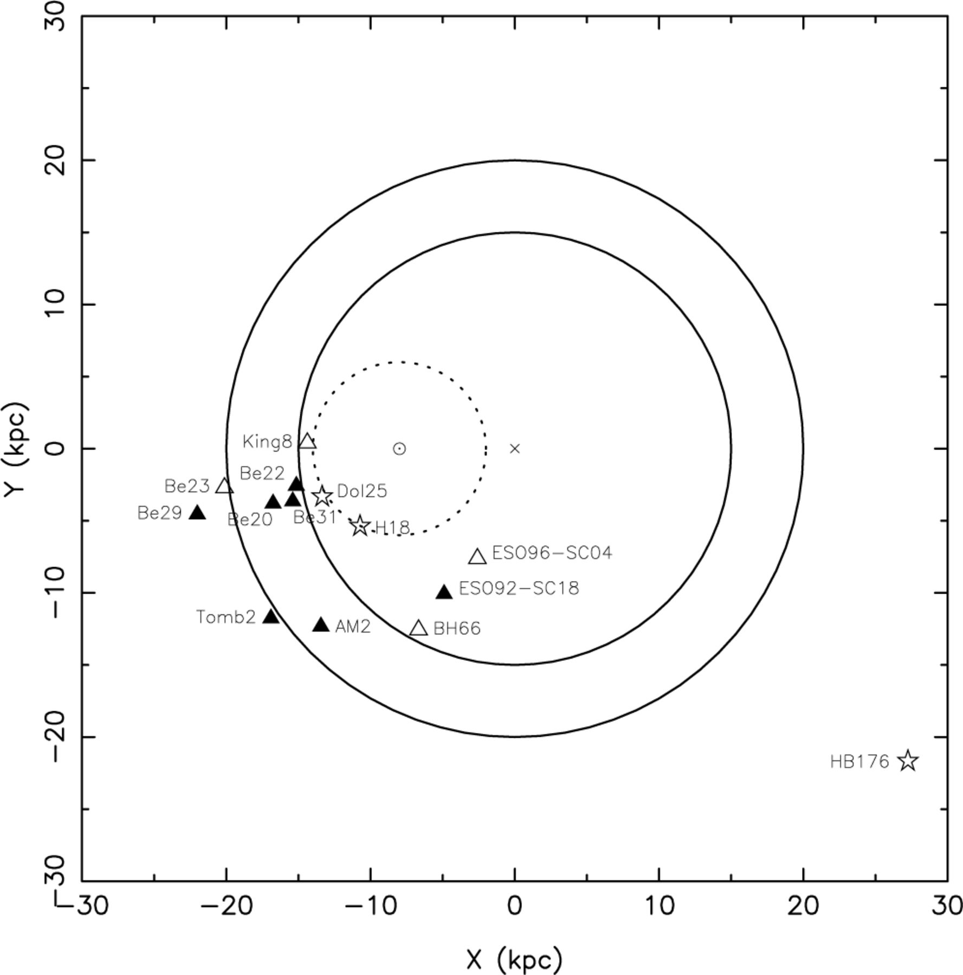
Figure 13. Distribution of open clusters with D⊙ > 6 kpc. The Galactic centre has been marked (cross) as well ...
Notes:
Figure 13. Distribution of open clusters with D⊙ > 6 kpc. The Galactic centre has been marked (cross) as well as the Sun (dotted circle). The full line circles correspond to a distance of 15 kpc and 20 kpc from the Galactic centre; the dotted circle corresponds to the D⊙= 6 kpc limit. The symbols correspond to the estimated age of the open clusters: log(age) < 8.5 (stars), 8.5 < log (age) 9.0 (filled triangles). All the open clusters have |b| < 18°.
Unless provided in the caption above, the following copyright applies to the content of this slide: © 2004 RAS

Slide 14
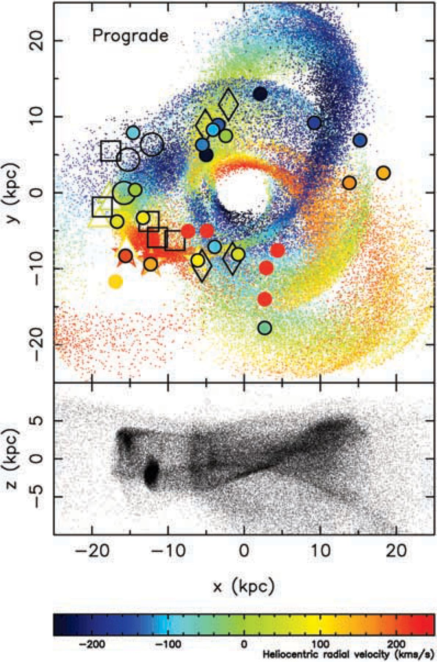
Figure 14. Two different projections of an N-body simulation of the disruption of the progenitor of the Galactic ‘Ring’ ...
Notes:
Figure 14. Two different projections of an N-body simulation of the disruption of the progenitor of the Galactic ‘Ring’ and the Canis Major structure. The Galactic Centre is at the origin, and the Sun at (x, y, z=−8, 0, 0 kpc). The dwarf galaxy model was placed on an orbit that co-rotates with the Galactic disc. The upper panel shows the x–y distribution (i.e. as seen from the Galactic north pole), with colour-coded radial velocities. In black, we show the positions and distances of the INT fields from Ibata et al. (2003) (large open circles), and the 2MASS data presented in this contribution (open squares and diamonds). The diamonds represent those fields for which a distance estimate was secured by summing in Galactocentric, rather than heliocentric distance. The colour-coded graph markers show the positions, distances and velocities of the four SDSS fields from Yanny et al. (2003) (open triangles), and of the 4 globular clusters detailed in Section 4 (star symbols). The filled circles represent all globular and open clusters of known radial velocity within 8 kpc of the Galactic plane, and that have Galactocentric distances RGC > 8 kpc; the subset of these that are circled black are those objects listed in Table 1, which are close in phase-space to the simulation particles. This velocity-distance-position coincidence with the model suggests that several globular clusters around the Milky Way may be associated with the Canis Major accretion event.
Unless provided in the caption above, the following copyright applies to the content of this slide: © 2004 RAS

Slide 15
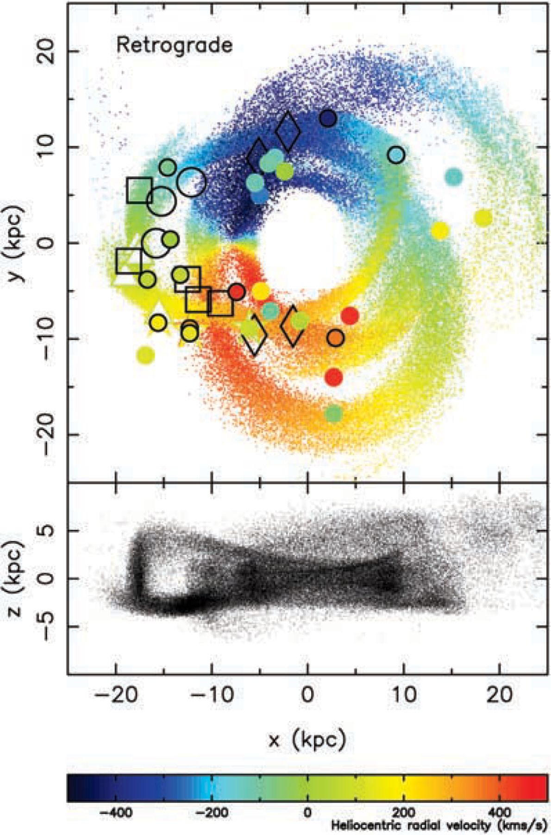
Figure 15. As Fig. 14, but for a model on a retrograde orbit.
Notes:
Figure 15. As Fig. 14, but for a model on a retrograde orbit.
Unless provided in the caption above, the following copyright applies to the content of this slide: © 2004 RAS

Slide 16
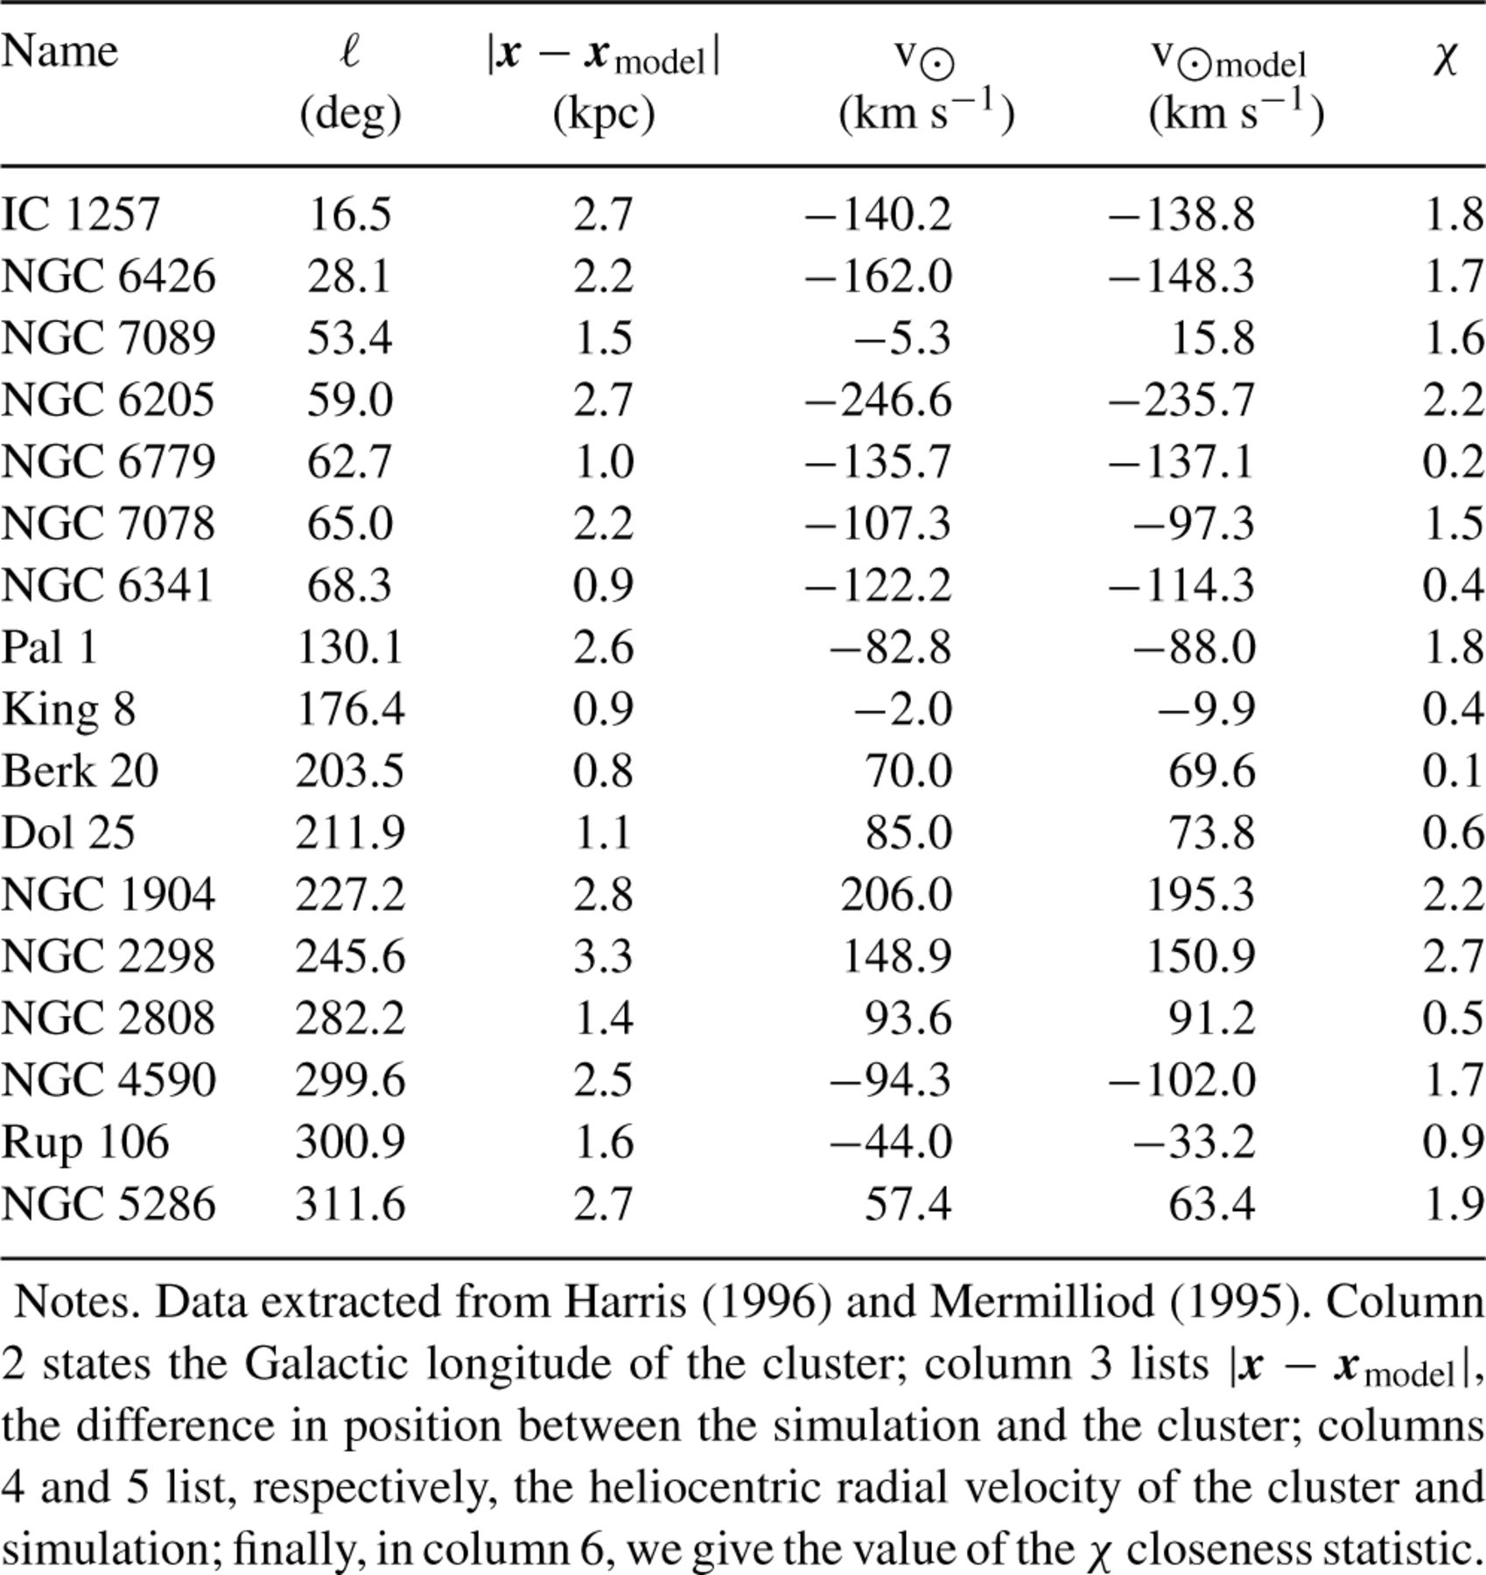
Table 1. Star clusters close in phase-space to the prograde model.
Notes:
Table 1. Star clusters close in phase-space to the prograde model.
Unless provided in the caption above, the following copyright applies to the content of this slide: © 2004 RAS

Slide 17
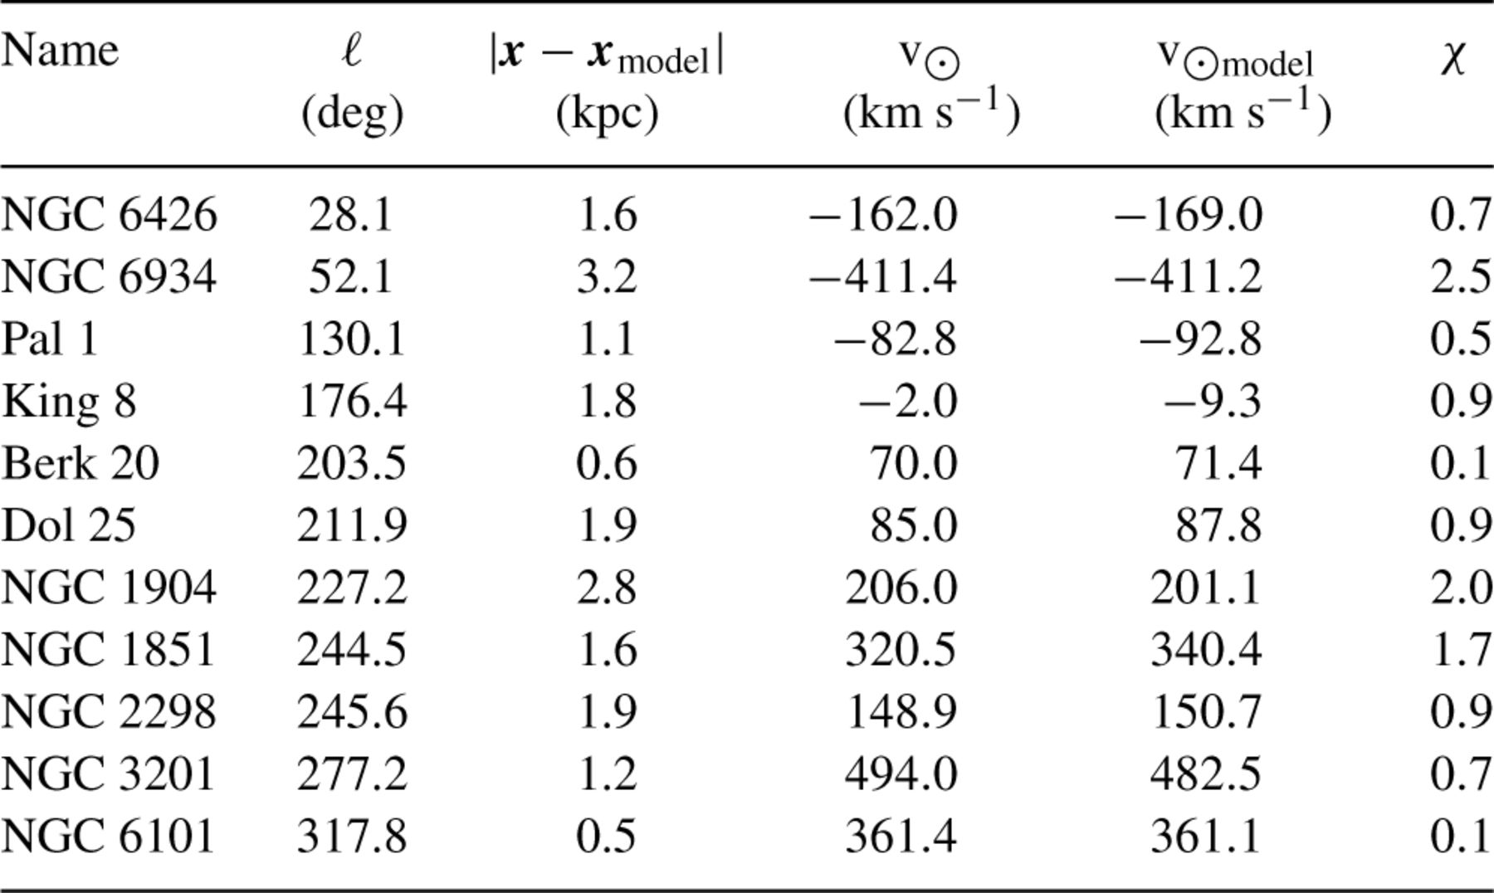
Table 2.
Notes:
Table 2.
Unless provided in the caption above, the following copyright applies to the content of this slide: © 2004 RAS

Slide 18
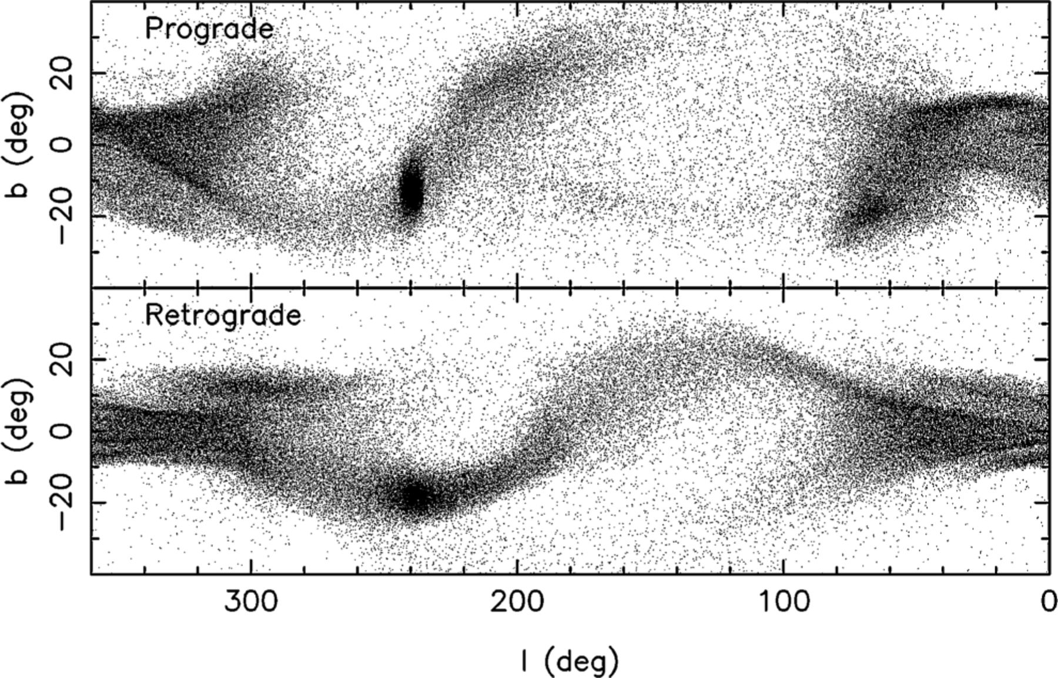
Figure 16. The ℓ–b distribution of the prograde model (upper panel) and retrograde model (lower panel). Most of the ...
Notes:
Figure 16. The ℓ–b distribution of the prograde model (upper panel) and retrograde model (lower panel). Most of the observed large-scale asymmetries of the Galactic M-giant distribution are reproduced in this projection of the simulations: the broad curved distribution of the Northern Arc seen towards the anticentre, the strong overdensity seen towards Canis Major at ℓ∼ 240°, b∼−10°, a weak feature similar to the ‘Southern Arc’ is also present, plus the overdensities ‘A’ and ‘B’ at Φ∼ 100°, and Φ∼ 260°.
Unless provided in the caption above, the following copyright applies to the content of this slide: © 2004 RAS

Slide 19
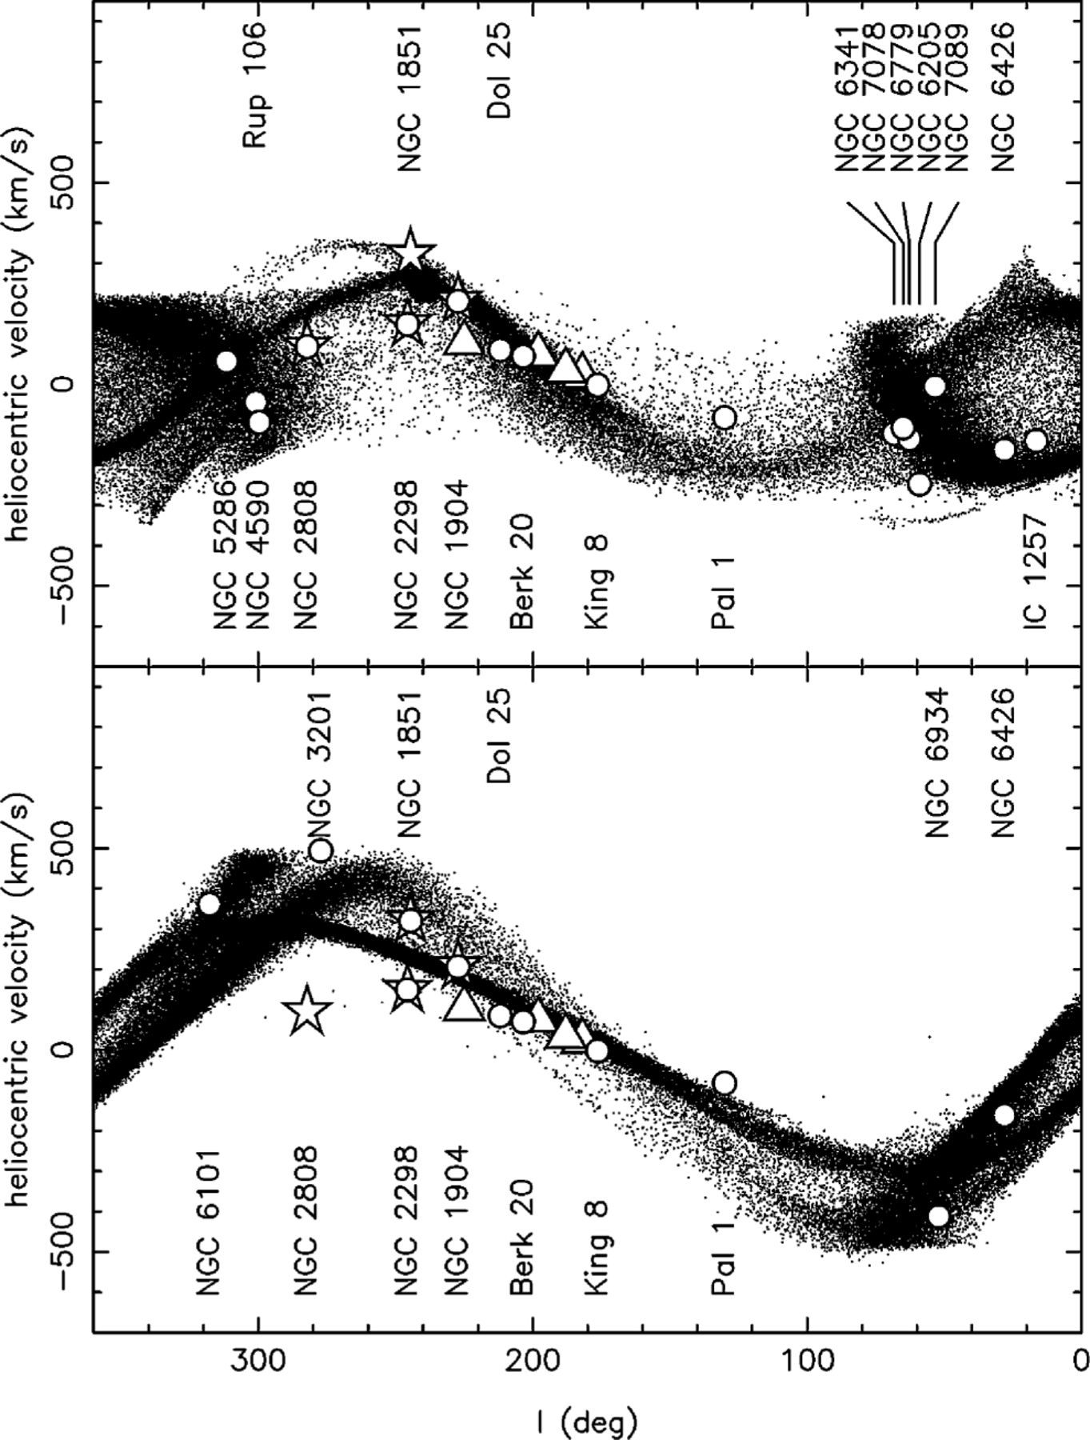
Figure 17. The heliocentric radial velocity of the prograde model (upper panel) and retrograde model (lower panel) as a ...
Notes:
Figure 17. The heliocentric radial velocity of the prograde model (upper panel) and retrograde model (lower panel) as a function of Galactic longitude, is compared to the Y03 SDSS fields (open triangles) and the 4 globular clusters NGC 1851, 1904, 2298 and 2808 (star symbols). In addition, the open circles show, from right to left, the positions of the star clusters in Table 1 (for the top panel) and Table 2 (for the bottom panel), in the order listed.
Unless provided in the caption above, the following copyright applies to the content of this slide: © 2004 RAS

Slide 20
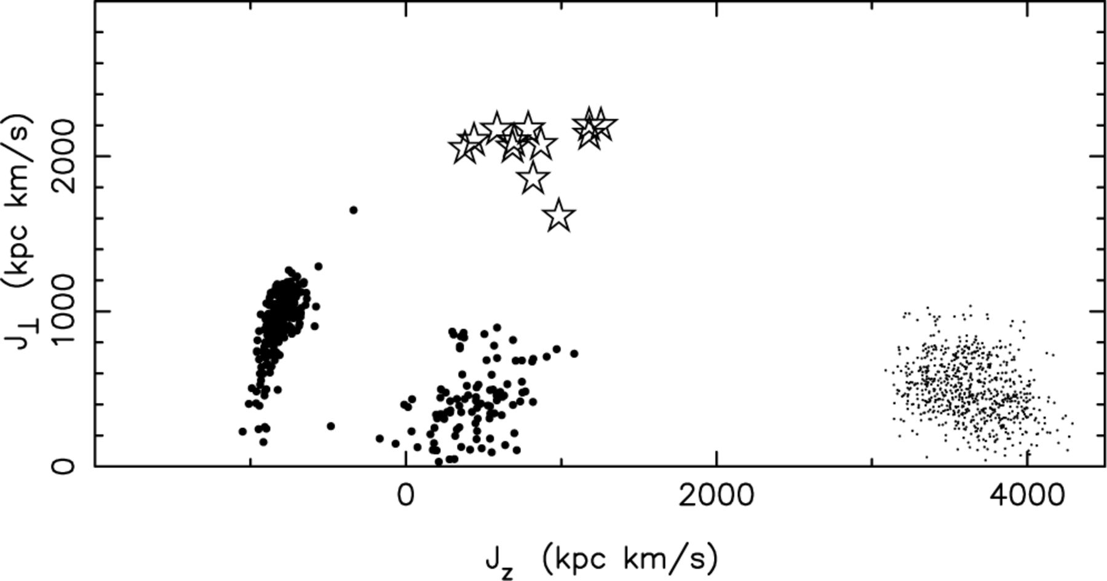
Figure 18. The larger dots show the angular momentum distribution of particles in the prograde simulation within 2 kpc ...
Notes:
Figure 18. The larger dots show the angular momentum distribution of particles in the prograde simulation within 2 kpc of the Sun, while the smaller dots show the same parameters for particles in the retrograde simulation. These distributions differ substantially from that found by Helmi et al. (1999) for the star stream detected in the solar neighbourhood (star symbols). The particles in both the Canis Major simulations follow a more planar orbit, with the prograde particles having typical Galactic disc kinematics. This large difference implies that the Canis Major stream is not associated with the Helmi et al. (1999) structure.
Unless provided in the caption above, the following copyright applies to the content of this slide: © 2004 RAS

