Slide 1
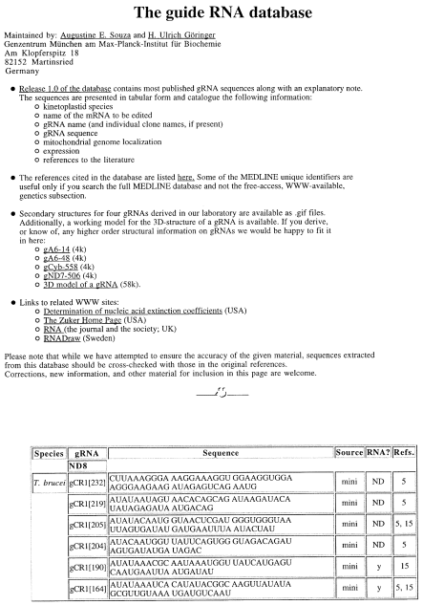
Figure 1 Homepage of the gRNA database (URL: http://www.biochem.mpg.de/∼goeringe/) including an example of the data ...
Notes:
Figure 1 Homepage of the gRNA database (URL: http://www.biochem.mpg.de/∼goeringe/) including an example of the data presentation.
Unless provided in the caption above, the following copyright applies to the content of this slide: © 1997 Oxford University Press

Slide 2
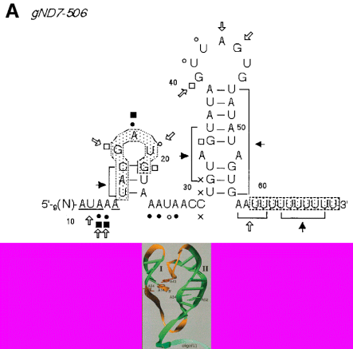
Figure 2 (A) Secondary structure model of gRNA gND7-506 from T.brucei based on surface probing data (5). Sensitivities ...
Notes:
Figure 2 (A) Secondary structure model of gRNA gND7-506 from T.brucei based on surface probing data (5). Sensitivities of the RNA molecules to the various reagents and enzymes are indicated by the following symbols: kethoxal, open square; DMS, filled circle; DEPC, filled square; CMCT, open circle; C V, filled arrow plus bracket; S1, T1, T2: open arrow. X annotates frequent termination sites in untreated control samples. The oligo(U) tail and the achor region are boxed. (B) Three dimensional model of gND7-506 (Göringer and Hermann, unpublished). Helical regions are annotated in green, loop regions in orange, and the oligo(U) tail is in blue.
Unless provided in the caption above, the following copyright applies to the content of this slide: © 1997 Oxford University Press

