Slide 1
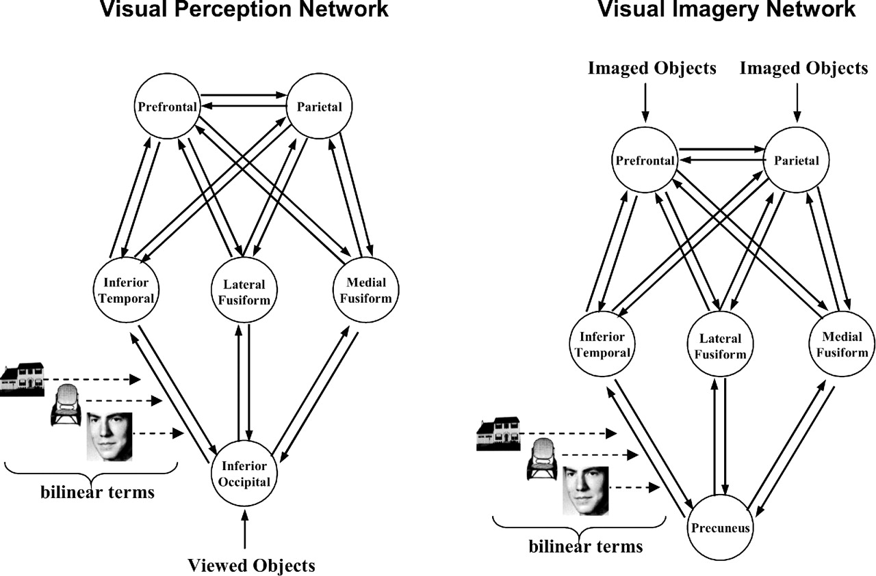
Figure 1. The visual perception (left) and visual imagery (right) networks used for the DCM analysis. The ...
Notes:
Figure 1. The visual perception (left) and visual imagery (right) networks used for the DCM analysis. The visual perception network comprised of both category-responsive regions in the occipito-temporal cortex and non-selective regions (inferior occipital cortex, prefrontal cortex and superior parietal cortex). The vector ‘Visual Objects’ encoded the visual presentation of houses, faces and chairs and entered the visual perception network through the ‘input area’ in inferior occipital cortex. The visual imagery network also comprised of both category-responsive regions in the occipito-temporal cortex and non-selective regions (precuneus, prefrontal cortex, superior parietal cortex). The vector ‘Imaged Objects’ encoded the visual imagery of houses, faces and chairs and entered the visual imagery network through prefrontal and superior parietal cortices. DCM was used to estimate bilinear terms for all forward and backward connections, in the visual perception and the visual imagery models independently.
Unless provided in the caption above, the following copyright applies to the content of this slide:

Slide 2
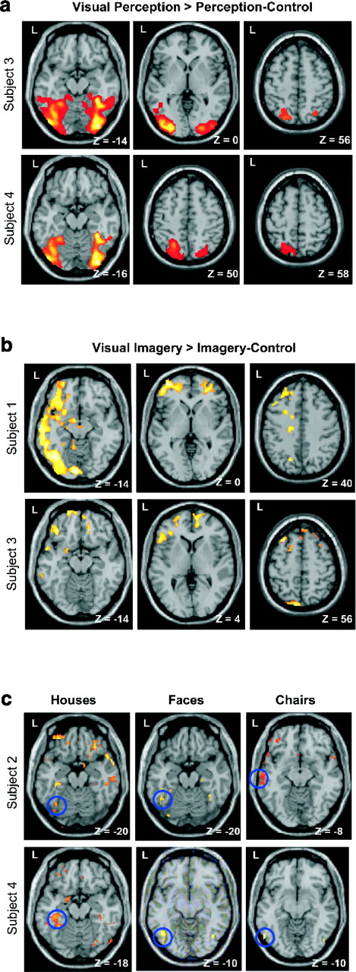
Figure 2. Activations as identified using statistical parametric mapping at P < 0.001. (a) Regions showing ...
Notes:
Figure 2. Activations as identified using statistical parametric mapping at P faces and chairs; faces > houses and chairs; and chair > houses and faces), during both visual perception and visual imagery in subjects 2 and 4. The blue circle indicates the category-sensitive regions in the occipito-temporal cortex which were selected for the DCM analysis. A number of regions outside the occipito-temporal cortex also showed category-sensitive activation, but there were no replications across subjects.
Unless provided in the caption above, the following copyright applies to the content of this slide:

