Slide 1
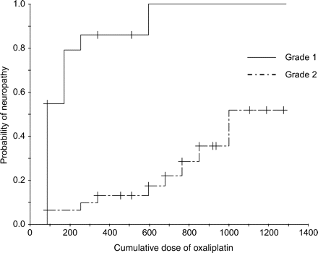
Figure 1. Cumulative incidence of neuropathy.
Notes:
Figure 1. Cumulative incidence of neuropathy.
Unless provided in the caption above, the following copyright applies to the content of this slide: © 2007 Foundation for Promotion of Cancer Research

Slide 2
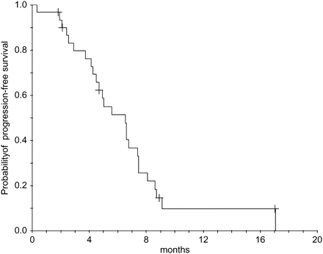
Figure 2. Progression-free survival.
Notes:
Figure 2. Progression-free survival.
Unless provided in the caption above, the following copyright applies to the content of this slide: © 2007 Foundation for Promotion of Cancer Research

Slide 3
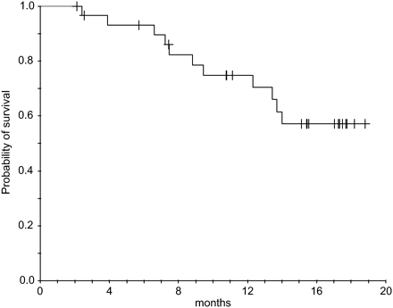
Figure 3. Overall survival.
Notes:
Figure 3. Overall survival.
Unless provided in the caption above, the following copyright applies to the content of this slide: © 2007 Foundation for Promotion of Cancer Research

