Slide 1
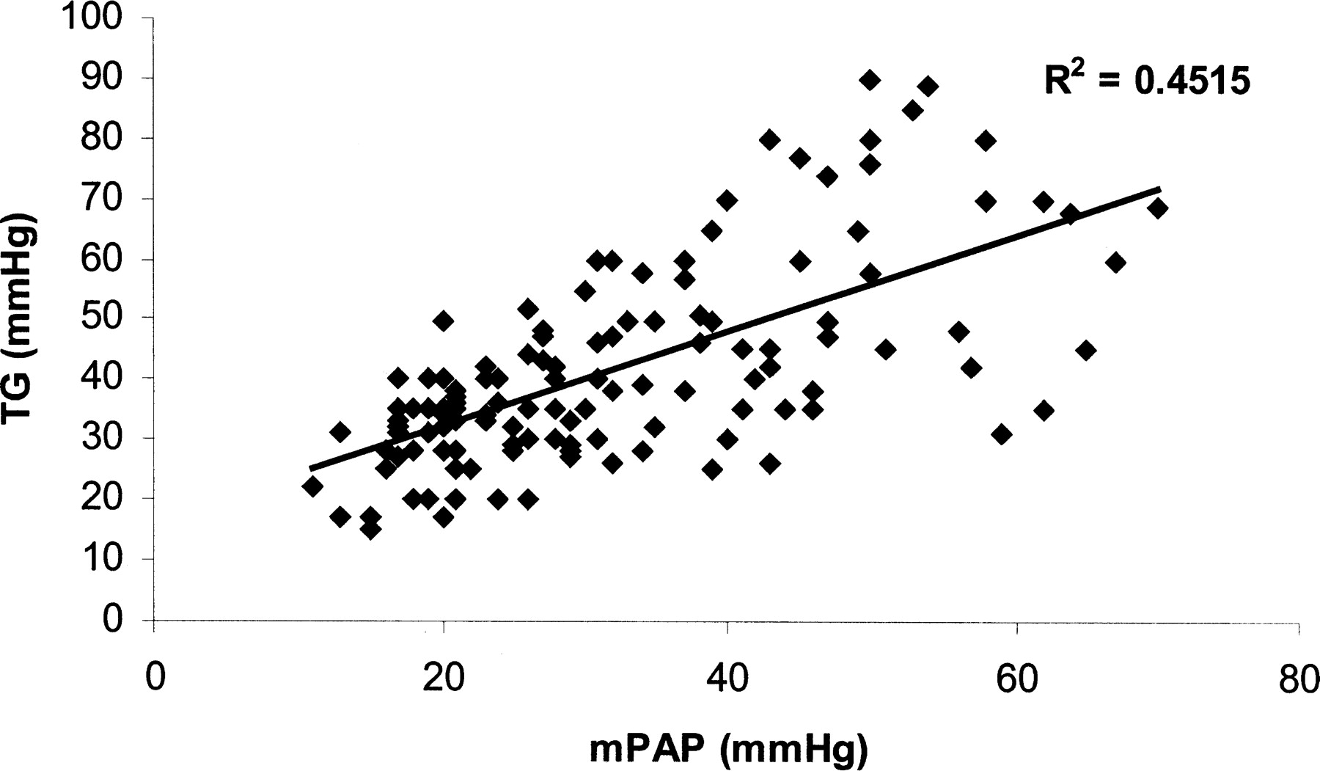
Fig. 1. Relationship between systolic pulmonary pressures on cardiac catheter and echocardiographically determined ...
Notes:
Fig. 1. Relationship between systolic pulmonary pressures on cardiac catheter and echocardiographically determined tricuspid gradient (echo TG) in 137 patients. A clear positive correlation is evident (r2 = 0.45); however, PAH is evident in many patients with low tricuspid gradients.
Unless provided in the caption above, the following copyright applies to the content of this slide: Rheumatology Vol. 43 No. 4 (c) British Society for Rheumatology 2004; all rights reserved

Slide 2
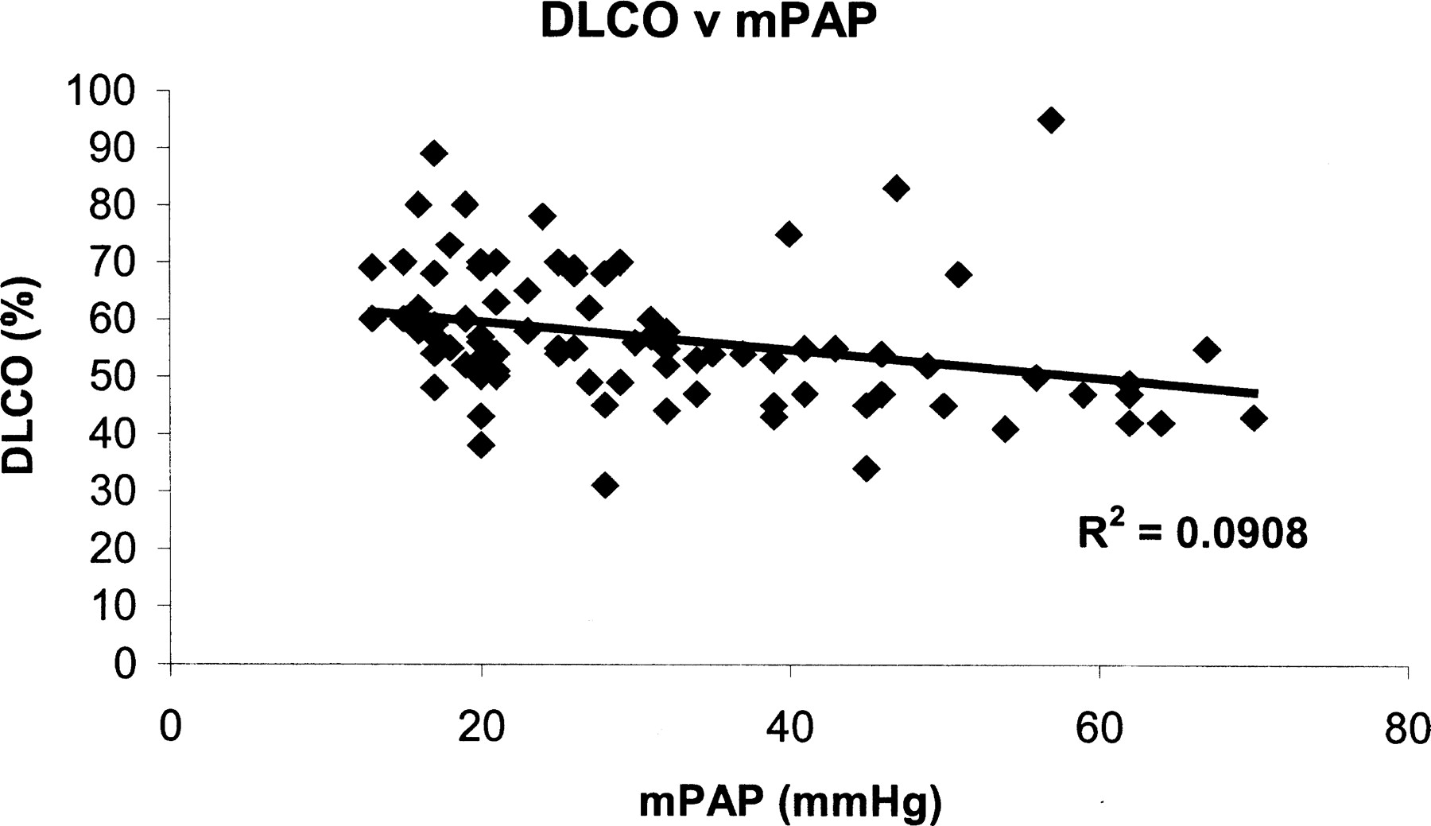
Fig. 2. Relationship between mean pulmonary pressures (mPAP) on cardiac catheter and corrected DLCO in 85 SSc ...
Notes:
Fig. 2. Relationship between mean pulmonary pressures (mPAP) on cardiac catheter and corrected DLCO in 85 SSc patients without significant pulmonary fibrosis. A weak negative correlation is seen (r2 = 0.09), but few patients with very low gas transfer do not have PAH.
Unless provided in the caption above, the following copyright applies to the content of this slide: Rheumatology Vol. 43 No. 4 (c) British Society for Rheumatology 2004; all rights reserved

