Slide 1
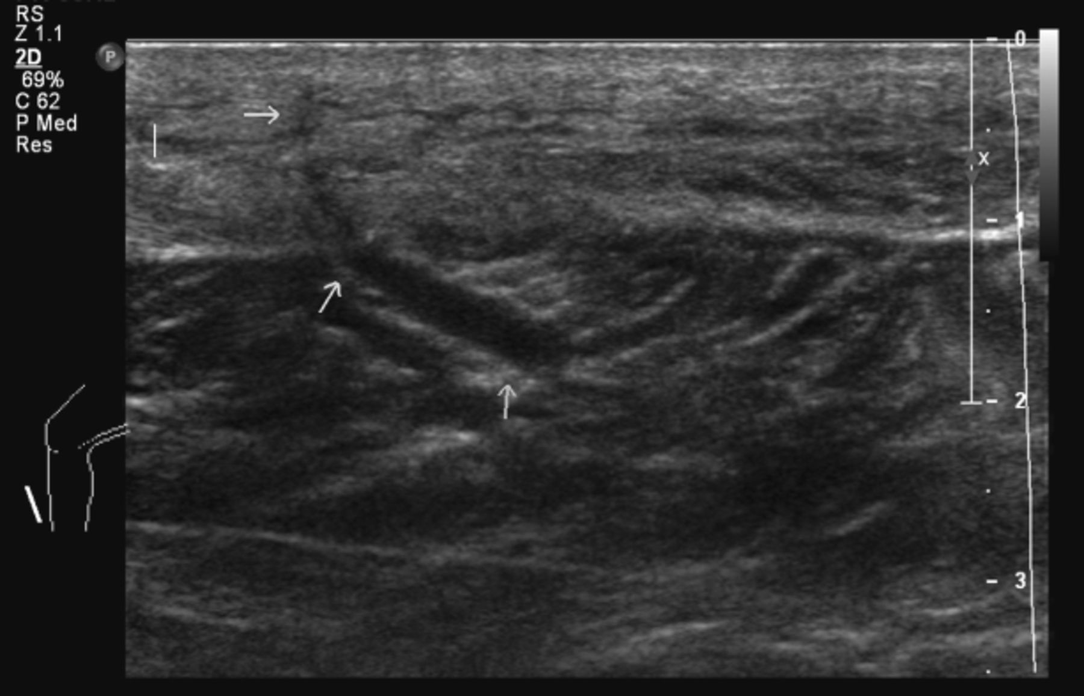
Figure 1 Ultrasonograph of the right calf. Three arrows point out a pipeline‐shape lesion without signals of blood ...
Notes:
Figure 1 Ultrasonograph of the right calf. Three arrows point out a pipeline‐shape lesion without signals of blood flow, which appears to be a worm.
Unless provided in the caption above, the following copyright applies to the content of this slide: © 2012 International Society of Travel Medicine

