Slide 1
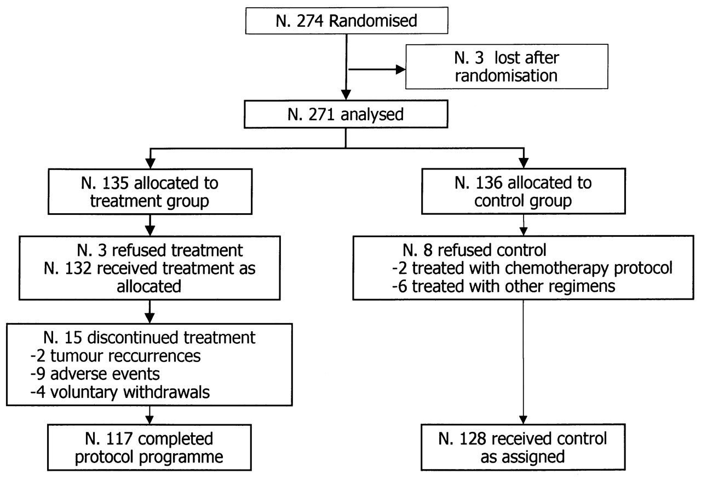
Figure 1. Study flow chart.
Notes:
Figure 1. Study flow chart.
Unless provided in the caption above, the following copyright applies to the content of this slide: © 2002 European Society for Medical Oncology

Slide 2
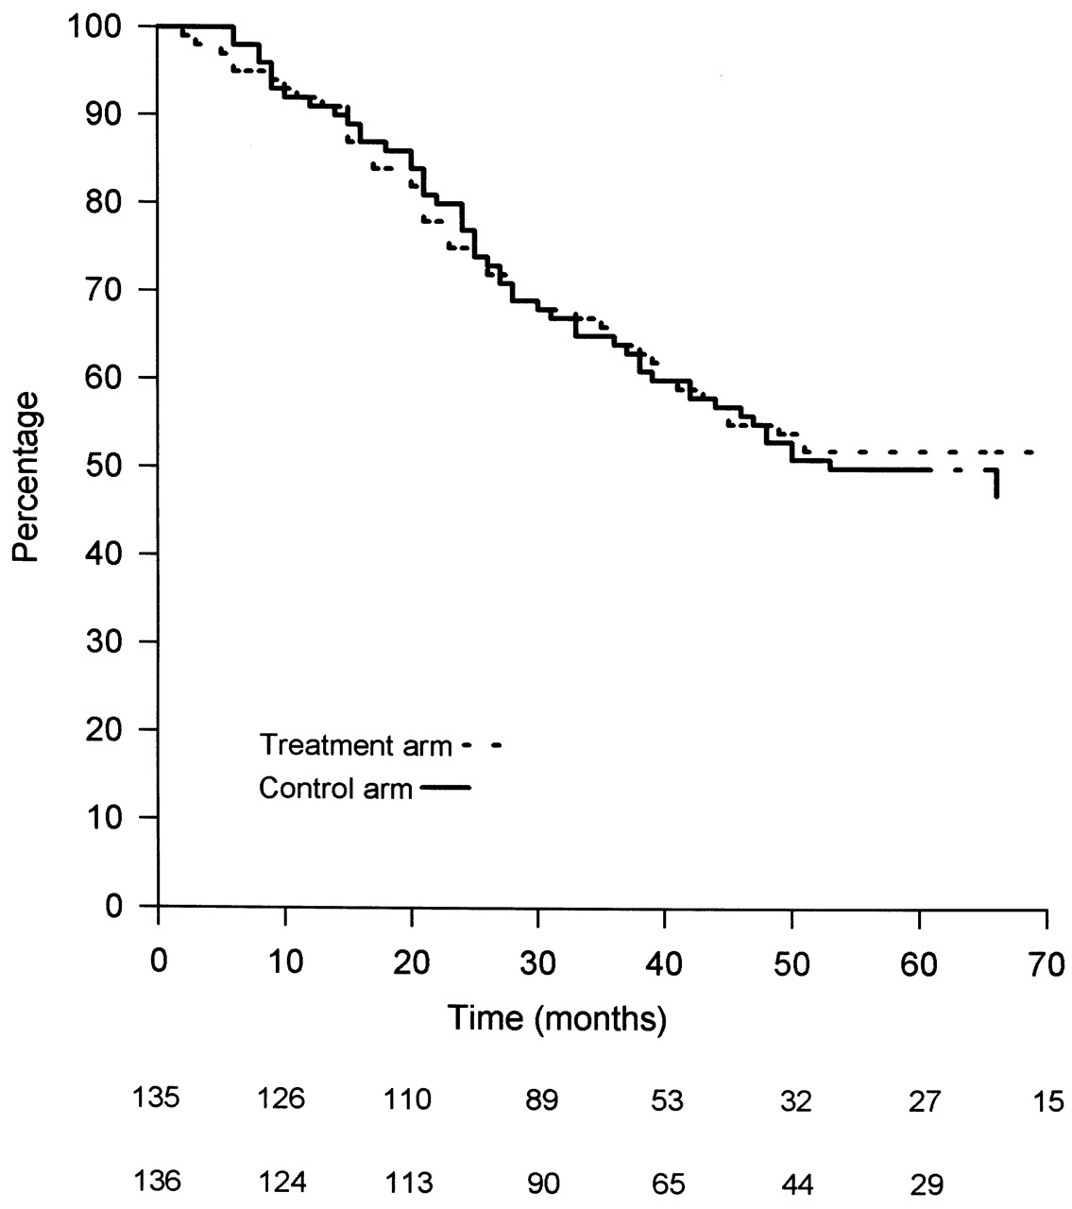
Figure 2. Intention-to-treat analysis of all randomised patients. Kaplan–Meier survival by treatment. Bottom: ...
Notes:
Figure 2. Intention-to-treat analysis of all randomised patients. Kaplan–Meier survival by treatment. Bottom: number of patients at risk by treatment arm.
Unless provided in the caption above, the following copyright applies to the content of this slide: © 2002 European Society for Medical Oncology

Slide 3
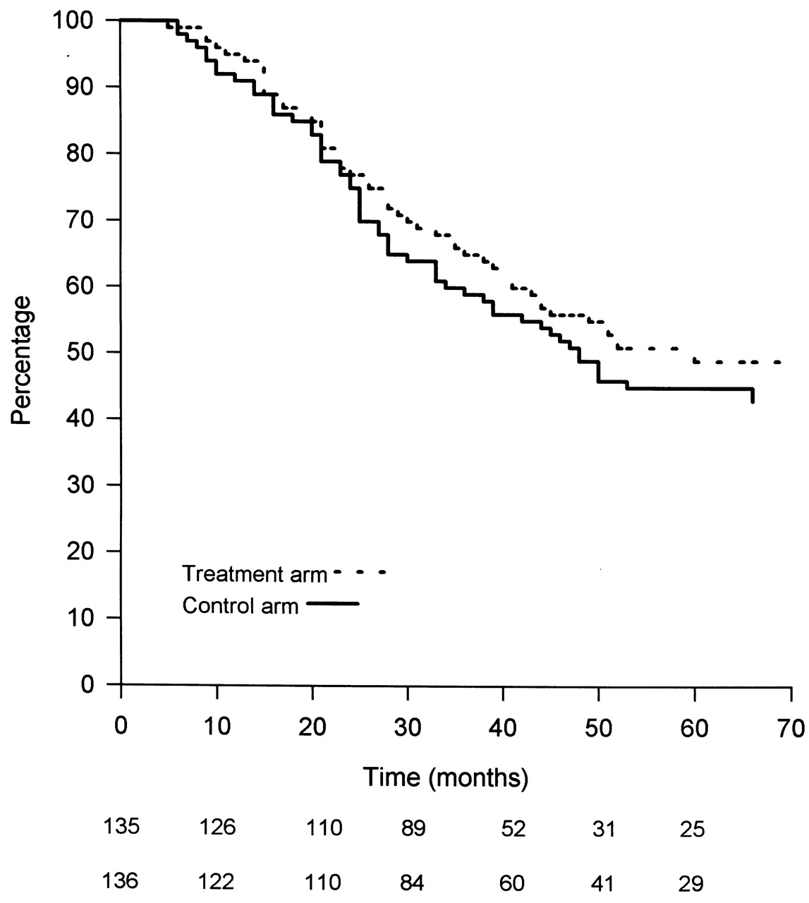
Figure 3. Kaplan–Meier DFS by treatment arm. Bottom: number of patients at risk by treatment arm.
Notes:
Figure 3. Kaplan–Meier DFS by treatment arm. Bottom: number of patients at risk by treatment arm.
Unless provided in the caption above, the following copyright applies to the content of this slide: © 2002 European Society for Medical Oncology

Slide 4
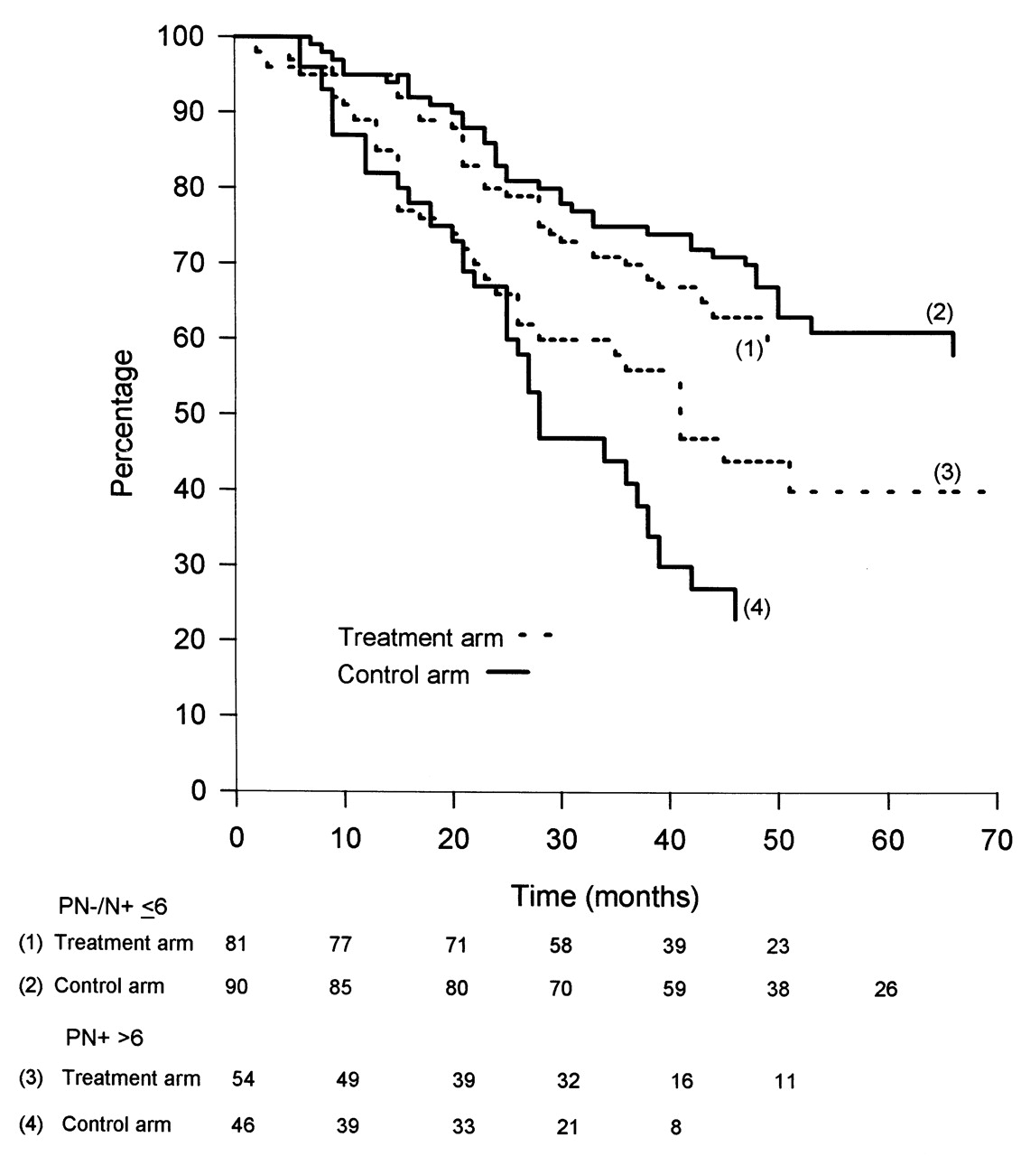
Figure 4. OS by number of involved nodes (N–/N+ <6 and N+ >6). Bottom: number of patients at risk by ...
Notes:
Figure 4. OS by number of involved nodes (N–/N+ 6). Bottom: number of patients at risk by treatment arm.
Unless provided in the caption above, the following copyright applies to the content of this slide: © 2002 European Society for Medical Oncology

Slide 5
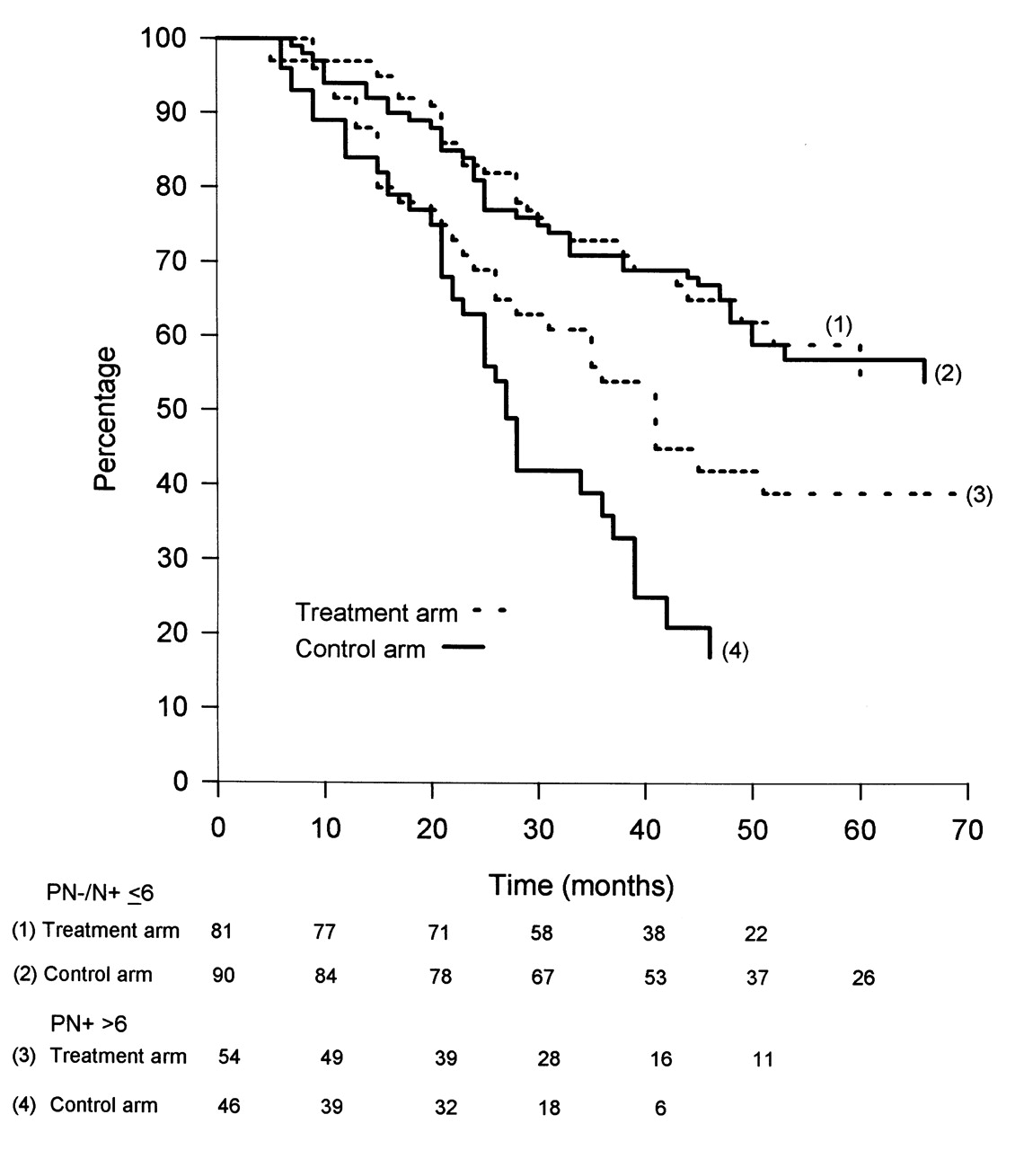
Figure 5. DFS by number of involved nodes (N–/N+ <6 and N+ >6). Bottom: number of patients at risk by ...
Notes:
Figure 5. DFS by number of involved nodes (N–/N+ 6). Bottom: number of patients at risk by treatment arm.
Unless provided in the caption above, the following copyright applies to the content of this slide: © 2002 European Society for Medical Oncology

