Slide 1
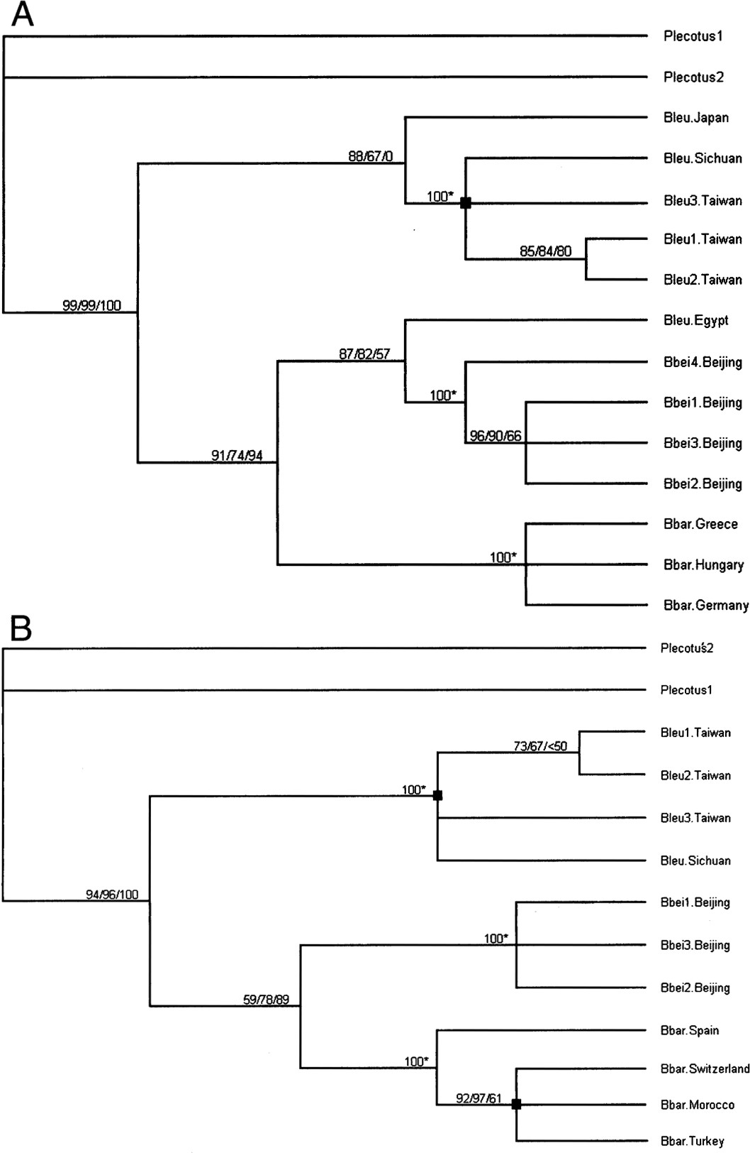
Fig. 1 A) Ciadogram without branch lengths by integrating neighbor-joining, maximum-parsimony, and ...
Notes:
Fig. 1 A) Ciadogram without branch lengths by integrating neighbor-joining, maximum-parsimony, and maximum-likelihood trees based on nicotinamide adenine dinucleotide dehydrogenase subunit 1 (ND1) gene sequences. B) Cladogram without branch lengths by integrating neighbor-joining, maximum-parsimony, and maximum-likelihood trees based on cytochrome b (Cytb) gene sequences. Three numbers at the nodes separated by “/” from left to right are bootstrap values following neighbor-joining (2,000 replicates), maximum-parsimony (2,000 replicates), and maximum-likelihood (100 replicates) approaches, respectively. An asterisk (*) indicates 3 approaches obtained the same bootstrap values. Black squares indicate that the interior topologies of the 3 clades are disparate by 3 methods despite high bootstrap values. The number “0” in the ND1 cladogram tree indicates that the Japanese clade in maximum-likelihood tree locates at other position but with a poor bootstrap support (see text for details). Species abbreviations are defined in Table 1.
Unless provided in the caption above, the following copyright applies to the content of this slide: © 2007 American Society of Mammalogists

Slide 2
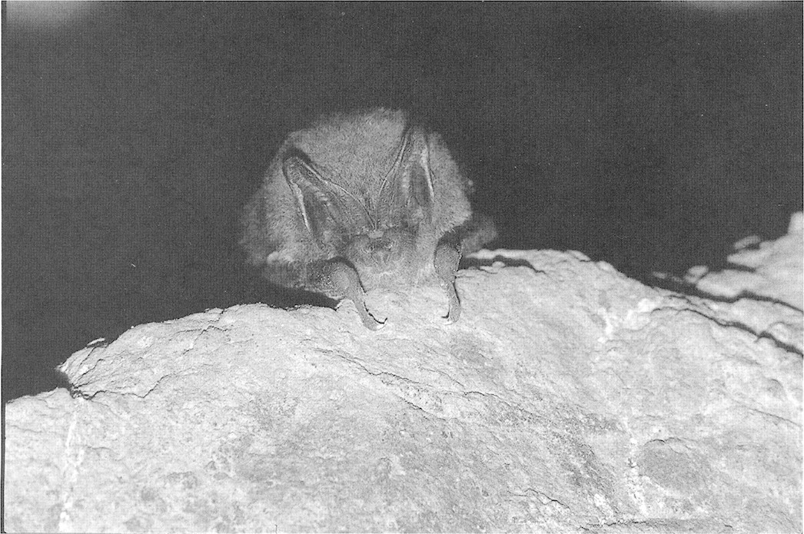
Fig. 2 Barbastella beijingensis (IOZ-BRG00054), male. Photo by Shu-Yi Zhang.
Notes:
Fig. 2 Barbastella beijingensis (IOZ-BRG00054), male. Photo by Shu-Yi Zhang.
Unless provided in the caption above, the following copyright applies to the content of this slide: © 2007 American Society of Mammalogists

Slide 3
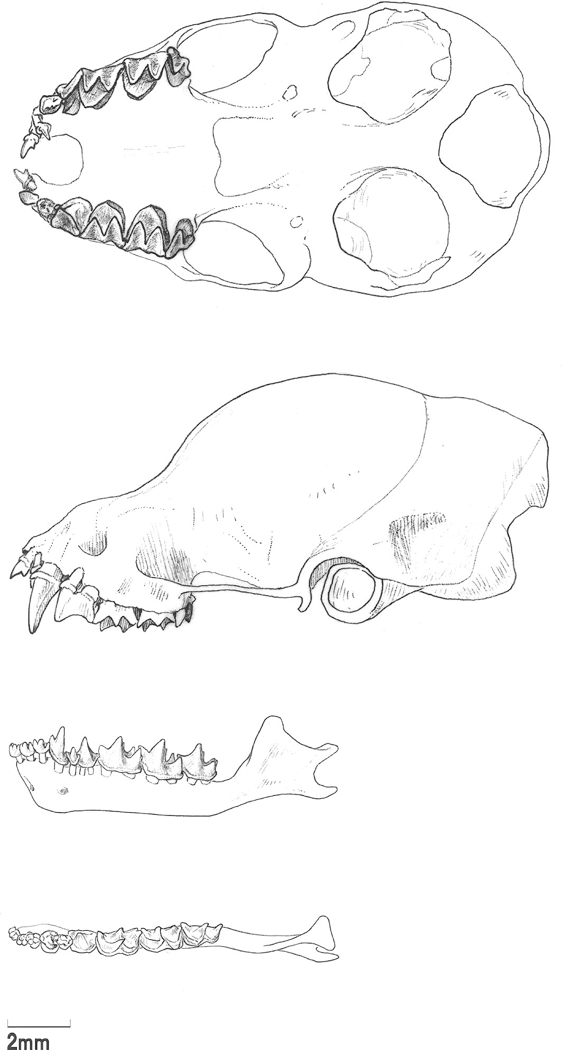
Fig. 3 Ventral and lateral views of the skull of Barbastella beijingensis (IOZ-BRG00054), male, with lateral and ...
Notes:
Fig. 3 Ventral and lateral views of the skull of Barbastella beijingensis (IOZ-BRG00054), male, with lateral and dorsal views of the lower jaw.
Unless provided in the caption above, the following copyright applies to the content of this slide: © 2007 American Society of Mammalogists

Slide 4
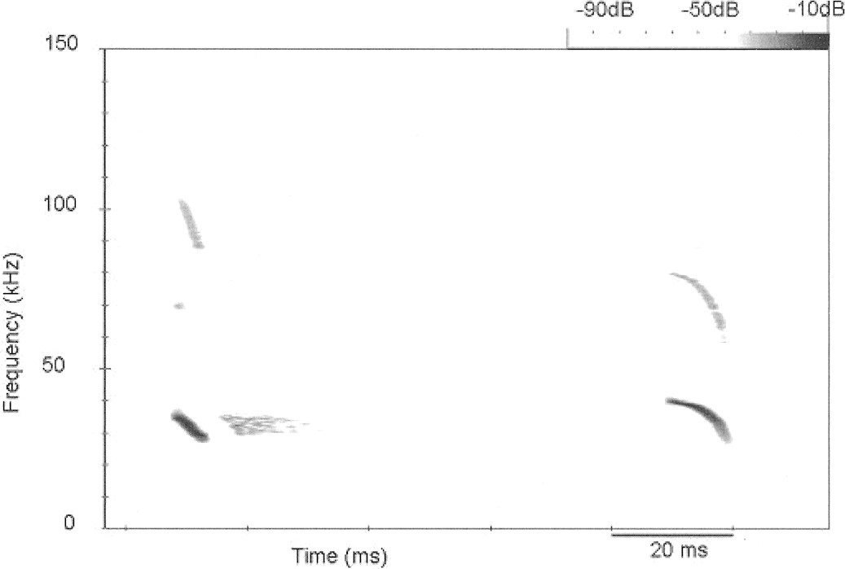
Fig. 4 Spectrogram of consecutive echolocation calls produced by Barbastella beijingensis. The spectrogram was made ...
Notes:
Fig. 4 Spectrogram of consecutive echolocation calls produced by Barbastella beijingensis. The spectrogram was made using a 1,024-point fast Fourier transform and a Hanning window. A brief frequency-modulated signal is followed by a longer call with a convex frequency-time course.
Unless provided in the caption above, the following copyright applies to the content of this slide: © 2007 American Society of Mammalogists

