Slide 1
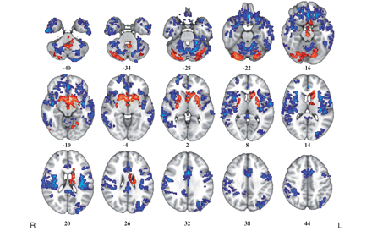
Figure 1 Whole-brain maps of significant differences in grey matter volume between healthy volunteers and cocaine ...
Notes:
Figure 1 Whole-brain maps of significant differences in grey matter volume between healthy volunteers and cocaine users. Voxels coloured blue indicate brain areas in which cocaine users have reduced grey matter volume compared with healthy volunteers, and voxels coloured red indicate brain areas in which cocaine users have abnormally increased grey matter volume. These results were generated by permutation testing of voxel cluster statistics with cluster-wise P < 0.001, at which level we expect less than one false positive cluster per map. The statistical results are overlaid on the FSL MNI152 standard T1 image and the numbers beneath each section of the image refer to its position (mm) relative to the intercommissural plane in standard stereotactic space. L = left; R = right.
Unless provided in the caption above, the following copyright applies to the content of this slide: © The Author (2011). Published by Oxford University Press on behalf of the Guarantors of Brain.This is an Open Access article distributed under the terms of the Creative Commons Attribution Non-Commercial License (http://creativecommons.org/licenses/by-nc/2.5), which permits unrestricted non-commercial use, distribution, and reproduction in any medium, provided the original work is properly cited.

Slide 2
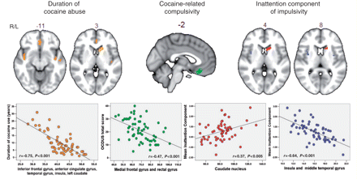
Figure 2 Maps of brain regions demonstrating significant association between grey matter volume and measures of ...
Notes:
Figure 2 Maps of brain regions demonstrating significant association between grey matter volume and measures of duration of cocaine use, compulsivity and impulsivity in the group of cocaine users. Regions where grey matter volume correlated significantly with the duration of cocaine use in drug users are indicated in orange. Regions that correlated significantly with compulsive cocaine-taking (as assessed by the OCDUS) are coloured in green. Regions where grey matter volume correlated significantly with the inattention component of impulsivity in cocaine users are indicated in red (if the correlation was positive) and blue (if the correlation was negative). The scatter plots beneath each section of the brain image show the correlation between these measures and the total grey matter volume for each drug user in those regions found to be significantly correlated by permutation testing of cluster-level statistics in the restricted search volume or mask defined by the areas of significant between-group difference in grey matter anatomy (Fig. 1). The probability threshold for significance was P ∼ 0.002 for each analysis, at which level we expect less than one false positive cluster per map. The statistical results are overlaid on the FSL MNI152 standard T1 image and the numbers above each section of the image refer to its plane position (mm) relative to the origin in MNI stereotactic space. L = left; R = right.
Unless provided in the caption above, the following copyright applies to the content of this slide: © The Author (2011). Published by Oxford University Press on behalf of the Guarantors of Brain.This is an Open Access article distributed under the terms of the Creative Commons Attribution Non-Commercial License (http://creativecommons.org/licenses/by-nc/2.5), which permits unrestricted non-commercial use, distribution, and reproduction in any medium, provided the original work is properly cited.

