Slide 1
Fig. 1. Profiles of Xenopus laevis embryos at two stages of development (24 and 28 hr after fertilization at ...
Notes:
Fig. 1. Profiles of Xenopus laevis embryos at two stages of development (24 and 28 hr after fertilization at 22°C), indicating the straightening and elongation of the notochord and the embryo (drawn from data and SEMs presented in Adams et al., 1990, and Koehl et al., 1990).
Unless provided in the caption above, the following copyright applies to the content of this slide: The Society for Integrative and Comparative Biology

Slide 2
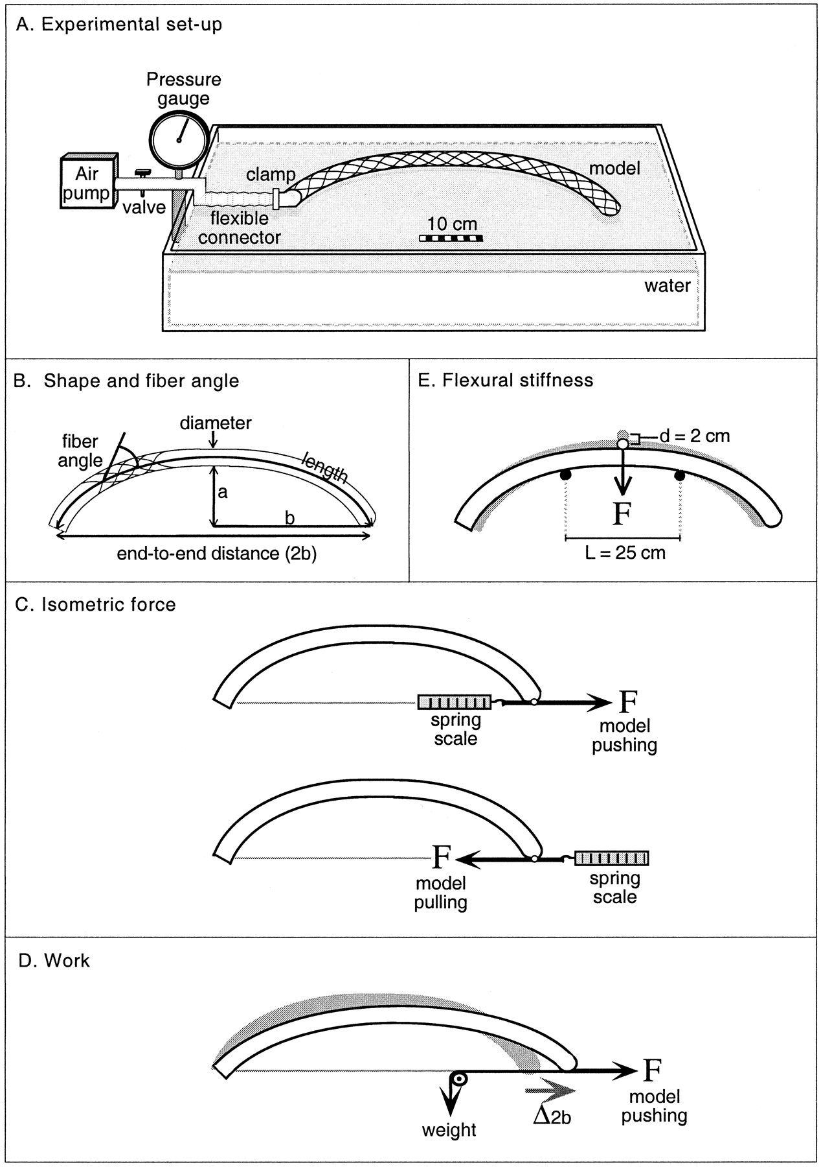
Fig. 2. Schematic summary of experiments conducted on model notochords. The experimental set-up shown in A ...
Notes:
Fig. 2. Schematic summary of experiments conducted on model notochords. The experimental set-up shown in A was used for all measurements (B–E). The details of the experimental protocols illustrated in B–E are given in Materials and Methods. Note that only some of the fibers are drawn in these diagrams of the models; the organza fabric used to construct the models had 36 warp and 36 woof fibers per cm2.
Unless provided in the caption above, the following copyright applies to the content of this slide: The Society for Integrative and Comparative Biology

Slide 3
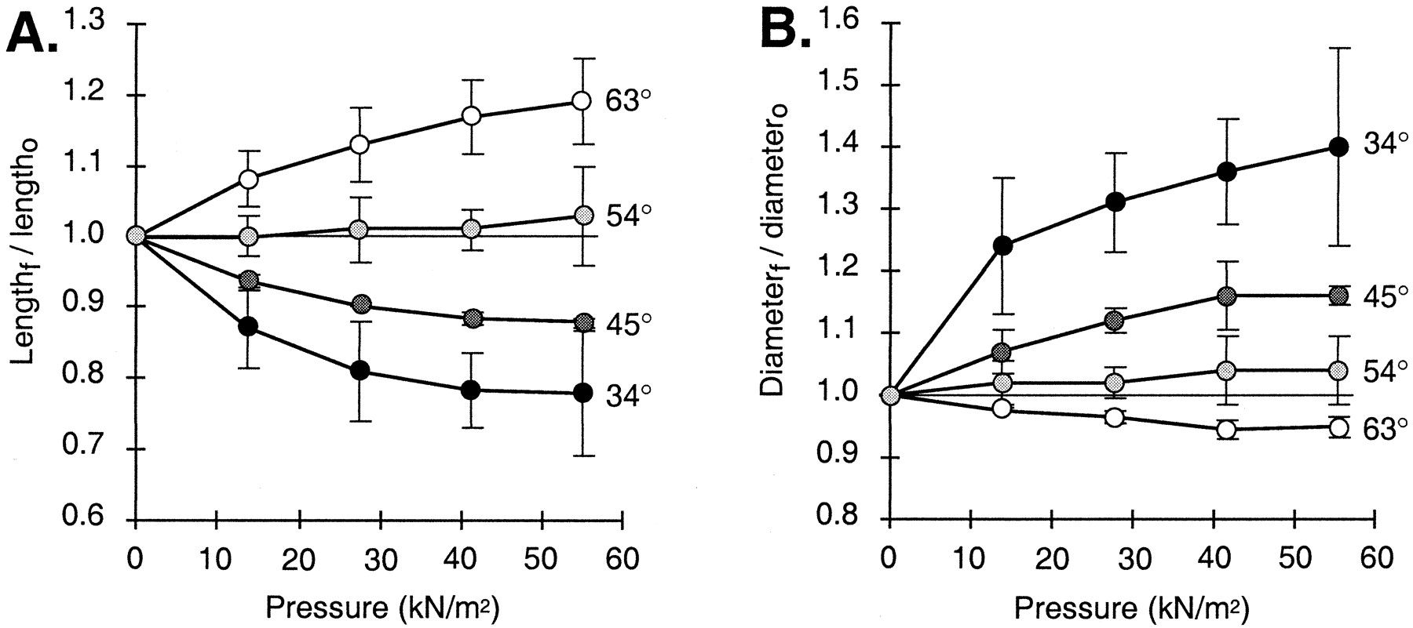
Fig. 3. Dimensions of model notochords during inflation. Each line represents the values for models ...
Notes:
Fig. 3. Dimensions of model notochords during inflation. Each line represents the values for models reinforced with fibers at the 𝛉 indicated to the right of the line. Each symbol represents the mean of the mean values from three replicate models. Error bars represent 95% confidence intervals. A. Model length (Fig. 2B) when inflated (Lengthf) normalized to model length when uninflated (Lengtho), plotted as a functon of the pressure in the model. Values of (Lengthf/Lengtho) greater than 1 indicate lengthening, while those lower than 1 indicate shortening. B. Model diameter (Fig. 2B) when inflated (Diameterf) normalized to model diameter when uninflated (Diametero), plotted as a function of the pressure in the model. Values of (Diameterf/Diametero) greater than one indicate widening, while those lower than one indicate narrowing.
Unless provided in the caption above, the following copyright applies to the content of this slide: The Society for Integrative and Comparative Biology

Slide 4
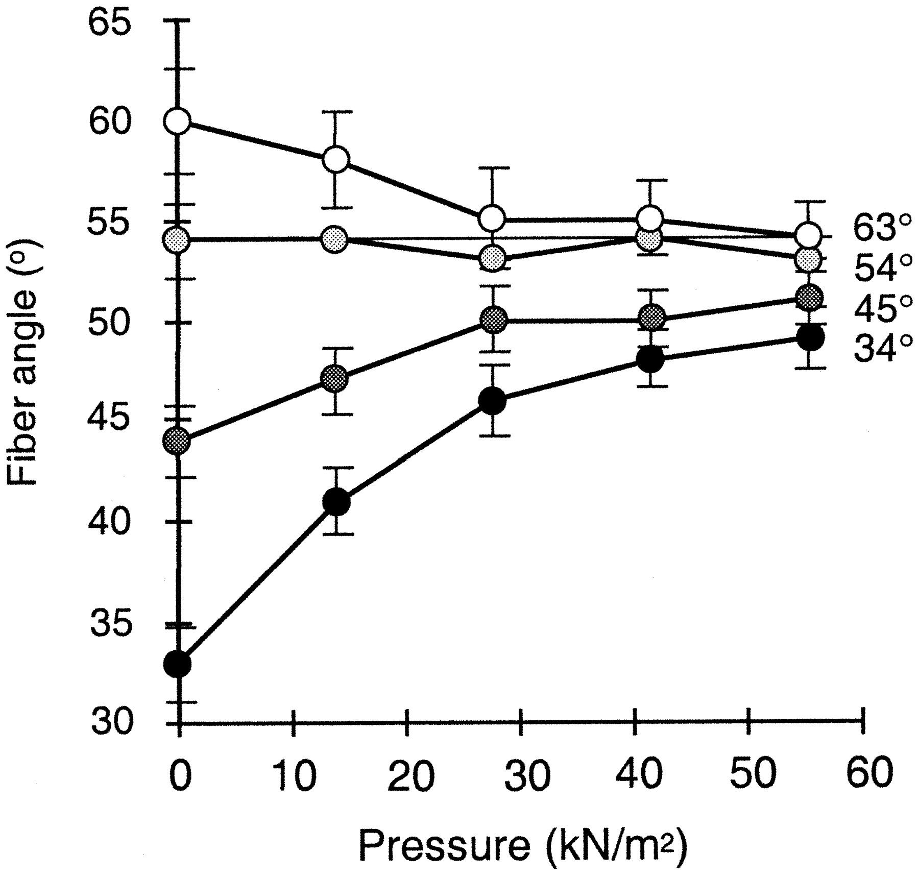
Fig. 4. Fiber angles of model notochords during inflation, plotted as a function of the pressure inside the ...
Notes:
Fig. 4. Fiber angles of model notochords during inflation, plotted as a function of the pressure inside the model. Each line represents the values for models that, when uninflated, had fibers at the 𝛉 indicated to the right of the line. Each symbol represents the mean of the mean values from three replicate models. Error bars represent 95% confidence intervals.
Unless provided in the caption above, the following copyright applies to the content of this slide: The Society for Integrative and Comparative Biology

Slide 5
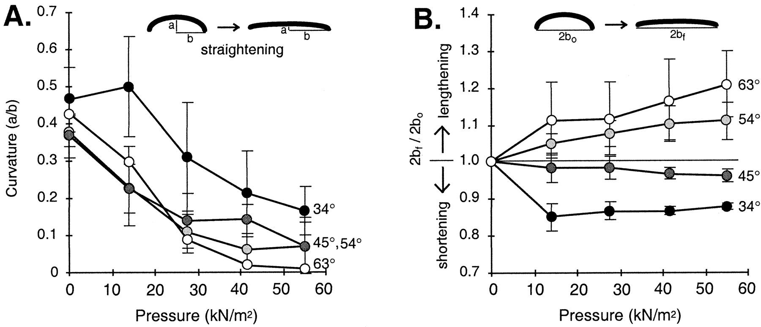
Fig. 5. Shape changes of models during inflation. Each line represents the values for models reinforced with ...
Notes:
Fig. 5. Shape changes of models during inflation. Each line represents the values for models reinforced with fibers at the 𝛉 indicated to the right of the line. Each symbol represents the mean of the mean values from three replicate models. Error bars represent 95% confidence intervals. A. Curvature (a/b) of model notochords plotted as a function of the pressure inside the model. B. End-to-end distance (along the axis corresponding to an embryo's anterior-posterior axis) of model notochords during inflation, plotted as a function of the pressure inside the model. End-to-end distance when inflated (2bf) was normalized to end-to-end distance (2bo) when uninflated. Values of 2bf/2bo greater than one indicate elongation of the end-to-end axis, while values less than one indicate shortening of that axis.
Unless provided in the caption above, the following copyright applies to the content of this slide: The Society for Integrative and Comparative Biology

Slide 6
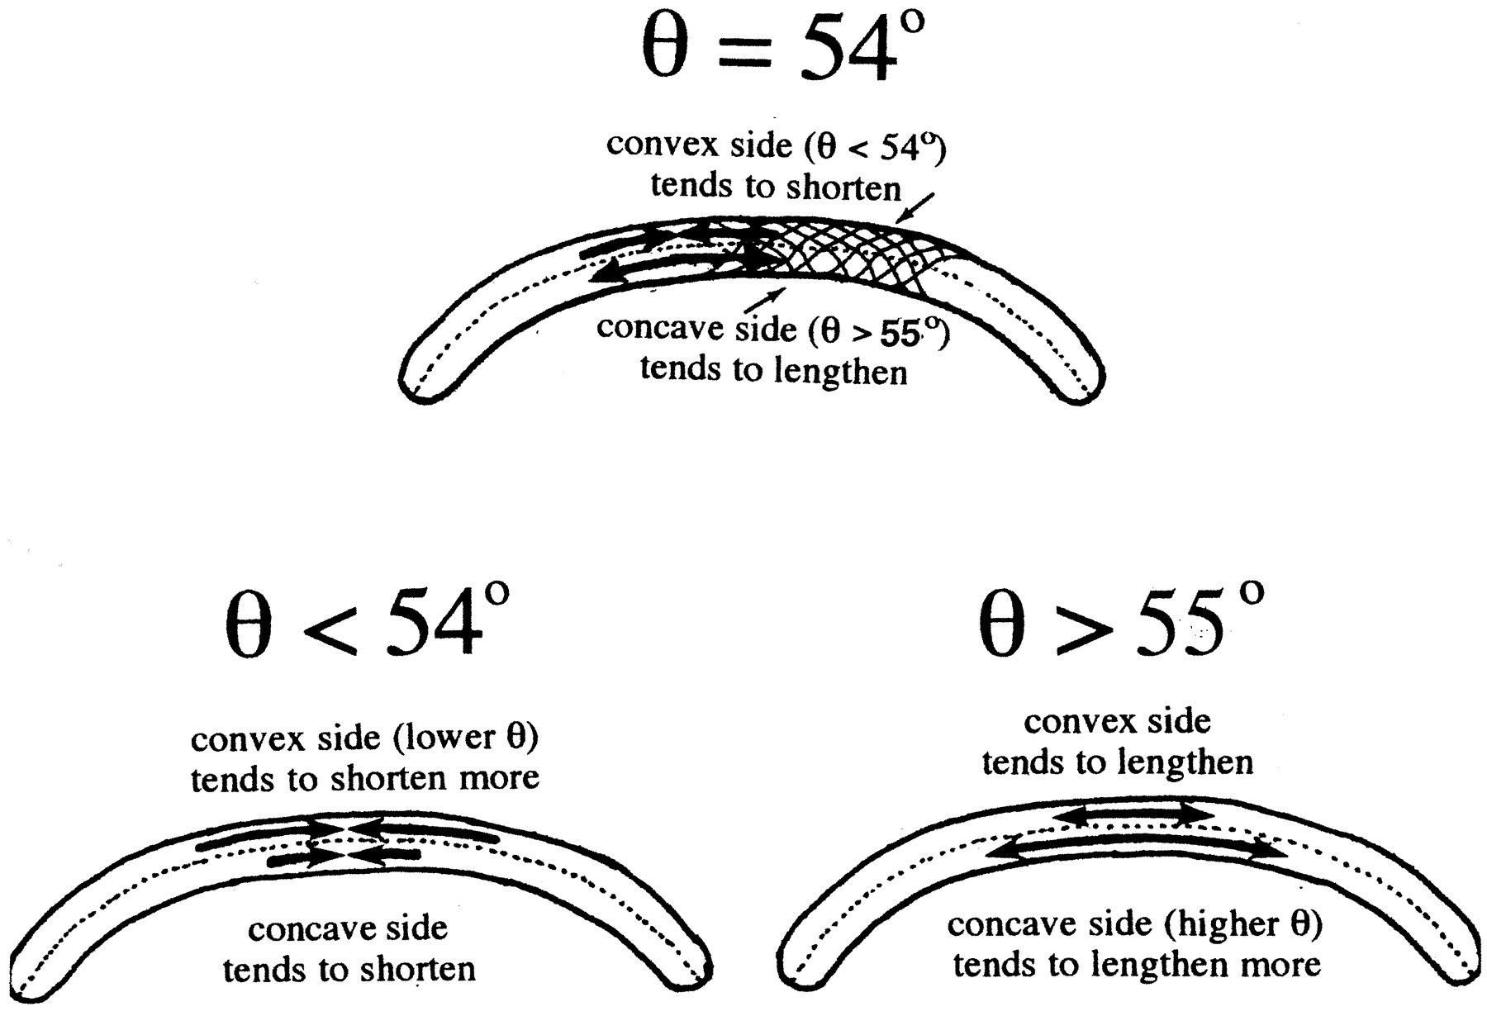
Fig. 9. Mechanism of straightening in notochord models. Continuous inextensible fibers wrap around the ...
Notes:
Fig. 9. Mechanism of straightening in notochord models. Continuous inextensible fibers wrap around the circumference of a curved model at an average fiber angle (𝛉) relative to the axis (dashed line) of the cylinder. However, because the convex side of the curved model is longer than the concave side, the 𝛉 of the fibers as they wrap around the convex side has to be lower than their 𝛉 as they wrap around the concave side. For a model with fibers at a mean 𝛉 of 54°, the 𝛉 of fibers on the convex side is slightly greater than 54°44′, so that side tends to shorten when inflated, while the 𝛉 of the fibers on the concave side of the model is slightly less than 54°44′, hence that side tends to elongate when inflated. The net result of the concave side lengthening and the convex side shortening is straightening of the model. For a model with mean 𝛉 55°, both sides lengthen when inflated, but the concave side (which has a higher 𝛉 than the convex side) lengthens more before its 𝛉 reaches 54°44′ than can the convex side. Therefore, regardless of the initial mean 𝛉 of a curved model, the difference in the 𝛉 of fibers on the convex and concave sides of the model leads to the straightening of the model when inflated.
Unless provided in the caption above, the following copyright applies to the content of this slide: The Society for Integrative and Comparative Biology

Slide 7
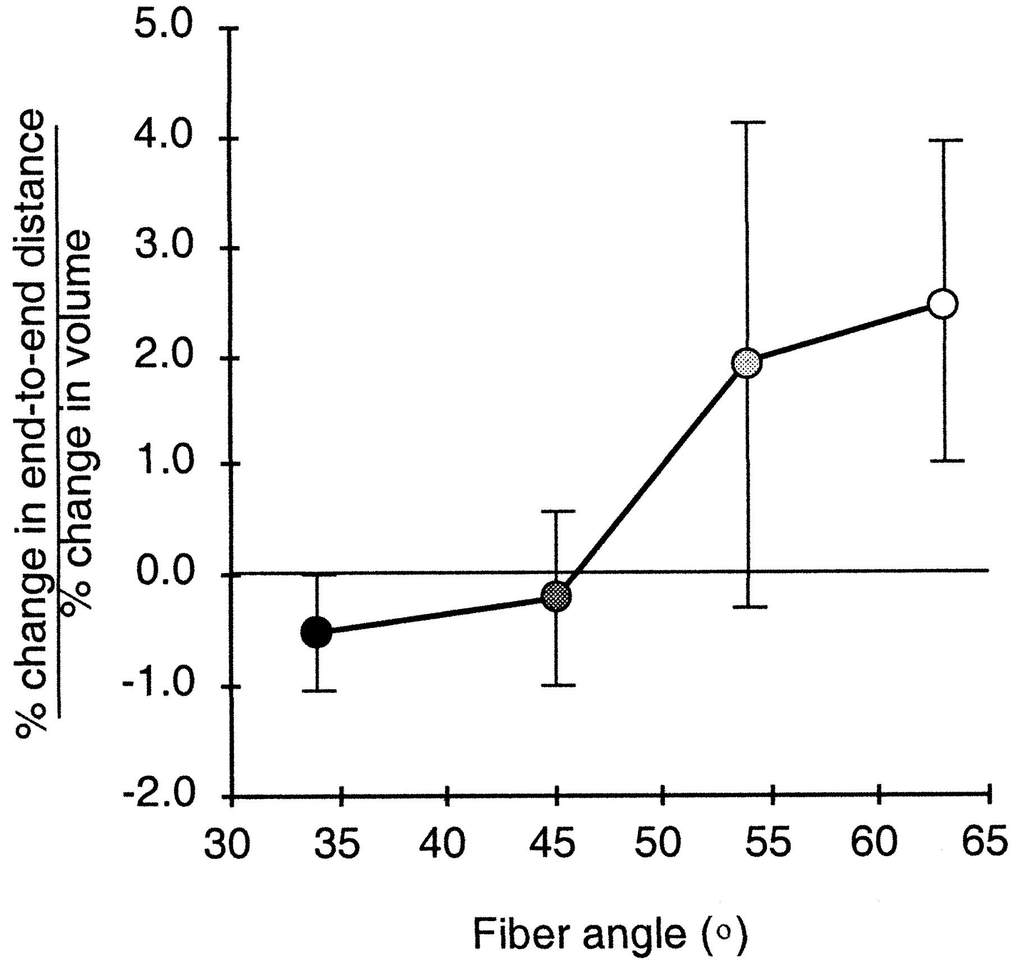
Fig. 6. Percent end-to-end elongation of notochord models per percent increase in volume when models were ...
Notes:
Fig. 6. Percent end-to-end elongation of notochord models per percent increase in volume when models were inflated to an internal pressure of 14 kN/m2, plotted as a function of the fiber angle of the model when uninflated. Negative values of [(% change in end-to-end distance)/(% change in volume) indicate that the models shortened along the end-to-end axis when inflated, while positive values indicate that the models elongated along that axis. Each symbol represents the mean of the mean values from three replicate models. Error bars represent 95% confidence intervals.
Unless provided in the caption above, the following copyright applies to the content of this slide: The Society for Integrative and Comparative Biology

Slide 8
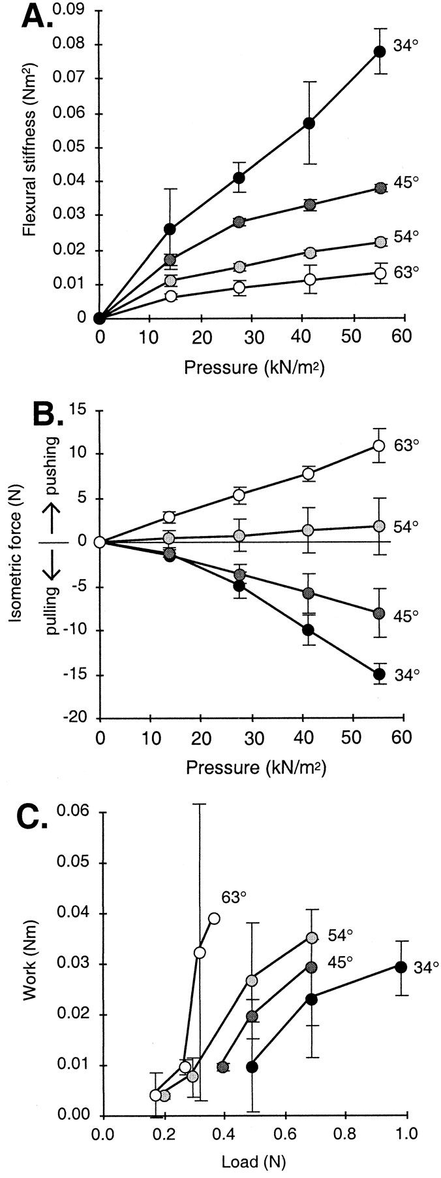
Fig. 7. Measurements of model mechanical performance when inflated. Each symbol represents the mean of the ...
Notes:
Fig. 7. Measurements of model mechanical performance when inflated. Each symbol represents the mean of the mean values from three replicate models. Error bars represent 95% confidence intervals. A. Flexural stiffness (resistance to bending) of models plotted as a function of pressure inside the model. B. Isometric force exerted by the models plotted as a function of pressure inside the model. Positive values of isometric force indicate pushing along the end-to-end axis of the model, while negative values indcate pulling along that axis (Fig. 2D). C. Work done by models pushing along the end-to-end axis (Fig. 2E) plotted as a function of the load against which they were pushing. Work was calculated as described in Materials and Methods using the change in end-to-end distance as the models were inflated from an internal pressure of 28kN/m2 to an internal pressure of 41 kN/m2.
Unless provided in the caption above, the following copyright applies to the content of this slide: The Society for Integrative and Comparative Biology

Slide 9
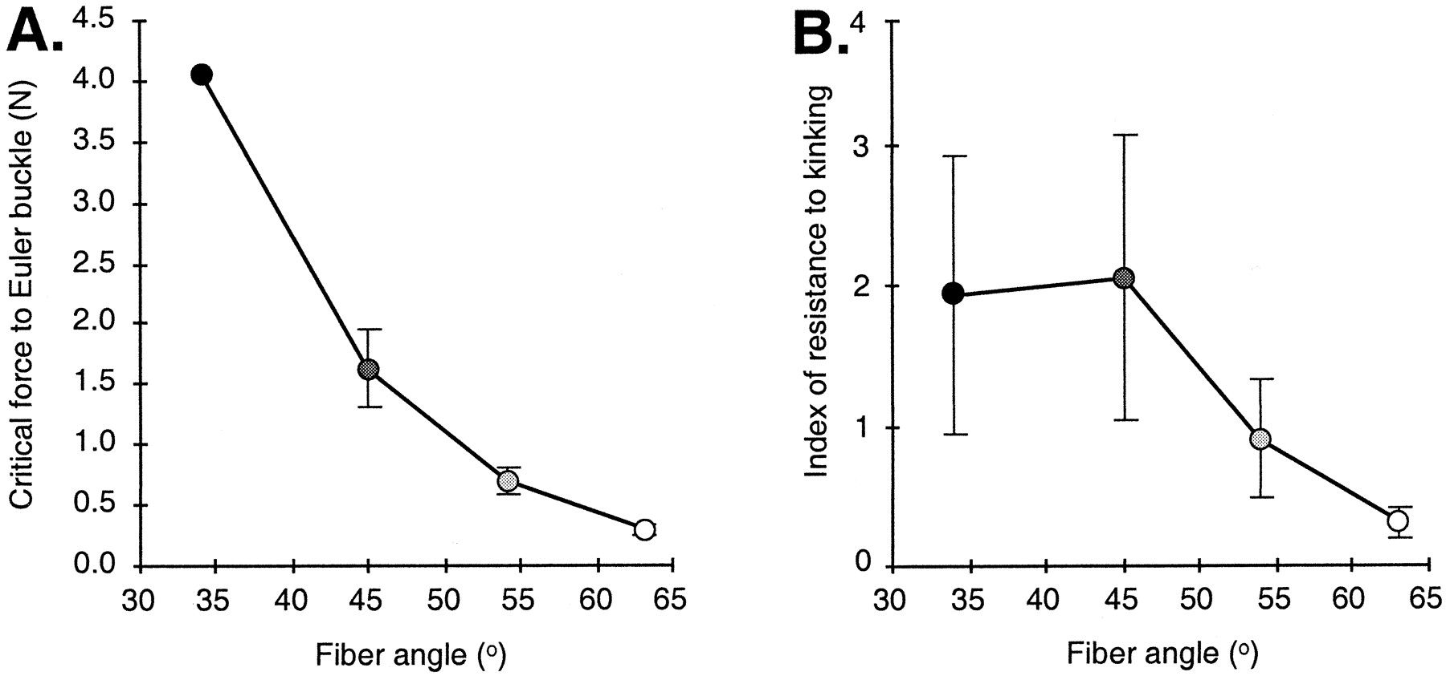
Fig. 8. Indices of the relative resistance of models to buckling when inflated to an internal pressure of 55 ...
Notes:
Fig. 8. Indices of the relative resistance of models to buckling when inflated to an internal pressure of 55 kN/m2, plotted as a function of fiber angle when uninflated. Error bars represent 95% confidence intervals. Calculation of these indices is described in Materials and Methods. A. The critical force to Euler buckle is an index of the resistance to elastic bowing of a column bearing a compressive load. Each symbol represents the mean of the mean values from three replicate models. B. The index of resistance to kinking is a measure of the relative resistance to undergoing local bucking of a hollow, pressurized column or beam subjected to a bending load. Each symbol represents the mean of the values calculated for each of the three replicate models.
Unless provided in the caption above, the following copyright applies to the content of this slide: The Society for Integrative and Comparative Biology

