Slide 1
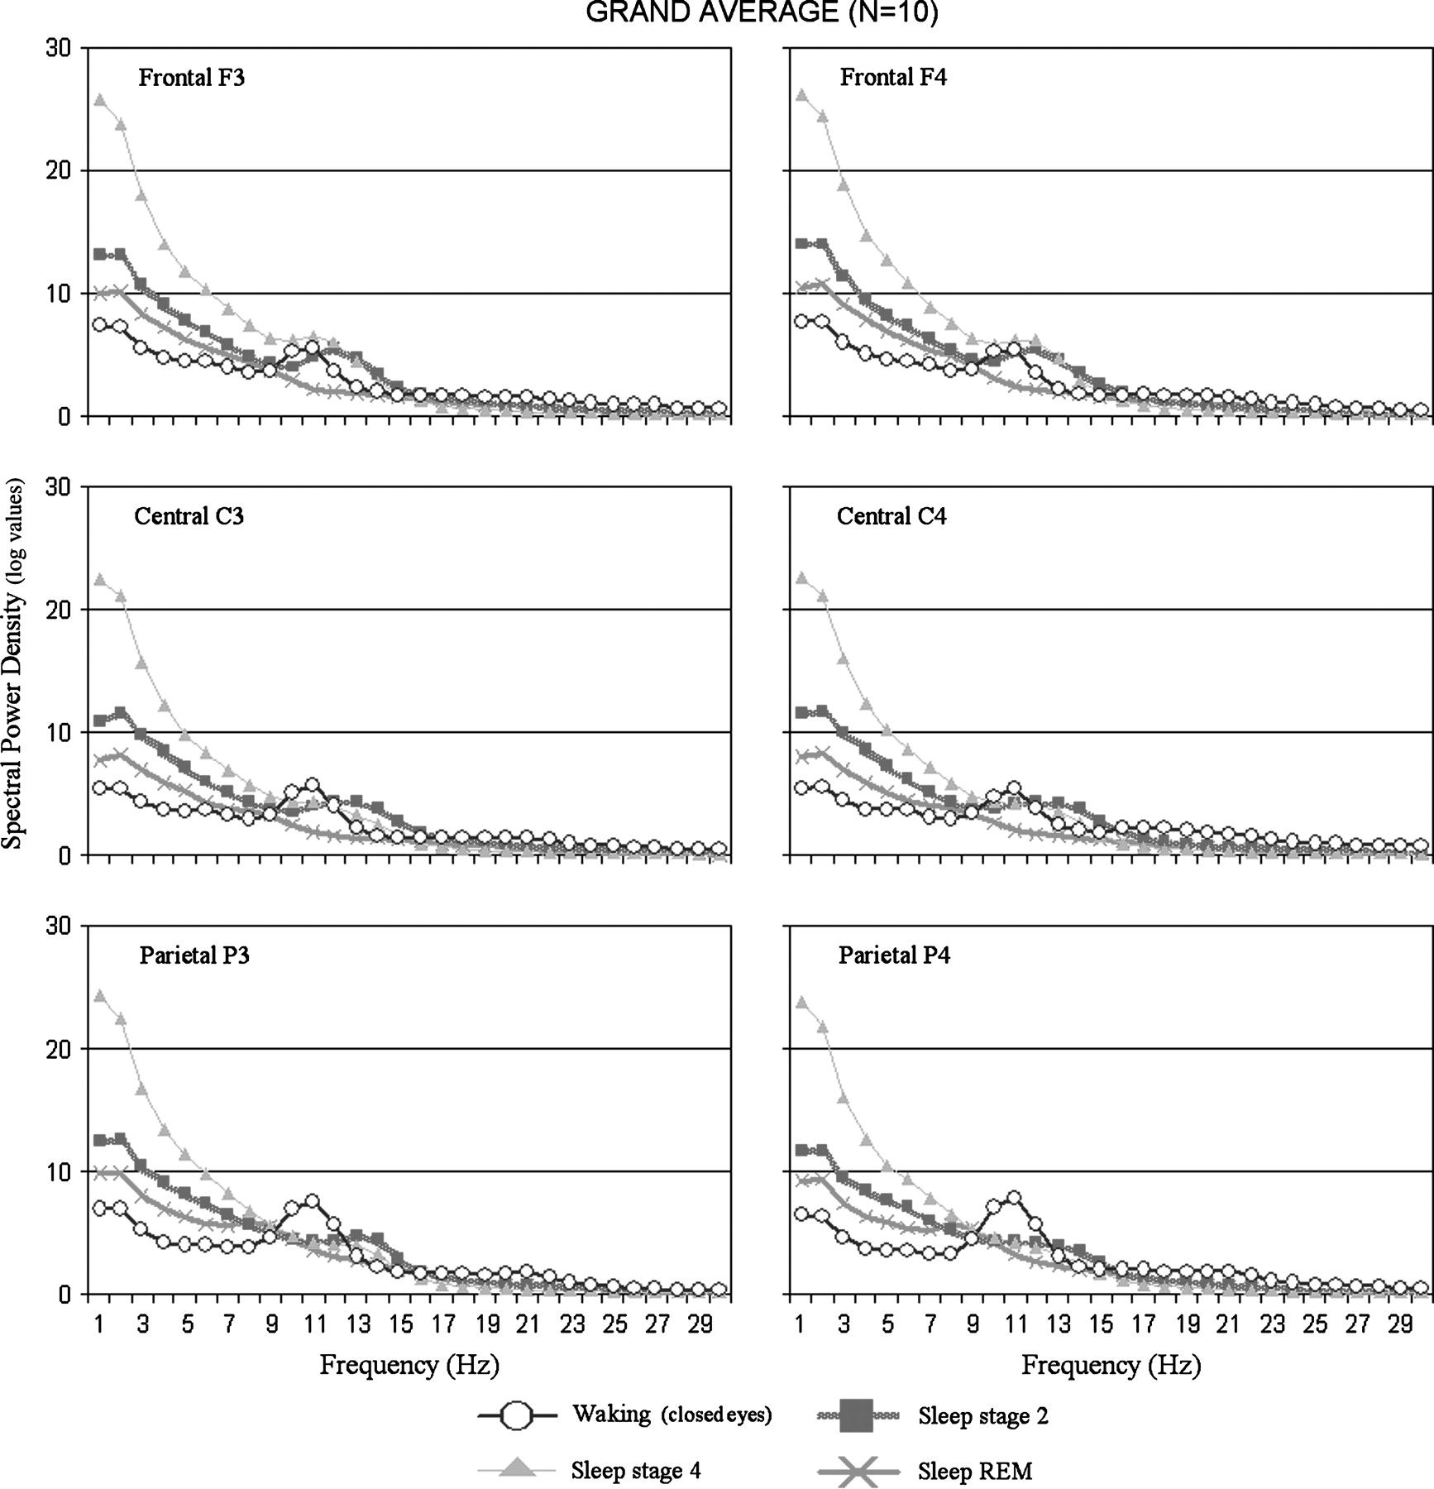
Figure 1. Grand average (N = 10) of the EEG power density spectra for the electrodes of interest (F3, F4, C3, C4, P3, ...
Notes:
Figure 1. Grand average (N = 10) of the EEG power density spectra for the electrodes of interest (F3, F4, C3, C4, P3, and P4) across the wake–early sleep stages. These spectra depicted the typical increase of delta, theta, and sigma power during NREM sleep stages as compared with wakefulness and REM sleep stages.
Unless provided in the caption above, the following copyright applies to the content of this slide: © The Author 2006. Published by Oxford University Press. All rights reserved. For permissions, please e-mail: journals.permissions@oxfordjournals.org

Slide 2
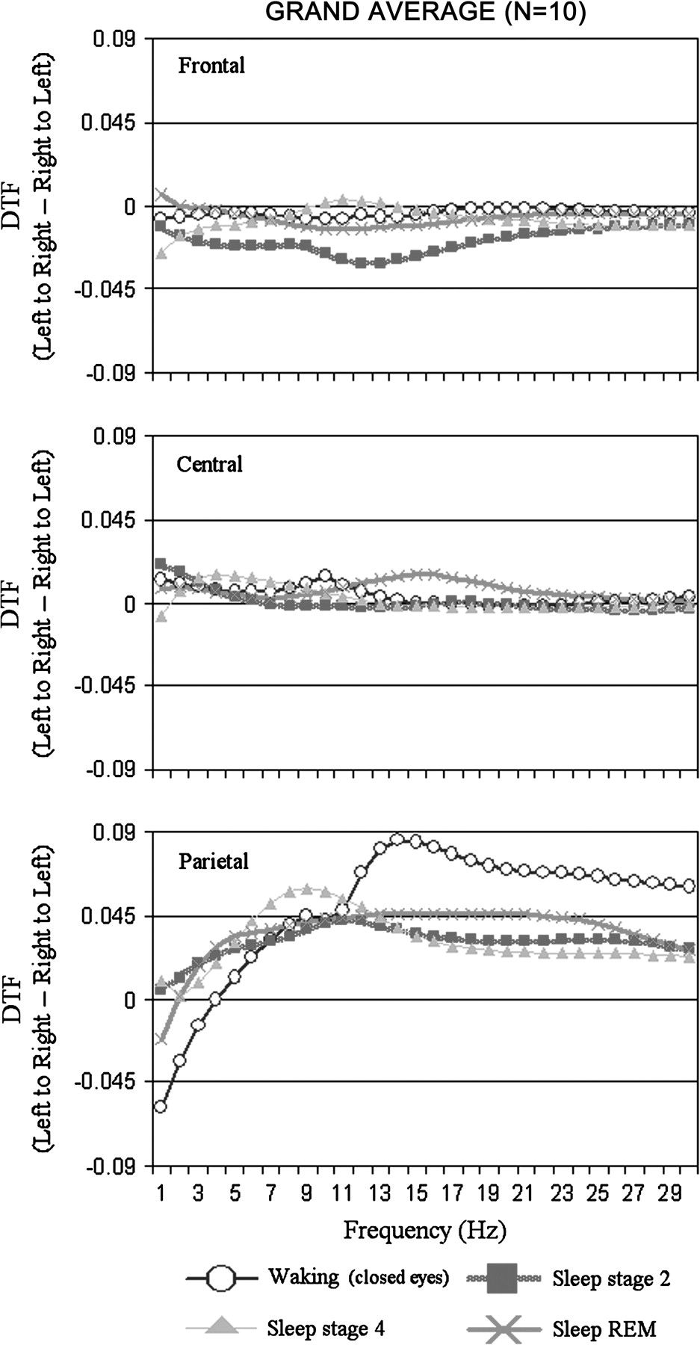
Figure 2. Grand average (N = 10) of the interhemispheric DTF values for the frontal (F3–F4), central (C3–C4), and ...
Notes:
Figure 2. Grand average (N = 10) of the interhemispheric DTF values for the frontal (F3–F4), central (C3–C4), and parietal (P3–P4) electrode pairs. These values refer to the DTF difference between left to right and right to left directions (i.e., DTFdiff). The DTFdiff values were illustrated for all EEG frequencies of interest.
Unless provided in the caption above, the following copyright applies to the content of this slide: © The Author 2006. Published by Oxford University Press. All rights reserved. For permissions, please e-mail: journals.permissions@oxfordjournals.org

Slide 3
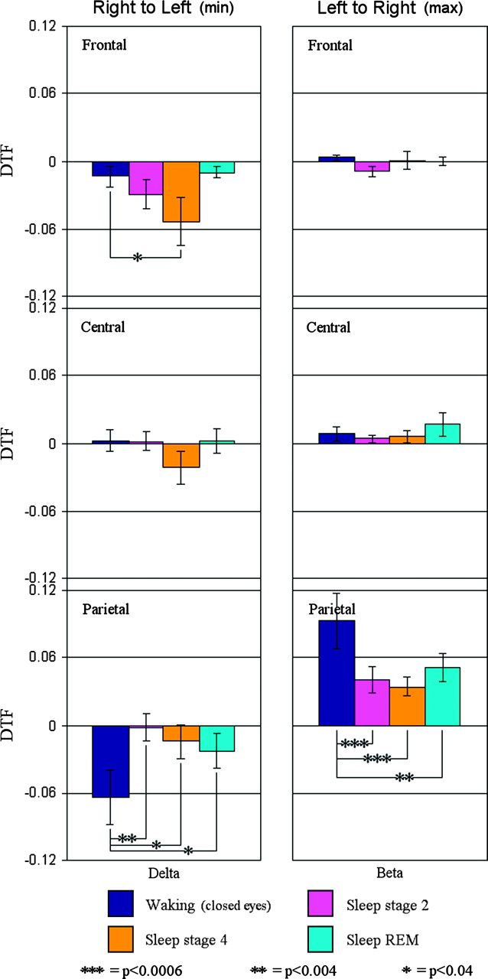
Figure 3. Grand average (N = 10) of the maximum and minimum means (±standard errors) of the DTFdiff values for the ...
Notes:
Figure 3. Grand average (N = 10) of the maximum and minimum means (±standard errors) of the DTFdiff values for the delta and beta bands (see Methods for further details). Max DTFdiff values indexed left to right direction of the DTF (most positive DTF values). Min DTFdiff values indexed right to left direction of the DTF (most negative DTF values). The means illustrate the results of 2 statistically significant (P < 0.05) 2-way ANOVA interactions. The ANOVA included the factors scalp site and stage for each band.
Unless provided in the caption above, the following copyright applies to the content of this slide: © The Author 2006. Published by Oxford University Press. All rights reserved. For permissions, please e-mail: journals.permissions@oxfordjournals.org

