Slide 1
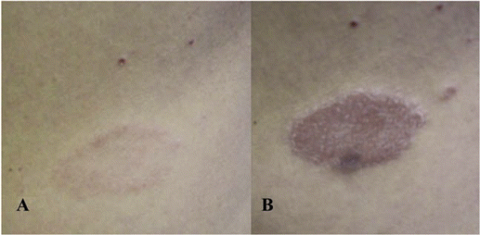
Figure 1 A, Nonpainful erythematous plaque on the right lumbar region in patient 2, before commencement of HAART. B, ...
Notes:
Figure 1 A, Nonpainful erythematous plaque on the right lumbar region in patient 2, before commencement of HAART. B, Hypersthesic edematous plaque in patient 2 two months later, after the commencement of HAART.
Unless provided in the caption above, the following copyright applies to the content of this slide: © 2008 by the Infectious Diseases Society of America

Slide 2
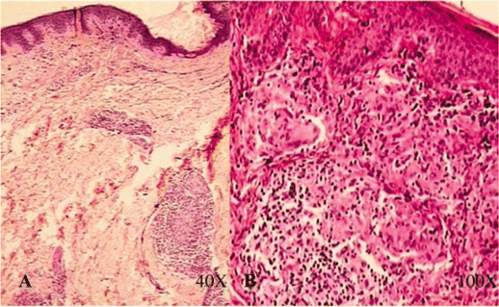
Figure 2 A, Skin biopsy of the lumbar lesion with typical tuberculous granuloma in patient 2, before commencement of ...
Notes:
Figure 2 A, Skin biopsy of the lumbar lesion with typical tuberculous granuloma in patient 2, before commencement of HAART (hematoxilin-eosin stain; original magnification, ×40). B, Intense tuberculous infiltrate, comprising lymphocytes, epithelioid cells, and Langhans giant cells, in patient 2 two months later, after the commencement of HAART (hematoxilin-eosin stain; original magnification, ×100).
Unless provided in the caption above, the following copyright applies to the content of this slide: © 2008 by the Infectious Diseases Society of America

Slide 3
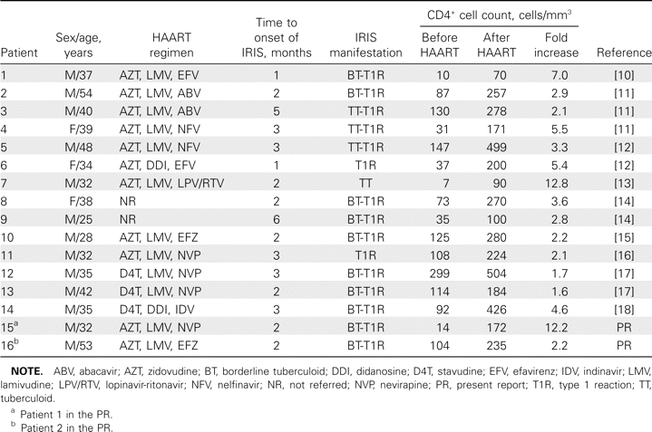
Table 1 Leprosy as a manifestation of immune reconstitution inflammatory syndrome (IRIS).
Notes:
Table 1 Leprosy as a manifestation of immune reconstitution inflammatory syndrome (IRIS).
Unless provided in the caption above, the following copyright applies to the content of this slide: © 2008 by the Infectious Diseases Society of America

