Slide 1
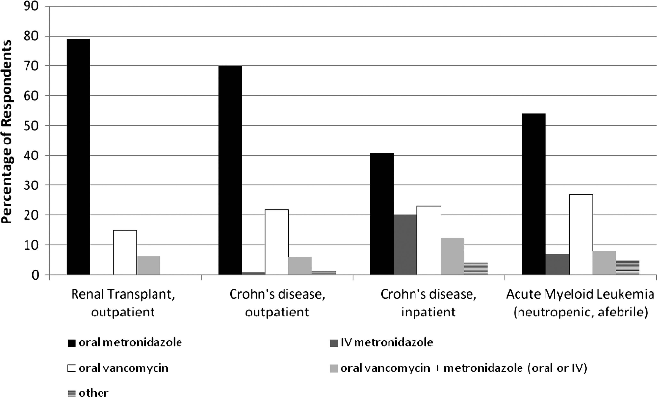
Figure 1. Management of initial, mild Clostridium difficile infection by patient type. Abbreviation: IV, intravenous.
Notes:
Figure 1. Management of initial, mild Clostridium difficile infection by patient type. Abbreviation: IV, intravenous.
Unless provided in the caption above, the following copyright applies to the content of this slide: © The Author 2013. Published by Oxford University Press on behalf of the Pediatric Infectious Diseases Society. All rights reserved. For Permissions, please e-mail: journals.permissions@oup.com.

Slide 2
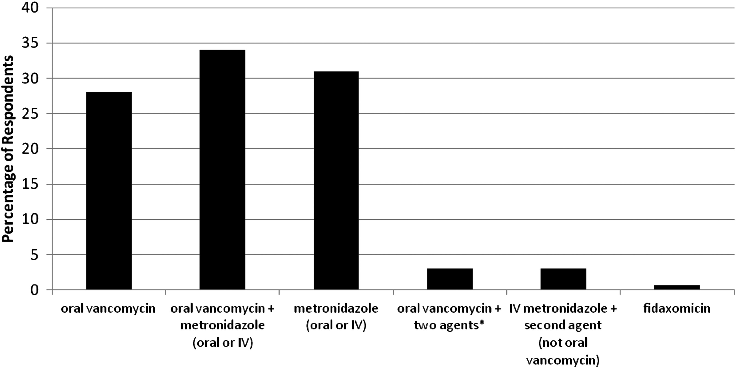
Figure 2. Therapeutic preference for management of severe Clostridium difficile infection.
Notes:
Figure 2. Therapeutic preference for management of severe Clostridium difficile infection. *Two additional agents included by 4 respondents as follows: 1) intravenous (IV) metronidazole, oral metronidazole; 2) IV metronidazole, intravenous immunoglobulin; 3) IV metronidazole, vancomycin per rectum; 4) IV metronidazole, fecal microbiota transplant. Abbreviation: IV, intravenous.
Unless provided in the caption above, the following copyright applies to the content of this slide: © The Author 2013. Published by Oxford University Press on behalf of the Pediatric Infectious Diseases Society. All rights reserved. For Permissions, please e-mail: journals.permissions@oup.com.

