Slide 1
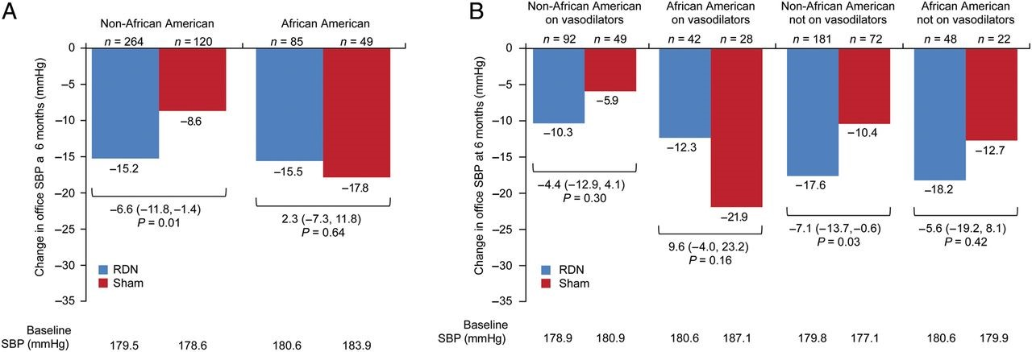
Figure 1 Change in office systolic blood pressure at 6 months for non-African-American and African-American subgroups ...
Notes:
Figure 1 Change in office systolic blood pressure at 6 months for non-African-American and African-American subgroups (A) and for non-African-American and African-American subgroups according to baseline vasodilator use (B). P-values shown are for the difference between the 6-month change from baseline for the RDN group and the sham group. All 6-month change from baseline values are significant (P < 0.001).
Unless provided in the caption above, the following copyright applies to the content of this slide: Published on behalf of the European Society of Cardiology. All rights reserved. © The Author 2014. For permissions please email: journals.permissions@oup.com.

Slide 2
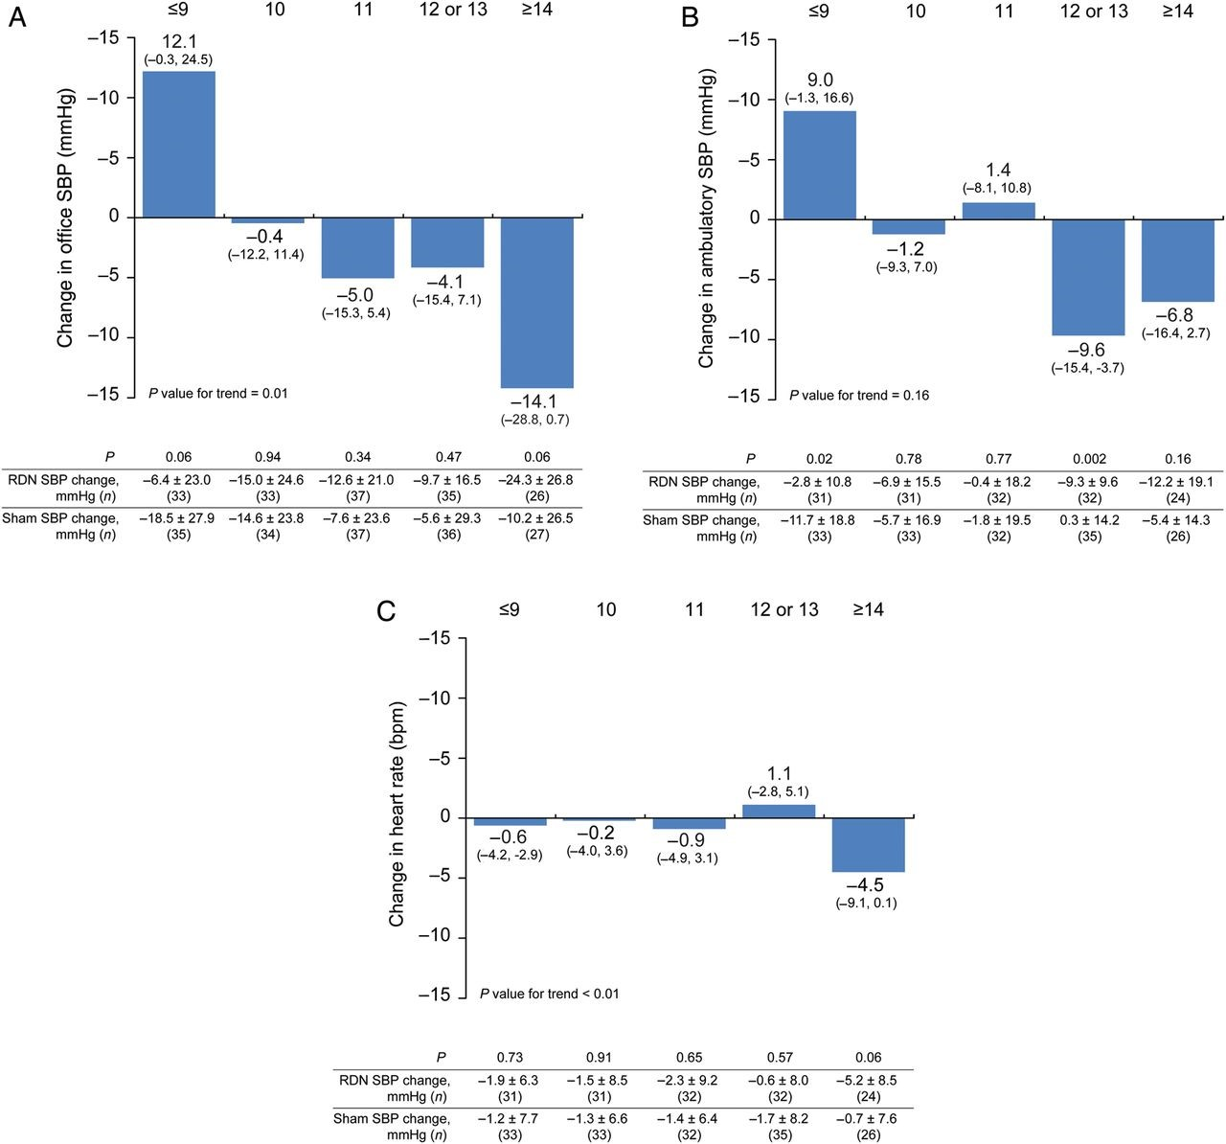
Figure 2 The impact of number of ablation attempts on difference in 6-month change in office systolic blood pressure ...
Notes:
Figure 2 The impact of number of ablation attempts on difference in 6-month change in office systolic blood pressure (A), 24-h ambulatory systolic blood pressure (B), and heart rate (C) between treated and matched sham patients. Baseline characteristics of the sham patients were propensity scored matched with the RDN patients. The SBP change measures for the RDN and matched sham patients, 95% confidence intervals, and P-values for the difference in change between the groups are shown.
Unless provided in the caption above, the following copyright applies to the content of this slide: Published on behalf of the European Society of Cardiology. All rights reserved. © The Author 2014. For permissions please email: journals.permissions@oup.com.

Slide 3
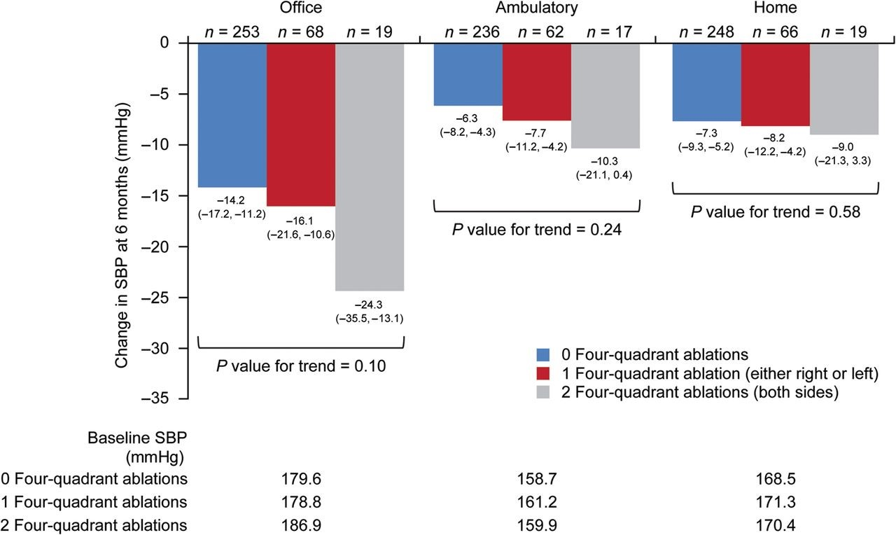
Figure 3 Systolic blood pressure change at 6 months according to the ablation pattern. Change in office, ambulatory, ...
Notes:
Figure 3 Systolic blood pressure change at 6 months according to the ablation pattern. Change in office, ambulatory, and home systolic blood pressure at 6 months are shown based on delivery of ablations in four quadrants of the renal artery for both kidneys, one kidney, or neither kidney. A four-quadrant ablation is defined as one superior, one inferior, and two anterior/posterior ablations delivered.
Unless provided in the caption above, the following copyright applies to the content of this slide: Published on behalf of the European Society of Cardiology. All rights reserved. © The Author 2014. For permissions please email: journals.permissions@oup.com.

