Slide 1
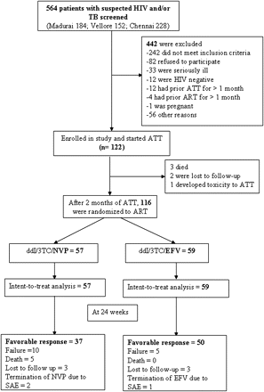
Figure 1. Trial profile.
Notes:
Figure 1. Trial profile.
Unless provided in the caption above, the following copyright applies to the content of this slide: © The Author 2011. Published by Oxford University Press on behalf of the Infectious Diseases Society of America. All rights reserved. For Permissions, please e-mail: journals.permissions@oup.com.

Slide 2
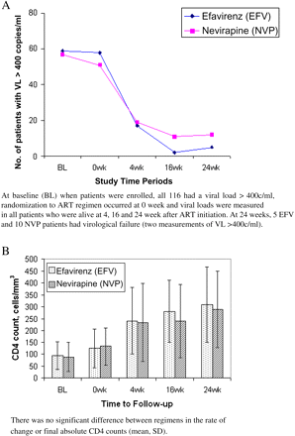
Figure 2. A, Virological response to treatment for patients available for evaluation over time (no. of patients with ...
Notes:
Figure 2. A, Virological response to treatment for patients available for evaluation over time (no. of patients with viral load >400 copies/mL). B, Immunological response to treatment (mean CD4+ cell count) over time for all evaluable patients.
Unless provided in the caption above, the following copyright applies to the content of this slide: © The Author 2011. Published by Oxford University Press on behalf of the Infectious Diseases Society of America. All rights reserved. For Permissions, please e-mail: journals.permissions@oup.com.

