Slide 1
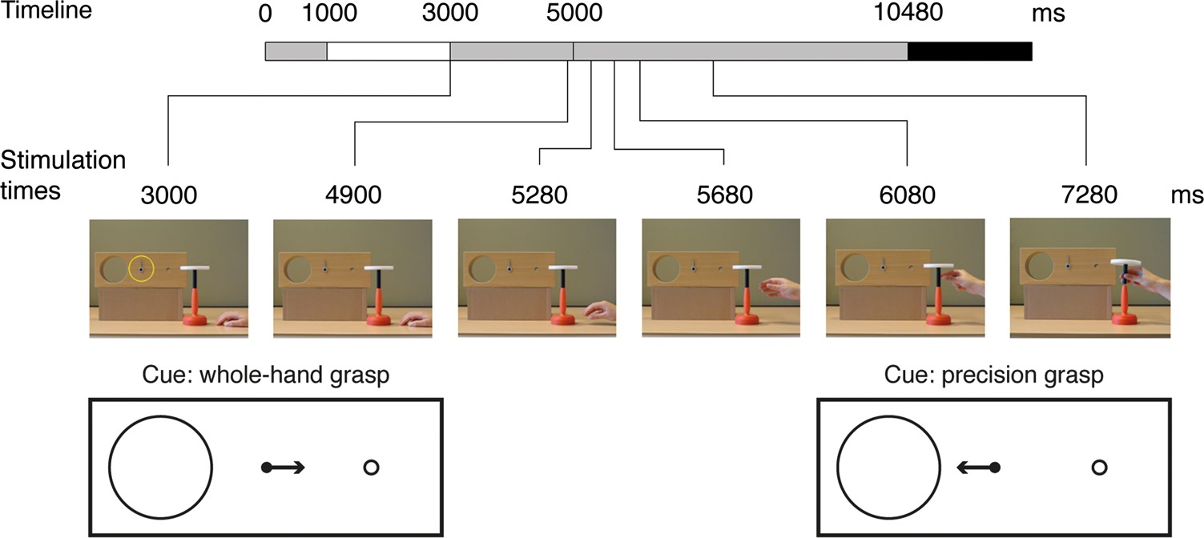
Figure 1. The sequence of events is illustrated for a composite trial. The bar at the top of the figure represents the ...
Notes:
Figure 1. The sequence of events is illustrated for a composite trial. The bar at the top of the figure represents the video timeline. The individual frames (shown for a no-cue condition) correspond to the times (phases) at which TMS was delivered, that is, in separate trials. Also depicted schematically are the instructional cues in which the arrow pointed to the small hole—indicating the requirement for a whole-hand grasp, and in which the arrow pointed to the large hole—indicating the requirement for a precision grasp.
Unless provided in the caption above, the following copyright applies to the content of this slide: © The Author 2013. Published by Oxford University Press. All rights reserved. For Permissions, please e-mail: journals.permissions@oup.com

Slide 2
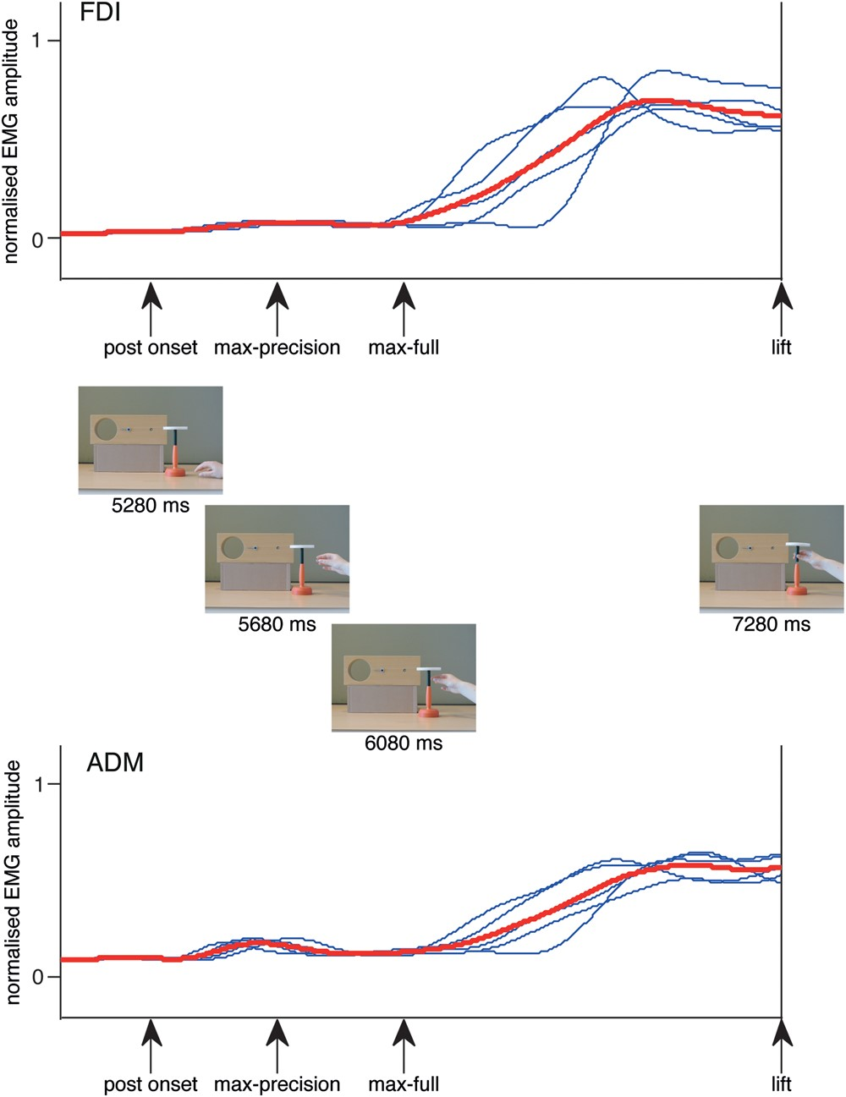
Figure 2. Normalized amplitude of EMG (FDI and ADM) recordings obtained from a group of 5 participants during real ...
Notes:
Figure 2. Normalized amplitude of EMG (FDI and ADM) recordings obtained from a group of 5 participants during real execution of the precision grasp variant of the task presented in the main experiment. The data were also normalized in time with respect to the onset and offset of the movement derived from a video record. Each blue curve represents the mean (of 10 trials) profile obtained for an individual participant. The red curve represents the profile obtained by averaging across participants. The arrows indicate the intervals at which TMS was administered in the main experiment. These are aligned with the corresponding video frames drawn from the condition in which—following an instructional cue in which the arrow pointed to the large hole, the actor is shown using a precision grasp to insert the object into the target hole.
Unless provided in the caption above, the following copyright applies to the content of this slide: © The Author 2013. Published by Oxford University Press. All rights reserved. For Permissions, please e-mail: journals.permissions@oup.com

Slide 3
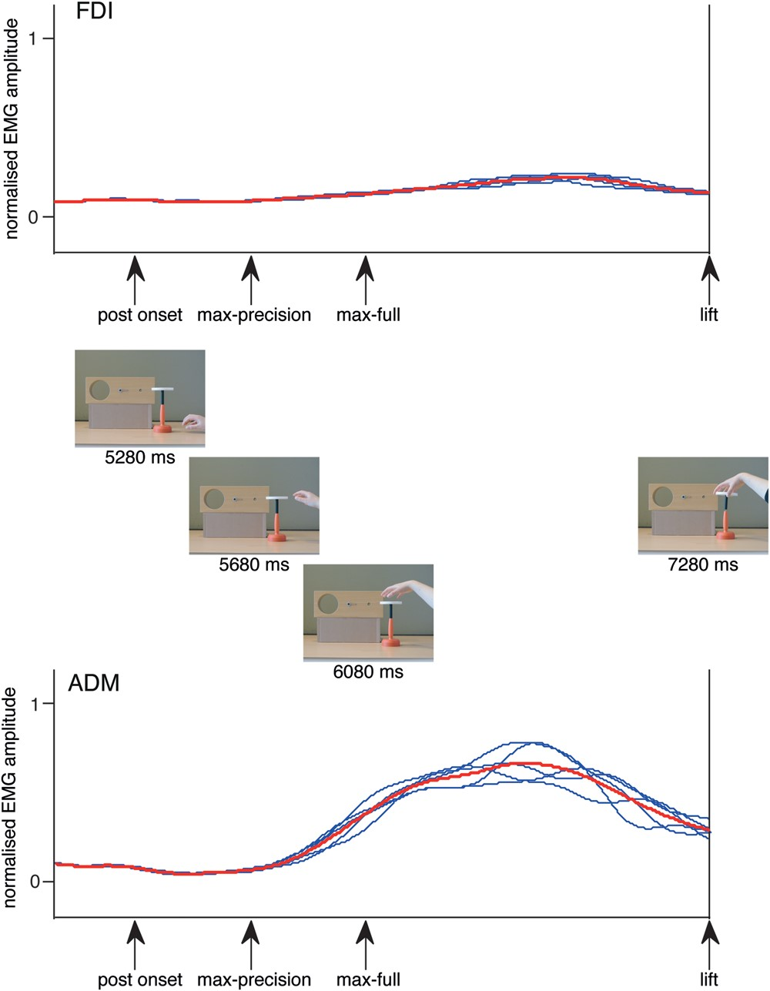
Figure 3. Normalized amplitude of EMG (FDI and ADM) recordings obtained from a group of 5 participants during real ...
Notes:
Figure 3. Normalized amplitude of EMG (FDI and ADM) recordings obtained from a group of 5 participants during real execution of the whole-hand grasp variant of the task presented in the main experiment. The data were also normalized in time with respect to the onset and offset of the movement derived from a video record. Each blue curve represents the mean (of 10 trials) profile obtained for an individual participant. The red curve represents the profile obtained by averaging across participants. The arrows indicate the intervals at which TMS was administered in the main experiment. These are aligned with the corresponding video frames drawn from the condition in which—following an instructional cue in which the arrow pointed to the small hole, the actor is shown using a whole-hand grasp to insert the object into the target hole.
Unless provided in the caption above, the following copyright applies to the content of this slide: © The Author 2013. Published by Oxford University Press. All rights reserved. For Permissions, please e-mail: journals.permissions@oup.com

Slide 4
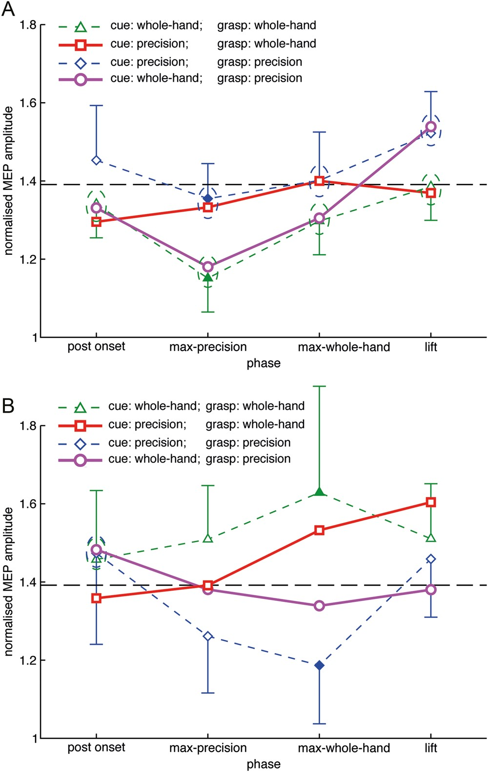
Figure 4. Amplitudes of MEPs evoked in the (A), right FDI and (B), right ADM by left M1 stimulation are shown for the ...
Notes:
Figure 4. Amplitudes of MEPs evoked in the (A), right FDI and (B), right ADM by left M1 stimulation are shown for the congruent and incongruent conditions. The values (mean of 13 participants) are normalized with respect to controls obtained prior to and following the observation trials. Values greater than one represent an elevation of MEP amplitude relative to that obtained in the control trials. The horizontal dashed lines indicate the means of responses obtained prior to the onset of the action in the no-cue trials. TMS was not delivered following the onset of movement in the no-cue trials. Responses obtained in the (congruent) cue: whole-hand; grasp: whole-hand condition are shown as triangles, and in the (congruent) cue: precision; grasp: precision condition as diamonds; in the (incongruent) cue: whole-hand; grasp: precision as circles, and in the (incongruent) cue: precision; grasp: whole-hand as squares. Filled symbols represent instances in which the values obtained in the respective congruent conditions differed reliably (i.e., at a given time point). The error bars shown for the congruent conditions are the corresponding 95% confidence intervals for repeated measures designs, calculated following Morey (2008). The dashed ovals enclose pairs of values that were statistically equivalent (P ≤ 0.05). Blue ovals indicate a value equivalent to that of the cue: precision; grasp: precision condition; green ovals indicate a value equivalent to that of the cue: whole-hand; grasp: whole-hand condition.
Unless provided in the caption above, the following copyright applies to the content of this slide: © The Author 2013. Published by Oxford University Press. All rights reserved. For Permissions, please e-mail: journals.permissions@oup.com

