Slide 1
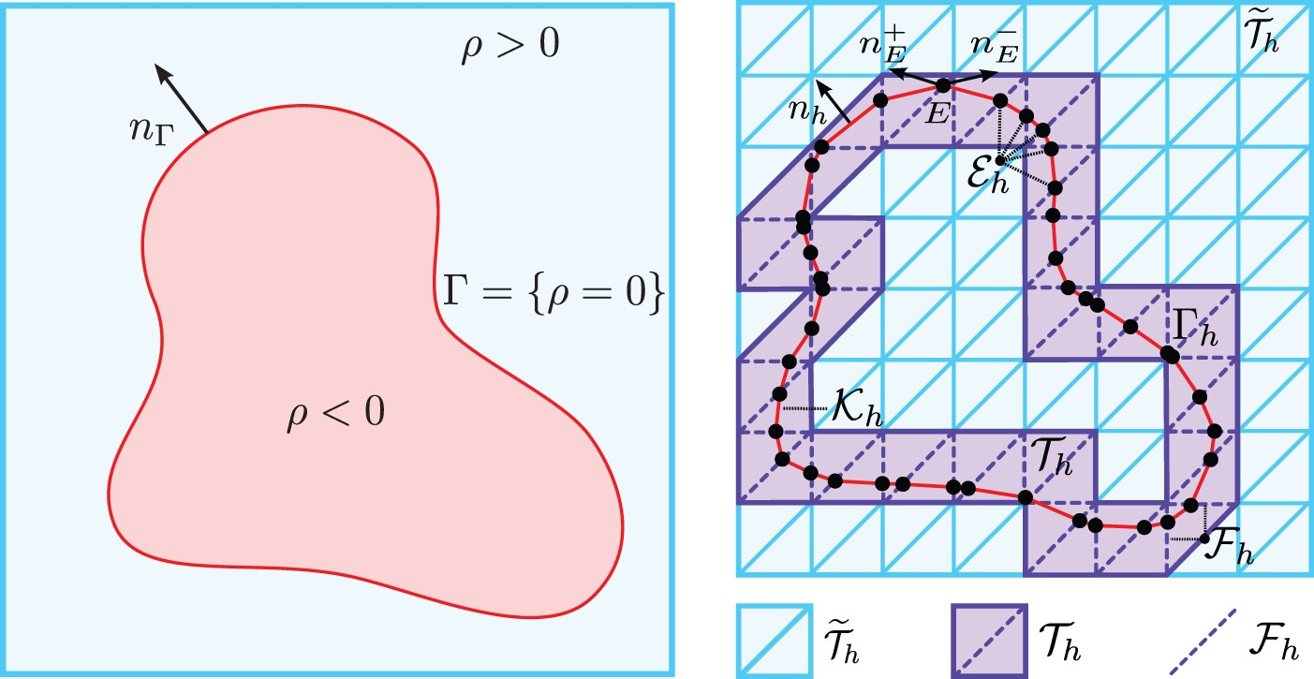
(2.14) Domain set-up.
Notes:
(2.14) Domain set-up.
Unless provided in the caption above, the following copyright applies to the content of this slide: © The Authors 2016. Published by Oxford University Press on behalf of the Institute of Mathematics and its Applications. All rights reserved.

Slide 2
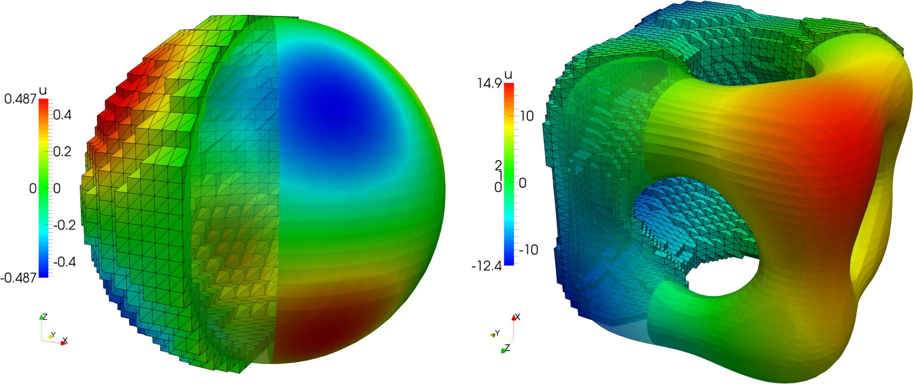
Fig. 2. Computed solutions for example 1 (left) and example 2 (right). The left part of each solution plot shows the ...
Notes:
Fig. 2. Computed solutions for example 1 (left) and example 2 (right). The left part of each solution plot shows the approximation $u_h$ as computed on the active mesh $\mathscr {T}_h,$ while the right part displays $u_h$ restricted to the surface mesh $\mathscr {K}_h$.
Unless provided in the caption above, the following copyright applies to the content of this slide: © The Authors 2016. Published by Oxford University Press on behalf of the Institute of Mathematics and its Applications. All rights reserved.

Slide 3
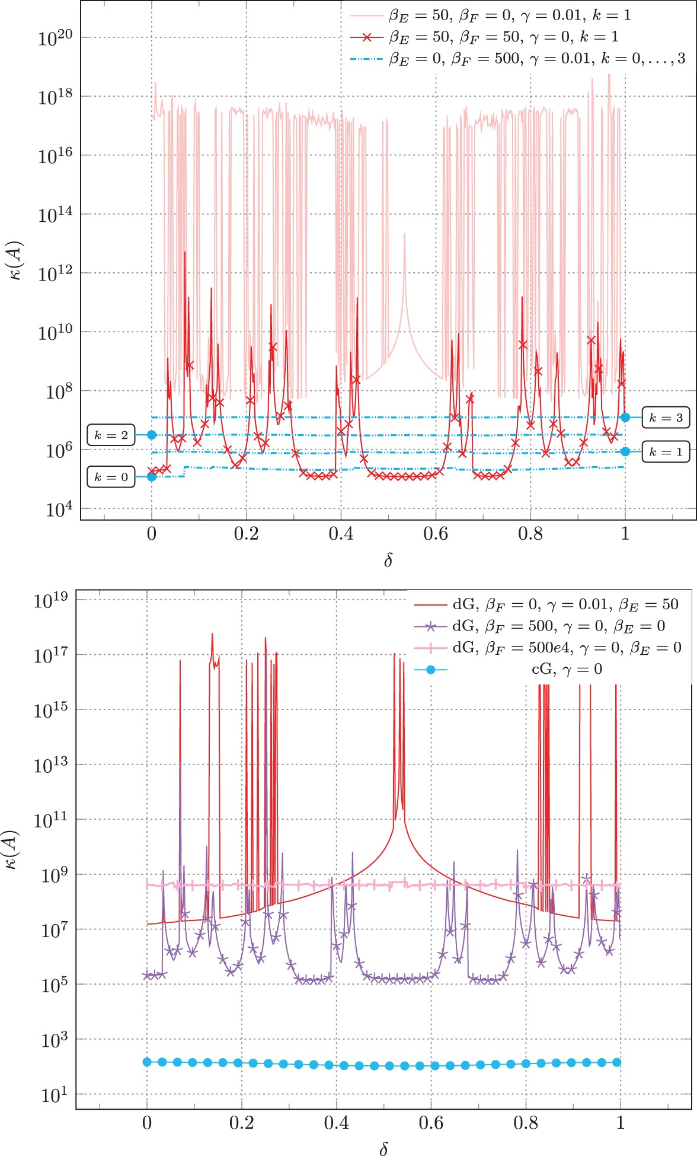
Fig. 3. Condition numbers plotted as a function of the position parameter $\delta $. Top: With either $\beta _F=0$ or ...
Notes:
Fig. 3. Condition numbers plotted as a function of the position parameter $\delta $. Top: With either $\beta _F=0$ or $\gamma = 0$, the condition number is highly sensitive to the surface positioning in the background mesh. With both penalties activated, the condition number is robust and the edge-based penalty term $\beta _E$ can be omitted. Bottom: Diagonally preconditioned surface CutFEMs. For an unstabilized continuous Galerkin (cG) method, preconditioning gives robust condition numbers, while for our discontinuous CutFEM (dG), the preconditioned system is still highly dependent on the surface position if either $\beta _F = 0$ or $\gamma = 0$.
Unless provided in the caption above, the following copyright applies to the content of this slide: © The Authors 2016. Published by Oxford University Press on behalf of the Institute of Mathematics and its Applications. All rights reserved.

