Slide 1
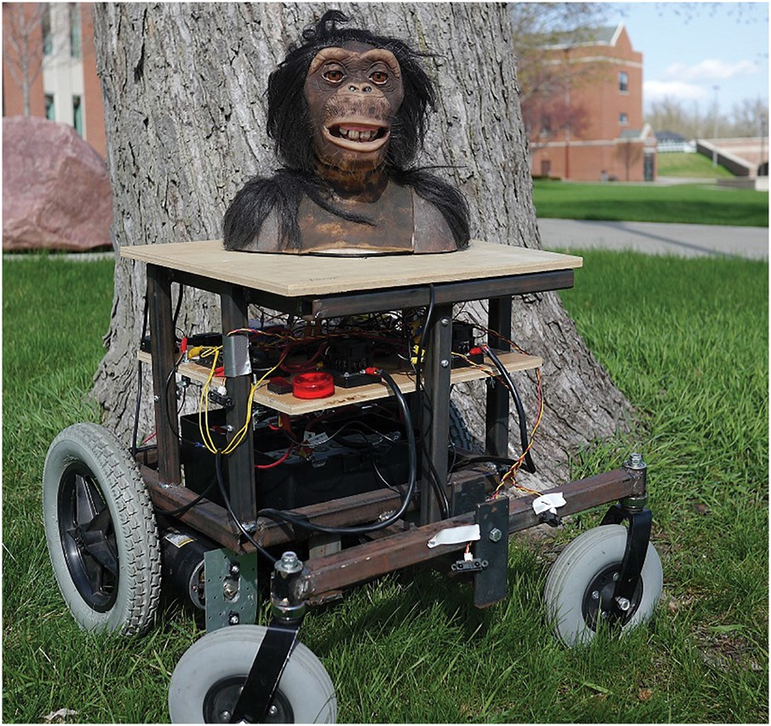
Figure 1. A photograph of the Robo-bonobo bot (115 × 108 mm).
Notes:
Figure 1. A photograph of the Robo-bonobo bot (115 × 108 mm).
Unless provided in the caption above, the following copyright applies to the content of this slide: © The Author (2017). Published by Oxford University Press.This is an Open Access article distributed under the terms of the Creative Commons Attribution Non-Commercial License (http://creativecommons.org/licenses/by-nc/4.0/), which permits non-commercial re-use, distribution, and reproduction in any medium, provided the original work is properly cited. For commercial re-use, please contact journals.permissions@oup.com

Slide 2
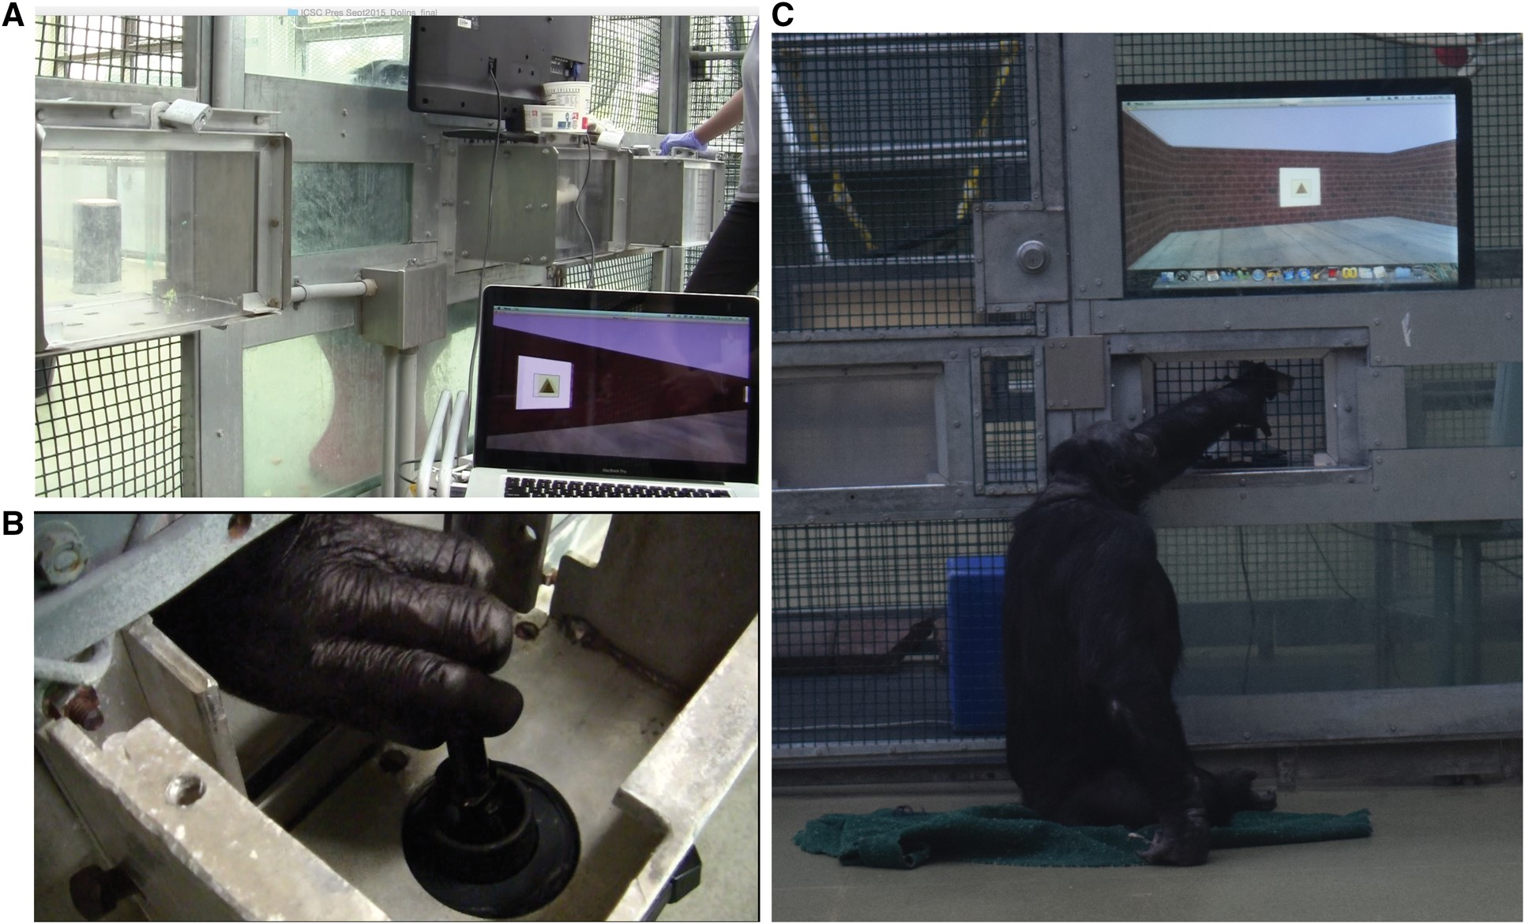
Figure 3. (A) A photograph of Kanzi pushing the joystick while navigating in virtual reality (321 × 218mm). (B) ...
Notes:
Figure 3. (A) A photograph of Kanzi pushing the joystick while navigating in virtual reality (321 × 218mm). (B) Panzee’s hand on the joystick while she's navigating in virtual reality (332 × 188mm). (C) Kanzi manipulating the joystick to navigate in a virtual environment (202 × 240 mm).
Unless provided in the caption above, the following copyright applies to the content of this slide: © The Author (2017). Published by Oxford University Press.This is an Open Access article distributed under the terms of the Creative Commons Attribution Non-Commercial License (http://creativecommons.org/licenses/by-nc/4.0/), which permits non-commercial re-use, distribution, and reproduction in any medium, provided the original work is properly cited. For commercial re-use, please contact journals.permissions@oup.com

Slide 3
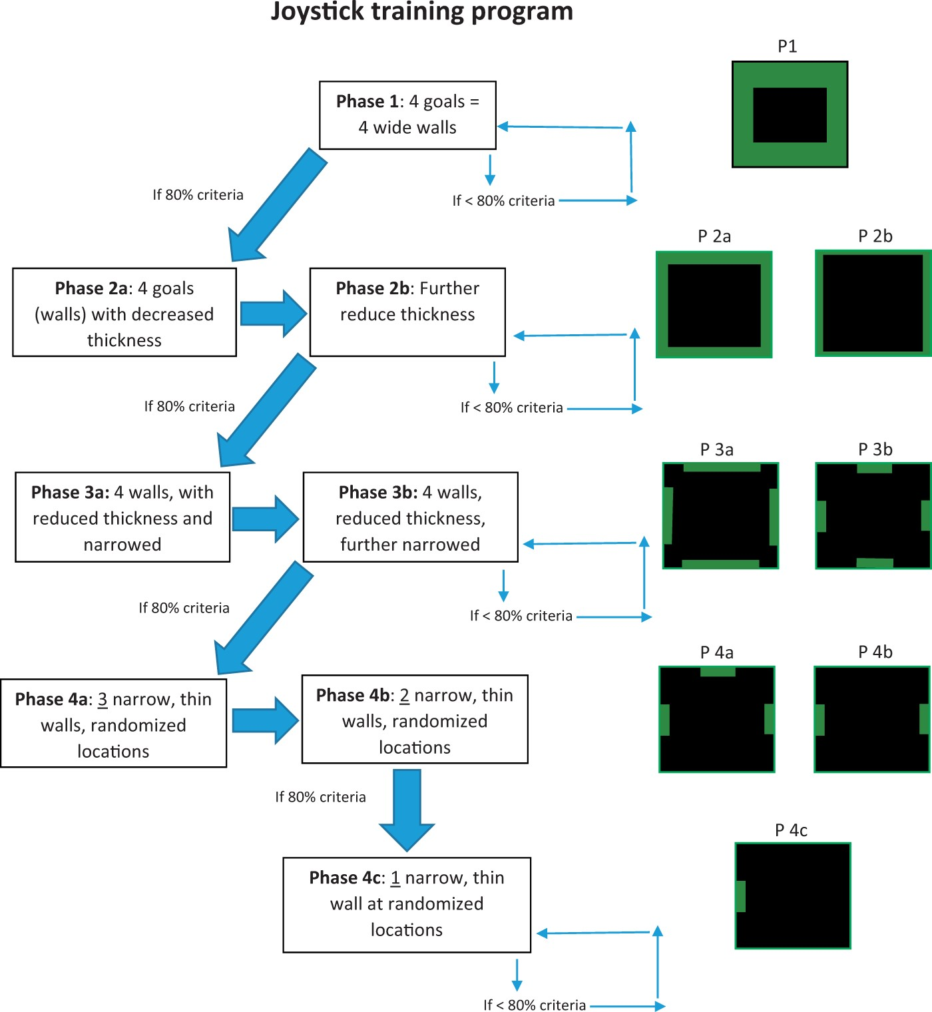
Figure 2. Diagram of 4 phases for joystick training nonhuman primates to use virtual reality.
Notes:
Figure 2. Diagram of 4 phases for joystick training nonhuman primates to use virtual reality.
Unless provided in the caption above, the following copyright applies to the content of this slide: © The Author (2017). Published by Oxford University Press.This is an Open Access article distributed under the terms of the Creative Commons Attribution Non-Commercial License (http://creativecommons.org/licenses/by-nc/4.0/), which permits non-commercial re-use, distribution, and reproduction in any medium, provided the original work is properly cited. For commercial re-use, please contact journals.permissions@oup.com

Slide 4
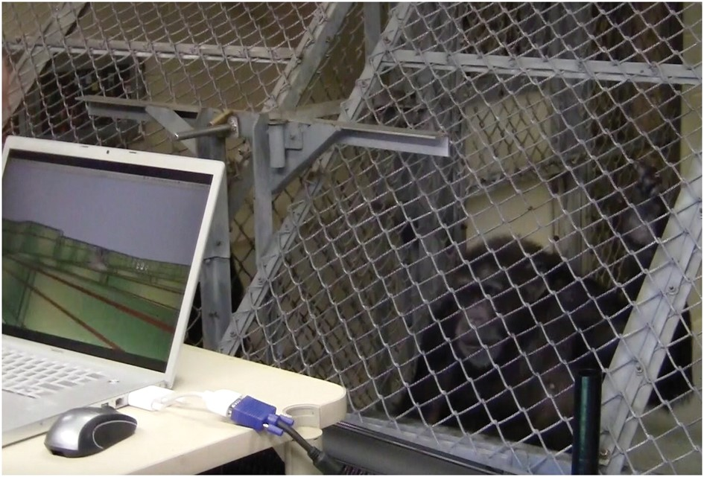
Figure 4. Panzee navigating in a virtual maze (274 × 185 mm).
Notes:
Figure 4. Panzee navigating in a virtual maze (274 × 185 mm).
Unless provided in the caption above, the following copyright applies to the content of this slide: © The Author (2017). Published by Oxford University Press.This is an Open Access article distributed under the terms of the Creative Commons Attribution Non-Commercial License (http://creativecommons.org/licenses/by-nc/4.0/), which permits non-commercial re-use, distribution, and reproduction in any medium, provided the original work is properly cited. For commercial re-use, please contact journals.permissions@oup.com

