Slide 1
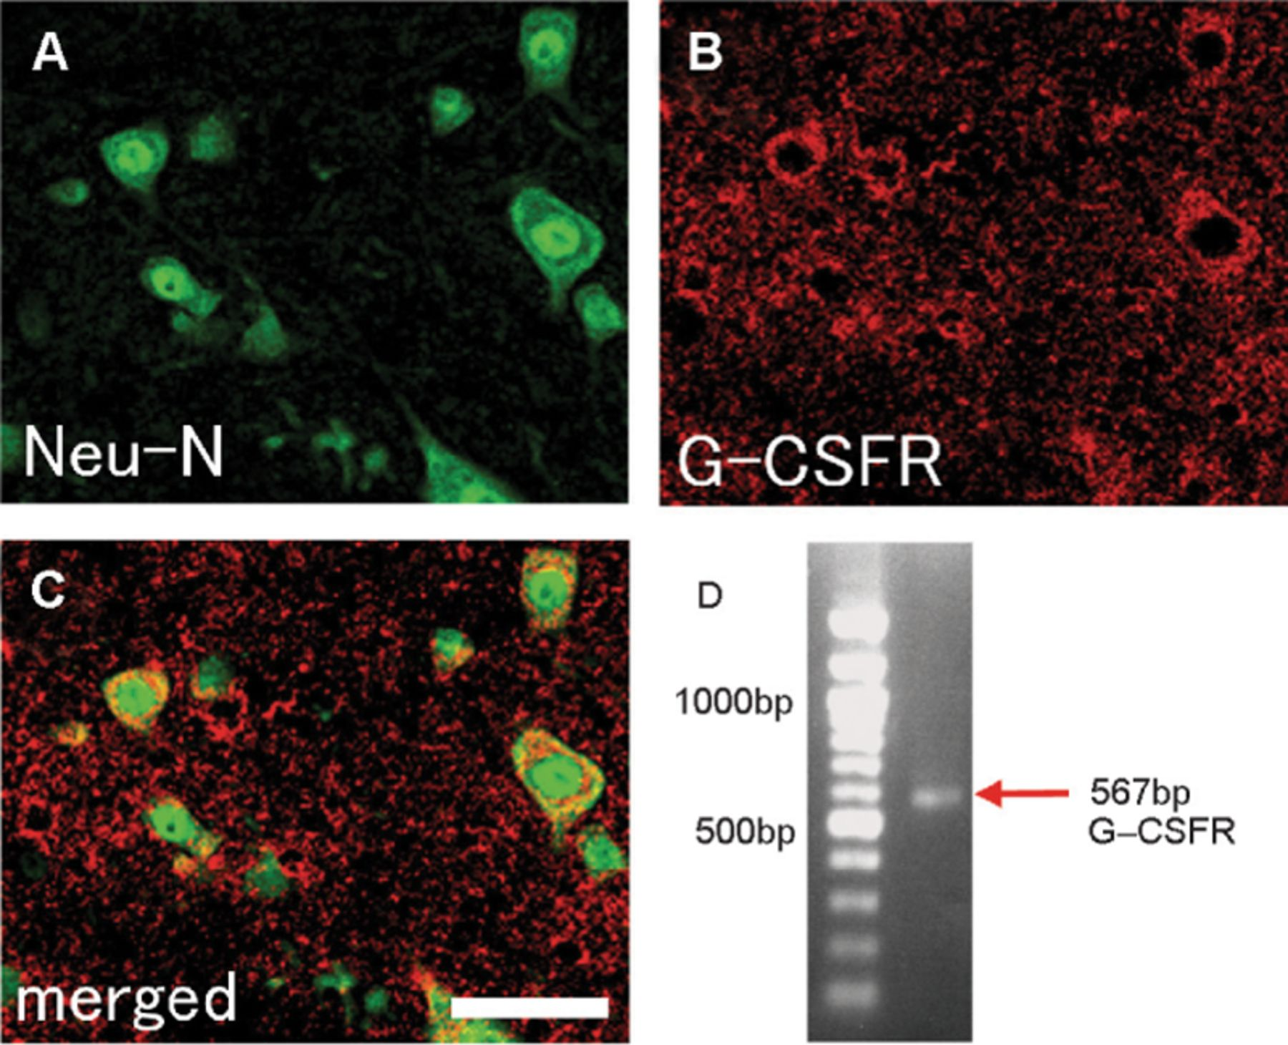
FIGURE 1. Granulo cyte colony-stimulating factor receptor (G-CSFR) expression in mouse intact spinal cord. ...
Notes:
FIGURE 1. Granulo cyte colony-stimulating factor receptor (G-CSFR) expression in mouse intact spinal cord. Immunofluorescence staining for (A) anti-neuronal nuclei mouse monoclonal antibody, a marker for neuron (green), (B) G-CSFR, and (C) merged view. G-CSFR expression was predominantly neuronal in mouse spinal cord. (D) Reverse transcriptase-polymerase chain reaction for mouse G-CSFR. Expression of G-CSFR mRNA was detected in mouse intact spinal cord with an expected size of 567 base pairs. Scale bar = (A-C) 50 μm.)
Unless provided in the caption above, the following copyright applies to the content of this slide: Copyright © 2007 by the American Association of Neuropathologists, Inc.

Slide 2
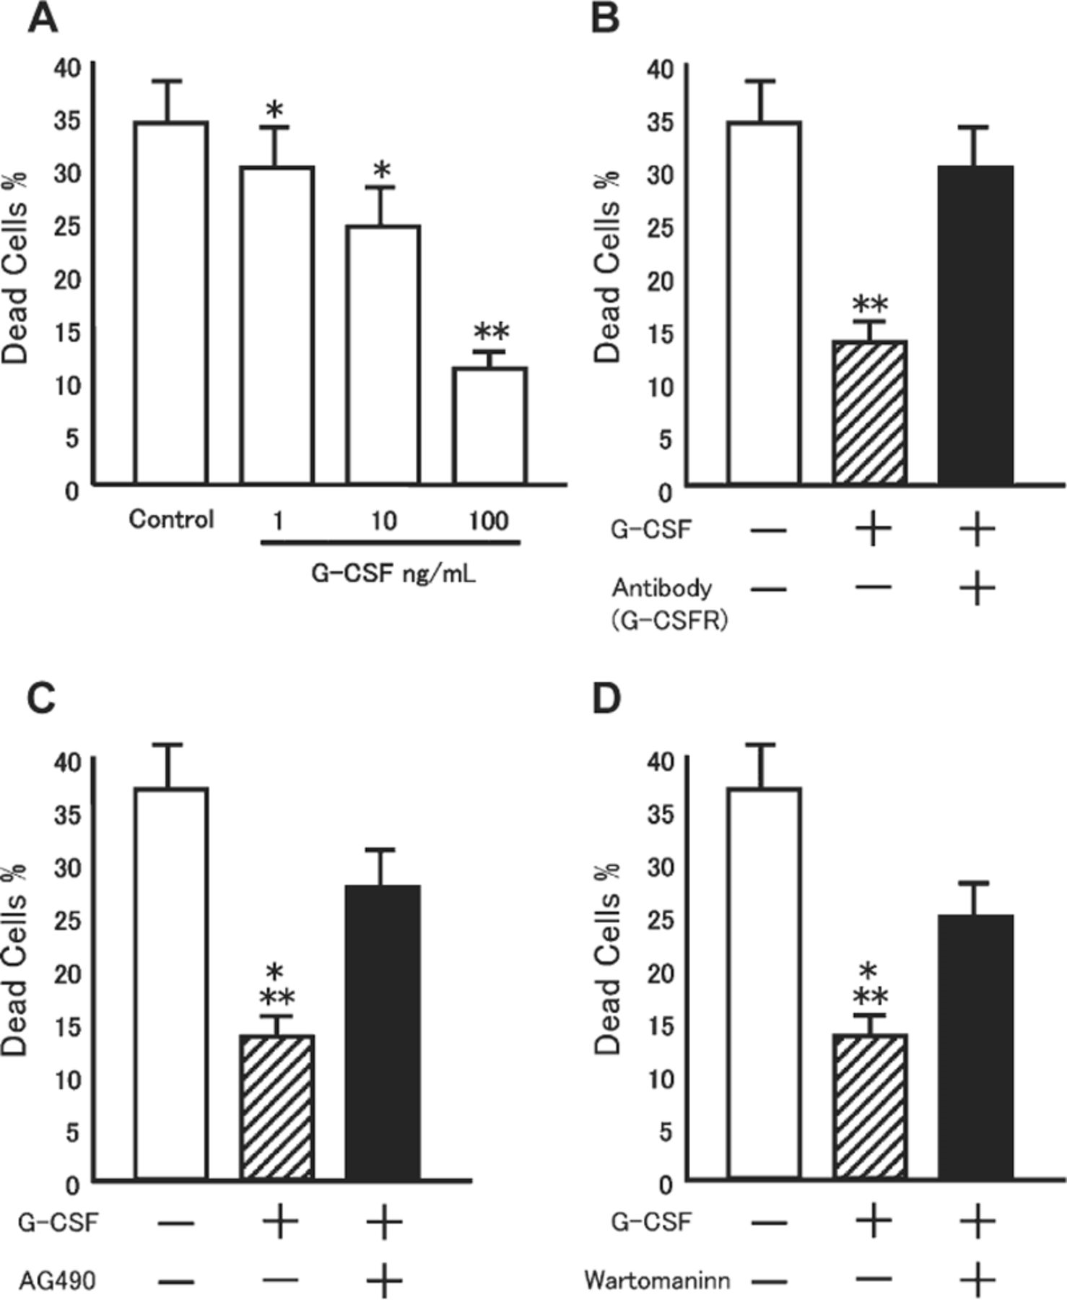
FIGURE 2. Granulocyte colony-stimulating factor (G-CSF) attenuates glutamate-induced neuronal death of cultured ...
Notes:
FIGURE 2. Granulocyte colony-stimulating factor (G-CSF) attenuates glutamate-induced neuronal death of cultured cerebellar granule neurons (CGNs). CGNs were exposed to glutamate (100 μM), and G-CSF was added to the culture medium. Viability of CGNs was evaluated with a Live/Dead Double Staining Kit. Granulocyte colony-stimulating factor attenuated glutamate-induced cell death of CGNs in a dose-dependent manner (A). At the G-CSF concentration of 100 ng/mL, the neuroprotective effect was most apparent. Pretreatment of CGNs with anti G-CSFR antibody abolished G-CSF-mediated neuroprotection against glutamate-induced neuronal death (B). Both the JAK2 inhibitor AG490 and the PI3K inhibitor wortmannin partially abolished G-CSF-mediated neuroprotection (C, D). Data are expressed as means ± SE. *, significant difference compared with control (p < 0.05); **, significant difference compared with control (p < 0.01).
Unless provided in the caption above, the following copyright applies to the content of this slide: Copyright © 2007 by the American Association of Neuropathologists, Inc.

Slide 3
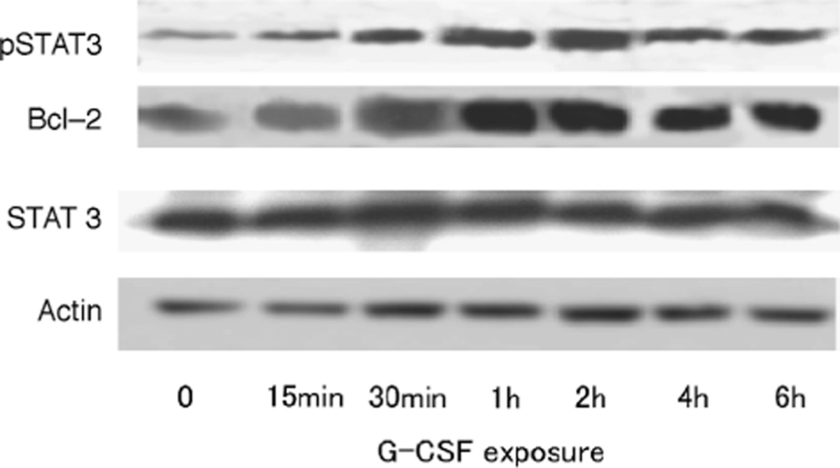
FIGURE 3. Western blot analysis for signaling molecules downstream of granulocyte colony-stimulating factor (G-CSF) ...
Notes:
FIGURE 3. Western blot analysis for signaling molecules downstream of granulocyte colony-stimulating factor (G-CSF) receptor in cultured cerebellar granule neurons (CGNs). Cultured CGNs were exposed to G-CSF (100 ng/mL) and expression of phosphorylated signal transducer and activator of transcription 3 (pSTAT3) and Bcl-2 was detected by Western blot. The level of pSTAT3 increased by 15 minutes after G-CSF exposure, peaked 1 or 2 hours after exposure and then decreased after 6 hours. The level of Bcl-2 increased by 30 minutes after G-CSF exposure and remained elevated for 6 hours. There was no change in the expression levels of total STAT3 and actin, showing equal protein sample loading.
Unless provided in the caption above, the following copyright applies to the content of this slide: Copyright © 2007 by the American Association of Neuropathologists, Inc.

Slide 4
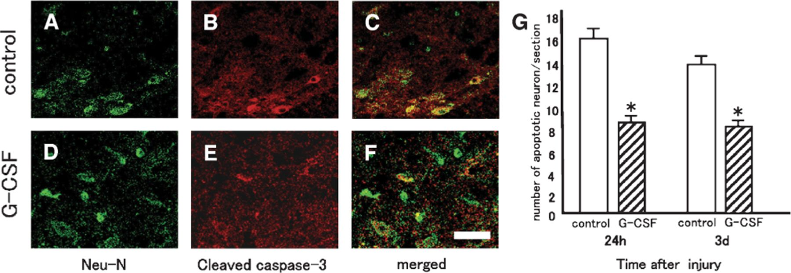
FIGURE 4. Immunohistochemical assessment of neuronal apoptosis in the acute phase after spinal cord injury. Double ...
Notes:
FIGURE 4. Immunohistochemical assessment of neuronal apoptosis in the acute phase after spinal cord injury. Double immunofluorescence staining for anti-neuronal nuclei mouse monoclonal antibody (Neu-N), a marker for neuron (green) ((A, D) and cleaved caspase-3 (red) (B, E) and the merged views (C, F). (A-C) are the control group, and (D-F)) are the G-CSF-treated group. The number of apoptotic neurons (cells double positive for Neu-N and cleaved caspase-3) in the G-CSF group (hatched columns) was significantly smaller than that in the control group (open columns) at 24 hours and 3 days after injury. Data are expressed as means ± SE. *, significant difference (p < 0.05). Scale bar = 50 μm.
Unless provided in the caption above, the following copyright applies to the content of this slide: Copyright © 2007 by the American Association of Neuropathologists, Inc.

Slide 5
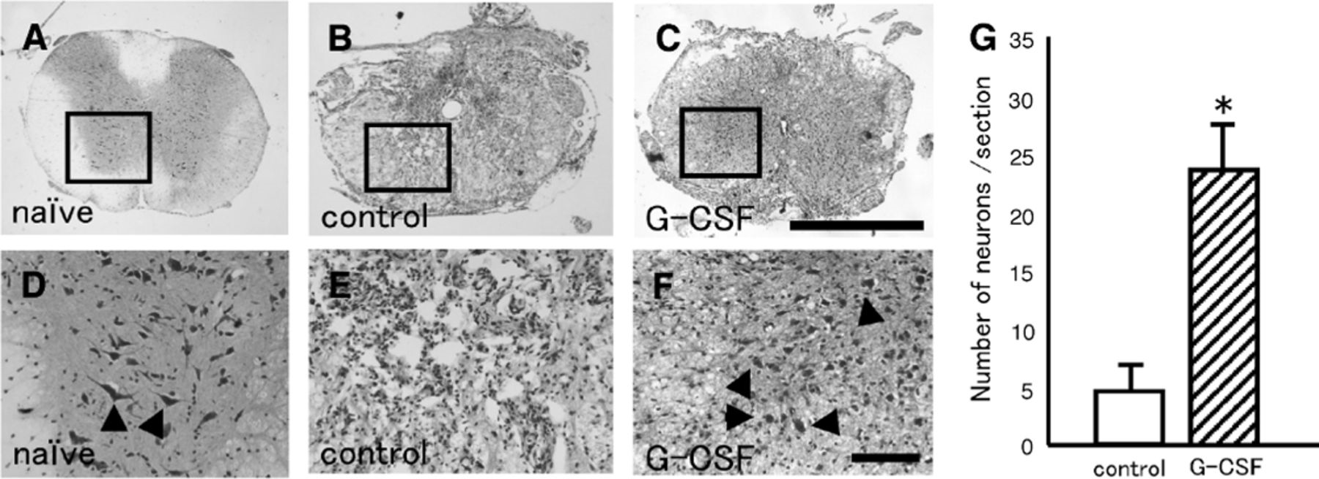
FIGURE 5. Histologic assessment with cresyl violet staining after spinal cord injury. Few neurons survived in the ...
Notes:
FIGURE 5. Histologic assessment with cresyl violet staining after spinal cord injury. Few neurons survived in the spinal cord of control mice 6 weeks after injury (B, E). In the granulocyte colony-stimulating factor (G-CSF)-treated mice, increased neuronal survival was observed in the spinal cord 6 weeks after injury (C, F, arrowheads). Neurons in the anterior horn of the naive mouse spinal cords (A, D, arrowheads). Scale bars = (A-C) 1,000 μm; (D-F) = 100 μm. The number of surviving neurons in the G-CSF group was significantly larger than that of the control group (G). The average number of the surviving neuron in the G-CSF group was 24.0/slice (hatched column), whereas neuronal survival in the control group was 4.6/slice (open column). Data are expressed as means ± SE. *, significant difference (p < 0.05).
Unless provided in the caption above, the following copyright applies to the content of this slide: Copyright © 2007 by the American Association of Neuropathologists, Inc.

Slide 6
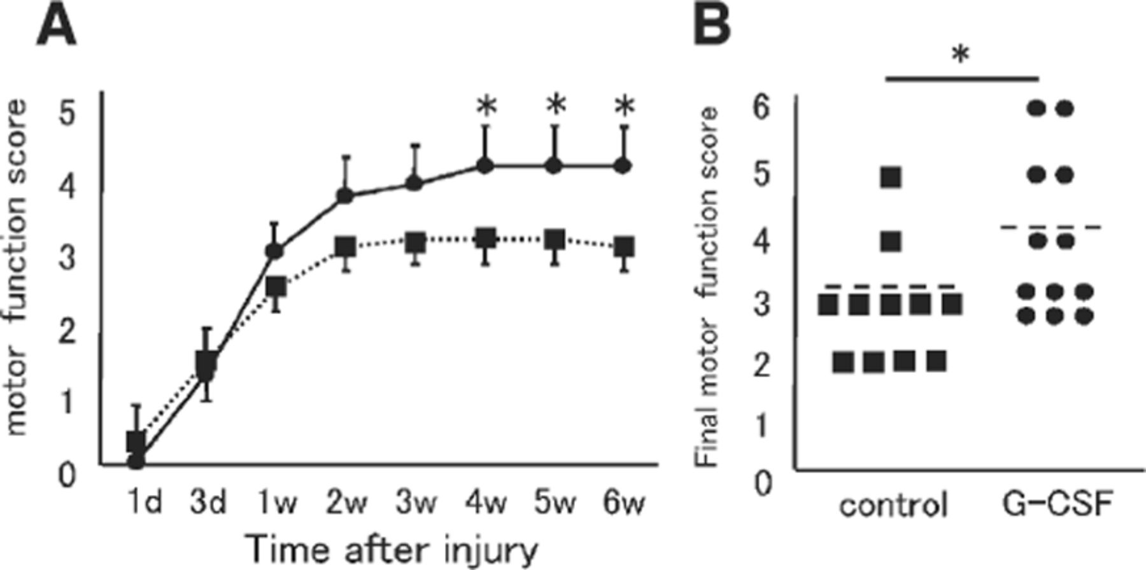
FIGURE 6. Hindlimb functional assessment using the motor functional scale (Farooque et al 10). Time course of hindlimb ...
Notes:
FIGURE 6. Hindlimb functional assessment using the motor functional scale (Farooque et al 10). Time course of hindlimb functional recovery (A), and comparison of final motor function score between the groups (B). A significant recovery of hindlimb function was observed in granulocyte colony-stimulating factor (G-CSF)-treated mice (circles) 4 weeks after injury compared with the control group (A, squares) (p < 0.05). The average recovery score in the G-CSF-treated mice 6 weeks after injury was 4.0 (3-6) (B, circles), whereas the average recovery score in the control group was 2.9 (2-5) (B, squares). Data are expressed as means ± SE. *, significant difference (p < 0.05).
Unless provided in the caption above, the following copyright applies to the content of this slide: Copyright © 2007 by the American Association of Neuropathologists, Inc.

