Slide 1
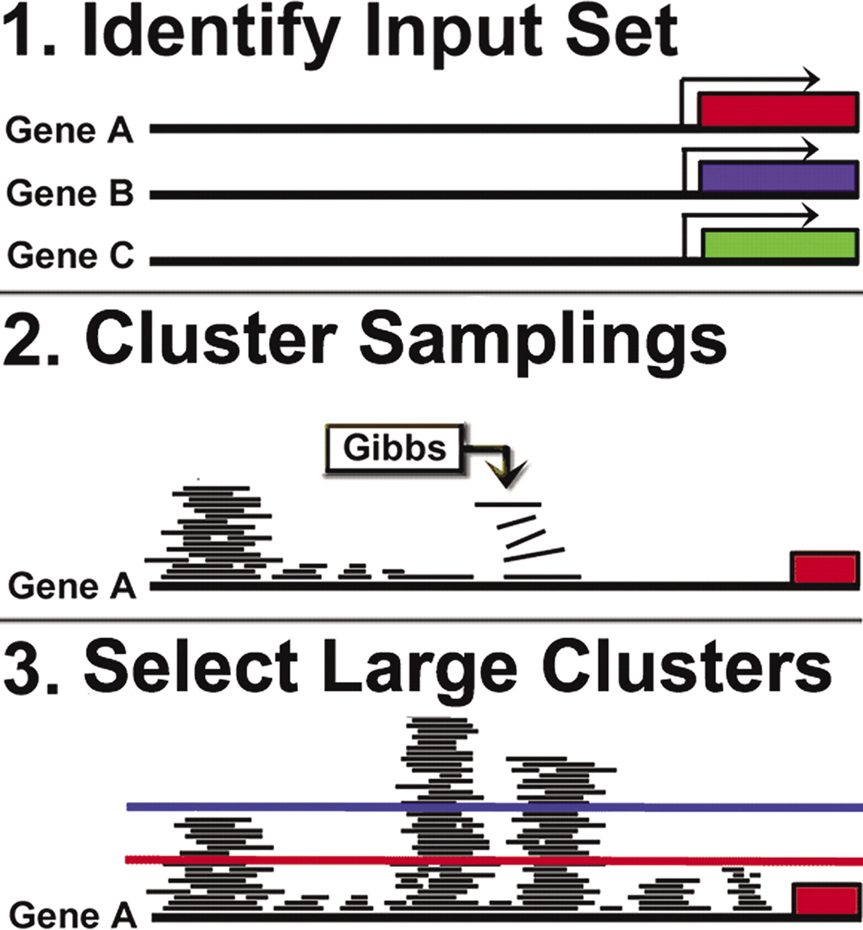
Figure 1 Schematic diagrams of the positional clustering process. (1) Sets of putatively co-regulated genes are ...
Notes:
Figure 1 Schematic diagrams of the positional clustering process. (1) Sets of putatively co-regulated genes are identified. (2) Gibbs sampling is iterated on the input set thousands of times across numerous motif widths. Results are clustered on promoter position, creating a per-nucleotide frequency of the long term recurrence of Gibbs sampling. (3) A linear threshold is used to isolate the most frequently recurring positions, discarding all positions which fall below the threshold.
Unless provided in the caption above, the following copyright applies to the content of this slide: © 2006 The Author(s).This is an Open Access article distributed under the terms of the Creative Commons Attribution Non-Commercial License (http://creativecommons.org/licenses/by-nc/2.0/uk/) which permits unrestricted non-commercial use, distribution, and reproduction in any medium, provided the original work is properly cited.

Slide 2
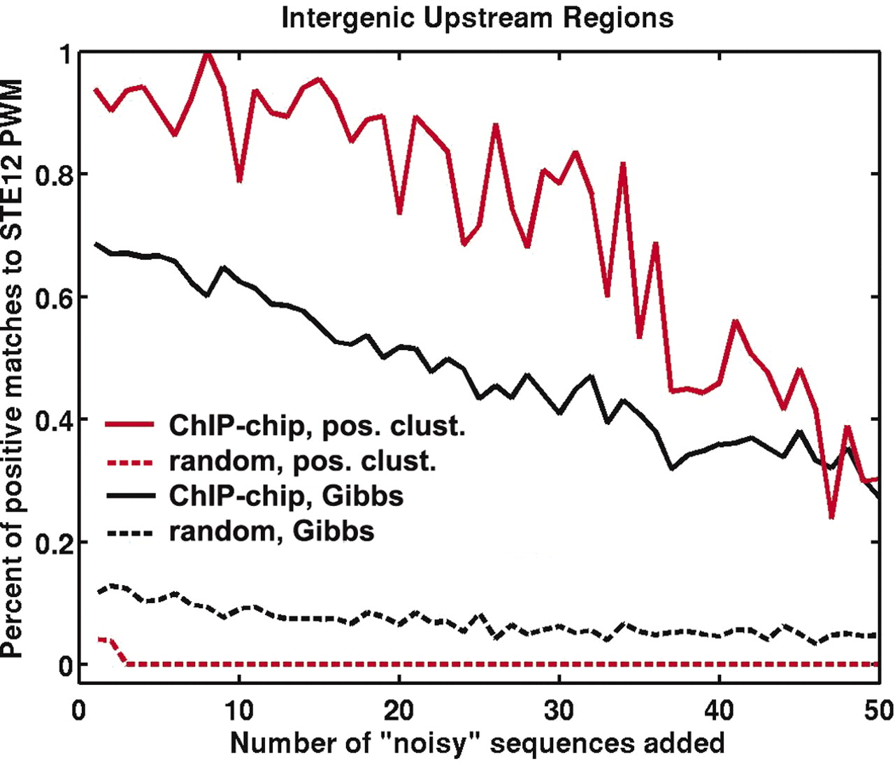
Figure 2 The robustness to decoy sequences (DSs) of Gibbs sampling with and without positional clustering. Fifty-one ...
Notes:
Figure 2 The robustness to decoy sequences (DSs) of Gibbs sampling with and without positional clustering. Fifty-one increasingly noisy STE12-binding site enriched datasets were analyzed using Gibbs sampling with positional clustering (red solid line) and without (black solid line). The dotted lines represent null controls, e.g. identification of STE12-like motifs by Gibbs sampling (black dotted line) and positional clustering (red dotted line) given random upstream regions. x -axis counts over the addition of DSs. Each set of DSs was chosen independently from all upstream regions in the S.cerevisiae genome. We evaluated the positive predictive value of each technique on each dataset, and found positional clustering significantly improved the PPV through addition of 45 DSs.
Unless provided in the caption above, the following copyright applies to the content of this slide: © 2006 The Author(s).This is an Open Access article distributed under the terms of the Creative Commons Attribution Non-Commercial License (http://creativecommons.org/licenses/by-nc/2.0/uk/) which permits unrestricted non-commercial use, distribution, and reproduction in any medium, provided the original work is properly cited.

Slide 3
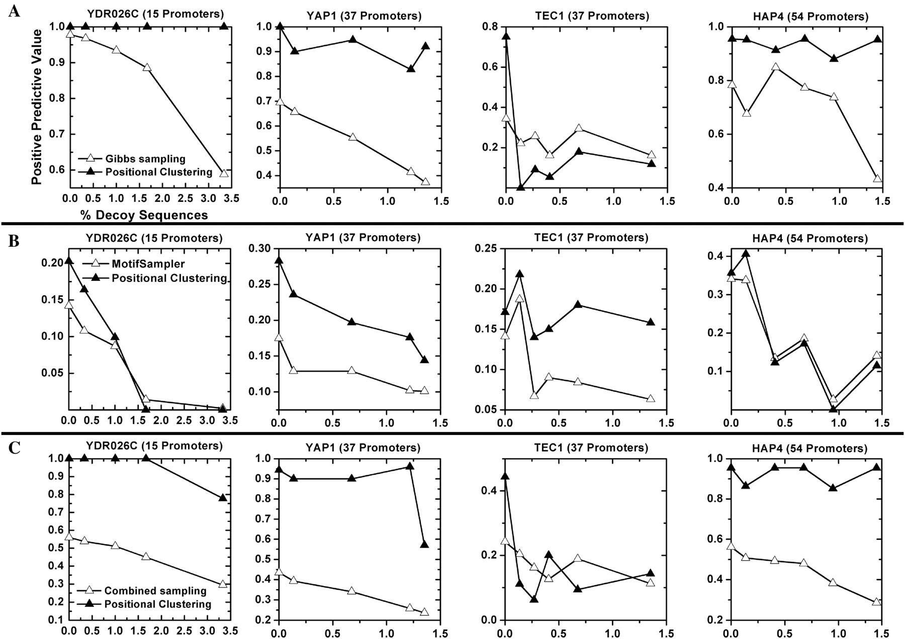
Figure 3 Improvement and robustness of positional clustering on promoters bound to other yeast TFs. Sets of ...
Notes:
Figure 3 Improvement and robustness of positional clustering on promoters bound to other yeast TFs. Sets of S.cerevisiae promoters bound by the TFs YAP1, TEC1, HAP4 and YDR026C were chosen according to ChIP-chip experiments ( 10 ). For each set, the initial promoters were analyzed using Gibbs sampling with positional clustering (solid triangles) and without (open triangles). Two Gibbs sampling approaches were applied to each dataset: a Gibbs sampler procedure similar to BioProspector ( 8 ) (row A), and MotifSampler ( 39 ) (row B). Row C shows the combination of both sampling procedures, along with positional clustering of the combined results. x -axis counts over addition of DSs. We evaluated the positive predictive value of each technique on each dataset, and found positional clustering generally improved the PPV through addition of 100% random DSs.
Unless provided in the caption above, the following copyright applies to the content of this slide: © 2006 The Author(s).This is an Open Access article distributed under the terms of the Creative Commons Attribution Non-Commercial License (http://creativecommons.org/licenses/by-nc/2.0/uk/) which permits unrestricted non-commercial use, distribution, and reproduction in any medium, provided the original work is properly cited.

Slide 4
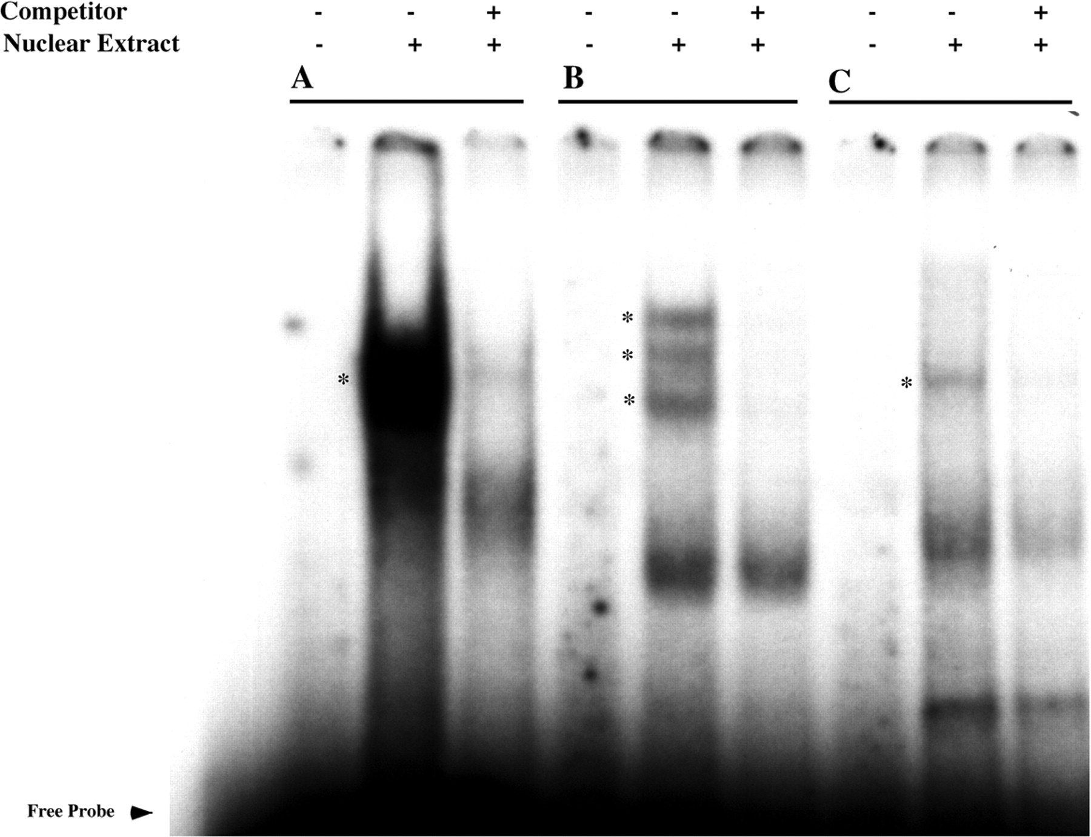
Figure 4 Three putative transcription factor binding sites form DNA–protein complexes in neocortical nuclear ...
Notes:
Figure 4 Three putative transcription factor binding sites form DNA–protein complexes in neocortical nuclear extracts. Neocortical nuclear extracts from E18 rat embryos were incubated with three 32 P-radiolabeled probes from human GABRB1, GABRD and GABRB3. Cold wild-type oligonucleotides were used to define specificity through competition. Cold oligonucleotides were added at 100-fold excess over probe. The conditions for each lane are as indicated. Specific binding complexes are shown using asterisks (*). The probe sequences are as follows: ( A ) GABRB1: AATACGGTCCCTACT, ( B ) GABRD: ACTTAATTTGATTCCAT and ( C ) GABRB3: CGTGCCGGGGCGCGGCGGA.
Unless provided in the caption above, the following copyright applies to the content of this slide: © 2006 The Author(s).This is an Open Access article distributed under the terms of the Creative Commons Attribution Non-Commercial License (http://creativecommons.org/licenses/by-nc/2.0/uk/) which permits unrestricted non-commercial use, distribution, and reproduction in any medium, provided the original work is properly cited.

Slide 5
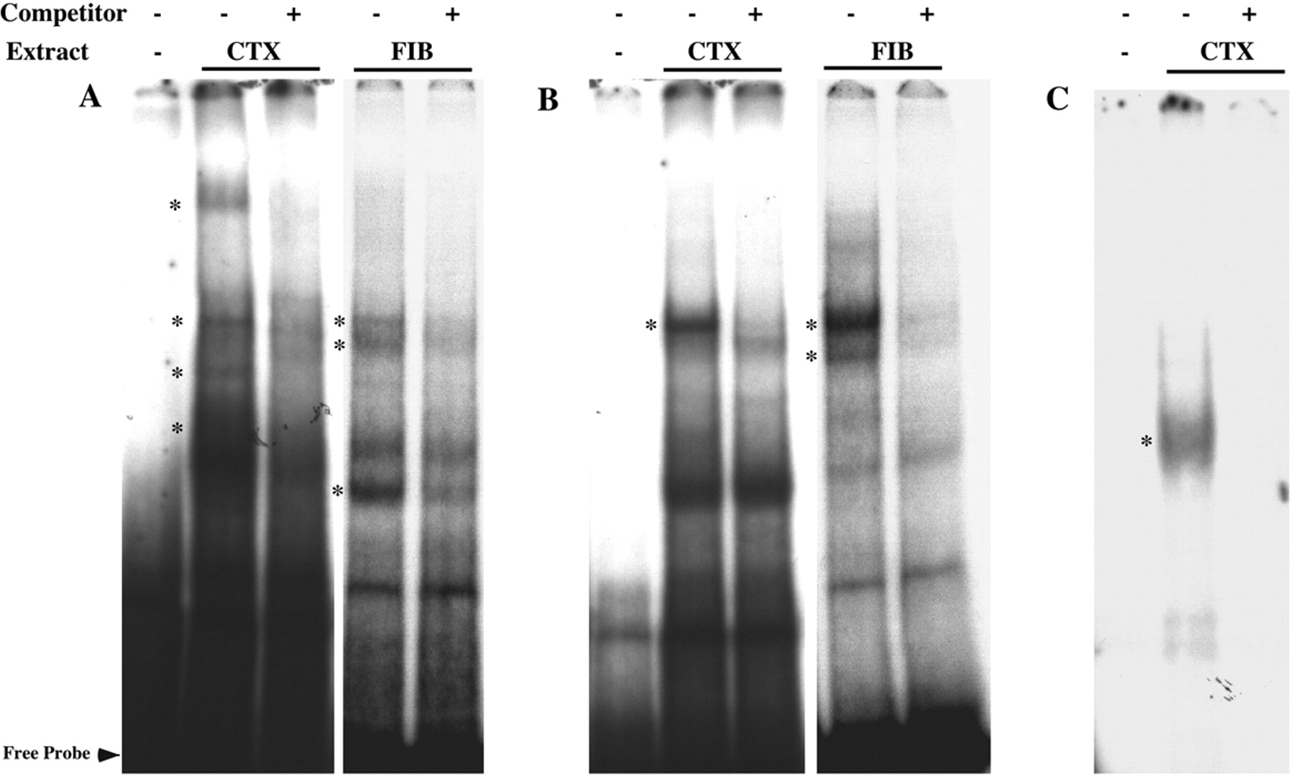
Figure 5 EMSA of three putative TF binding sites form DNA–protein complexes in neocortical and fibroblast nuclear ...
Notes:
Figure 5 EMSA of three putative TF binding sites form DNA–protein complexes in neocortical and fibroblast nuclear extracts. Neocortical (NEO) and fibroblast (FIB) nuclear extracts from E18 rat embryos were incubated with three 32 P-radiolabeled probes from human A4 and D receptor subunits. Cold wild-type oligonucleotides were used to define specificity through competition. Cold oligonucleotides were added at 100-fold excess over probe. The conditions for each lane are as indicated. Specific binding complexes are shown using asterisks (*). The probe sequences are as follows: ( A ) GABA-A4: AGCGCGGGCGAGTGTGAG CGCGAGTGTGCGCACGCCGCGGG, ( B ) GABA-A4: GTGCACACACACGCCCACC GCGGCTCGGG and ( C ) GABA-D: TGACCGTAGTAGA.
Unless provided in the caption above, the following copyright applies to the content of this slide: © 2006 The Author(s).This is an Open Access article distributed under the terms of the Creative Commons Attribution Non-Commercial License (http://creativecommons.org/licenses/by-nc/2.0/uk/) which permits unrestricted non-commercial use, distribution, and reproduction in any medium, provided the original work is properly cited.

Slide 6
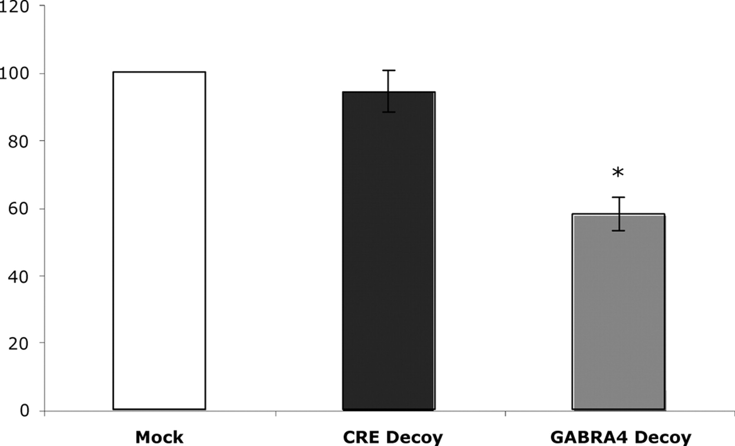
Figure 6 Double-stranded oligonucleotide functional assay for GABRA4 regulation. Primary cultures of rat neocortical ...
Notes:
Figure 6 Double-stranded oligonucleotide functional assay for GABRA4 regulation. Primary cultures of rat neocortical neurons were treated with DOTAP ( N -[1-(2,3-dioleoyloxy)propyl]- N , N , N -trimethylammonium methylsulfate) alone (Mock) or with DOTAP and phosphothioate oligonucleotides from either a cAMP response element (CRE Decoy) or a sequence from the GABA-A4 promoter predicted using positional clustering (GABA-A4 Decoy) (GTGCACACACACGCCCACCGCGGCTCGGG). mRNA was harvested after 24 h, and real-time RT–PCR was performed with GABA-A4 specific primers. Error bars refer to individual experiments; i.e. different platings of cells from different animals. Data was normalized to rRNA levels, and expressed as relative mRNA levels (GABA-A4/rRNA). Results are shown as mean ± SEM, N = 3, asterisk indicates significantly different from control at the 95% confidence interval.
Unless provided in the caption above, the following copyright applies to the content of this slide: © 2006 The Author(s).This is an Open Access article distributed under the terms of the Creative Commons Attribution Non-Commercial License (http://creativecommons.org/licenses/by-nc/2.0/uk/) which permits unrestricted non-commercial use, distribution, and reproduction in any medium, provided the original work is properly cited.

