Slide 1
Figure 1. Binding affinity measurements by EMSA of p53 consensus REs as a function of the central CWWG motif. ( A ) ...
Notes:
Figure 1. Binding affinity measurements by EMSA of p53 consensus REs as a function of the central CWWG motif. ( A ) Con1, with a central CATG motif. ( B ) Con2, with CTAG. ( C ) Con3, with CAAG. DNA targets were imbedded in hairpin constructs (concentration <0.1 nM). Upper bands show protein bound DNA and lower bands show unbound DNA. The number below each gel is the concentration of p53DBD monomers active for DNA binding. The gels are representative examples of four to eight independent experiments conducted with each sequence.
Unless provided in the caption above, the following copyright applies to the content of this slide: © The Author(s) 2010. Published by Oxford University Press.This is an Open Access article distributed under the terms of the Creative Commons Attribution Non-Commercial License (http://creativecommons.org/licenses/by-nc/2.5), which permits unrestricted non-commercial use, distribution, and reproduction in any medium, provided the original work is properly cited.

Slide 2
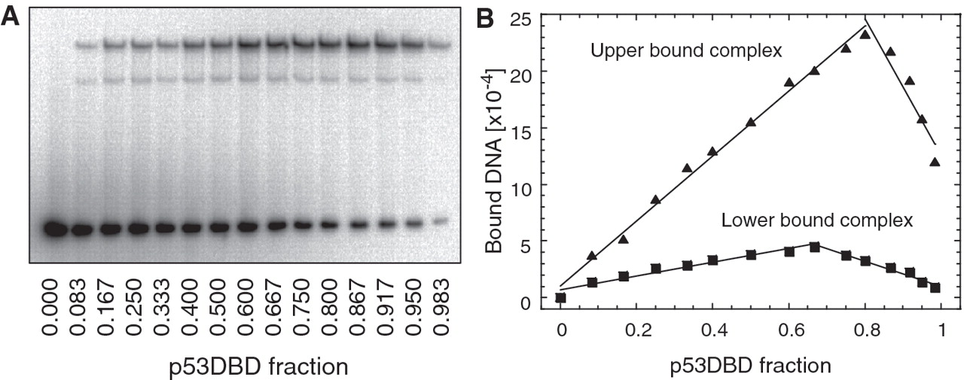
Figure 2. Continuous variation analysis of p53DBD binding to Con1. ( A ) A representative EMSA gel of p53DBD binding ...
Notes:
Figure 2. Continuous variation analysis of p53DBD binding to Con1. ( A ) A representative EMSA gel of p53DBD binding to Con1 (of three independent experiments). Total macromolecular concentration was fixed at 600 nM. The mole fraction of protein, shown below the gel, increased across the gel. ( B ) Analysis by a Job plot of the data from (A). The lines are the least-square fits to the rising and falling subsets of the data. Their intersection yields a binding stoichiometry of 1:3.94 (0.06) for the upper bound complex and 1:1.94 (0.08) for the lower bound complex.
Unless provided in the caption above, the following copyright applies to the content of this slide: © The Author(s) 2010. Published by Oxford University Press.This is an Open Access article distributed under the terms of the Creative Commons Attribution Non-Commercial License (http://creativecommons.org/licenses/by-nc/2.5), which permits unrestricted non-commercial use, distribution, and reproduction in any medium, provided the original work is properly cited.

Slide 3
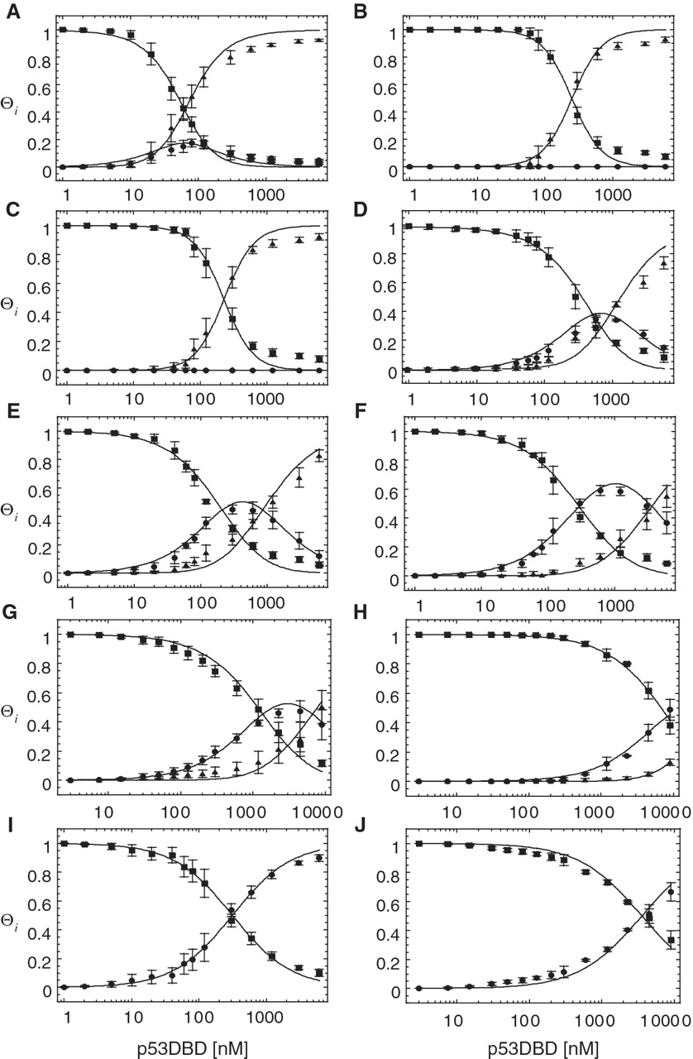
Figure 3. Determination of the relative affinities of p53DBD for binding to the DNA targets studied here. ( A ) Con1. ...
Notes:
Figure 3. Determination of the relative affinities of p53DBD for binding to the DNA targets studied here. ( A ) Con1. ( B ) Con2. ( C ) Con3. ( D ) Nicked Con3. ( E ) Con1 and 2 bp. ( F ) Con1 and 4 bp. ( G ) Con2 and 2 bp. ( H ) Con2 and 4 bp. ( I ) Con1HS. ( J ) Con2HS. The fraction of DNA molecules with i p53DBD molecules bound as a function of the concentration of p53DBD monomers is shown here. DNA concentration is <0.1 nM. Binding was analyzed by a two-site model for all targets except con1HS and con2HS were a one site model was used (solid lines). Squares, unliganded DNA; circles, DNA with one bound dimer; triangles, DNA with two bound dimers (tetramers). The error bars are the SD from four to eight independent experiments conducted with each sequence.
Unless provided in the caption above, the following copyright applies to the content of this slide: © The Author(s) 2010. Published by Oxford University Press.This is an Open Access article distributed under the terms of the Creative Commons Attribution Non-Commercial License (http://creativecommons.org/licenses/by-nc/2.5), which permits unrestricted non-commercial use, distribution, and reproduction in any medium, provided the original work is properly cited.

Slide 4
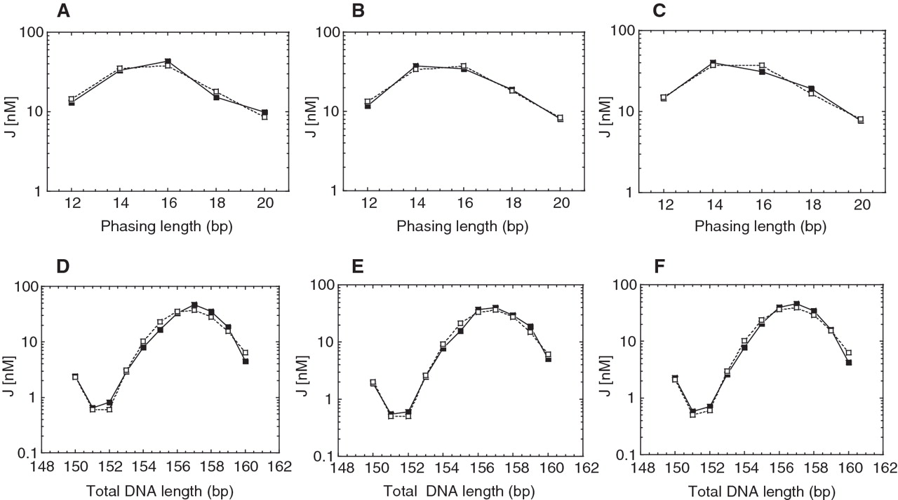
Figure 4. Cyclization kinetics of p53 REs as a function of the central CWWG motif. The J -factors for the DNA ...
Notes:
Figure 4. Cyclization kinetics of p53 REs as a function of the central CWWG motif. The J -factors for the DNA constructs as a function of either the phasing length ( A–C ), or the total DNA length ( D–F ), for Con1 (A and D), Con2 (B and E) and Con3 (C and F) are shown here. In each case, the test sequence was three repeats of the decameric half site. The solid lines are the experimental curves and the dashed lines are the curves from simulating the data.
Unless provided in the caption above, the following copyright applies to the content of this slide: © The Author(s) 2010. Published by Oxford University Press.This is an Open Access article distributed under the terms of the Creative Commons Attribution Non-Commercial License (http://creativecommons.org/licenses/by-nc/2.5), which permits unrestricted non-commercial use, distribution, and reproduction in any medium, provided the original work is properly cited.

Slide 5
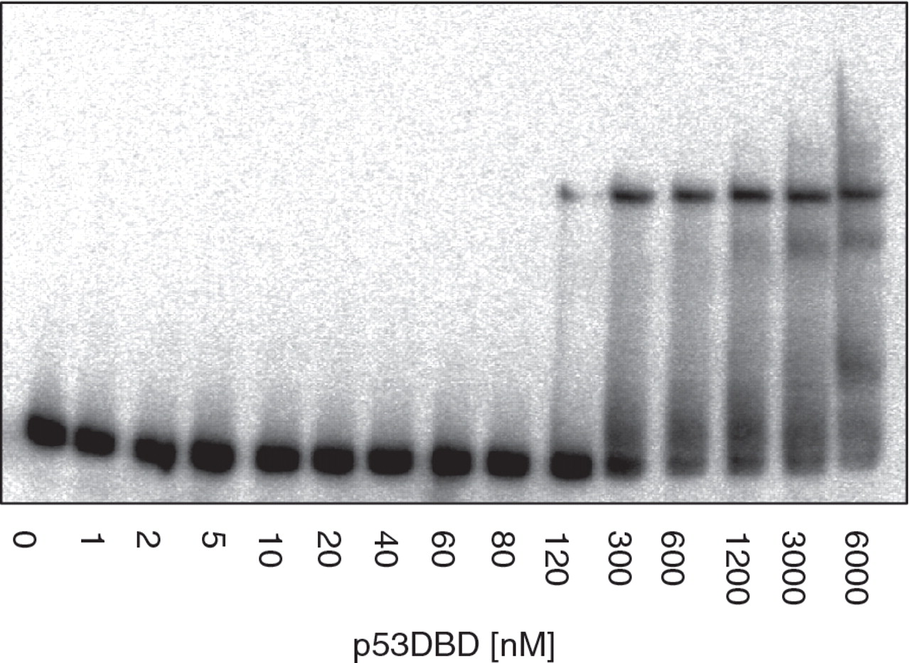
Figure 5. Binding affinity measurements by EMSA of p53DBD binding to the Con3 target with a nick in the center of the ...
Notes:
Figure 5. Binding affinity measurements by EMSA of p53DBD binding to the Con3 target with a nick in the center of the 5′-half-site (as shown in Table 1 ). This DNA target was synthesized as an intramolecular dumbbell construct with two hairpin loops. For other details, see Figure 1 .
Unless provided in the caption above, the following copyright applies to the content of this slide: © The Author(s) 2010. Published by Oxford University Press.This is an Open Access article distributed under the terms of the Creative Commons Attribution Non-Commercial License (http://creativecommons.org/licenses/by-nc/2.5), which permits unrestricted non-commercial use, distribution, and reproduction in any medium, provided the original work is properly cited.

Slide 6
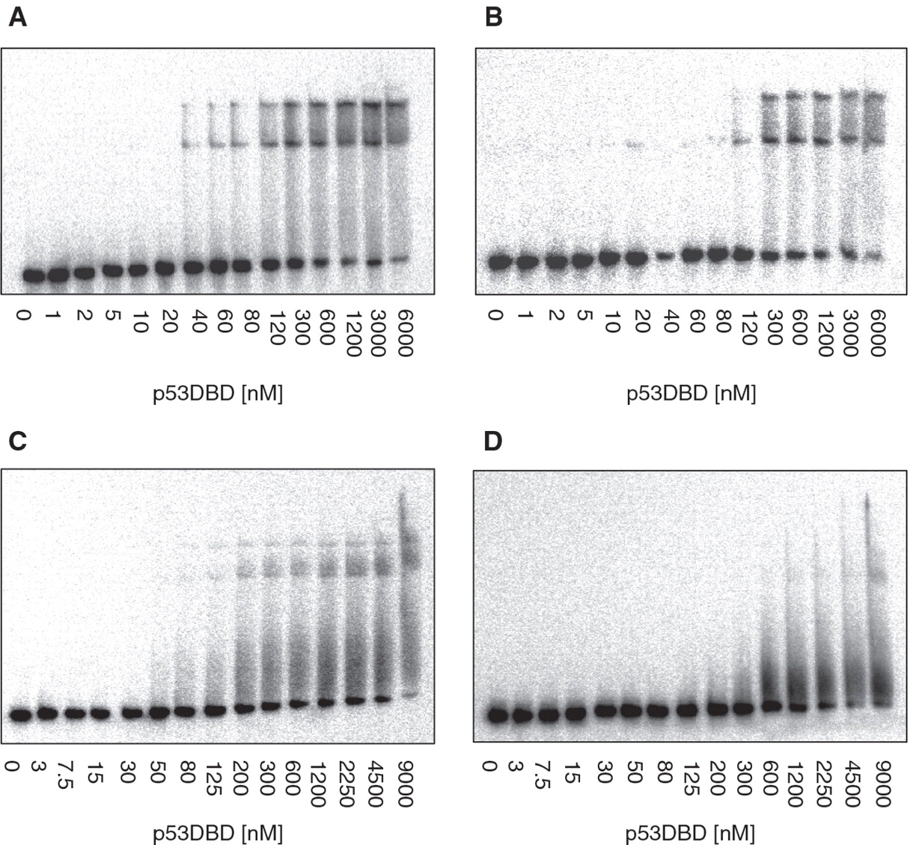
Figure 6. Binding affinity measurements by EMSA of p53DBD binding to REs with spacers between half-sites. ( A ) Con1 ...
Notes:
Figure 6. Binding affinity measurements by EMSA of p53DBD binding to REs with spacers between half-sites. ( A ) Con1 with 2-bp spacer. ( B ) Con1 with 4-bp spacer. ( C ) Con2 with 2-bp spacer. ( D ) con2 with 4-bp spacer. For details, see Figure 1 .
Unless provided in the caption above, the following copyright applies to the content of this slide: © The Author(s) 2010. Published by Oxford University Press.This is an Open Access article distributed under the terms of the Creative Commons Attribution Non-Commercial License (http://creativecommons.org/licenses/by-nc/2.5), which permits unrestricted non-commercial use, distribution, and reproduction in any medium, provided the original work is properly cited.

Slide 7
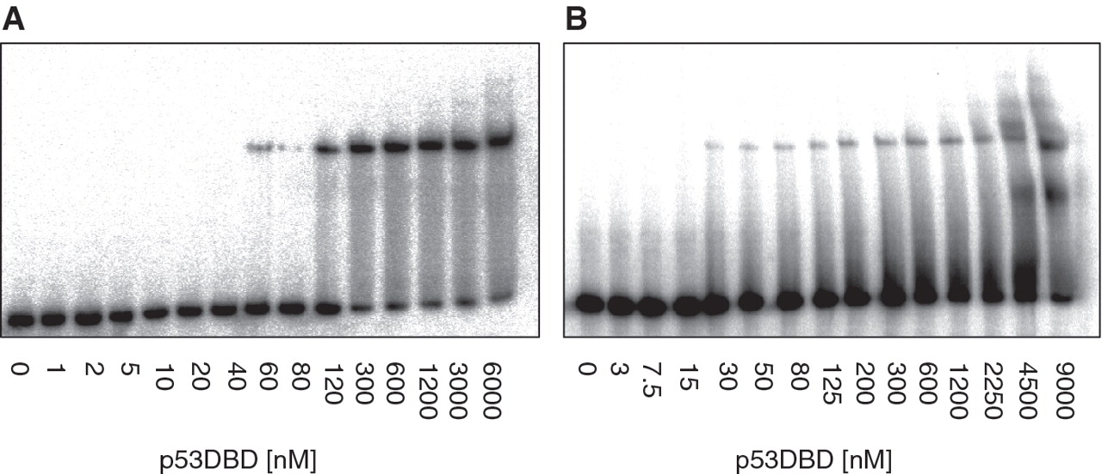
Figure 7. Binding affinity measurements by EMSA of p53DBD binding to half-site REs. ( A ) Con1HS. ( B ) Con2HS. For ...
Notes:
Figure 7. Binding affinity measurements by EMSA of p53DBD binding to half-site REs. ( A ) Con1HS. ( B ) Con2HS. For details, see Figure 1 . The band below the bound band in (B) (which is a complex of p53DBD dimer to con2HS) may be a p53DBD monomer bound to con2HS.
Unless provided in the caption above, the following copyright applies to the content of this slide: © The Author(s) 2010. Published by Oxford University Press.This is an Open Access article distributed under the terms of the Creative Commons Attribution Non-Commercial License (http://creativecommons.org/licenses/by-nc/2.5), which permits unrestricted non-commercial use, distribution, and reproduction in any medium, provided the original work is properly cited.

