Slide 1
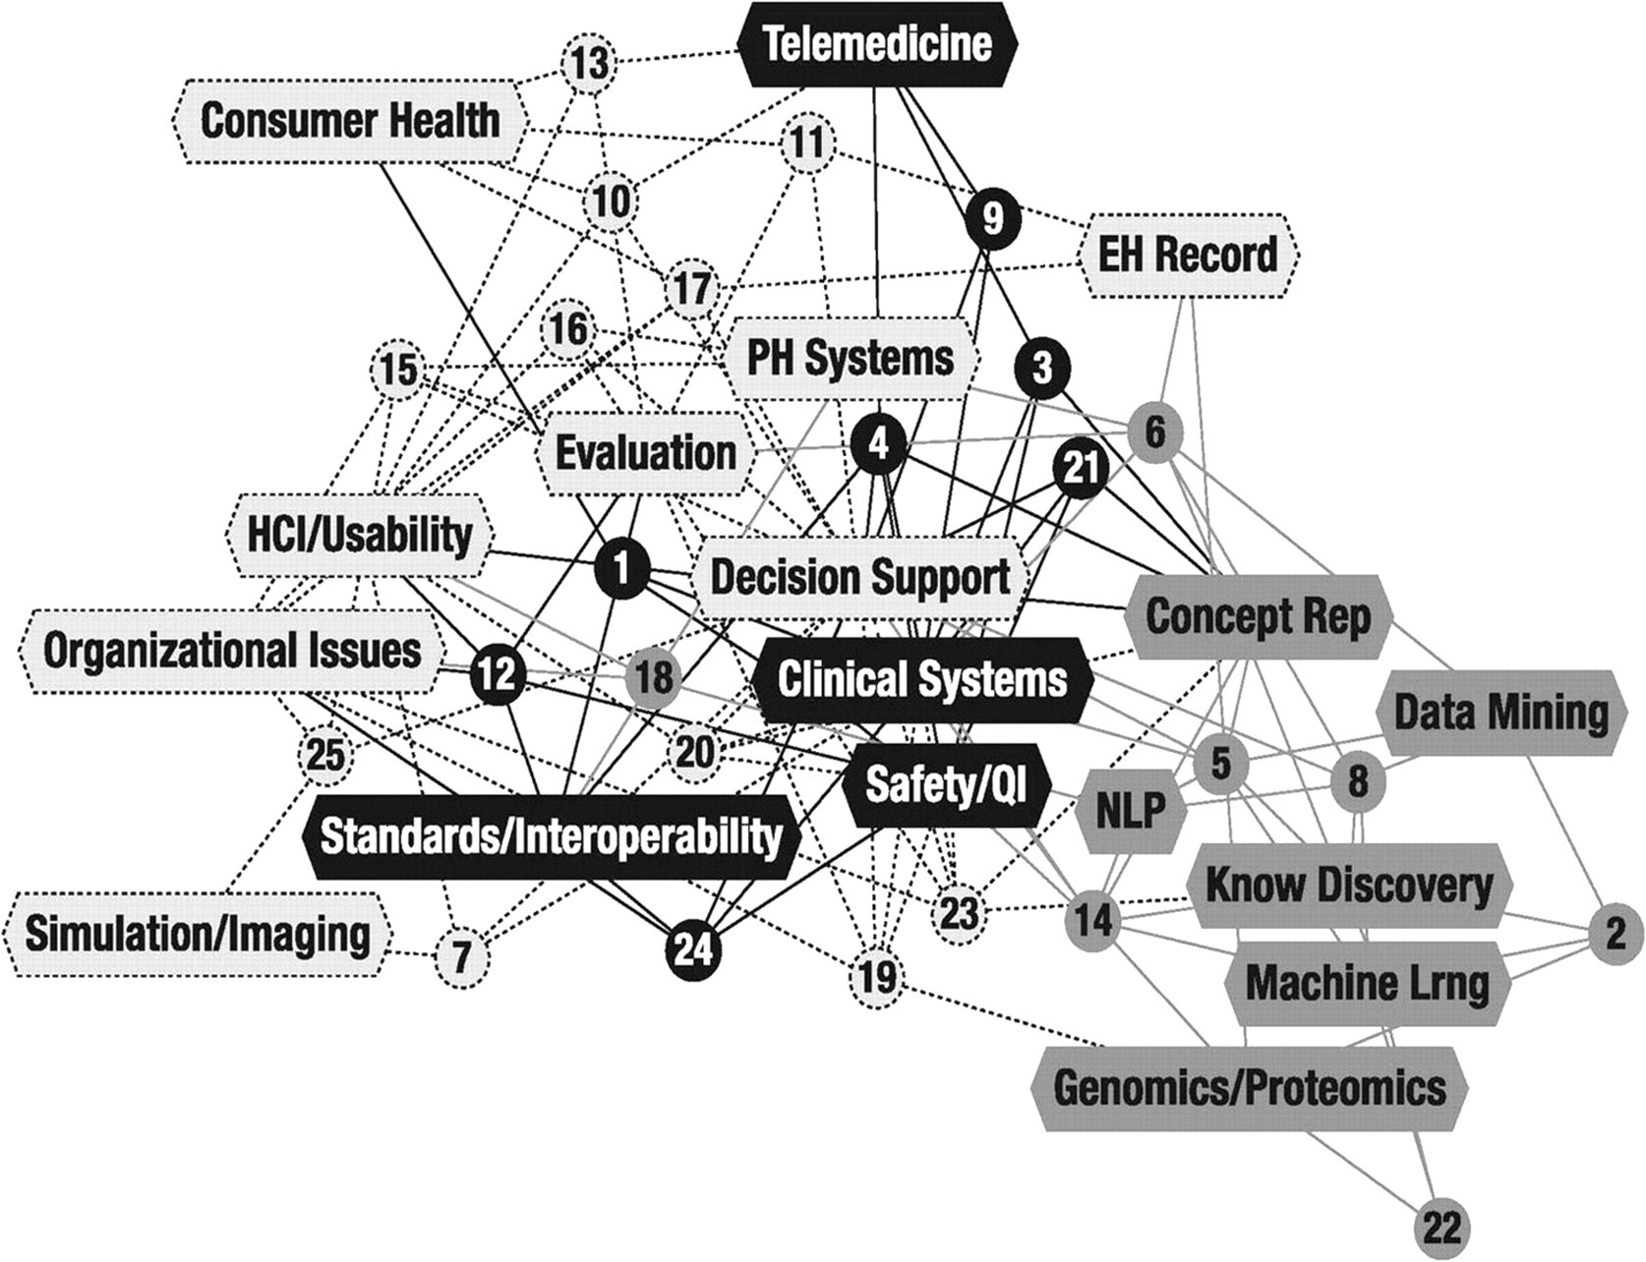
Figure 1 Network Diagram of Faculty Communities of Practice In the network graph each numbered circle is a node ...
Notes:
Figure 1 Network Diagram of Faculty Communities of Practice In the network graph each numbered circle is a node representing an individual faculty member; each polygon is a node representing a method or area of expertise. The lines linking circles and oblongs indicate that a faculty member associated him or herself with a particular method or area of expertise when summarizing their research interests for a faculty retreat. The node colors correspond to how faculty and methods or areas of expertise were grouped within one of three communities identified by the Newman modularity algorithm: Light Grey A community around methods and expertise related to human and organizational factors Dark Grey A community around methods and expertise related to empirical discovery and prediction Black A community around methods and expertise related to information management Details on the methods and areas of expertise associated with each community of practice is found in Table 1.
Unless provided in the caption above, the following copyright applies to the content of this slide: American Medical Informatics Association

