Slide 1
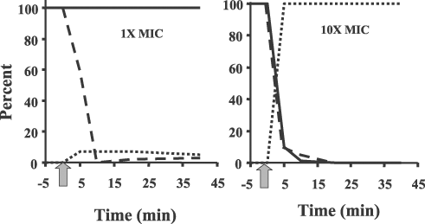
1 Concentration-dependent influence of a cationic peptide (a pleurocidin–dermaseptin hybrid termed P-Der) on E. ...
Notes:
1 Concentration-dependent influence of a cationic peptide (a pleurocidin–dermaseptin hybrid termed P-Der) on E. coli. After addition of the peptide at time zero (denoted by the arrow), at concentrations equal to (left panel) and 10-fold (right panel) the MIC, residual cell viability (bold lines, assessed by colony counting), rate of RNA synthesis (dashed line, assessed by measuring the incorporation of radiolabelled uracil into RNA) and membrane potential (dotted lines, assessed using the membrane potential sensitive fluorophore diSC35) were measured. Results are taken from experiments performed by Aleks Patrzykat and Carol Friedrich and have been submitted for publication.
Unless provided in the caption above, the following copyright applies to the content of this slide: © 2002 Federation of European Microbiological Societies

Slide 2
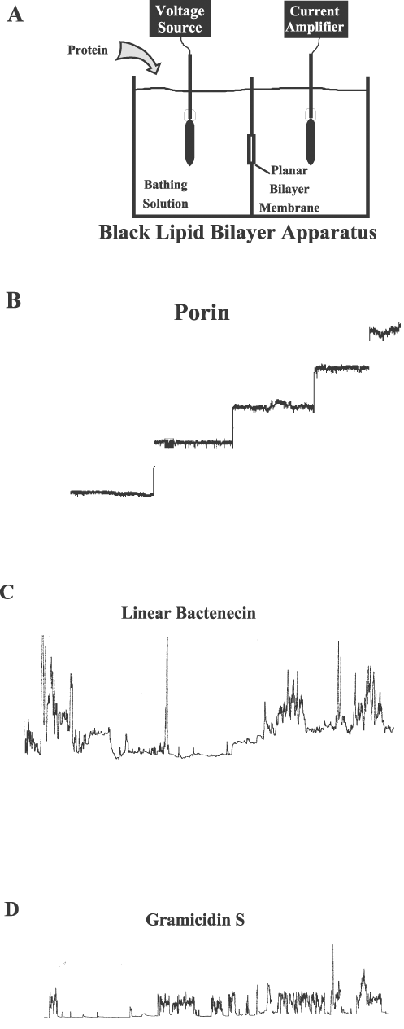
2 Planar lipid bilayers as a tool for assessing channel forming ability by cationic antimicrobial peptides. A: ...
Notes:
2 Planar lipid bilayers as a tool for assessing channel forming ability by cationic antimicrobial peptides. A: Description of the apparatus. Lipid bilayer membranes are painted across a 2 mm2 circular hole in a Teflon divider separating two compartments containing a bathing solution of 1 M KCl. Proteins or peptides are added to either compartment. Voltages are then applied across this membrane through Calomel electrodes connected by a salt bridge and the resultant current boosted 109–1010-fold by a current amplifier, monitored on a Tektronix model 7633 oscilloscope and recorded on a Rikadenki R-01 strip chart recorder. The resultant current increases are due to incorporation of the proteins or peptides into the membranes, providing conduits for ions since naked membranes are rather impermeable to ions. B: Results observed when a bacterial outer membrane porin is added to the bathing solution (applied voltage 50 mV). Large channels of rather consistent size and substantial stability are observed. C: Results observed when a typical cationic antimicrobial peptide is added to the system (applied voltage −180 mV). Increases in current are observed that vary substantially in magnitude and duration. D: Results observed with a few cationic antimicrobial peptides, e.g. gramicidin S (applied voltage −180 mV). Channels still vary substantially in lifetime but appear to have rather consistent sizes. These may be true channels of regular composition. Since this peptide is rather small (a cyclic 10-mer), these results fit the concept of a toroidal or aggregate channel rather than a barrel-stave channel [14,19,20]. The baseline in C and D is flat since in the absence of channels the membrane lets through a small but consistent current, and since the channels observed are transient.
Unless provided in the caption above, the following copyright applies to the content of this slide: © 2002 Federation of European Microbiological Societies

Slide 3
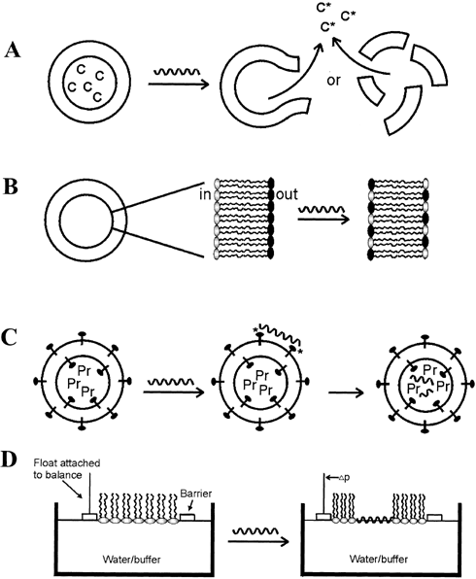
3 Model membrane methods for assessing peptide interaction with membranes. A: Calcein release. Unilamellar ...
Notes:
3 Model membrane methods for assessing peptide interaction with membranes. A: Calcein release. Unilamellar liposomes are reconstituted such that they contain calcein at high enough concentrations such that calcein fluorescence is self-quenched. Membrane leakage is assessed by dequenching (increase) of calcein fluorescence after release from the unilamellar liposomes. B: Lipid flip-flop. The spontaneous flip-flop rate of the fluorescent zwitterionic lipid probe, C6-NBD-PC, has been shown to be extremely small and no measurable transfer from one monolayer to the other occurred even after 48 h of incubation in asymmetrically labelled liposomes. Therefore peptide-induced lipid flip-flop can be measured using unilamellar liposomes that are asymmetrically labelled with 0.5 mole% C6-NBD-PC in the inner leaflet (asymmetric labelling is accomplished by the quenching of external NBD fluorescence with the water-soluble quencher sodium dithionite). Peptides are added to unilamellar liposomes, and the extent of peptide-mediated lipid flip-flop is indicated by the percentage of the NBD groups being transposed from the inner leaflet to the outer leaflet where they are quenched by dithionite. C: Translocation. The extent of peptide translocation across a bilayer may be estimated by monitoring the uptake and enzymatic digestion of peptides in unilamellar liposomes, containing the fluorescent lipid DNS-PE. The liposomes are prepared to incorporate the protease α-chymotrypsin with external enzyme being deactivated with a trypsin–chymotrypsin inhibitor added outside the liposomes. Resonance energy transfer from the tryptophan residue of the peptide to the dansyl group of DNS-PE results in an initial increase in fluorescence upon binding of the peptide to the liposomes. If the peptide becomes translocated it is digested by the α-chymotrypsin encapsulated in the liposomes, leading to desorption of the peptide fragments from the bilayer, leading to a loss of energy transfer to DNS-PE upon excitation of tryptophan residues in the peptide. The extent of translocation is thus measured by the consequent decrease in fluorescence intensity. D: Monolayer assays. Lipid monolayers are formed by applying the appropriate lipids dissolved in hexane or chloroform to water contained in a circular Teflon trough with a float on one side attached to a sensitive device for measuring pressure. Monolayers with the head groups in the water phase and the hydrophobic tails pointing towards the air are allowed to equilibrate until a stable surface pressure is obtained (<0.2 mN m−1 drift in surface pressure Δπ). A small port in the side of the trough enables injection of peptides into the aqueous subphase without disruption of the monolayer. The subphase is gently mixed with a magnetic stir bar. Molecules that interact only with the head groups of monolayer lipids typically induce minimal changes in surface pressure. In contrast, cationic amphiphilic peptides insert into the hydrophobic region of the lipid monolayer causing a significant increase in monolayer surface pressure. The degree of surface pressure change (Δπ) can be used to assess the extent of insertion and disturbance of the fatty acyl core of the membrane.
Unless provided in the caption above, the following copyright applies to the content of this slide: © 2002 Federation of European Microbiological Societies

