Slide 1
Figure 1. Zinc tolerance is dependent on YPK9 expression levels. Wild-type, ypk9Δ and wild-type cells over-expressing ...
Notes:
Figure 1. Zinc tolerance is dependent on YPK9 expression levels. Wild-type, ypk9Δ and wild-type cells over-expressing YPK9 (YPK9↑) were grown, serially diluted and spotted onto media with or without manganese or zinc. Differential sensitivity is determined by the growth difference in spot numbers between the wild-type cells and either the ypk9Δ cells or YPK9 over-expressing cells, not the total number of spots that grow.
Unless provided in the caption above, the following copyright applies to the content of this slide: © The Author 2014. Published by Oxford University Press. All rights reserved. For Permissions, please email: journals.permissions@oup.com

Slide 2
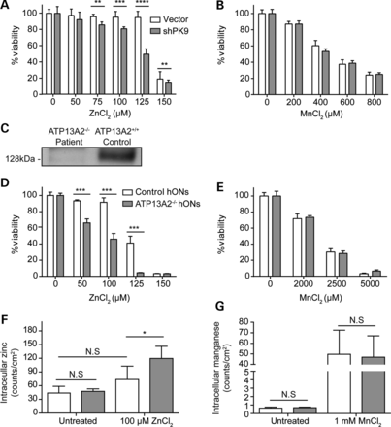
Figure 2. Reduced ATP13A2 expression confers zinc sensitivity in SHSY5Y cells and human patient cells. SHSY5Y cells ...
Notes:
Figure 2. Reduced ATP13A2 expression confers zinc sensitivity in SHSY5Y cells and human patient cells. SHSY5Y cells stably infected with either vector or PARK9 shRNA (shPK9) encoding lentivirus were differentiated and treated with zinc (A) or manganese (B) at concentrations indicated and viability assayed. Data are from six biological replicates (*P < 0.05, **P < 0.001). Statistical analysis was conducted by a Student's t-test. (C) Immunoblots of proteins extracted from ATP13A2−/− patient and control (ATP13A2+/+) hONs were probed with anti-ATP13A2 antibody. Control and ATP13A2−/− patient hONs were treated with zinc (D) or manganese (E) at concentrations indicated and cell viability assayed (***P < 0.0001). Statistical analysis was conducted by a Student's t-test. Control and ATP13A2−/− patient hONs were cultured with either 100 µm zinc (F), or 1 mm manganese (G), and intracellular zinc/manganese quantified by measuring elemental content in cellular ROI's from µ-XRF images (*P < 0.05). Statistical analysis was conducted by one-way ANOVA with Bonferroni post-hoc analysis. Data are represented as mean ± SD.
Unless provided in the caption above, the following copyright applies to the content of this slide: © The Author 2014. Published by Oxford University Press. All rights reserved. For Permissions, please email: journals.permissions@oup.com

Slide 3
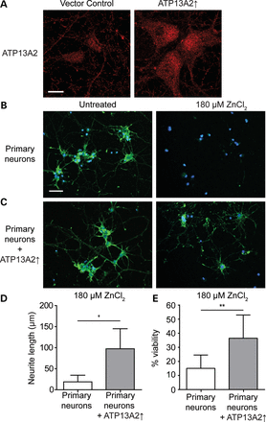
Figure 3. ATP13A2 over-expression confers zinc resistance in primary neurons. (A) Rat primary neurons infected with ...
Notes:
Figure 3. ATP13A2 over-expression confers zinc resistance in primary neurons. (A) Rat primary neurons infected with vector or ATP13A2 over-expressing lentivirus and stained with anti-ATP13A2 antibody. Scale bar = 10 µm. Control rat primary neurons have decreased viability with 180 µm zinc treatment (B), whereas rat neurons infected with ATP13A2 over-expressing lentivirus (C) are resistant to 180 µm zinc treatment. Rat primary neurons were cultured and exposed to zinc for 48 h before fixing and staining with phalloidin (green) and DAPI (blue). Scale bar = 25 µm. (D) Analysis of neurite length in rat primary neurons with and without over-expression of ATP3A2 after treatment of 180 µm zinc. Analysis conducted using Simple Neurite Tracer, Fiji (*P < 0.05). Statistical analysis was conducted by one-way ANOVA with Bonferroni post-hoc analysis. (E) Analysis of live neurons by nuclear counting of dead neurons (stained with ethidium homodimer) compared with total neurons (stained with DAPI) in rat primary neuron with and without ATP13A2 over-expression after treatment of 180 µm zinc (**P < 0.01). Statistical analysis was conducted by a Student's t-test. Data are represented as mean ± SD.
Unless provided in the caption above, the following copyright applies to the content of this slide: © The Author 2014. Published by Oxford University Press. All rights reserved. For Permissions, please email: journals.permissions@oup.com

Slide 4
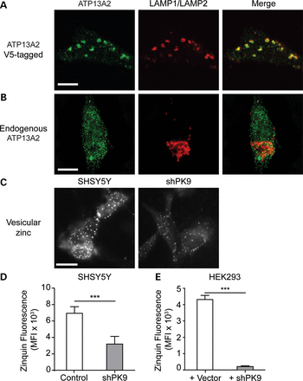
Figure 4. Endogenous ATP13A2 localizes to vesicular structures that contain zinc. (A) ATP13A2-V5-6xHis localized to ...
Notes:
Figure 4. Endogenous ATP13A2 localizes to vesicular structures that contain zinc. (A) ATP13A2-V5-6xHis localized to lysosomes as indicated by co-localization with lysosomal markers, LAMP1 and LAMP2. (B) Endogenous ATP13A2 displayed a vesicular, punctate signal with an absence of co-localization with LAMP1 and LAMP2. (C) Reduced expression of ATP13A2 in SHSY5Y cells decreases zinquin fluorescence. Zinquin FACS analysis on SHSY5Y vector control and SHSY5Y-shPK9 cells (D) and HEK293 cells were transfected with vector or the ATP13A2 knockdown plasmid (E). Cells were stained with zinquin, the zinquin fluorescence quantified by FACS analysis and gated for GFP (a marker for shPK9) (*** P < 0.0001). Statistical analysis conducted by a Student's t-test. Image B was captured on a Nikon N-SIM Super Resolution Microscope. Scale bar = 10 µm.
Unless provided in the caption above, the following copyright applies to the content of this slide: © The Author 2014. Published by Oxford University Press. All rights reserved. For Permissions, please email: journals.permissions@oup.com

Slide 5
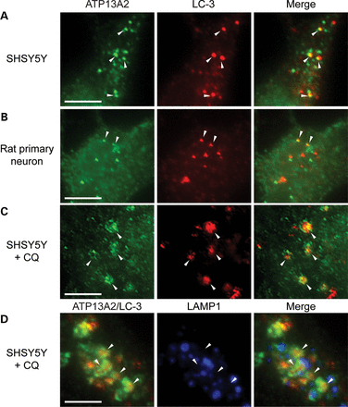
Figure 5. Endogenous ATP13A2 associates with autophagosomes not associated with lysosomes. Endogenous ATP13A2 is ...
Notes:
Figure 5. Endogenous ATP13A2 associates with autophagosomes not associated with lysosomes. Endogenous ATP13A2 is closely associated with endogenous LC3 puncta in differentiated SHSY5Y cells (A) and rat primary neurons (B) as indicated by arrowheads. (C) CQ treatment of SHSY5Y cells resulted in a redistribution of endogenous ATP13A2 into rings surrounding LC3-positive autophagosomes as indicated by arrowheads. (D) Triple-staining of CQ-treated SHSY5Y cells shows ATP13A2 rings (green) surrounding LC-3-postive autophagosomes (red) that have not fused with lysosomes, as indicative by the lack of overlap with LAMP1 (blue). Arrowheads indicate co-localization of ATP13A2 and LC-3 and an absence of LAMP1 staining. Scale bar = 5 µm.
Unless provided in the caption above, the following copyright applies to the content of this slide: © The Author 2014. Published by Oxford University Press. All rights reserved. For Permissions, please email: journals.permissions@oup.com

Slide 6
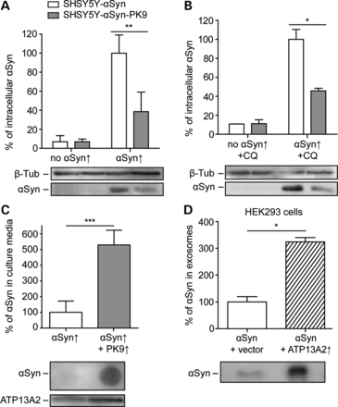
Figure 6. ATP13A2 over-expression reduces intracellular and increases extracellular α-Synuclein (αSyn) levels. Protein ...
Notes:
Figure 6. ATP13A2 over-expression reduces intracellular and increases extracellular α-Synuclein (αSyn) levels. Protein extracts from SHSY5Y-αSyn and SHSY5Y-αSyn-PK9 cells, un-induced (no αSyn↑) or induced for elevated human wild-type αSyn expression (αSyn↑) without (A) and with CQ treatment (B) were immunoblotted and probed with anti-α-Synuclein antibody. Data are representative of three replicates. Levels of α-Synuclein over-expression in SHSY5Y-αSyn cells were set to 100% for each replicate (*P < 0.05, **P < 0.001). Statistical analysis conducted by one-way ANOVA with Bonferroni post-hoc analysis. Cell-free culture media of SHSY5Y-αSyn and SHSY5Y-αSyn-PK9 cells (C), and purified exosomes from HEK293 cells (D) were immunobloted and probed with anti-α-Synuclein antibody. Data are representative of three replicates. Statistical analysis conducted by a Student's t-test. (*P < 0.05). Data are represented as mean ± SD.
Unless provided in the caption above, the following copyright applies to the content of this slide: © The Author 2014. Published by Oxford University Press. All rights reserved. For Permissions, please email: journals.permissions@oup.com

Slide 7
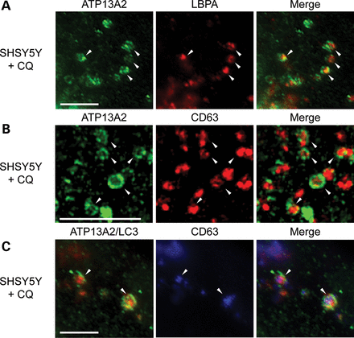
Figure 7. Endogenous ATP13A2 associates with MVBs fused with autophagosomes, which form amphisomes. In CQ-treated ...
Notes:
Figure 7. Endogenous ATP13A2 associates with MVBs fused with autophagosomes, which form amphisomes. In CQ-treated SHSY5Y cells, endogenous ATP13A2 ‘rings’ surround LBPA-positive MVBs (A) and CD63-positive MVBs (B) as indicated by arrowheads. ATP13A2 is also localized to CD63-positive MVBs fused with LC3-positive autophagosomes (C) as indicated by arrowheads. Image B was captured on a Nikon N-SIM Super Resolution Microscope. Scale bar = 5 µm.
Unless provided in the caption above, the following copyright applies to the content of this slide: © The Author 2014. Published by Oxford University Press. All rights reserved. For Permissions, please email: journals.permissions@oup.com

Slide 8
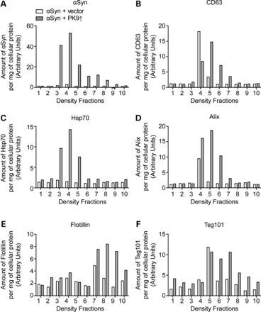
Figure 8. The effect of elevated ATP13A2 expression on exosomes containing human α-Synuclein (αSyn). Purified exosomes ...
Notes:
Figure 8. The effect of elevated ATP13A2 expression on exosomes containing human α-Synuclein (αSyn). Purified exosomes from HEK293 cells over-expressing αSyn, with vector control or ATP13A2 over-expression, were floated on a 0–50% OptiPrep density gradient (bottom loaded). Density gradient fractions (#1 lightest and # 10 heaviest) were then immunoprobed for (A) αSyn, (B) CD63, (C) Hsp70, (D) Alix, (E) Flotillin and (F) Tsg101. The immunoblot signal was quantified by densitometry analysis in ImageJ.
Unless provided in the caption above, the following copyright applies to the content of this slide: © The Author 2014. Published by Oxford University Press. All rights reserved. For Permissions, please email: journals.permissions@oup.com

Slide 9
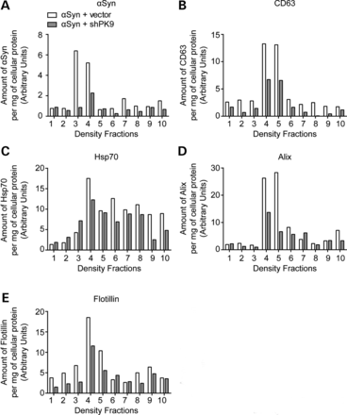
Figure 9. The effect of reduced ATP13A2 expression on exosomes containing human α-Synuclein (αSyn). Purified exosomes ...
Notes:
Figure 9. The effect of reduced ATP13A2 expression on exosomes containing human α-Synuclein (αSyn). Purified exosomes from HEK293 cells over-expressing αSyn, with vector control or ATP13A2 knockdown, were floated on a 0–50% OptiPrep density gradient (bottom loaded). Density gradient fractions (#1 lightest and # 10 heaviest) were then immunoprobed for (A) αSyn, (B) CD63, (C) Hsp70, (D) Alix and (E) Flotillin. The immunoblot signal was quantified by densitometry analysis in ImageJ.
Unless provided in the caption above, the following copyright applies to the content of this slide: © The Author 2014. Published by Oxford University Press. All rights reserved. For Permissions, please email: journals.permissions@oup.com

Slide 10
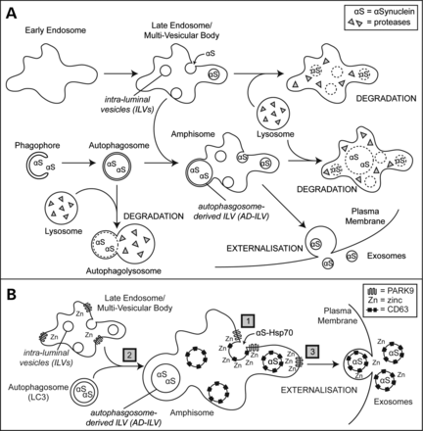
Figure 10. ATP13A2 functions in the endo-lysosomal pathway to reduce intracellular α-Synuclein levels by externalization ...
Notes:
Figure 10. ATP13A2 functions in the endo-lysosomal pathway to reduce intracellular α-Synuclein levels by externalization in exosomes. Intracellular α-Synuclein levels can be reduced by lysosomal degradation via endosomal transport or autophagy, or by externalization in exosomes. (B) – (1) ATP13A2 may pump zinc to create a micro-environment to stabilize lipid clustering during ILV invagination, (2) ATP13A2 may increase vesicular zinc levels to aid in efficient autophagosome to MVB fusion or (3) ATP13A2 may pump zinc to create a micro-environment to sort ILVs to the plasma membrane resulting for release as exosomes.
Unless provided in the caption above, the following copyright applies to the content of this slide: © The Author 2014. Published by Oxford University Press. All rights reserved. For Permissions, please email: journals.permissions@oup.com

