Slide 1
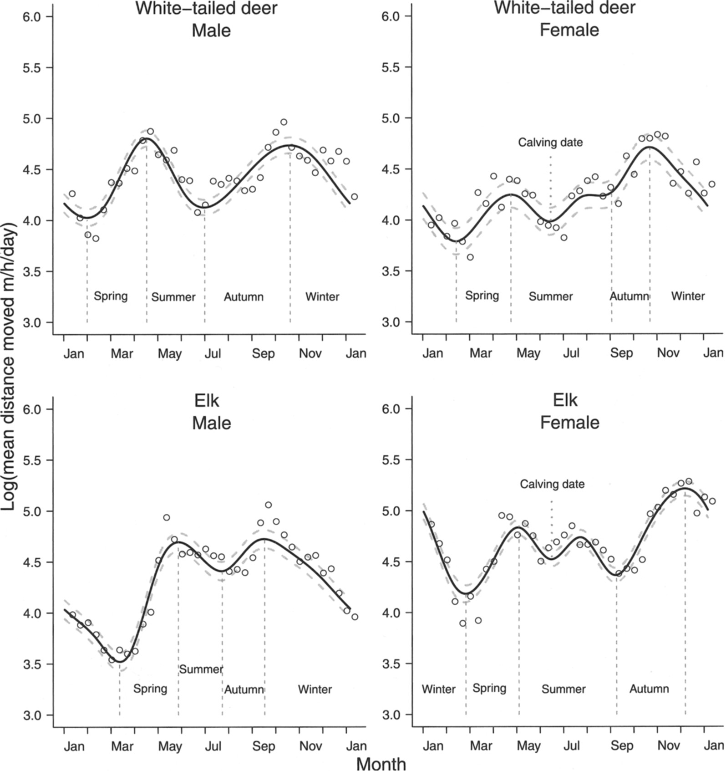
Fig. 1 Results of population-level generalized additive mixed model analysis showing predicted movement rate over a ...
Notes:
Fig. 1 Results of population-level generalized additive mixed model analysis showing predicted movement rate over a year for male and female elk and white-tailed deer. Seasons (winter, spring, summer, autumn, and calving date for females) are delineated based on inflection points (i.e., day with a significant change [increase or decrease] in movement rate). The plotted raw data points (open circles) are the population-level mean movement rates calculated over a 10-day period.
Unless provided in the caption above, the following copyright applies to the content of this slide: © 2013 American Society of Mammalogists

Slide 2
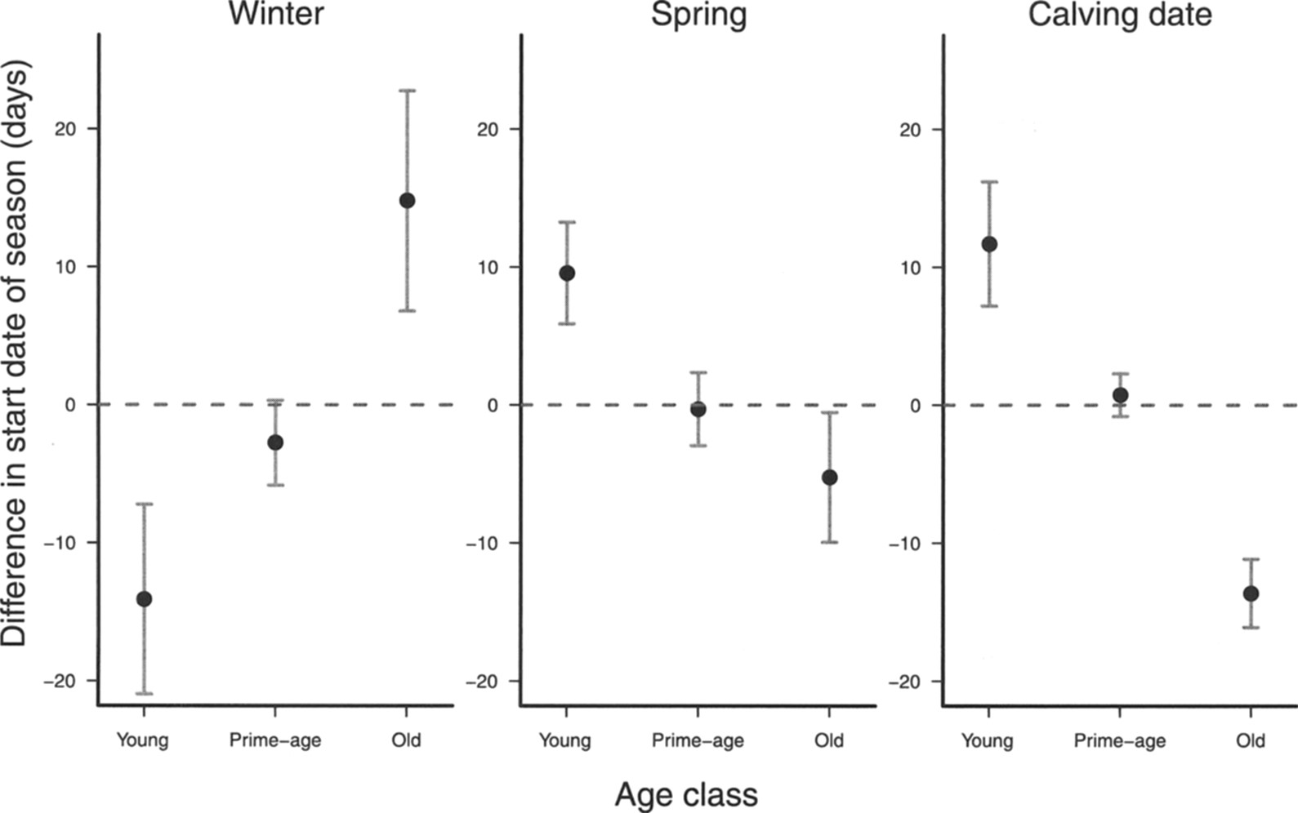
Fig. 2 Plot showing the effect of age class on individual variation (elk and white-tailed deer combined) in seasonal ...
Notes:
Fig. 2 Plot showing the effect of age class on individual variation (elk and white-tailed deer combined) in seasonal transition date (days) for winter, spring, and calving date. Error bars represent 95% confidence interval. Positive values on the y-axis indicate delayed start of a season compared to the population level (horizontal line at 0), whereas negative values indicate earlier start of a season compared to the population level. Predictions were made while keeping other variables retained in the final models constant at their mean value.
Unless provided in the caption above, the following copyright applies to the content of this slide: © 2013 American Society of Mammalogists

Slide 3
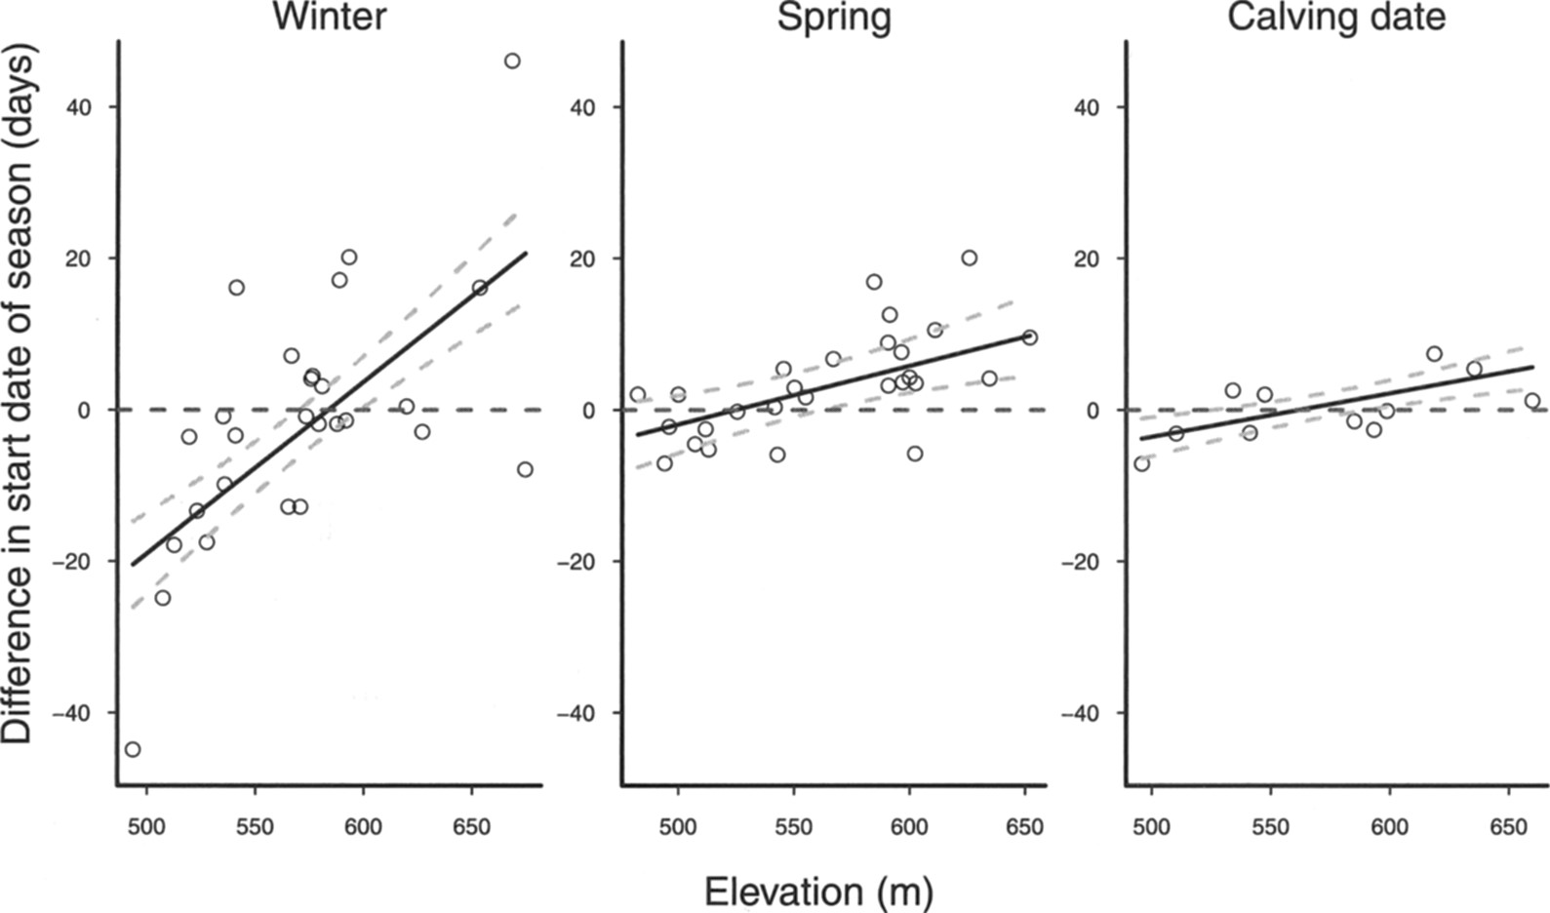
Fig. 3 Plot showing the effect of elevation (m) on individual variation (elk and white-tailed deer combined) in ...
Notes:
Fig. 3 Plot showing the effect of elevation (m) on individual variation (elk and white-tailed deer combined) in seasonal transition date (days) for winter, spring, and calving date. Note that the line for calving date shows a trend (P = 0.078). Positive values on the y-axis indicate delayed start of a season compared to the population level (horizontal line at 0), whereas negative values indicate earlier start of a season compared to the population level. Lines show predicted values, and points are model residuals. Predictions were made while keeping other variables retained in the final models constant at their mean value.
Unless provided in the caption above, the following copyright applies to the content of this slide: © 2013 American Society of Mammalogists

Slide 4
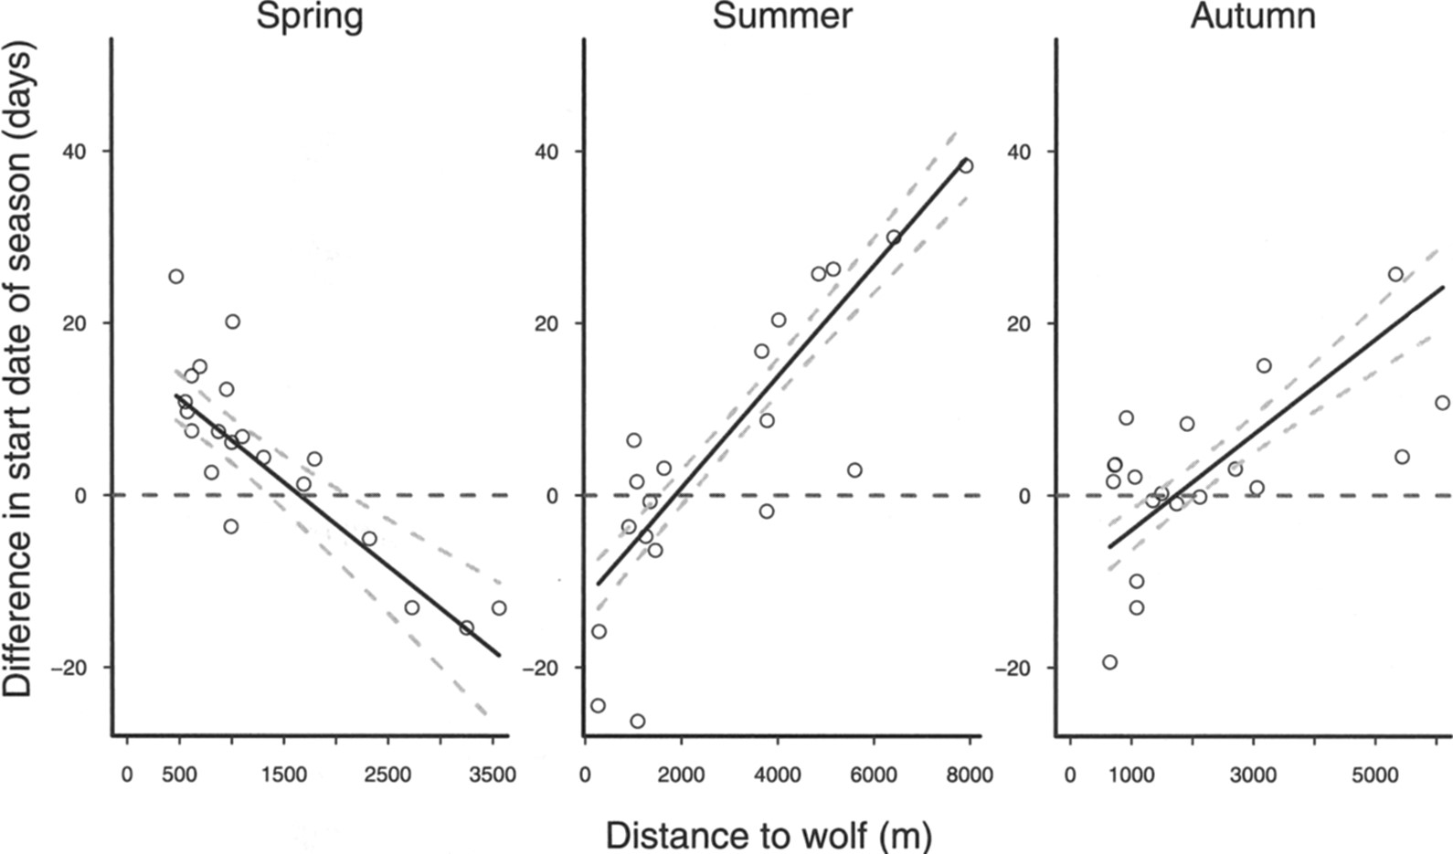
Fig. 4 Plot showing the effect of distance to wolf (m) on individual variation (elk and white-tailed deer combined) ...
Notes:
Fig. 4 Plot showing the effect of distance to wolf (m) on individual variation (elk and white-tailed deer combined) in seasonal transition date (days) for spring, summer, and autumn. Positive values on the y-axis indicate delayed start of a season compared to the population level (horizontal line at 0), whereas negative values indicate earlier start of a season compared to the population level. Lines show predicted values, and points are model residuals. Predictions were made while keeping other variables retained in the final models constant at their mean value.
Unless provided in the caption above, the following copyright applies to the content of this slide: © 2013 American Society of Mammalogists

