Slide 1
Figure 1 Mitral annular force transducer marked with outer dimensions and red markings for strain gauge positions for ...
Notes:
Figure 1 Mitral annular force transducer marked with outer dimensions and red markings for strain gauge positions for in-plane (left) and out-of-plane (middle) force measurements. The transducer was preattached to an annuloplasty ring with separate sutures prior to implantation (right). ANT: anterior; POST: posterior; ACOM: anterior commissure; PCOM: posterior commissure; SL: septal-lateral; CC: commissure to commissure.
Unless provided in the caption above, the following copyright applies to the content of this slide: © The Author 2017. Published by Oxford University Press on behalf of the European Association for Cardio-Thoracic Surgery. All rights reserved.

Slide 2
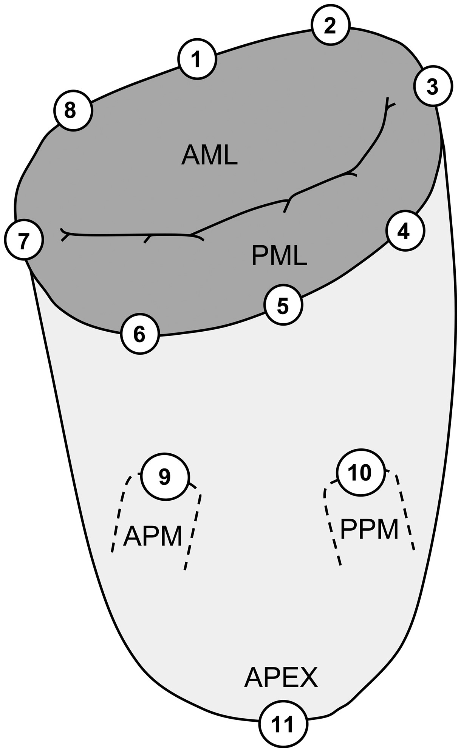
Figure 2 Location of implanted sonomicrometry crystals distributed around the mitral annulus and subvalvular ...
Notes:
Figure 2 Location of implanted sonomicrometry crystals distributed around the mitral annulus and subvalvular apparatus. The positions of the crystals are defined from the anatomical landmarks: 1: centre of trigones; 2: right trigone; 3: posterior commissure; 4: P3 scallop; 5: centre of the posterior annulus (P2 scallop); 6: P1 scallop; 7: anterior commissure; 8: left trigone; 9: anterior papillary muscle (APM); 10: posterior papillary muscle (PPM); 11: left ventricular apex; AML: anterior mitral leaflet; PML: posterior mitral leaflet.
Unless provided in the caption above, the following copyright applies to the content of this slide: © The Author 2017. Published by Oxford University Press on behalf of the European Association for Cardio-Thoracic Surgery. All rights reserved.

Slide 3
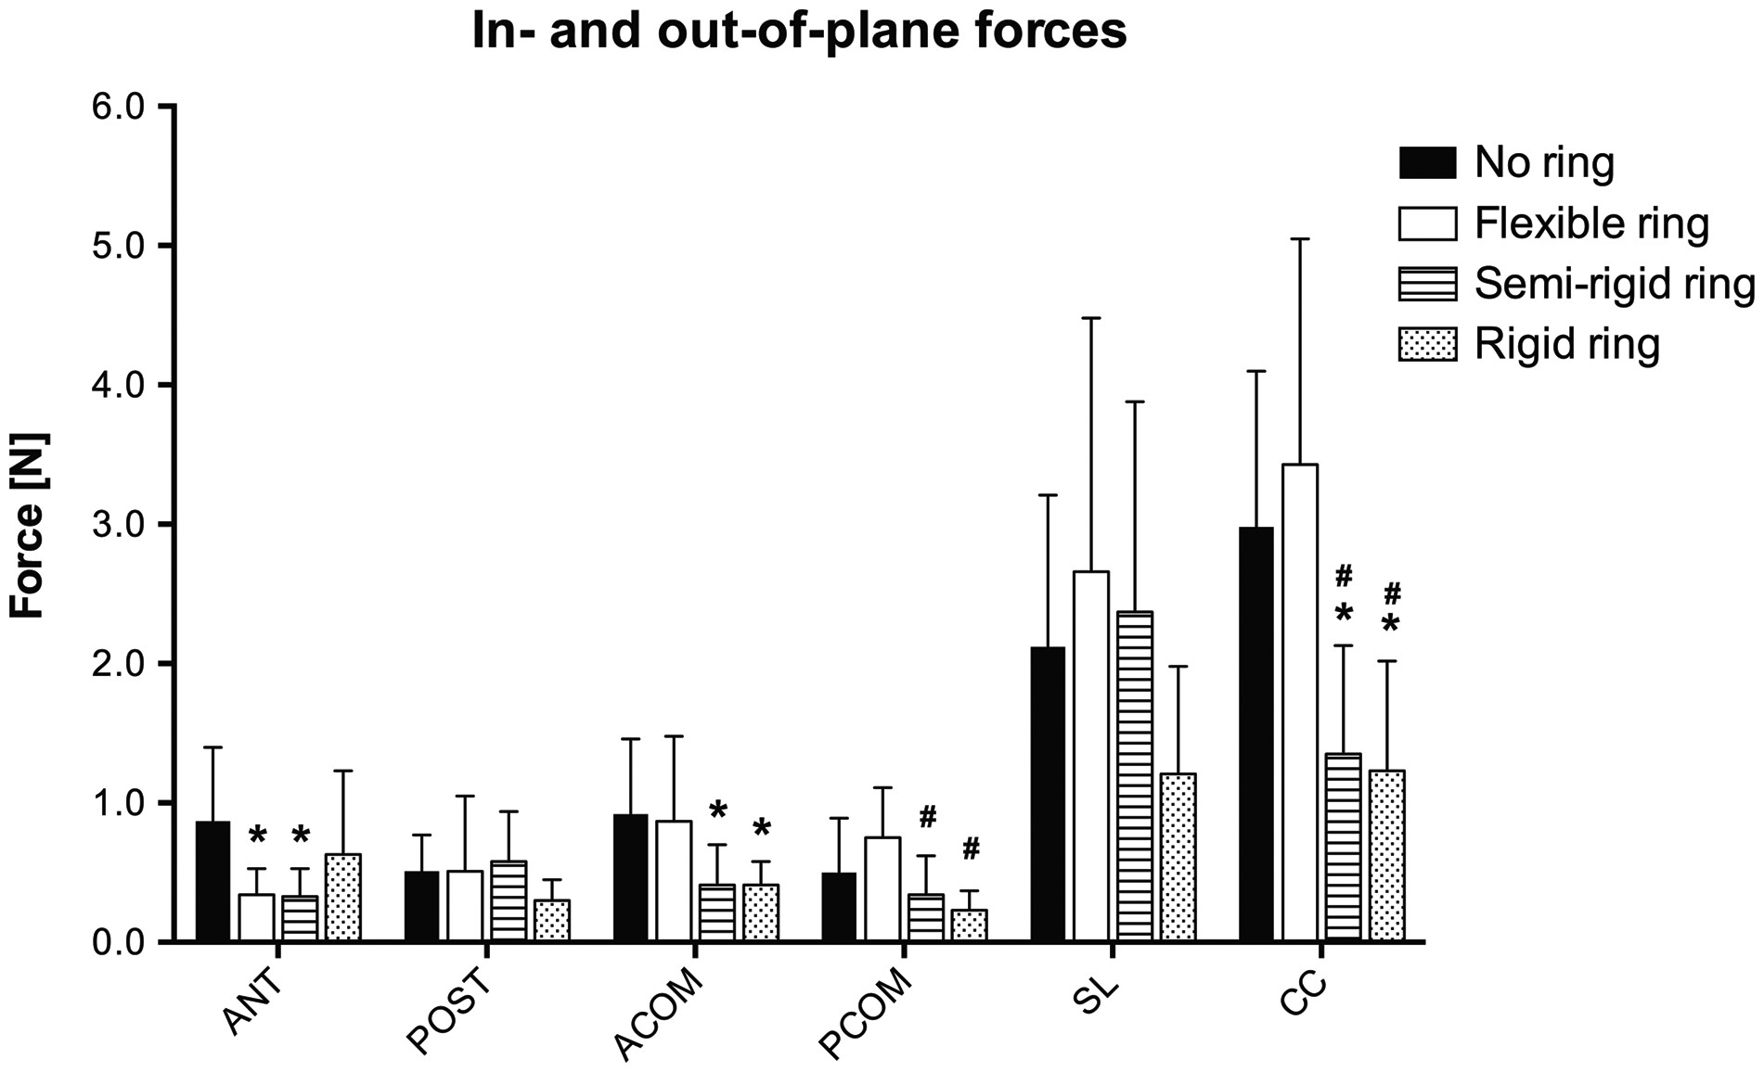
Figure 3 Forces measured in each group for the out-of-plane segments and in-plane directions. These forces represent ...
Notes:
Figure 3 Forces measured in each group for the out-of-plane segments and in-plane directions. These forces represent the amount of force transferred from the mitral annulus and through the annuloplasty ring to the transducer on top. Hence a low force compared to the no ring group represents an accumulation of force within the ring itself. ANT: anterior; POST: posterior; ACOM: anterior commissure; PCOM: posterior commissure; SL: septal-lateral; CC: commissure to commissure. *: Different from the no ring group; #: Different from the flexible ring group. P < 0.05. Mitral annulus deformational forces in different ring groups Out-of-plane segments, NIn-plane directions, NGroupsANTPOSTACOMPCOMSLCCNo ring0.87 ± 0.530.51 ± 0.260.92 ± 0.540.50 ± 0.392.12 ± 1.092.98 ± 1.12Flexible ring0.34 ± 0.19a0.51 ± 0.540.87 ± 0.610.75 ± 0.362.66 ± 1.823.43 ± 1.62a: 0.031Semi-rigid ring0.33 ± 0.20a0.58 ± 0.360.41 ± 0.29a0.34 ± 0.28b2.37 ± 1.511.35 ± 0.78a,ba: 0.037a: 0.045b: 0.023a: 0.024b: 0.003Rigid ring0.63 ± 0.600.30 ± 0.150.41 ± 0.17a0.23 ± 0.14b1.21 ± 0.771.23 ± 0.79a,ba: 0.042b: 0.006a: 0.015b: 0.002Mean ± standard deviation. ANT: anterior; POST: posterior; ACOM: anterior commissure; PCOM: posterior commissure. SL: septal-lateral; CC: commissure-commissure. aDifferent from no ring group. bDifferent from flexible ring group.
Unless provided in the caption above, the following copyright applies to the content of this slide: © The Author 2017. Published by Oxford University Press on behalf of the European Association for Cardio-Thoracic Surgery. All rights reserved.

Slide 4
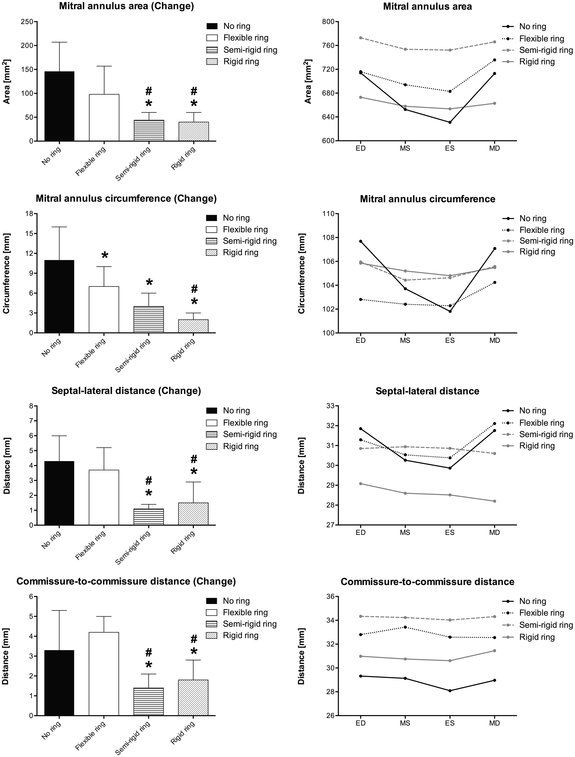
Figure 4 Mitral annulus deformation for each ring group. Left column illustrates the cyclic changes of selected ...
Notes:
Figure 4 Mitral annulus deformation for each ring group. Left column illustrates the cyclic changes of selected variables in each group. Right column illustrates the absolute values for the same variables at 4 defined time points throughout the cardiac cycle. ED: end-diastole; MS: mid-systole; ES: end-systole; MD: mid-diastole. *: Different from the no ring group, #: Different from the flexible ring group. P < 0.05.
Unless provided in the caption above, the following copyright applies to the content of this slide: © The Author 2017. Published by Oxford University Press on behalf of the European Association for Cardio-Thoracic Surgery. All rights reserved.

Slide 5
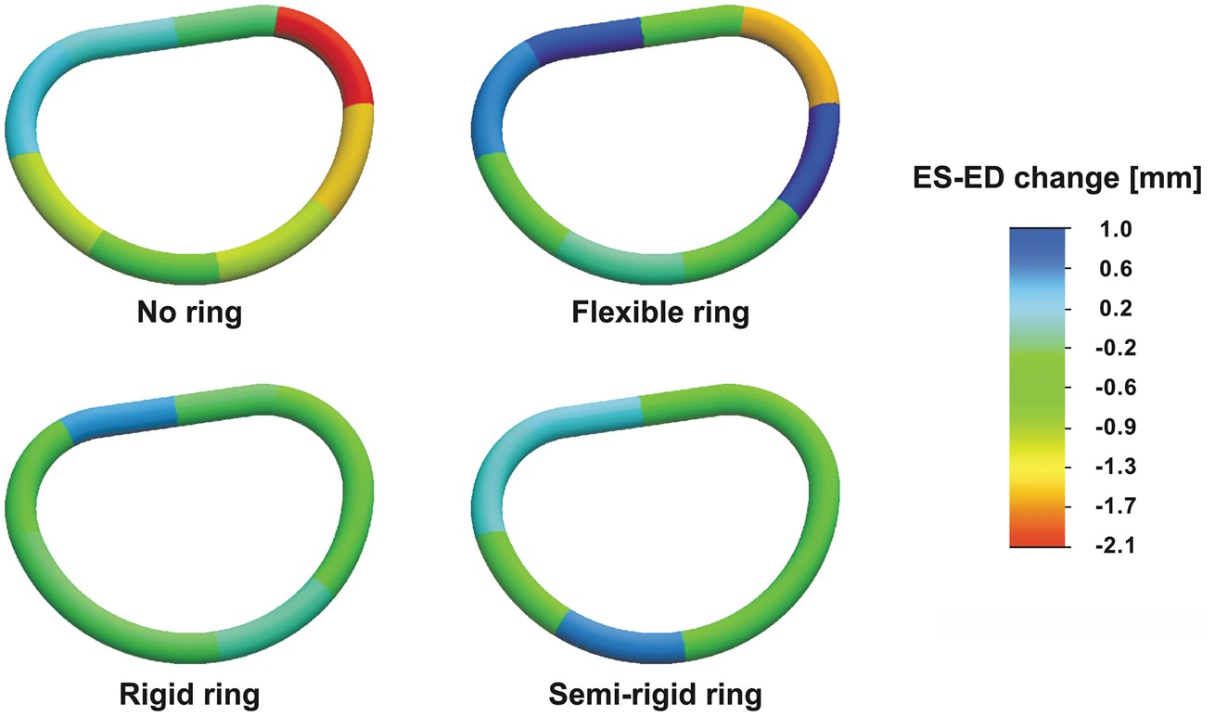
Figure 5 Segmental mitral annular circumferential changes from end-diastole to end-systole for the no ring group and ...
Notes:
Figure 5 Segmental mitral annular circumferential changes from end-diastole to end-systole for the no ring group and the three annuloplasty ring groups. The annular circumferential changes are illustrated with a scaled colour legend where blue represents a systolic annular circumferential expansion and red represents a systolic annular compression. ES: end-systole; ED: end-diastole.
Unless provided in the caption above, the following copyright applies to the content of this slide: © The Author 2017. Published by Oxford University Press on behalf of the European Association for Cardio-Thoracic Surgery. All rights reserved.

