Slide 1
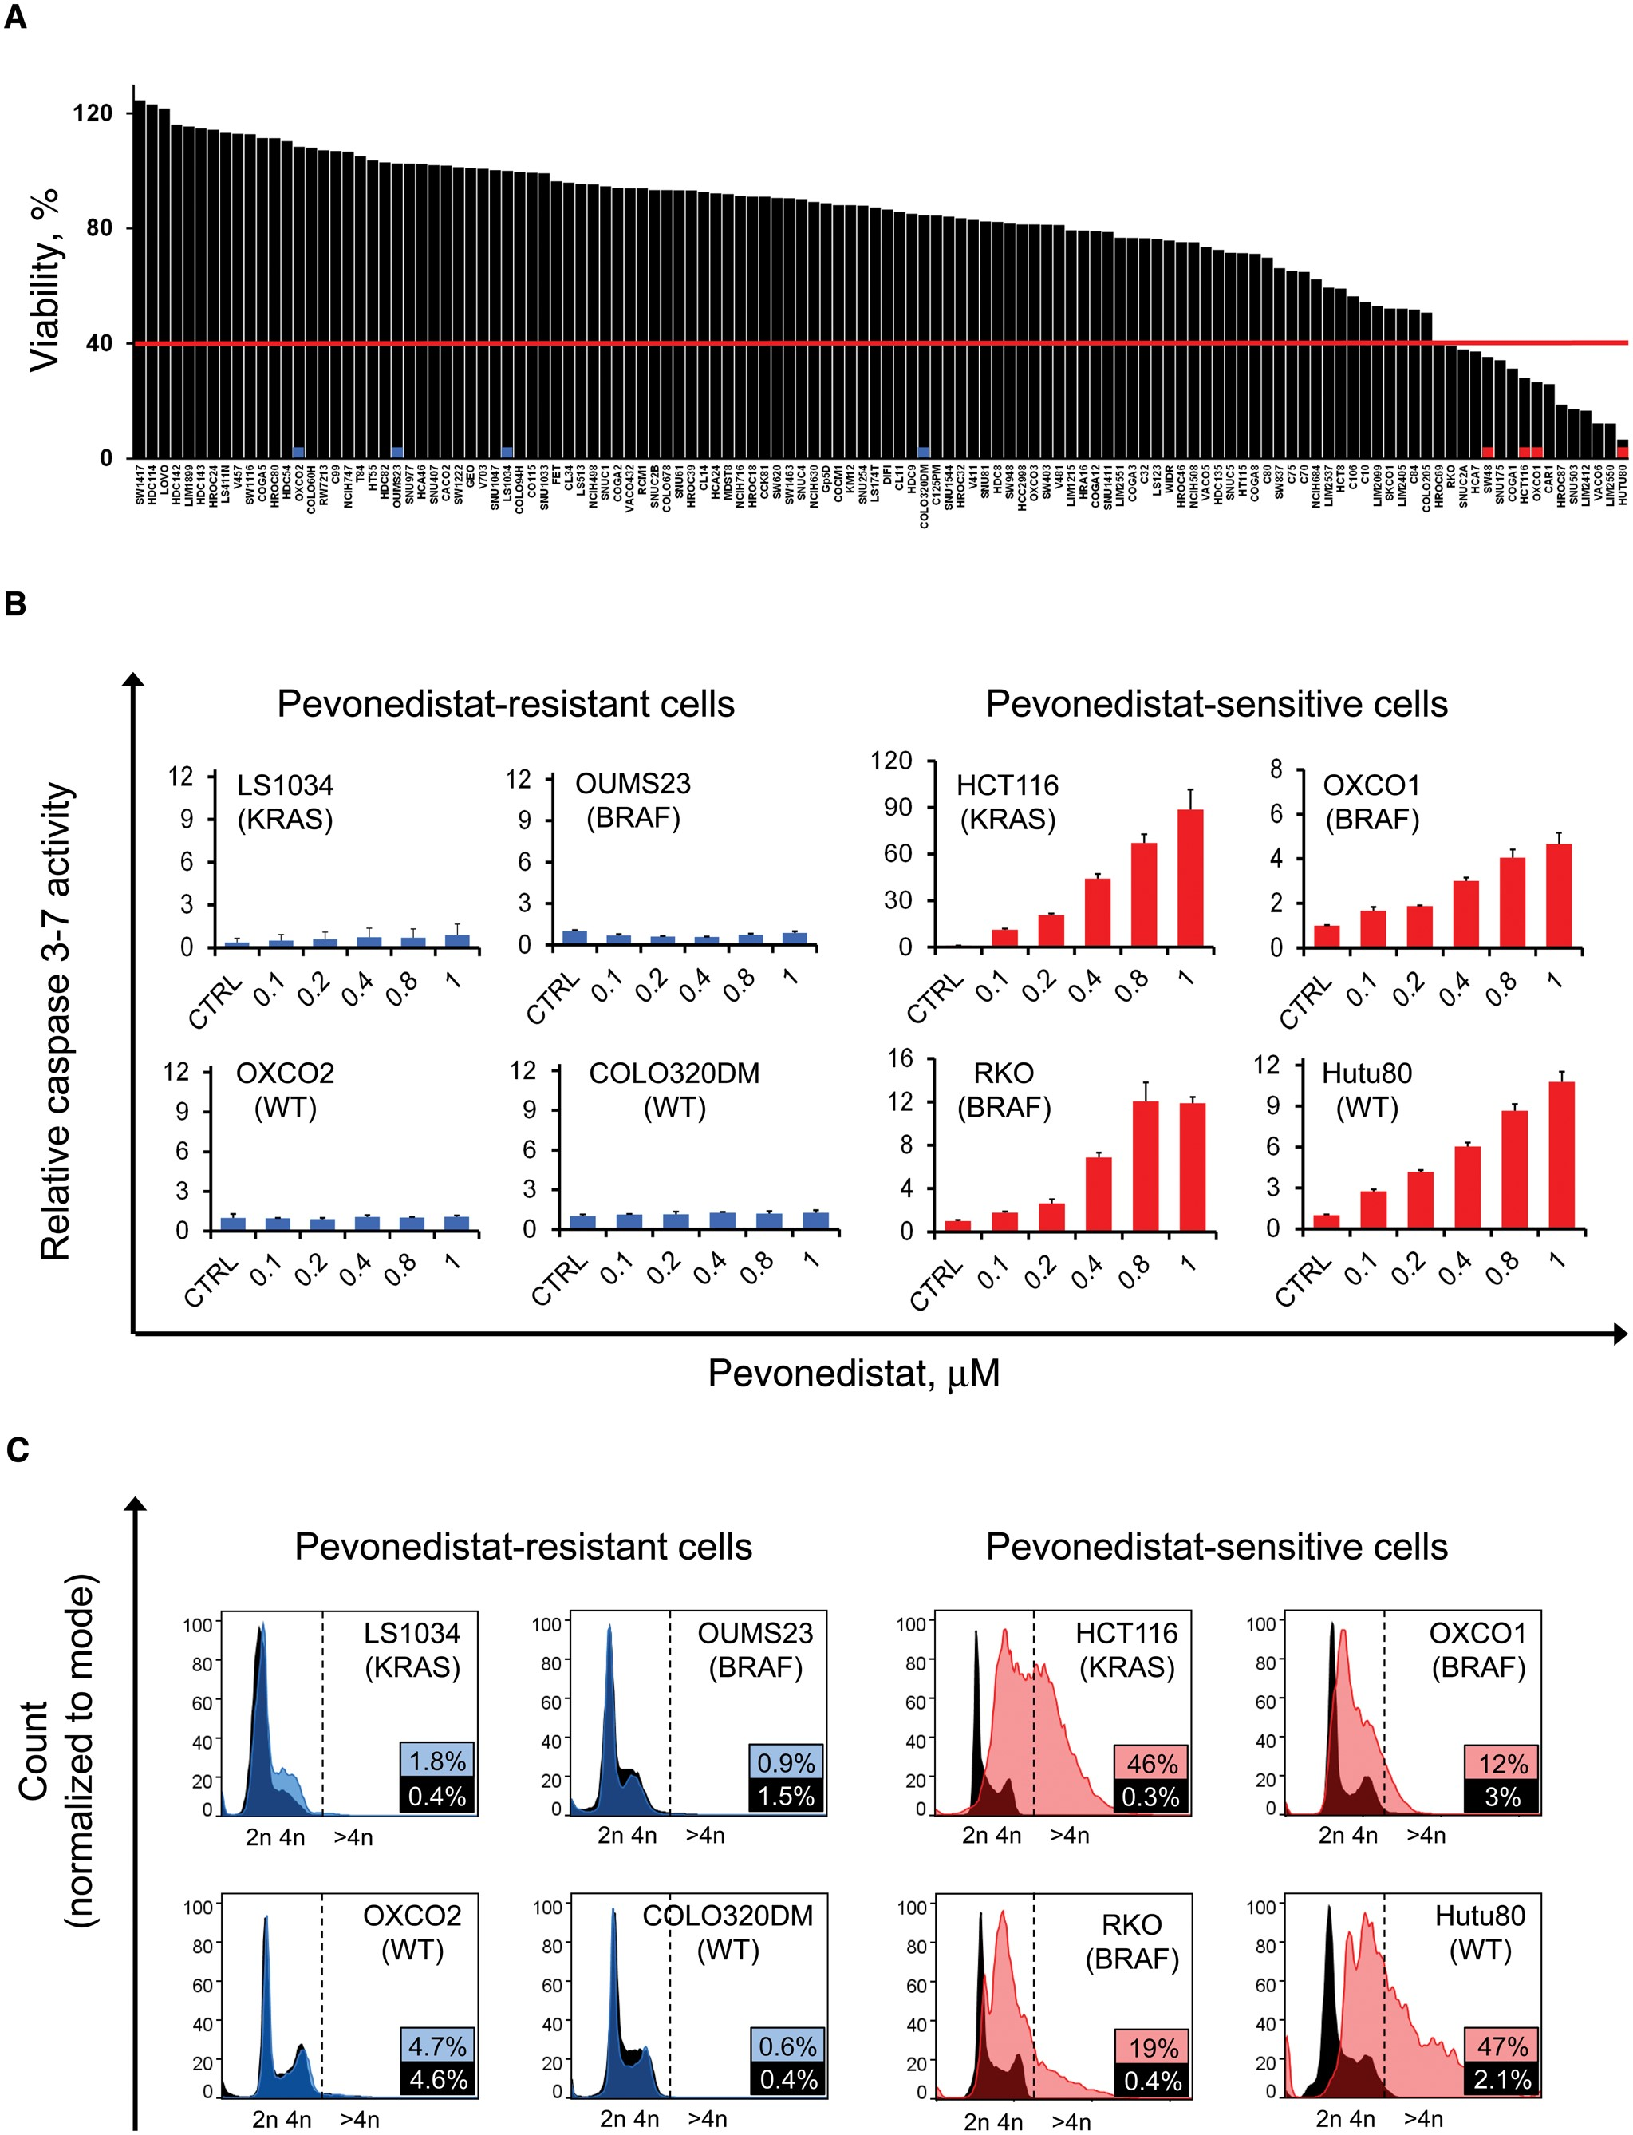
Figure 1. Sensitivity of colorectal cancer (CRC) cell lines to Pevonedistat in vitro. A) The indicated cell lines ...
Notes:
Figure 1. Sensitivity of colorectal cancer (CRC) cell lines to Pevonedistat in vitro. A) The indicated cell lines (n = 122) were treated with increasing concentrations of Pevonedistat for four days, and cell viability was assessed by measuring ATP content. Bars represent relative cell viability compared with vehicle after 96 hours of treatment (average between viability at 0.5 and viability at 1 µM pevonedistat). Cells lines with viability of less than 40% were considered sensitive (n = 16, 13%). Red (sensitive) and blue (resistant) squares at the bottom of the bars highlight representative cell lines selected for further characterization of the response. B) Histograms representing the relative caspase 3-7 activity of pevonedistat-sensitive (red) and -resistant (blue) cell lines after 48 hours of exposure to the drug at incremental concentration, as indicated. Caspase activity was normalized vs viability values (CellTiter-Glo), obtained from experiments performed in parallel ± SD (n = 3). C) DNA content evaluation by flow cytometry in CRC cell lines. Black histograms: vehicle-treated cells. Colored histograms: cells treated for 24 hours with 1 μM pevonedistat. Only sensitive cell lines display a remarkable increase of re-replicating cells (>4 n) when treated with pevonedistat (red histograms). The dotted vertical line indicates the threshold for DNA content greater than 4 n. The fraction of re-replicating cells in vehicle- and pevonedistat-treated cells is reported in black and colored boxes, respectively.
Unless provided in the caption above, the following copyright applies to the content of this slide: © The Author 2016. Published by Oxford University Press. All rights reserved. For Permissions, please email: journals.permissions@oup.com

Slide 2
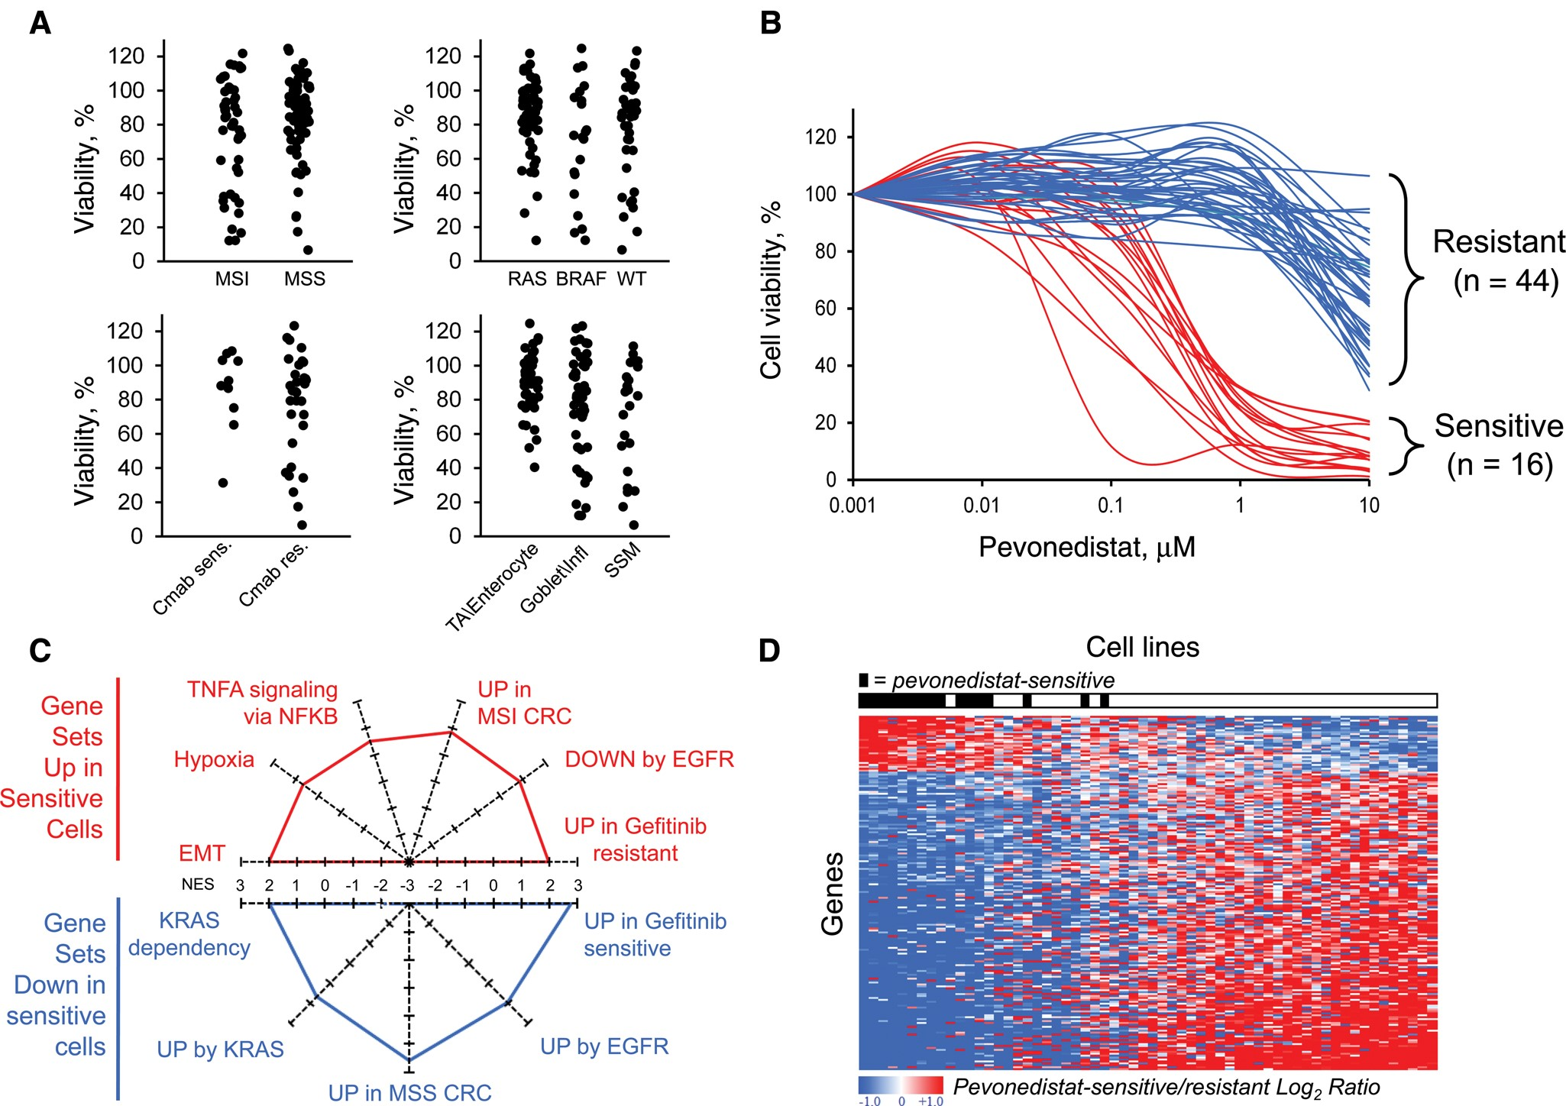
Figure 2. Molecular prediction of pevonedistat sensitivity in colorectal cancer (CRC) cell lines. A) Dot plots ...
Notes:
Figure 2. Molecular prediction of pevonedistat sensitivity in colorectal cancer (CRC) cell lines. A) Dot plots displaying sensitivity to Pevonedistat (average viability at 0.5 and 1 µM) of 122 CRC cell lines stratified by MSI status, KRAS/BRAF mutational status, cetuximab sensitivity (only in KRAS and BRAF wild-type cases), and consensus transcriptional subtypes, as indicated. B) Dose-response to Pevonedistat of 16 highly sensitive and 44 highly resistant CRC cell lines (red and blue curves, respectively). C) Outcome of gene set enrichment analysis (GSEA) displaying the most statistically significant gene sets upregulated (red text) or downregulated (blue text) in pevonedistat-sensitive CRC cell lines. The radar plot scale indicates the GSEA normalized enrichment score. D) Heat map representing the expression of the 184 signature genes (rows) in pevonedistat-sensitive and -resistant cell lines, ordered from left to right by decreasing sensitivity score. EGFR = epidermal growth factor receptor; EMT = epithelial mesenchymal transition; NES = normalized enrichment score.
Unless provided in the caption above, the following copyright applies to the content of this slide: © The Author 2016. Published by Oxford University Press. All rights reserved. For Permissions, please email: journals.permissions@oup.com

Slide 3
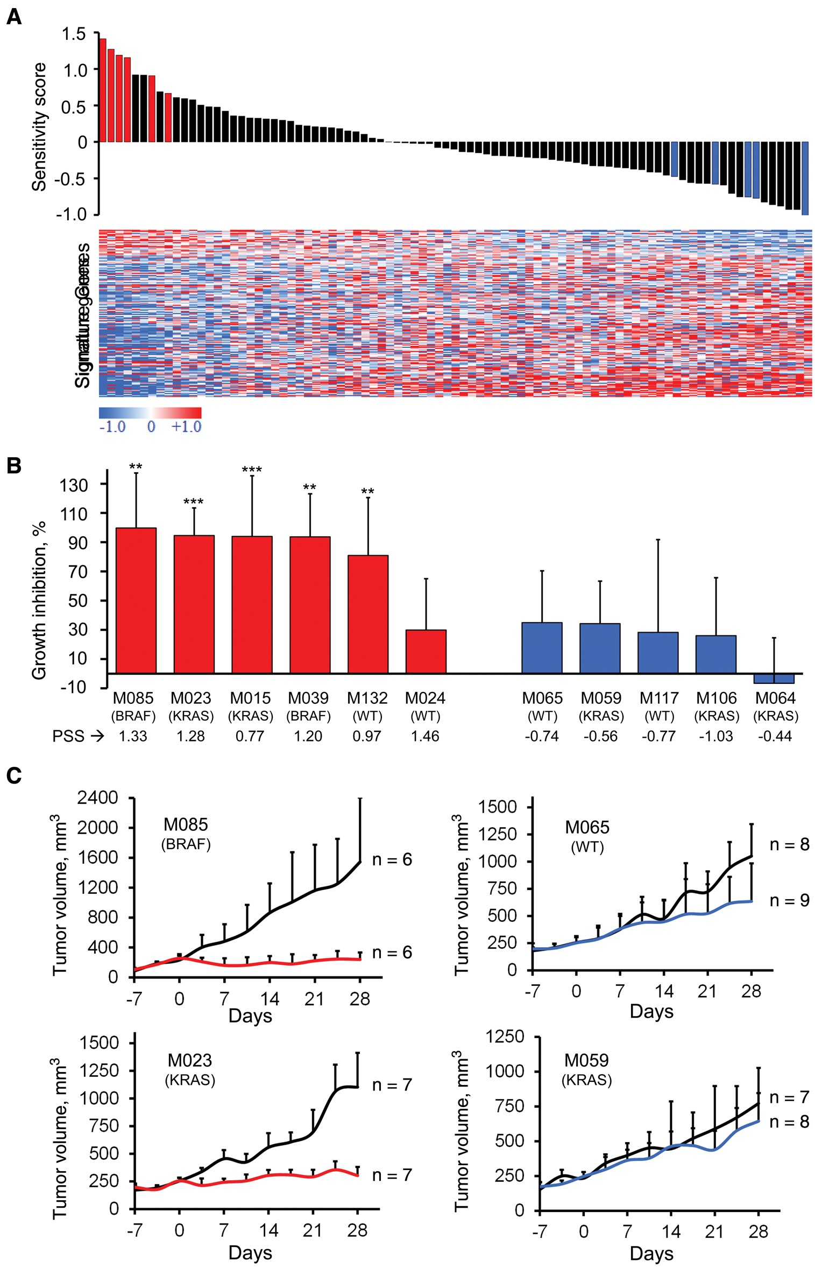
Figure 3. In vivo response to pevonedistat of colorectal cancer (CRC) patient-derived xenografts (PDXs) with high or ...
Notes:
Figure 3. In vivo response to pevonedistat of colorectal cancer (CRC) patient-derived xenografts (PDXs) with high or low predicted sensitivity. A) Waterfall plot displaying 87 CRC liver metastases ordered by decreasing pevonedistat sensitivity score (PSS; y-axis), from left to right. Red and blue bars highlight cases with high and low PSS, selected for validation in PDX models. The heat map reports expression (log2 ratio vs average) of signature genes in the same 87 samples. B) Bar graph reporting growth inhibition of PDXs after treatment for 28 days with pevonedistat vs vehicle-treated counterparts. Red bars: high PSS cases; blue bars: low PSS cases. Sample ID, KRAS/BRAF mutational status, and PSS are reported at the bottom of each bar. Asterisks on top of the bars indicate statistically significant growth inhibition after 28 days of treatment (Student's t test ***P < .01, ***P < .001). C) PDX growth curves (median ± SD) of the cases displaying the highest growth inhibition among the predicted sensitive (left panels, red curves) and among the predicted resistant (right panels, blue curves). Black curves: vehicle-treated. PSS = pevonedistat sensitivity score.
Unless provided in the caption above, the following copyright applies to the content of this slide: © The Author 2016. Published by Oxford University Press. All rights reserved. For Permissions, please email: journals.permissions@oup.com

Slide 4
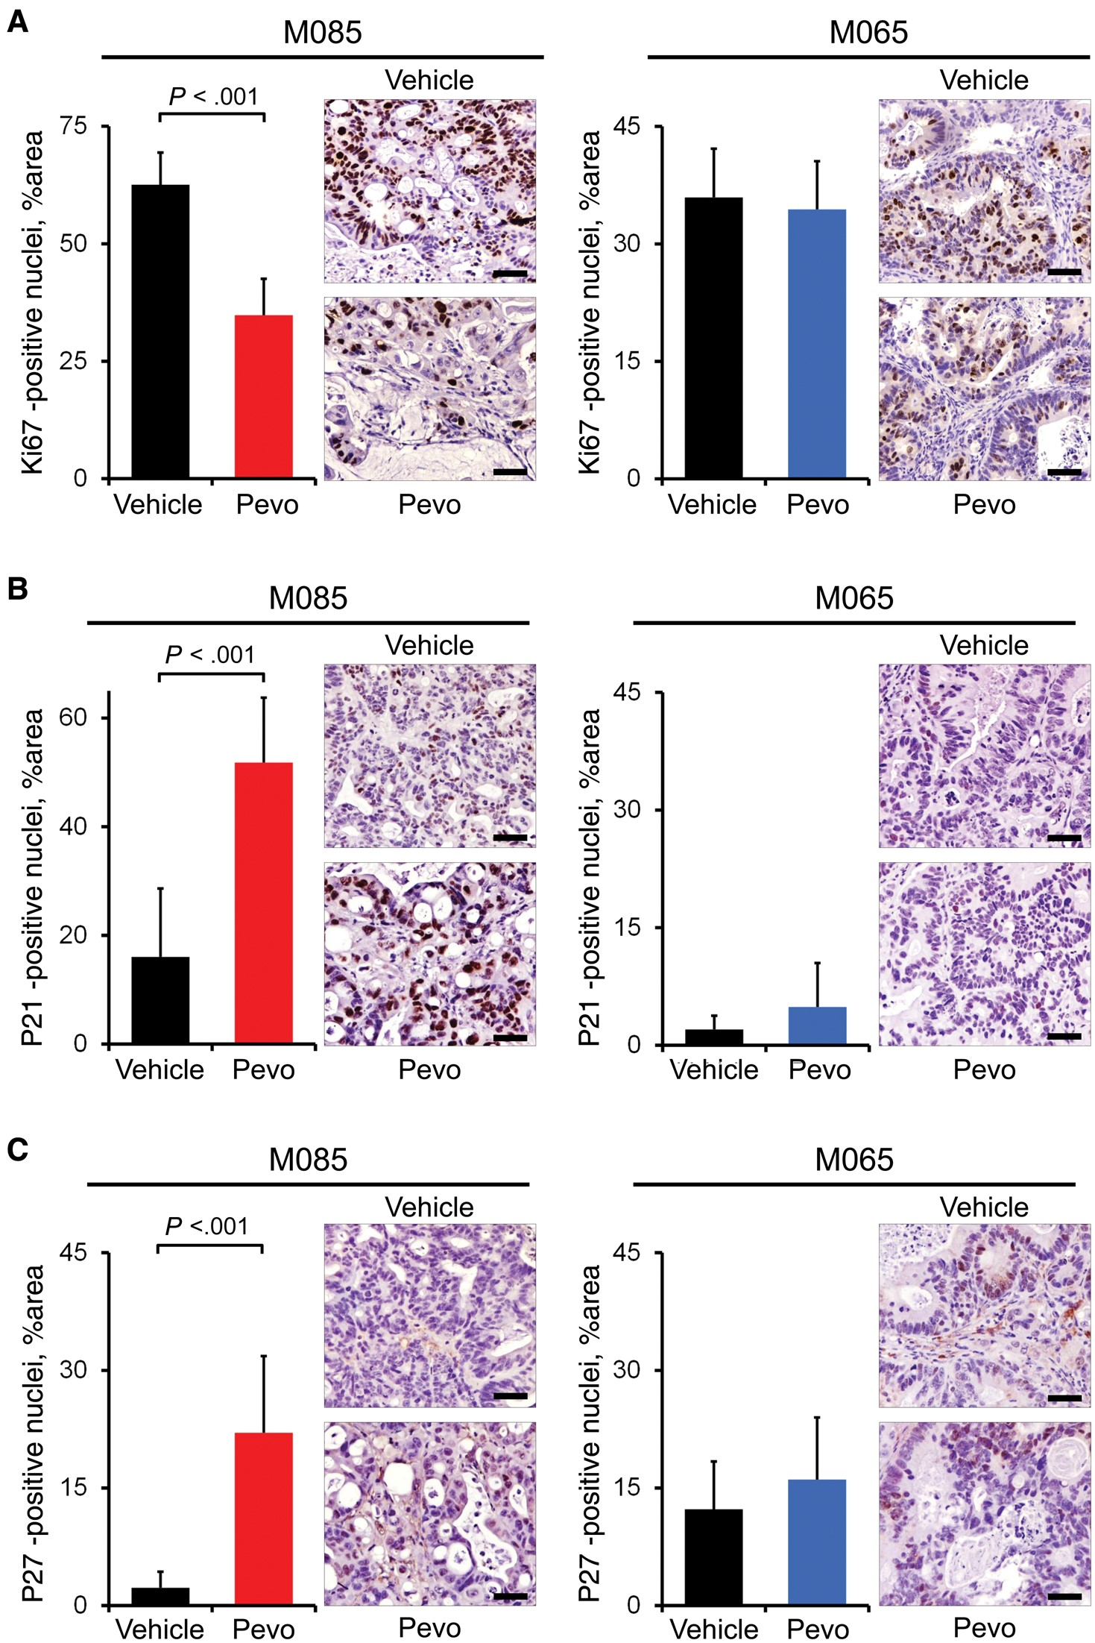
Figure 4. In vivo changes of ki67, p21, and p27 protein levels upon pevonedistat treatment of colorectal cancer (CRC) ...
Notes:
Figure 4. In vivo changes of ki67, p21, and p27 protein levels upon pevonedistat treatment of colorectal cancer (CRC) patient-derived xenografts (PDXs). Immunohistochemical staining and morphometric quantitation of ki67 (A), p21 (B), and p27 (C) of two representative PDX tumors derived from a sensitive (M085, red bars) and a resistant (M065, blue bars) case at the end of treatment with vehicle (black bar) or pevonedistat (colored bar), as indicated. Results are means ± SD of 10 fields (20×) for each experimental point. Bar graphs are flanked by micrographs of representative fields. Scale bar = 50 µm.
Unless provided in the caption above, the following copyright applies to the content of this slide: © The Author 2016. Published by Oxford University Press. All rights reserved. For Permissions, please email: journals.permissions@oup.com

Slide 5
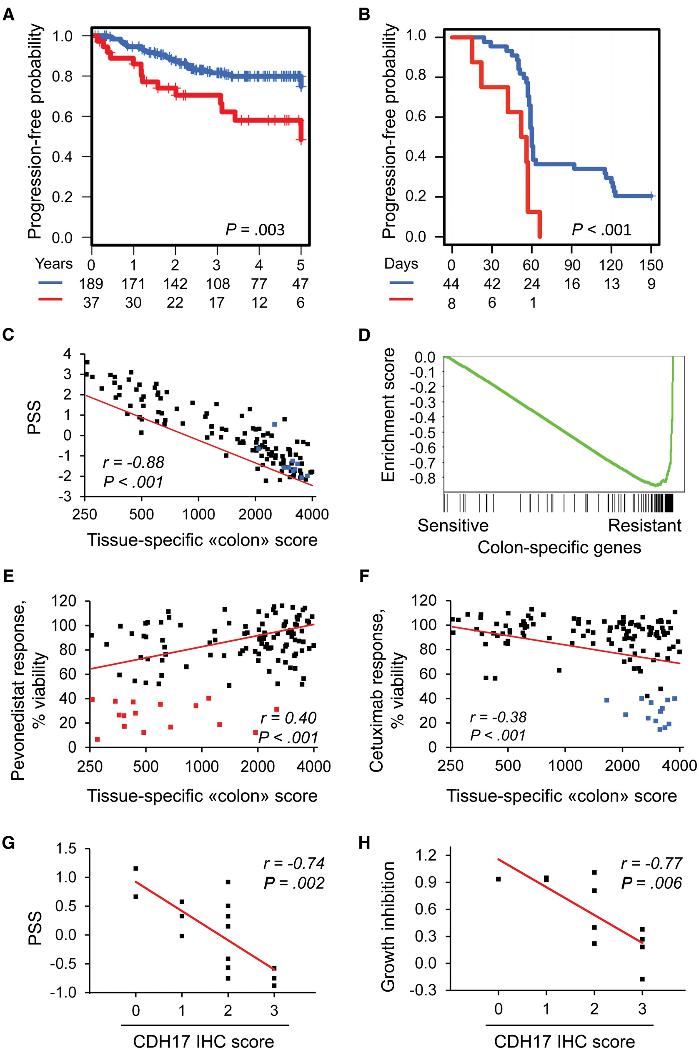
Figure 5. Association between predicted pevonedistat sensitivity, clinical aggressiveness, and poor differentiation of ...
Notes:
Figure 5. Association between predicted pevonedistat sensitivity, clinical aggressiveness, and poor differentiation of colorectal cancer (CRC). A) Kaplan-Meier analysis of disease-free survival after surgery of primary CRC cases with top 15% highest pevonedistat sensitivity score (PSS) score (red line) vs all remaining cases (blue line). B) Kaplan-Meier analysis of progression-free survival of liver metastatic cases with top 15% highest PSS score (red line) after treatment with cetuximab monotherapy. C) Dot plot displaying the correlation between the PSS (y-axis) and the tissue-specific “colon” score (x-axis) in 122 CRC cell lines. D) Gene set enrichment analysis (GSEA) of colon differentiation genes in pevonedistat-sensitive vs -resistant cell lines. Dot plots displaying the correlation between the tissue-specific “colon” score and viability upon pevonedistat (E) and cetuximab (F) treatment. Pevonedistat-sensitive lines are marked in red (left panel); cetuximab sensitive lines are marked in blue (right panel). G) Correlation between PSS and CDH17 protein expression detected by immunohistochemistry (IHC) in 16 liver metastatic CRC samples. H) Correlation between growth inhibition measured in 11 PDXs tested in vivo and CDH17 protein expression of the same patient-derived xenografts evaluated by IHC. All statistical tests were two-sided. P values are from: (A and B) log-rank Chi-squared test; (E–H) the SISA online calculator for statistical significance of a correlation (www.quantitativeskills.com/sisa/statistics/correl.htm). IHC = immunohistochemistry; PSS = pevonedistat sensitivity score.
Unless provided in the caption above, the following copyright applies to the content of this slide: © The Author 2016. Published by Oxford University Press. All rights reserved. For Permissions, please email: journals.permissions@oup.com

Slide 6
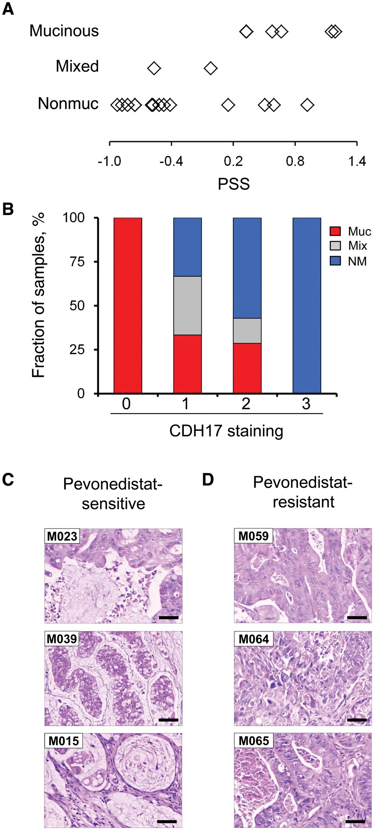
Figure 6. Association of pevonedistat sensitivity with the high-grade mucinous colorectal cancer (CRC) histotype. (A) ...
Notes:
Figure 6. Association of pevonedistat sensitivity with the high-grade mucinous colorectal cancer (CRC) histotype. (A) Dot plot reporting on the x-axis the pevonedistat sensitivity score values for CRC liver metastases grouped by their mucinous aspect: mucinous, mixed, nonmucinous. B) Bar plot showing, on the y-axis, the fraction of mucinous (red), mixed (gray), and nonmucinous (blue) cases grouped by their CDH17 staining signal, from 0 (absent) to 3 (high). C and D) Micrographs of representative patient-derived xenografts responsive or resistant to pevonedistat (left and right panels, respectively), stained by haematoxylin and eosin. Scale bar = 50 µm. NM = nonmucinous; PSS = pevonedistat sensitivity score.
Unless provided in the caption above, the following copyright applies to the content of this slide: © The Author 2016. Published by Oxford University Press. All rights reserved. For Permissions, please email: journals.permissions@oup.com

