Slide 1
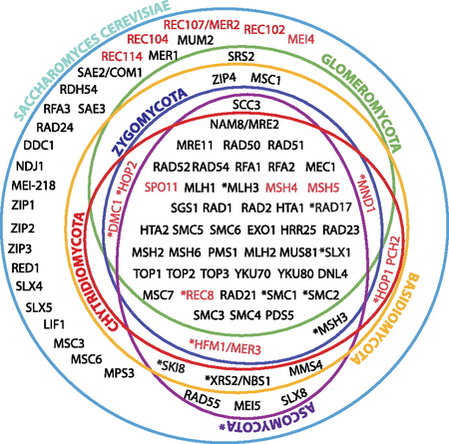
FIG. 1. Expanded catalog of fungal meiotic genes. Venn diagram showing the presence or absence of the genes known to ...
Notes:
FIG. 1. Expanded catalog of fungal meiotic genes. Venn diagram showing the presence or absence of the genes known to be directly or indirectly involved in meiotic processes in Saccharomyces cerevisiae (green circle) (Nowrousian et al. 2010). The presence or absence of these genes have been scored in the genomes of fungal relatives, including representative species belonging to the phylum Ascomycota ([Nowrousian et al. 2010], purple circle), Basidiomycota ([Donaldson and Saville 2008; Burns et al. 2010], orange circle), Chytridiomycota (red circle), Zygomycota (dark blue circle), and the AMF Glomeromycota (Green circle), inventoried in detail in supplementary table S1, Supplementary Material online. Meiosis-specific genes are shown in red text. Asterisks represent genes that are sometimes absent in the genome of one or more members of a given phylum. Data included in the purple circle were reported elsewhere (Nowrousian et al. 2010), and we did not repeat the analyses.
Unless provided in the caption above, the following copyright applies to the content of this slide: © The Author(s) 2011. Published by Oxford University Press on behalf of the Society for Molecular Biology and Evolution.This is an Open Access article distributed under the terms of the Creative Commons Attribution Non-Commercial License (http://creativecommons.org/licenses/by-nc/3.0), which permits unrestricted non-commercial use, distribution, and reproduction in any medium, provided the original work is properly cited.

Slide 2
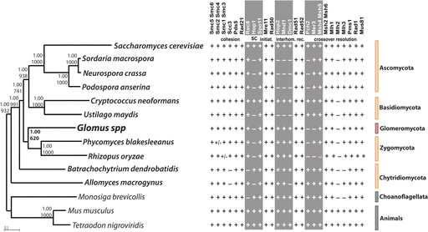
FIG. 2. Phylogenetic tree of 12 concatenated DNA repair protein sequences (Exo1, Rad1, Mlh1, Mre11, Msh6, Mus81, ...
Notes:
FIG. 2. Phylogenetic tree of 12 concatenated DNA repair protein sequences (Exo1, Rad1, Mlh1, Mre11, Msh6, Mus81, Smc6, Top1, Top3, Rad23, Rad50, Rad52) (left) and list of the core meiotic genes (right). Left side of the figure: Glomus spp. (G. irregulare and G. diaphanum) are highlighted in red, all surveyed fungi (Ascomycota, Basidiomycota, Chytridiomycota, and Zygomycota) in orange, and outgroup organisms (one choanoflagellate and two animals) in gray (supplementary table S2, Supplementary Material online). Numbers at nodes correspond to Bayesian posterior probabilities (top) and bootstrap supports from 1,000 replicates of maximum likelihood (PhyML) analysis (bottom). Scale bar represents 0.1 amino acid substitutions per site. Right side of the figure: list of the core meiotic proteins (adapted from references San-Segundo and Roeder 1999; Villeneuve and Hillers 2001; Malik et al. 2008; Joshi et al. 2009 and references therein) and their presence (+) and absence (−, i.e., not detected) in the fungal genomes surveyed in this study. +/− denotes the absence of the given genes in some species belonging to that specific phylum. Meiosis-specific proteins are shown in gray columns. A. Ascomycota; B. Basidiomycota; C. Chytridiomycota; Z. Zygomycota; G. Glomeromycota (i.e., AMF). Orthologs of Rad21, Rad51, Pms1, and Mlh and meiosis-specific Spo11-1, Rec8, Hop1, Hop2, Mnd1, and Dmc1 genes of basidiomycetes and B. dendrobatidis were identified with assistance from Arthur Pightling.
Unless provided in the caption above, the following copyright applies to the content of this slide: © The Author(s) 2011. Published by Oxford University Press on behalf of the Society for Molecular Biology and Evolution.This is an Open Access article distributed under the terms of the Creative Commons Attribution Non-Commercial License (http://creativecommons.org/licenses/by-nc/3.0), which permits unrestricted non-commercial use, distribution, and reproduction in any medium, provided the original work is properly cited.

Slide 3
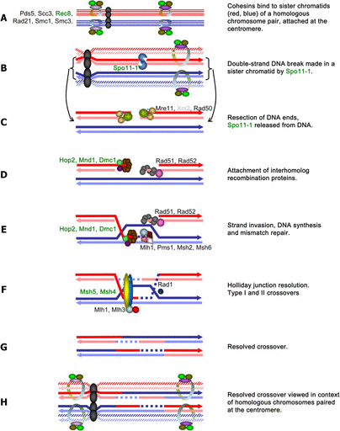
FIG. 3. Hypothetical model of meiotic recombination in AMF Glomus spp., depicting likely interactions among proteins ...
Notes:
FIG. 3. Hypothetical model of meiotic recombination in AMF Glomus spp., depicting likely interactions among proteins identified in this study. The names of meiosis-specific proteins are highlighted in green. Exact stoichiometry is not implied. In meiosis I, cohesins bind to sister chromatids (A), after which double-strand DNA breaks occur, with Spo11 and accessory recombination initiation proteins if present (B). Double-strand break repair is initiated (C). Interhomolog recombination and strand exchange proteins are attracted to the double-strand break (accessory proteins not shown) (D). The resulting heteroduplex (E) may be resolved by class II crossovers, which utilize meiosis-specific proteins (F, G) or by gene conversion (proteins not shown) or Class I crossovers (via Mus81), which do not. This model is derived from the general model that was based on details from Saccharomyces cerevisiae, Drosophila melanogaster, Caenorhabditis elegans, and Arabidopsis thaliana, and phylogenomic analyses described in references (Malik et al. 2008) and references within.
Unless provided in the caption above, the following copyright applies to the content of this slide: © The Author(s) 2011. Published by Oxford University Press on behalf of the Society for Molecular Biology and Evolution.This is an Open Access article distributed under the terms of the Creative Commons Attribution Non-Commercial License (http://creativecommons.org/licenses/by-nc/3.0), which permits unrestricted non-commercial use, distribution, and reproduction in any medium, provided the original work is properly cited.

