Slide 1
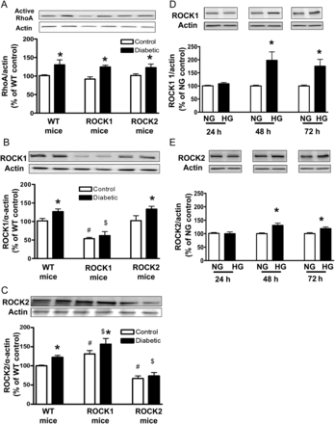
Figure 1 Levels of active RhoA expression (A) and ROCK1 (B) and ROCK2 (C) expression in aortas from WT and ROCK1+/− ...
Notes:
Figure 1 Levels of active RhoA expression (A) and ROCK1 (B) and ROCK2 (C) expression in aortas from WT and ROCK1+/− (ROCK1) and ROCK2+/− (ROCK2) control and diabetic mice. Data are expressed as percentage of WT. Values are represented as means ± SEM, n = 4–6 mice/group. *P < 0.05, diabetic mice vs. control mice, #P < 0.05, ROCK1 or ROCK2 control mice vs. WT control mice; $P < 0.05, ROCK1-D or ROCK2-D mice vs. WT-D mice. Levels of ROCK1 (D) and ROCK2 (E) expression in HG (25 mM)-treated BAECs. BAECs were cultured in HG media for indicated time periods. Results were quantified by densitometry and both ROCK isoforms were normalized to actin levels. Values for normal glucose (NG, 5.5 mM) at respective time points were considered as 100% and data are represented as percentage of respective NG control. Values are expressed as means ± SEM, n = 4–6/group. *P < 0.05 vs. its NG control.
Unless provided in the caption above, the following copyright applies to the content of this slide: Published on behalf of the European Society of Cardiology. All rights reserved. © The Author 2012. For permissions please email: journals.permissions@oup.com.

Slide 2
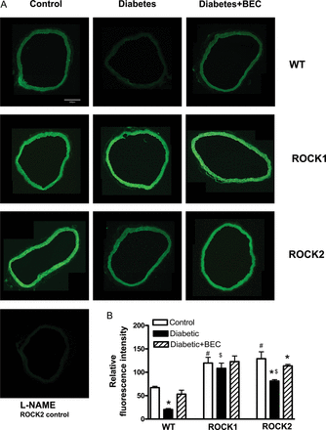
Figure 2 NO production assessment by DAF-2 in aortic rings from WT, ROCK1+/− (ROCK1) and ROCK2+/− (ROCK2) control, ...
Notes:
Figure 2 NO production assessment by DAF-2 in aortic rings from WT, ROCK1+/− (ROCK1) and ROCK2+/− (ROCK2) control, diabetic (D) mice and diabetic mice treated with arginase inhibitor BEC (10−4 M, 1 h). Representative DAF-2 fluorescence images were taken in aortic rings from all groups, corrected for fluorescence in the presence of L-NAME (A). Fluorometric analysis of DAF-2-loaded aortic rings in all groups is in (B). Values are represented as means ± SEM, n = 4–6 mice group. *P < 0.05 vs. its non-diabetic mice; #P < 0.05, ROCK1 or ROCK2 control mice vs. WT control mice; $P < 0.05, ROCK1-D or ROCK2-D mice vs. WT-D mice.
Unless provided in the caption above, the following copyright applies to the content of this slide: Published on behalf of the European Society of Cardiology. All rights reserved. © The Author 2012. For permissions please email: journals.permissions@oup.com.

Slide 3
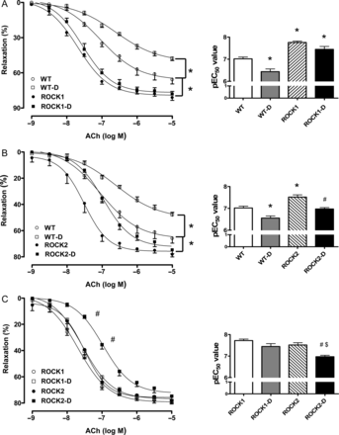
Figure 3 Endothelium-dependent vasorelaxation in aortas of WT, ROCK1+/− (ROCK1) and ROCK2+/− (ROCK2) control, and ...
Notes:
Figure 3 Endothelium-dependent vasorelaxation in aortas of WT, ROCK1+/− (ROCK1) and ROCK2+/− (ROCK2) control, and diabetic (D) mice. Endothelium-mediated relaxation to ACh (10−9 to 10−5M) was assessed in aortic rings from all groups. (A–C) Comparisons between genotypes. Data were calculated as changes from the contraction produced by PE (10−7 to 10−6 M) in each tissue, which was taken as 100%. To the right side of each relaxation curve are pEC50 values (negative logarithm of the concentration of ACh effective in producing 50% of the maximum relaxation). Data are represented as means ± SEM, n = 5–8 mice/group. *P < 0.05 vs. WT control mice; #P < 0.05 vs. ROCK2 control mice; $P < 0.05 vs. ROCK1-D mice.
Unless provided in the caption above, the following copyright applies to the content of this slide: Published on behalf of the European Society of Cardiology. All rights reserved. © The Author 2012. For permissions please email: journals.permissions@oup.com.

Slide 4
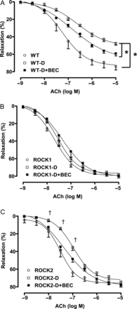
Figure 4 Effect of arginase inhibition on endothelium-dependent vasorelaxation. ACh (10⁻⁹ to ...
Notes:
Figure 4 Effect of arginase inhibition on endothelium-dependent vasorelaxation. ACh (10−9 to 10−5 M)-mediated relaxation was determined before and after the application of arginase inhibitor, BEC (100 μM) into the baths containing the aortic rings from ROCK1+/− (ROCK1), ROCK2+/− (ROCK2), and WT diabetic (D) mice. Data were calculated relative to the contraction produced by PE (10−7 to 10−6 M) in each tissue, which was taken as 100%. Data are represented as means ± SEM, n = 5–8 mice/group. *P < 0.05 vs. WT-D mice; †P < 0.05 ROCK2-D mice vs. ROCK2-D + BEC mice.
Unless provided in the caption above, the following copyright applies to the content of this slide: Published on behalf of the European Society of Cardiology. All rights reserved. © The Author 2012. For permissions please email: journals.permissions@oup.com.

Slide 5
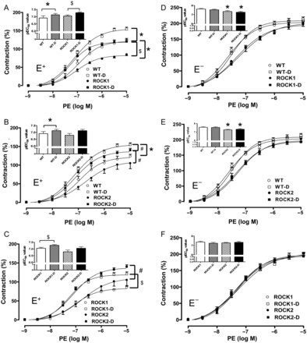
Figure 5 Contractile-response curve with PE in E⁺ and E⁻ aortas of WT, ROCK1+/− (ROCK1) and ...
Notes:
Figure 5 Contractile-response curve with PE in E+ and E− aortas of WT, ROCK1+/− (ROCK1) and ROCK2+/− (ROCK2) non-diabetic and diabetic (D) mice. Contraction to α1-adrenergic receptor agonist PE (10−9 to 10−5 M) was assessed in aortic rings from all groups. (A–C and D–F) Comparisons between genotypes. Data were calculated relative to the maximal changes from the contraction produced by KCl (80 mM), which was taken as 100%. To the left top side of each contraction curve are pEC50 values (negative logarithm of the concentration of PE effective in producing 50% of the maximum contraction). Data are represented as means ± SEM, n = 5–8 mice/group. *P < 0.05 vs. WT control mice; $P < 0.05 vs. ROCK1 control mice; #P < 0.05 vs. ROCK2-D mice.
Unless provided in the caption above, the following copyright applies to the content of this slide: Published on behalf of the European Society of Cardiology. All rights reserved. © The Author 2012. For permissions please email: journals.permissions@oup.com.

Slide 6
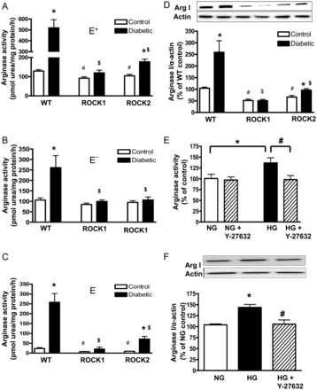
Figure 6 Arginase activity in the E⁺ (A) and E⁻ aortic tissue (B) and Arginase I expression in ...
Notes:
Figure 6 Arginase activity in the E+ (A) and E− aortic tissue (B) and Arginase I expression in E+ (D) from WT, ROCK1+/− (ROCK1) and ROCK2+/− (ROCK2) control and diabetic mice. Arginase activity was measured in E+ and E− aortas from all groups. The values of arginase activity in the endothelium (C) are calculated by the subtraction of the activity values in E− from those in E+. Values are represented as means ± SEM, n = 3–8/group. *P < 0.05 vs. its control mice; #P < 0.05, ROCK1 or ROCK2 control mice vs. WT control mice; $P < 0.05, ROCK1-D or ROCK2-D mice vs. WT-D mice. Arginase activity (E) and expression (F) in HG (25 mM)-treated BAECs. Some BAECs were pretreated with the ROCK inhibitor, Y-27632 (10 μM) for 1 h and then treated with normal glucose (NG, 5.5 mM) or HG for 72 h. Arginase activity and arginase I expression were analysed in these cells. Values are expressed as means ± SEM, n = 4 mice/group; *P < 0.05, HG vs. NG; #P < 0.05, Y-27632 vs. HG.
Unless provided in the caption above, the following copyright applies to the content of this slide: Published on behalf of the European Society of Cardiology. All rights reserved. © The Author 2012. For permissions please email: journals.permissions@oup.com.

