Slide 1
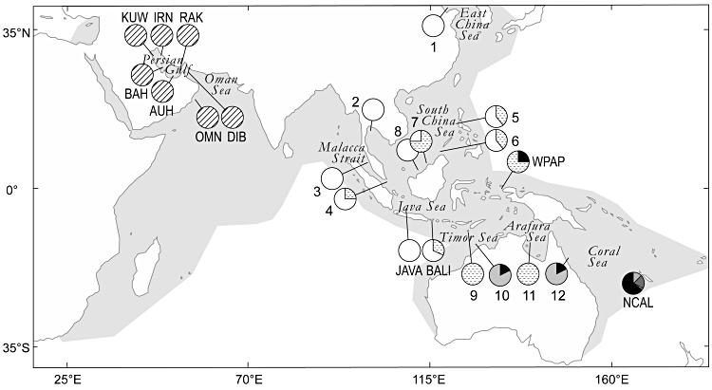
Figure 1. Sampling locations of narrow-barred Spanish mackerel, Scomberomorus commerson, across the Indo-West pacific. ...
Notes:
Figure 1. Sampling locations of narrow-barred Spanish mackerel, Scomberomorus commerson, across the Indo-West pacific. Pie diagrams represent control-region haplotype frequencies (hatched, clade I; black, haplogroup ii; dark grey, subclade IIa; dotted, subclade IIb; white, subclade IIc; pale grey, subclade IId; see Fig. 2). Abbreviations: BALI, Bali; JAVA, Java Sea; NCAL, New Caledonia; WPAP, West Papua. Samples AUH, BAH, DIB, IRN, KUW, OMN, and RAK were from Hoolihan, Anandh & van Herwerden (2006); samples 1–12 were from Sulaiman & Ovenden (2009). Shaded area: distribution range of S. commerson (Collette & Russo, 1984; Carpenter & Niem, 2001).
Unless provided in the caption above, the following copyright applies to the content of this slide: © 2011 The Linnean Society of London

Slide 2
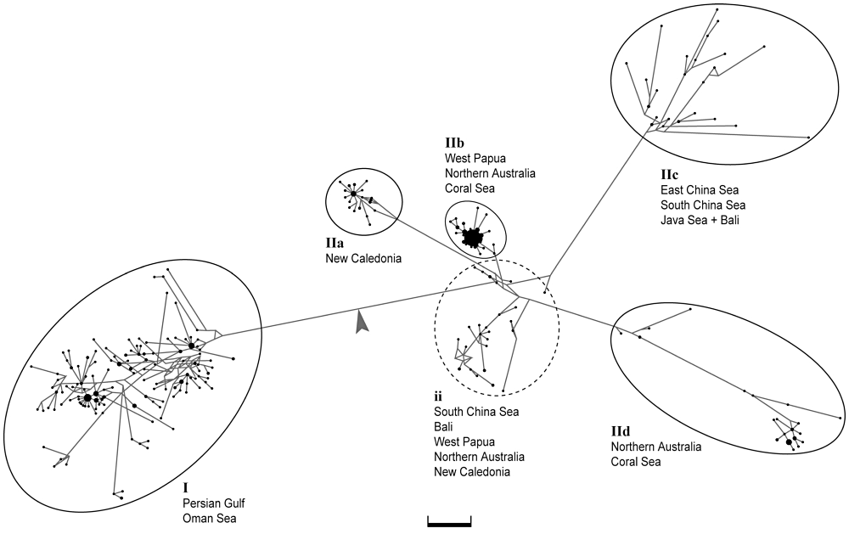
Figure 2. Median-joining parsimony network (Bandelt et al., 1999) of control-region haplotypes for the narrow-barred ...
Notes:
Figure 2. Median-joining parsimony network (Bandelt et al., 1999) of control-region haplotypes for the narrow-barred Spanish mackerel Scomberomorus commerson. Groups of haplotypes delineated according to genetic proximity, with an indication of area of occurrence: two main clades, numbered I and II, the latter with subclades IIa, IIb, IIc, and IId, radiating from a central haplogroup ii. Branch lengths are proportional to the number of mutational steps; closed circles represent individual haplotypes, with their area being proportional to their frequency in the total sample; arrow, indicates root. Bootstrap support (neighbour-joining algorithm; Kimura two-parameter distances; 1000 resampling runs; Tamura et al., 2007): 100% for clade I; 98% for subclade IIa; 32% for subclade IIb; 81% for subclade IIc; 98% for subclade IId. Scale bar: five mutational steps.
Unless provided in the caption above, the following copyright applies to the content of this slide: © 2011 The Linnean Society of London

Slide 3
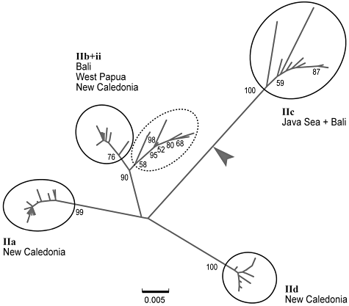
Figure 3. Neighbour-joining tree (Tamura three-parameter distances; MEGA 5) of composite mitochondrial sequences (281 ...
Notes:
Figure 3. Neighbour-joining tree (Tamura three-parameter distances; MEGA 5) of composite mitochondrial sequences (281 bp of cytochrome b gene + 392 bp of control region) from the narrow-barred Spanish mackerel Scomberomorus commerson. The arrow indicates the root.
Unless provided in the caption above, the following copyright applies to the content of this slide: © 2011 The Linnean Society of London

Slide 4
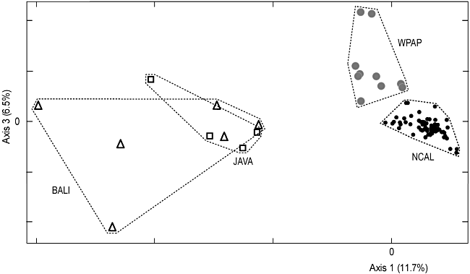
Figure 4. Correspondence analysis: projection on the two dimensions defined by axes 1 and 3, of 86 individuals of the ...
Notes:
Figure 4. Correspondence analysis: projection on the two dimensions defined by axes 1 and 3, of 86 individuals of the Narrow-barred Spanish mackerel, Scomberomorus commerson, sampled from Bali (BALI, N = 6), Java Sea (JAVA, N = 4), West Papua (WPAP, N = 10), and New Caledonia (NCAL, N = 66), characterized by their genotype at eight microsatellite loci. Multiple nuclear locus estimates of genetic differentiation were as follows: JAVA vs. BALI, = 0.014, P = 0.369; (JAVA + BALI) vs. WPAP, = 0.231, P < 0.001; (JAVA + BALI) vs. NCAL, = 0.311, P < 0.001; WPAP vs. NCAL, = 0.202, P < 0.001.
Unless provided in the caption above, the following copyright applies to the content of this slide: © 2011 The Linnean Society of London

