Slide 1
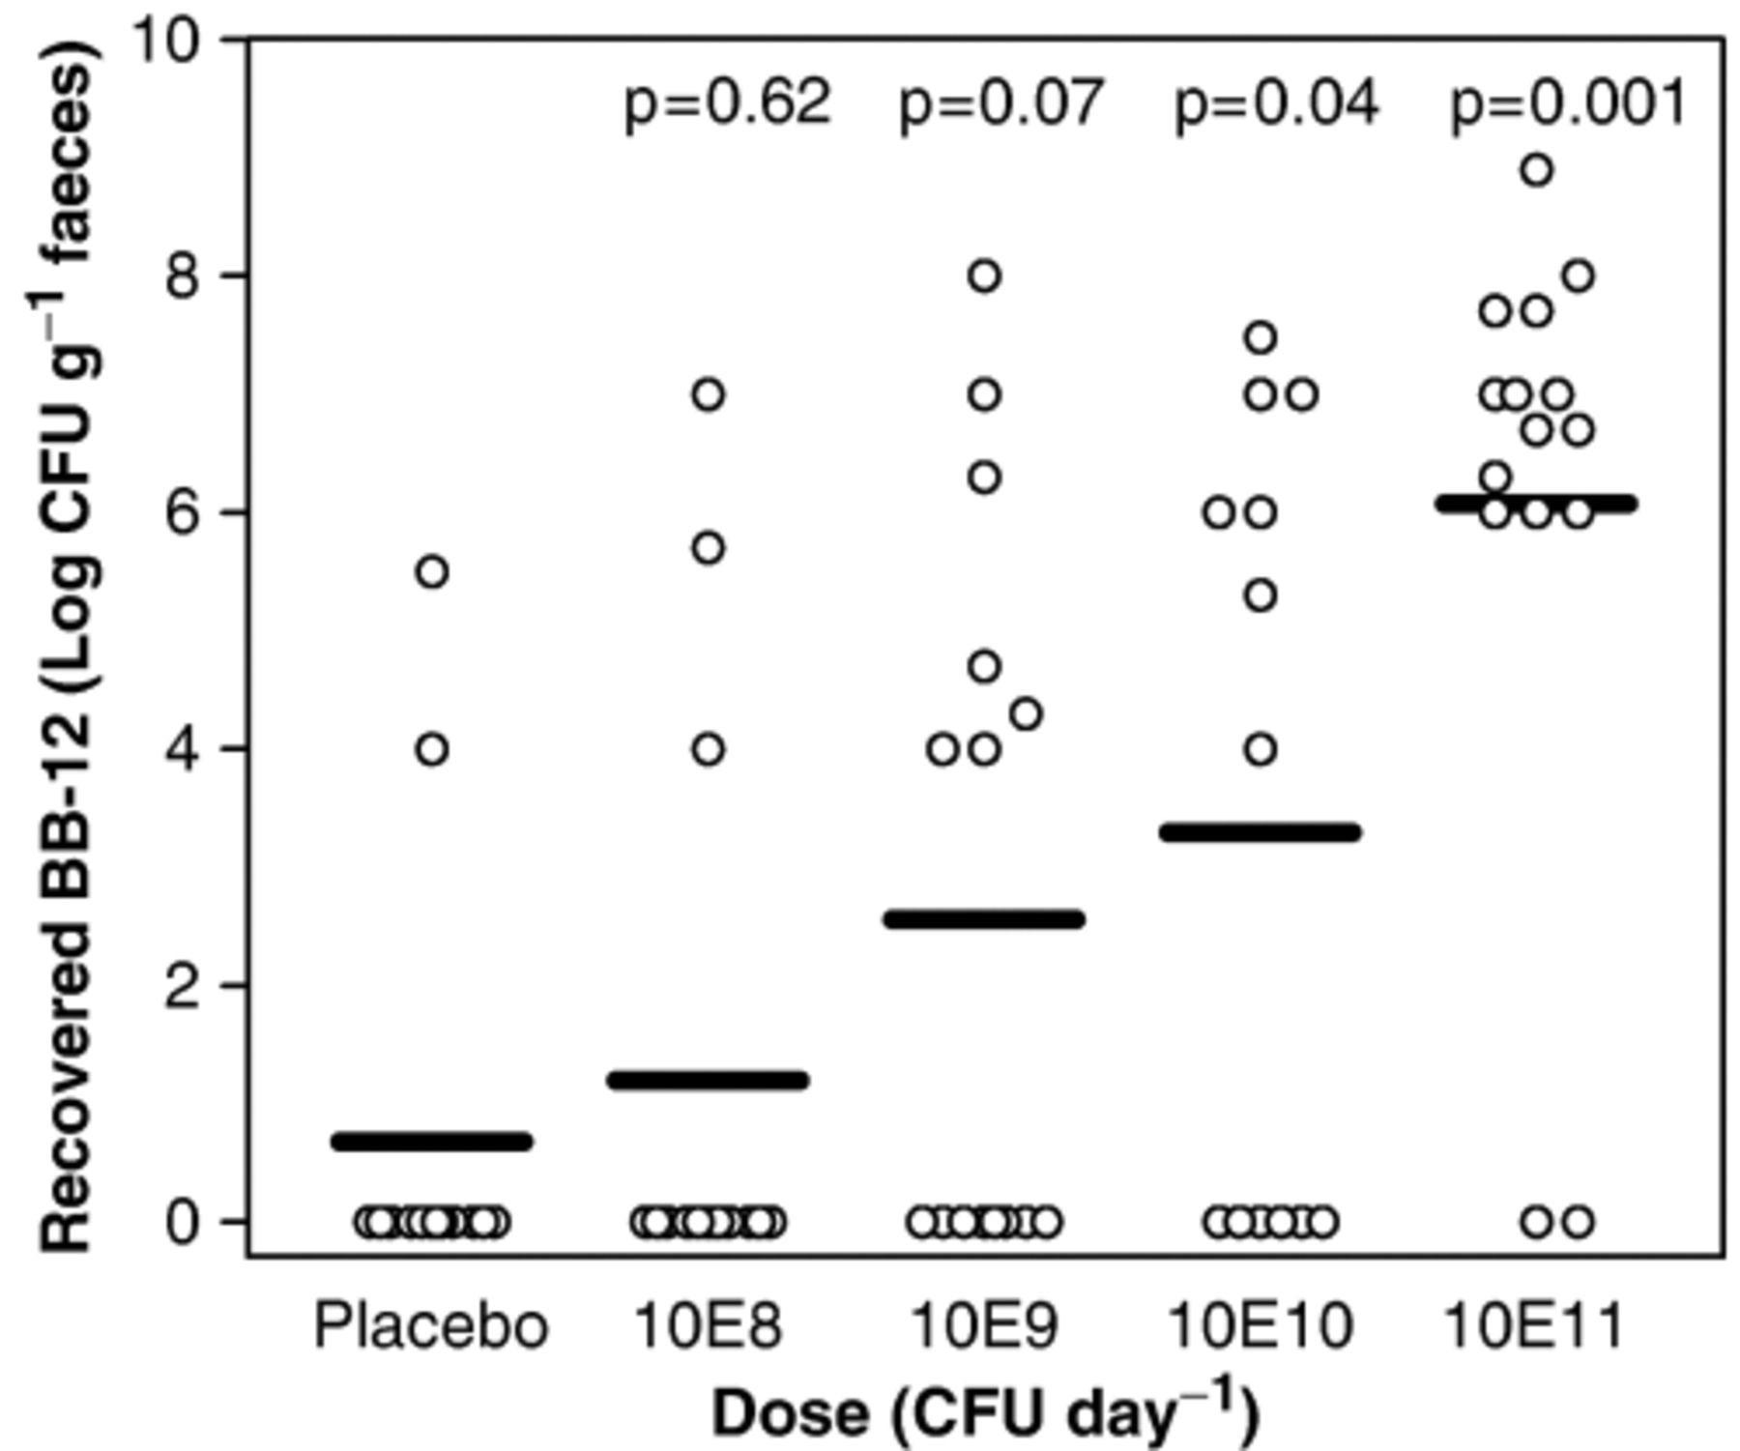
Figure 1 Recovery of Bifidobacterium animalis ssp. lactis BB-12 (BB-12) (±95% CI) in faeces immediately after ...
Notes:
Figure 1 Recovery of Bifidobacterium animalis ssp. lactis BB-12 (BB-12) (±95% CI) in faeces immediately after cessation of bacterial supplementation (visit 3 sample) depicted against supplementation dose. Linear regression analysis on dose–response relationship gives P<0.001. Logistic regression analysis (P<0.001) gives the P-values stated at the top of each column, indicating the statistical chance of recovering viable BB-12 in faeces from subjects supplemented with the given dose of BB-12; the 1010 CFU day−1 dose was the lowest dose providing a statistically significant chance of recovering viable bacteria.
Unless provided in the caption above, the following copyright applies to the content of this slide: © 2006 Federation of European Microbiological Societies

Slide 2
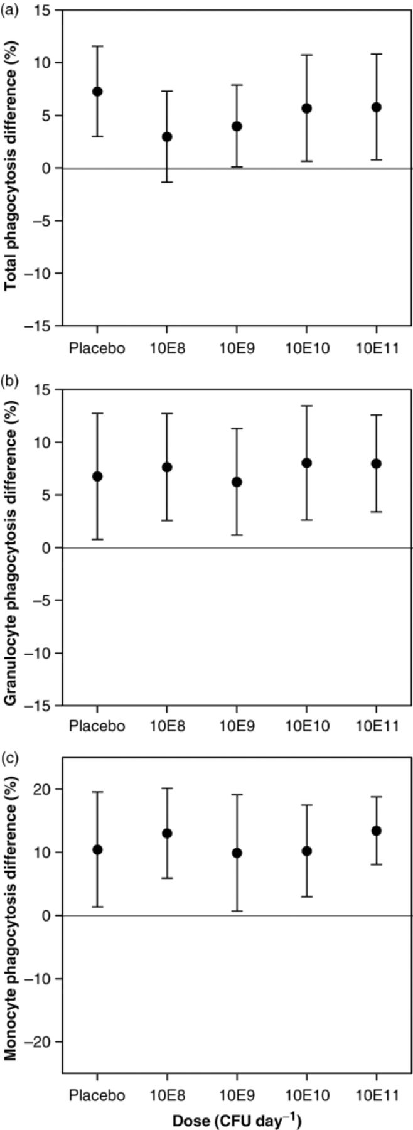
Figure 2 Difference in phagocytic activity (±95% CI) of peripheral blood (total) (a) the blood granulocytes (b) and ...
Notes:
Figure 2 Difference in phagocytic activity (±95% CI) of peripheral blood (total) (a) the blood granulocytes (b) and monocytes (c) from before supplementation with a mixture of Bifidobacterium animalis ssp. lactis BB-12 and Lactobacillus paracasei ssp. paracasei CRL-431 (baseline) to immediately after cessation of supplementation (visit 3). Baseline values (mean of visit 1 and 2) are given in Table 2. There was no statistically significant dose–response relationship (linear regression) for total, granulocyte or monocyte phagocytosis (P=0.68, 0.56 and 0.41, respectively).
Unless provided in the caption above, the following copyright applies to the content of this slide: © 2006 Federation of European Microbiological Societies

Slide 3
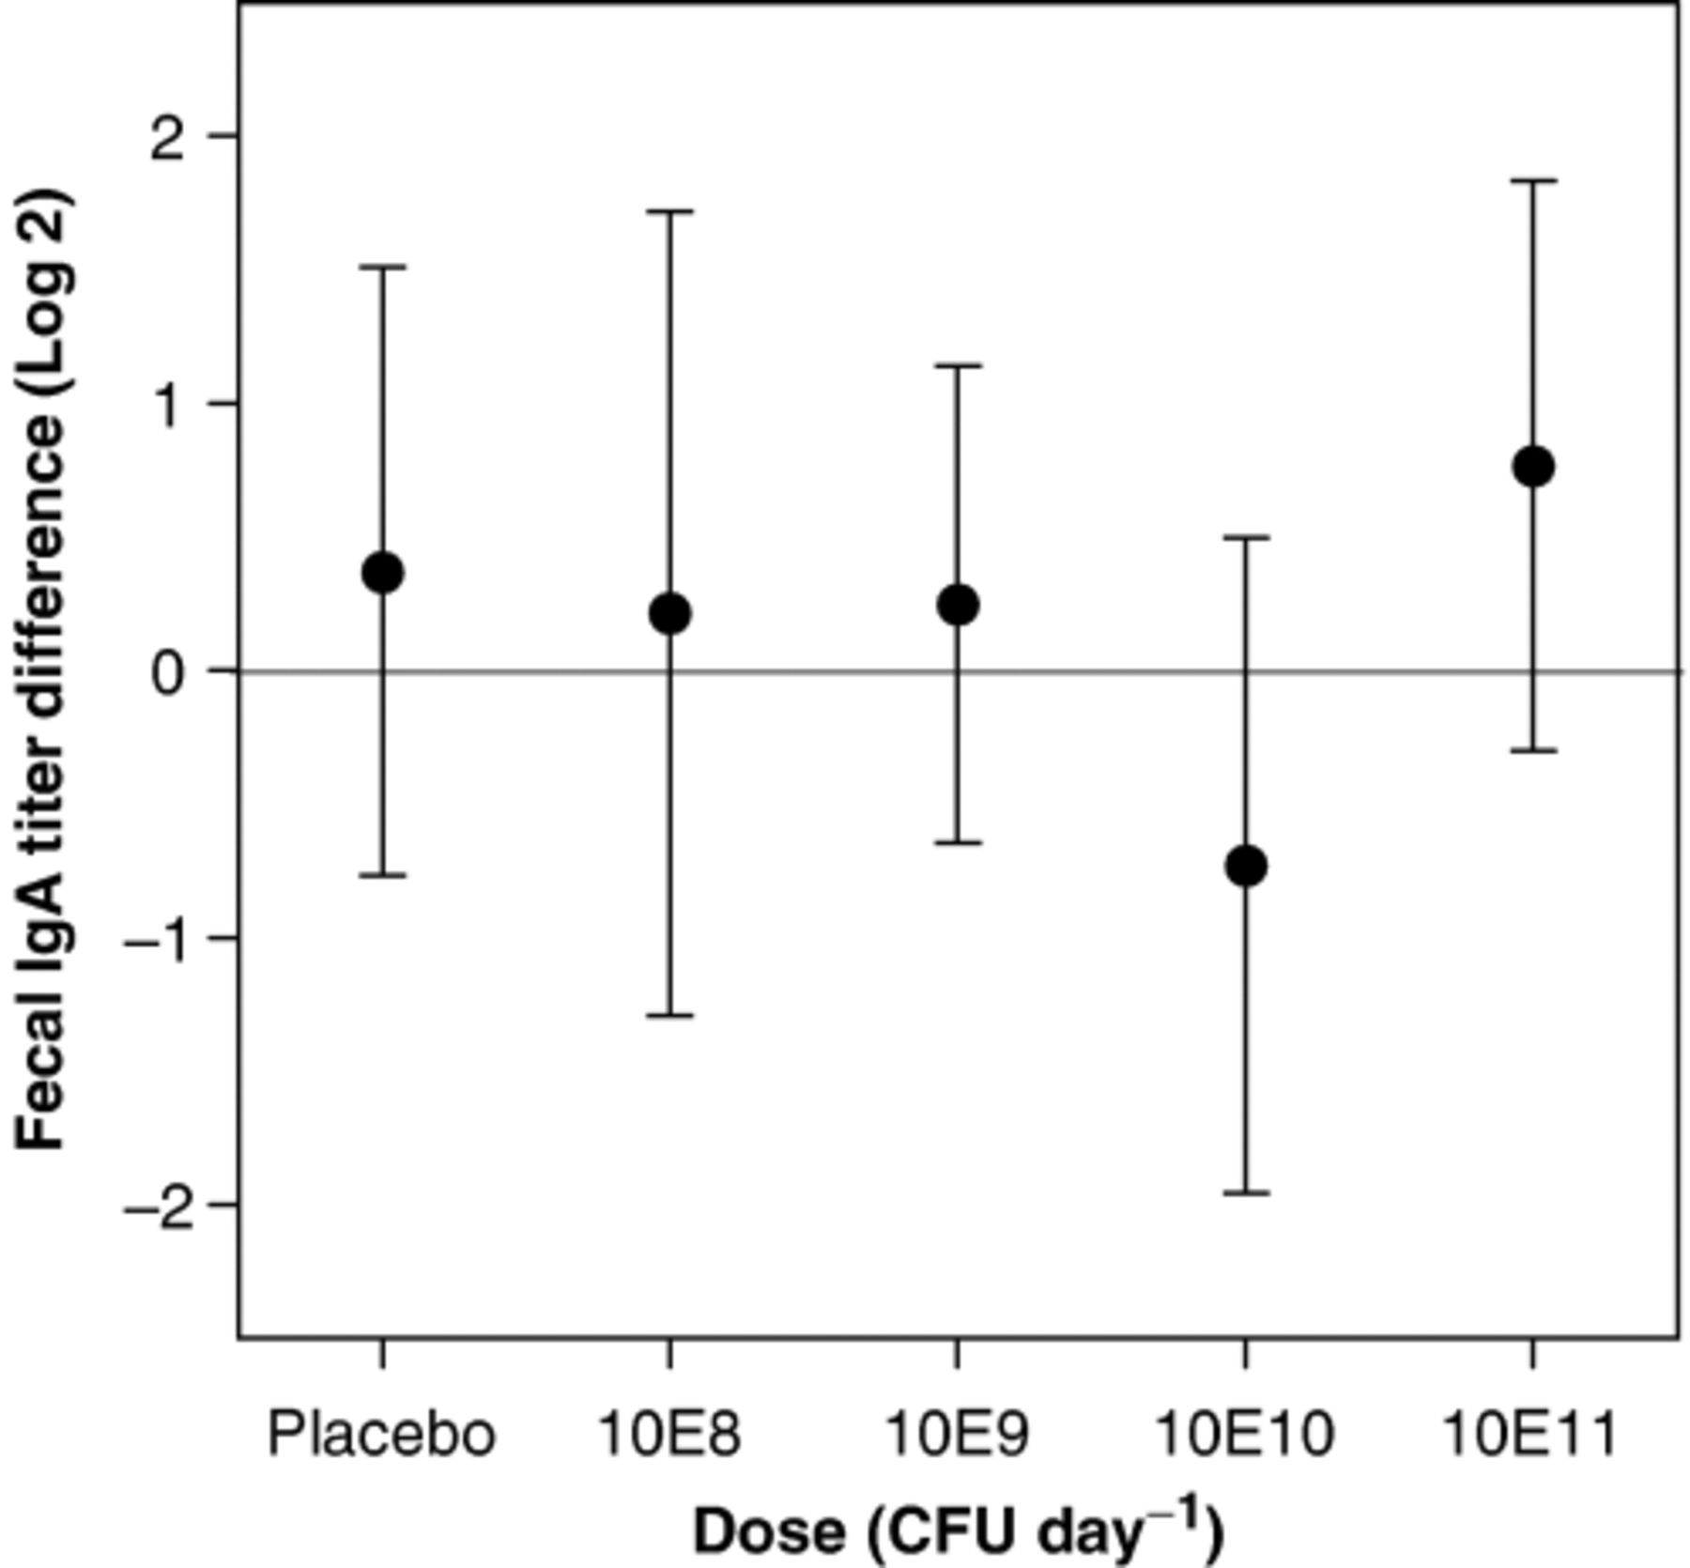
Figure 3 Difference in total fecal immunoglobulin A (±95% CI) from before supplementation with a mixture of ...
Notes:
Figure 3 Difference in total fecal immunoglobulin A (±95% CI) from before supplementation with a mixture of Bifidobacterium animalis ssp. lactis BB-12 and Lactobacillus paracasei ssp. paracasei CRL-431 (baseline) to immediately after cessation of supplementation (visit 3). Baseline values (mean of visit 1 and 2) are given in Table 2. There was no statistically significant dose–response relationship (linear regression, P=0.88).
Unless provided in the caption above, the following copyright applies to the content of this slide: © 2006 Federation of European Microbiological Societies

Slide 4
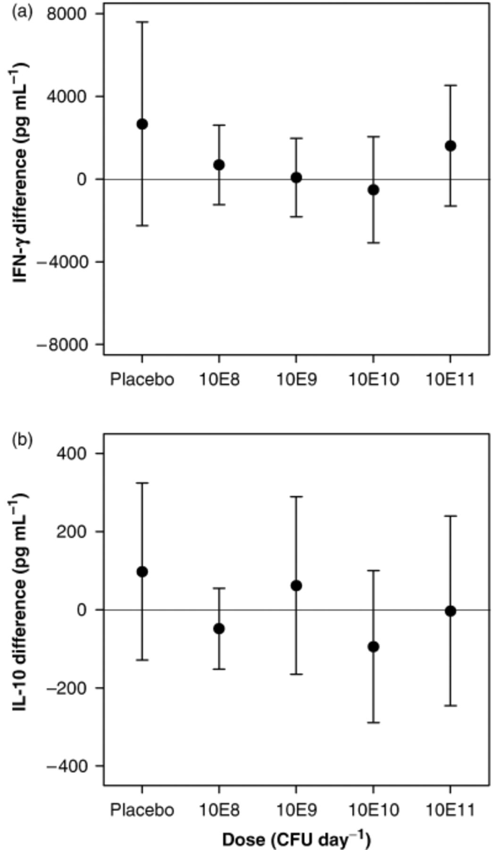
Figure 4 Difference in production of IFN-γ (a) and IL-10 (b) (±95% CI) in blood samples stimulated directly in the ...
Notes:
Figure 4 Difference in production of IFN-γ (a) and IL-10 (b) (±95% CI) in blood samples stimulated directly in the blood collection tube by a mixture of lipopolysaccharide and phytohaemagglutin from before (baseline) to immediately after cessation of supplementation (visit 3). Baseline values (mean of visit 1 and 2) are given in Table 2. There was no statistically significant dose–response relationship (linear regression, P=0.35 and 0.55, respectively).
Unless provided in the caption above, the following copyright applies to the content of this slide: © 2006 Federation of European Microbiological Societies

Slide 5
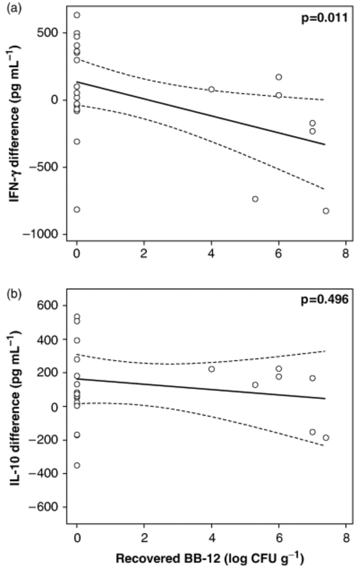
Figure 5 Difference in production of interferon-γ (a) and interleukin-10 (b) in blood samples from star-marked groups ...
Notes:
Figure 5 Difference in production of interferon-γ (a) and interleukin-10 (b) in blood samples from star-marked groups (placebo and 1010 CFU day−1 group) stimulated in vitro with lipopolysaccharide depicted according to fecal recovery of viable Bifidobacterium animalis ssp. lactis BB-12. The stated P-values come from linear regression analysis and the error lines are 95% CI.
Unless provided in the caption above, the following copyright applies to the content of this slide: © 2006 Federation of European Microbiological Societies

