Slide 1
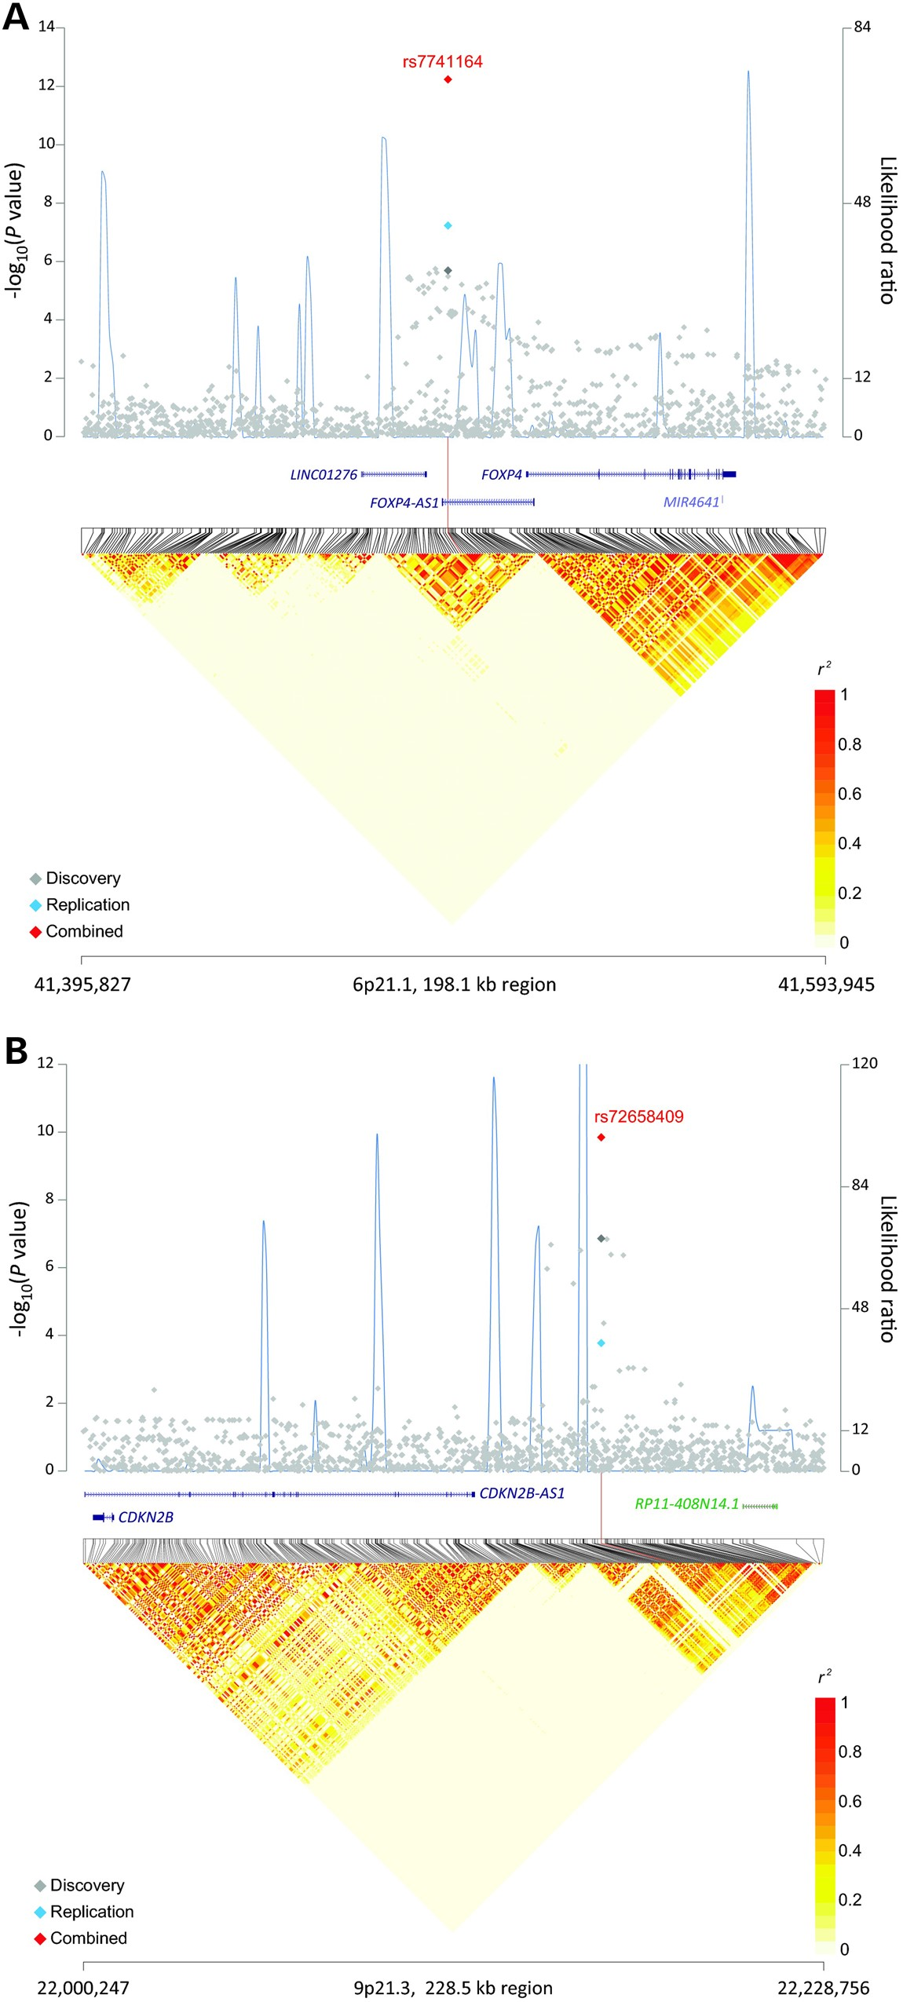
Figure 1. Association results, recombination hotspots and LD plot for three newly identified regions associated with ...
Notes:
Figure 1. Association results, recombination hotspots and LD plot for three newly identified regions associated with lung cancer risk in never-smoking Asian women. (A–C) Top, association P values from meta-analysis of four imputed GWAS scans included for discovery stage (gray diamond) were plotted on a negative log scale (left y-axis) against genomic coordinates (hg19). For each region, meta-analysis result of replication sets (blue diamond), and overall combined meta-analysis (red diamond) for the index SNP are also shown. Overlaid (blue line) are likelihood ratio statistics (right y-axis) for recombination hotspots inferred from the 1000 Genomes Project phase 1 Asian populations (100 random samples). Bottom, Linkage disequilibrium heat map based on r2 using the 1000 Genomes Project phase 1 Asian data (n = 286). Shown are results for (A) 6p21.1 (chr6:41395827-41593945); (B) 9p21.3 (chr9:22000247-22228756) and (C) 12p13.13 (chr12:52251272-52450046).
Unless provided in the caption above, the following copyright applies to the content of this slide: Published by Oxford University Press 2016. This work is written by (a) US Government employee(s) and is in the public domain in the US

Slide 2
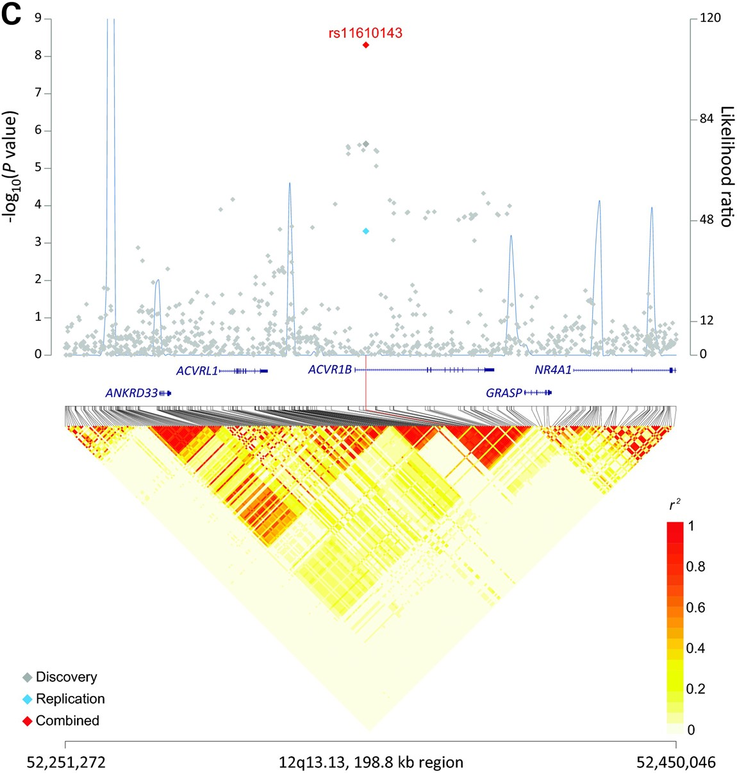
Figure 1. Association results, recombination hotspots and LD plot for three newly identified regions associated with ...
Notes:
Figure 1. Association results, recombination hotspots and LD plot for three newly identified regions associated with lung cancer risk in never-smoking Asian women. (A–C) Top, association P values from meta-analysis of four imputed GWAS scans included for discovery stage (gray diamond) were plotted on a negative log scale (left y-axis) against genomic coordinates (hg19). For each region, meta-analysis result of replication sets (blue diamond), and overall combined meta-analysis (red diamond) for the index SNP are also shown. Overlaid (blue line) are likelihood ratio statistics (right y-axis) for recombination hotspots inferred from the 1000 Genomes Project phase 1 Asian populations (100 random samples). Bottom, Linkage disequilibrium heat map based on r2 using the 1000 Genomes Project phase 1 Asian data (n = 286). Shown are results for (A) 6p21.1 (chr6:41395827-41593945); (B) 9p21.3 (chr9:22000247-22228756) and (C) 12p13.13 (chr12:52251272-52450046).
Unless provided in the caption above, the following copyright applies to the content of this slide: Published by Oxford University Press 2016. This work is written by (a) US Government employee(s) and is in the public domain in the US

