Slide 1
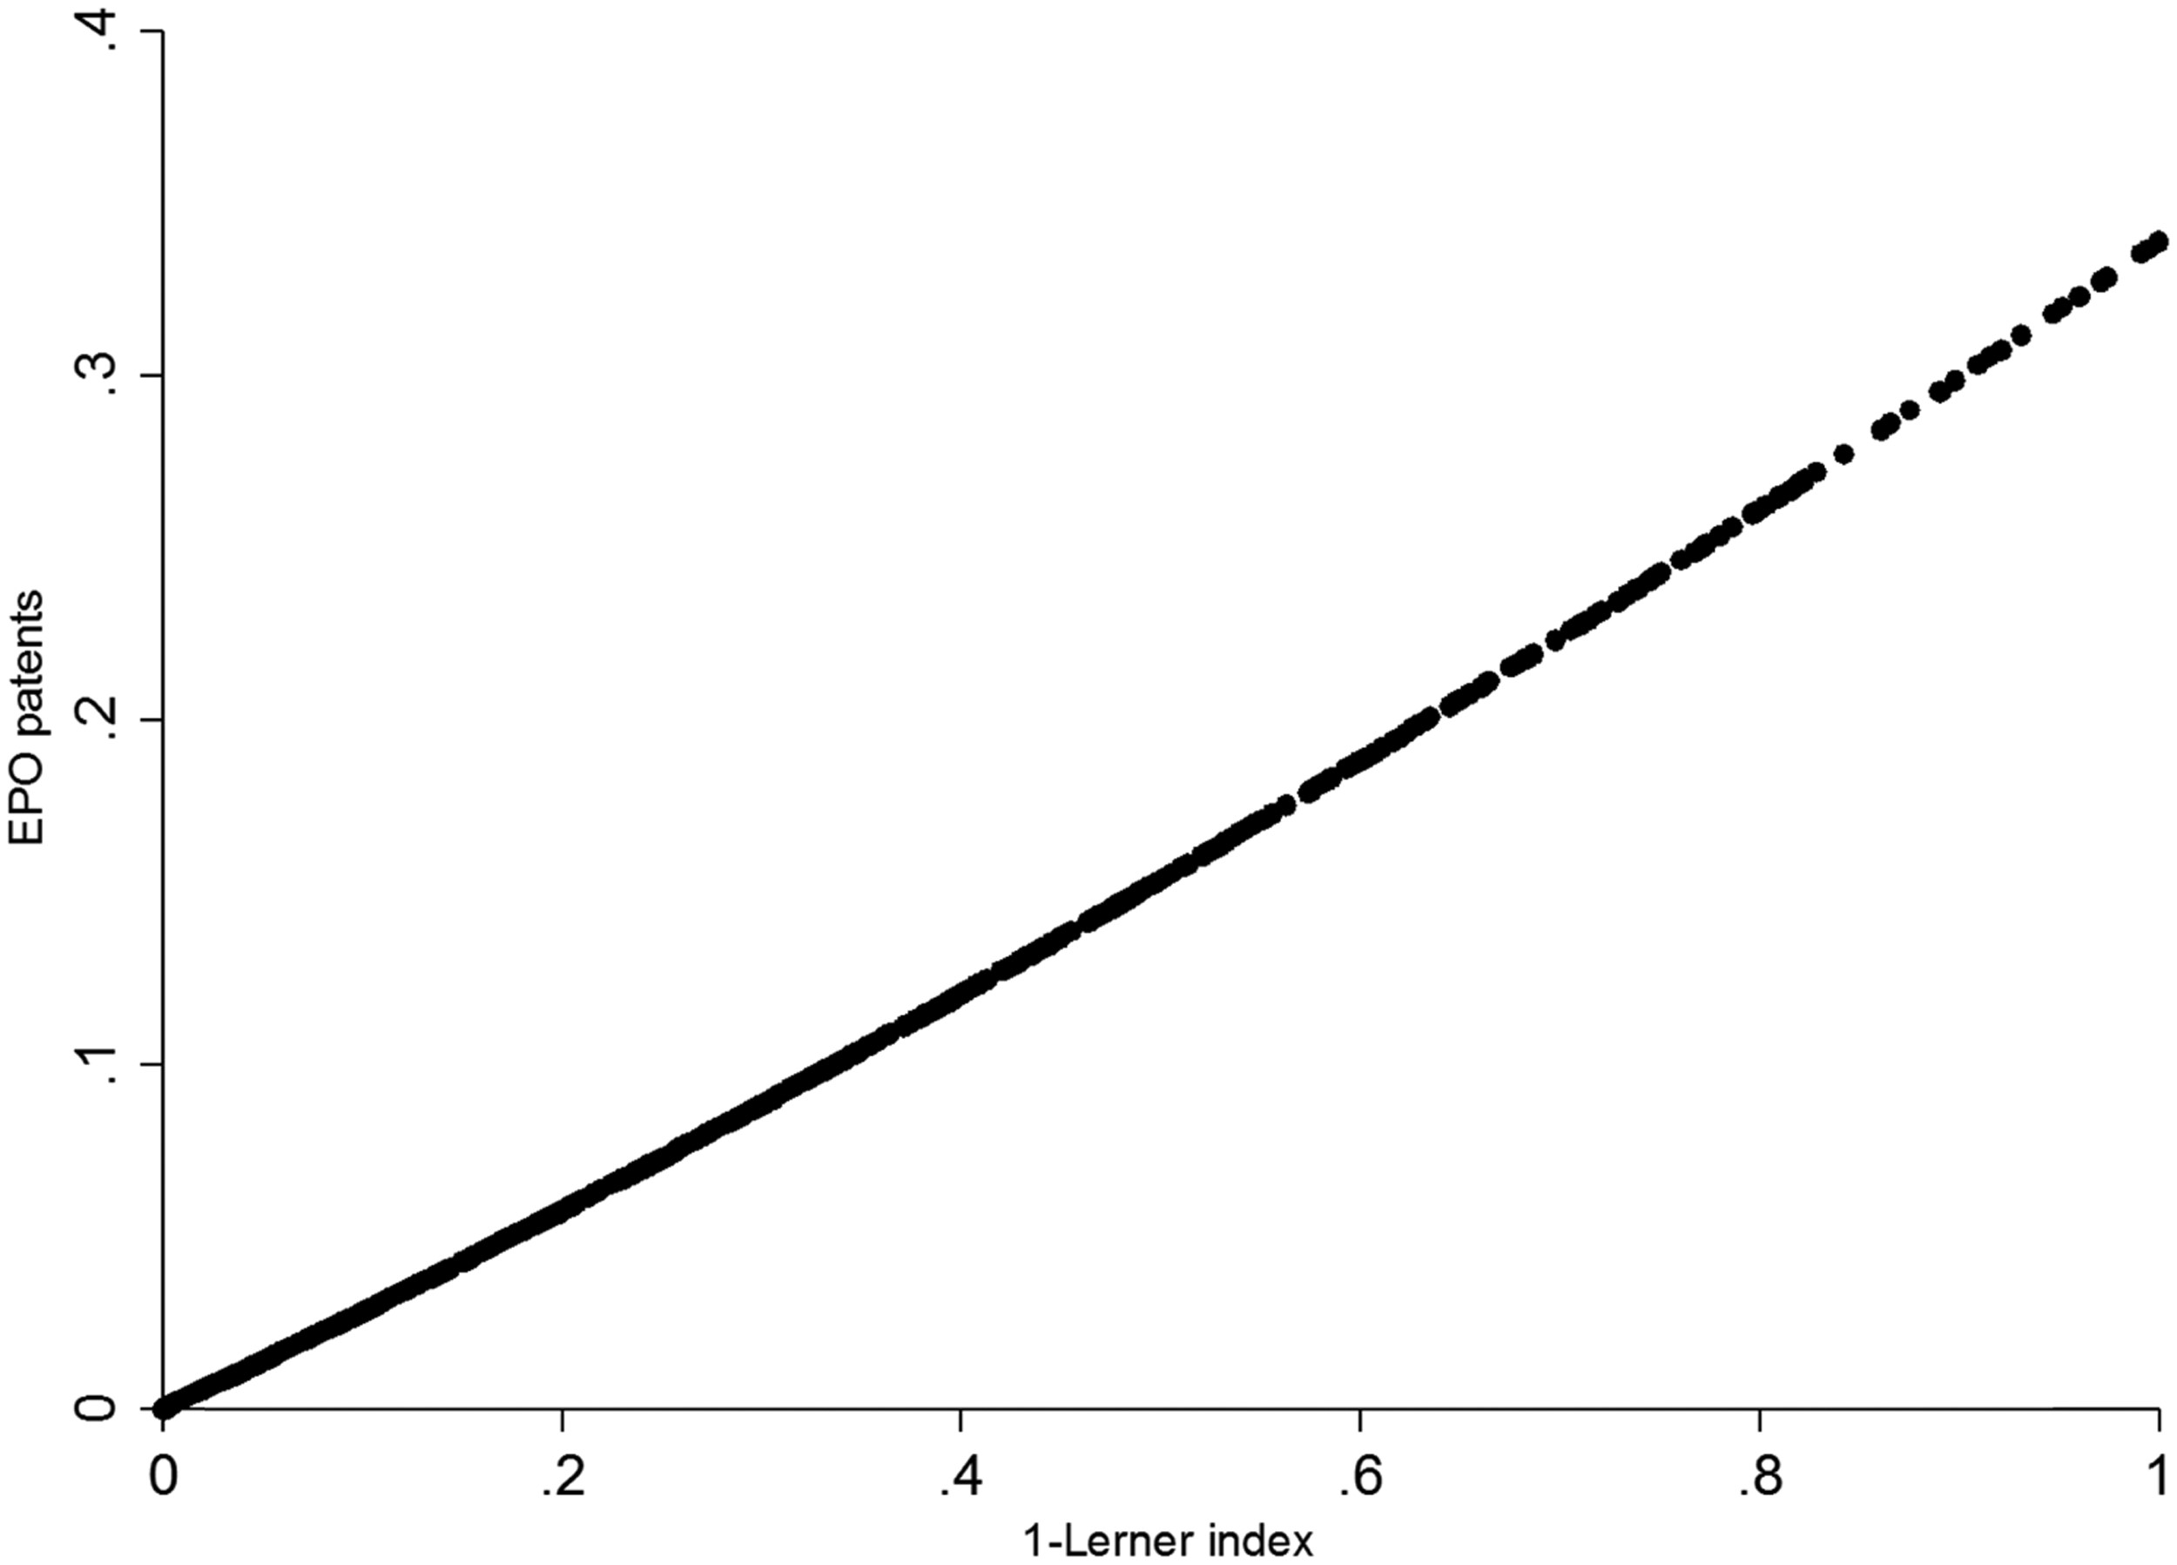
Fig. 1 Quadratic fit of EPO-patents on competition and competition squared (Spanish data from the ESEE). Note: ...
Notes:
Fig. 1 Quadratic fit of EPO-patents on competition and competition squared (Spanish data from the ESEE). Note: Adjusted line of EPO patents regressed on competition and competition squared that is reported in column (1) of Table 2. Firm-level data from the ESEE is aggregated at the 3-digit industry level. Competition is measured as 1-Lerner index. The estimation equation includes the full set of industrial and year dummies. A control function for possible endogeneity of competition is included (residuals coming from a first-stage reduced form estimation of competition on industry-year most-favoured-nation import tariffs plus the rest of exogenous regressors in the model).
Unless provided in the caption above, the following copyright applies to the content of this slide: © Oxford University Press 2017 All rights reserved

Slide 2
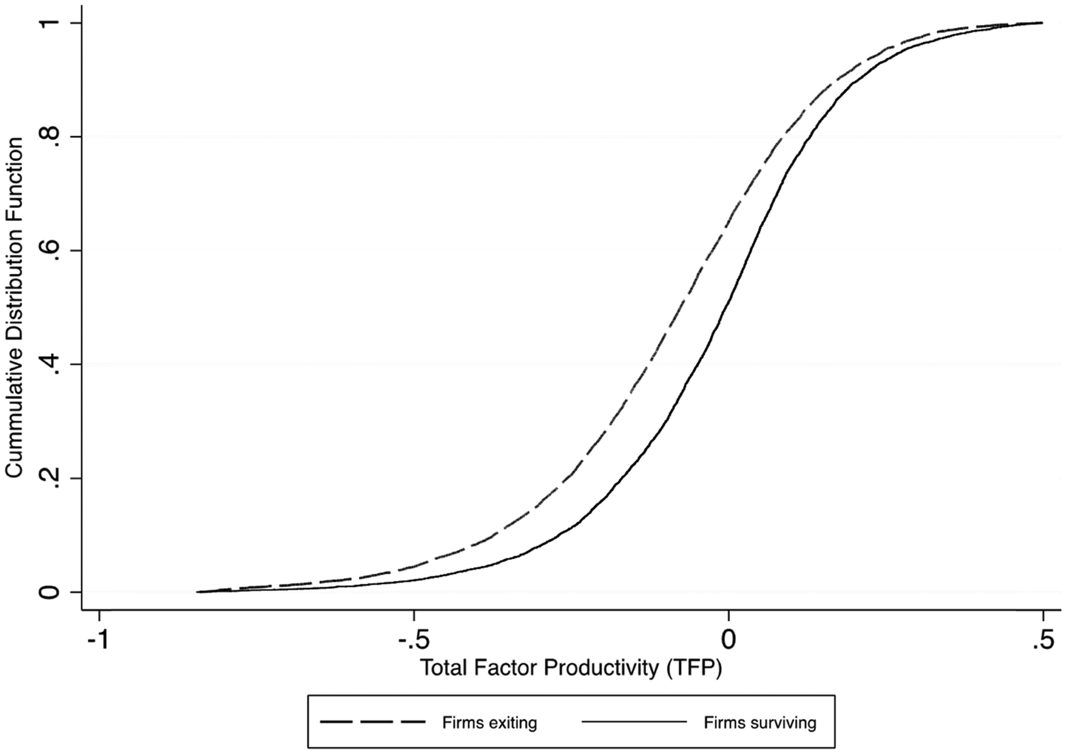
Fig. 2 Kernel cumulative distribution function of productivity for surviving vs. exiting (bankrupt) firms.
Notes:
Fig. 2 Kernel cumulative distribution function of productivity for surviving vs. exiting (bankrupt) firms.
Unless provided in the caption above, the following copyright applies to the content of this slide: © Oxford University Press 2017 All rights reserved

