Slide 1
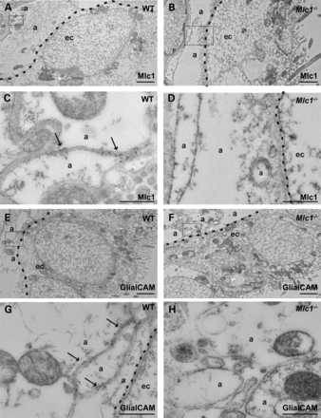
Figure 1. GlialCAM does not localize to astrocyte junctions in subependymal astrocytes in Mlc1^{−/−} mice. ...
Notes:
Figure 1. GlialCAM does not localize to astrocyte junctions in subependymal astrocytes in Mlc1−/− mice. (A–D) EM immunolabelling of ependymal cells shows localization of Mlc1 in astrocyte–astrocyte junctions (arrows) near ependymal cells (A and C). Dotted lines highlight boundaries between ependymal cells (ec) and inner astrocytic processes (a). The signal was specific as it was absent in Mlc1−/− mice (B and D). The insets in (A) and (B) are shown amplified in (C) and (D). Scale bars: (A, B): 2 μm; (C, D): 500 nm. (E–H) EM immunolabelling images of GlialCAM in astrocyte junctions below ependymal cells (arrows) (E, G). GlialCAM protein could not be observed in astrocyte–astrocyte junctions in Mlc1−/− mice (F, H). The insets in (E) and (F) are shown amplified in (G) and (H). Scale bars: (E and F): 2 μm; (G and H): 500 nm.
Unless provided in the caption above, the following copyright applies to the content of this slide: © The Author 2014. Published by Oxford University Press. All rights reserved. For Permissions, please email: journals.permissions@oup.com

Slide 2
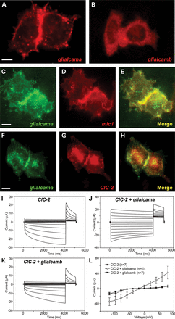
Figure 2. Characterization of the zebrafish orthologues of Mlc1 and Glialcam. (A and B) glialcama and glialcamb were ...
Notes:
Figure 2. Characterization of the zebrafish orthologues of Mlc1 and Glialcam. (A and B) glialcama and glialcamb were transfected separately in HeLa cells and detected through the FLAG epitope with immunofluorescence. While glialcama is specifically located in cell–cell junctions, glialcamb protein presented a diffuse location. Scale bar: 10 μm. (C–E) Co-transfection of glialcama and mlc1 in HeLa cells reveals their co-localization at cell junctions. Scale bar: 10 μm. (F–H) Co-transfection of glialcama and rat ClC-2 in HeLa cells reveals their co-localization at cell junctions. Scale bar: 10 μm. (I–L) A typical current trace mediated by rat ClC2 (I) expressed in oocytes and after co-expression with glialcama (J) or glialcamb (K). Only glialcama is able to modify the functional properties of ClC-2. The apparent inactivation observed sometimes at very negative voltages is an artefact caused by chloride depletion inside the oocytes (J). (L) Average steady-state current–voltage relationship of ClC-2 (black circles) and ClC-2 co-expressed with glialcama (white circles) or with glialcamb (triangles). Glialcama increased ClC-2-mediated conductance and changed its rectification properties.
Unless provided in the caption above, the following copyright applies to the content of this slide: © The Author 2014. Published by Oxford University Press. All rights reserved. For Permissions, please email: journals.permissions@oup.com

Slide 3
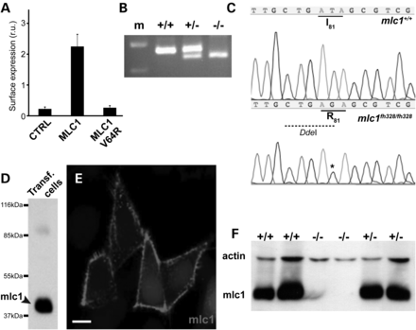
Figure 3. Generation of a zebrafish model for MLC based on the inactivation of mlc1. (A) Expression in Xenopus oocytes ...
Notes:
Figure 3. Generation of a zebrafish model for MLC based on the inactivation of mlc1. (A) Expression in Xenopus oocytes of human MLC1 carrying the V64R mutation abolishes its surface expression, as assayed by detection by an ELISA-based assay. (B) Restriction analysis with DdeI allows for the identification of wild-type (+/+), heterozygous (+/−) or homozygous mutant (−/−) fish of the mlc1fh328 allele. m: molecular weight marker. (C) Zebrafish mlc1fh328 allele originates the I81R mutation, and generates a DdeI restriction site. (D and E) Custom-generated antibody against mlc1 detects a protein of the expected molecular weight (around 42 kDa, arrowhead) and its localization in the membrane on mlc1-transfected HeLa cells. The band observed at about 85 kDa corresponds to mlc1 dimers. Scale bar (E): 10 μm. (F) Western blot of brain extracts from adult wild-type (+/+), heterozygous (+/−) or homozygous mutant (−/−) fish for the mlc1fh328 allele demonstrates the absence of the mlc1 protein in the homozygous zebrafish.
Unless provided in the caption above, the following copyright applies to the content of this slide: © The Author 2014. Published by Oxford University Press. All rights reserved. For Permissions, please email: journals.permissions@oup.com

Slide 4
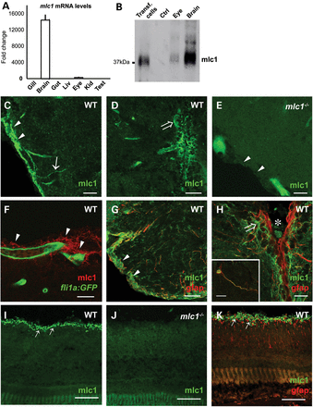
Figure 4. mlc1 expression and localization pattern in adult zebrafish. (A) qPCR with RNA from adult tissues shows the ...
Notes:
Figure 4. mlc1 expression and localization pattern in adult zebrafish. (A) qPCR with RNA from adult tissues shows the expression of mlc1 almost exclusively in the brain, and at a lesser level in the eye. (B) Western blot with the custom mlc1 antibody shows its expression on the brain and eye. As controls, we used extracts from mlc1-transfected and untransfected HeLa cells. (C–F) Immunofluorescence detection of mlc1 in the zebrafish adult brain. (C) mlc1 is expressed in radial glia processes (arrow) and pial end-feet (arrowheads). (D) mlc1 expression surrounds the ventricle of the brain (open arrow). (E) No immunoreactivity is observed in mlc1−/−. Arrowheads point to the pial surface of the brain. Scale bars: 20 μm. (F) Localization of mlc1 (red) in glial perivascular processes (arrowheads) around blood vessels (green) in the brain of a fli1a::GFP transgenic zebrafish. Scale bar: 10 μm. (G and H) mlc1 co-localizes with the astrocytic protein gfap in the zebrafish adult brain at the pial (arrowhead in G) and ventricular surfaces of the brain (open arrow in H). Asterisk labels the ventricle. Scale bars: 15 μm. Inset: gfap and mlc1 co-expression at the cell body and radial processes of an astrocyte located in a subependymal zone. Scale bar: 15 μm. (I–K) Localization of mlc1 on the retina. (I) mlc1 is expressed in the inner limiting membrane (arrows) of the retina. (J) No immunoreactivity against mlc1 is observed in mlc1−/− zebrafish retina. (K) Double immunofluorescence with gfap (red) confirms mlc1 expression (green) in radial glia processes and Müller glia end-feet (arrow) at inner limiting membrane. Scale bars: 100 μm.
Unless provided in the caption above, the following copyright applies to the content of this slide: © The Author 2014. Published by Oxford University Press. All rights reserved. For Permissions, please email: journals.permissions@oup.com

Slide 5
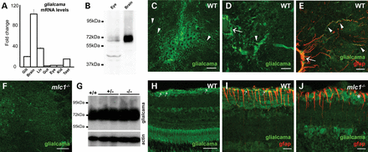
Figure 5. Glialcama is mislocalized in mlc1^{−/−} zebrafish. (A) qPCR with RNA from adult tissues shows the ...
Notes:
Figure 5. Glialcama is mislocalized in mlc1−/− zebrafish. (A) qPCR with RNA from adult tissues shows the highest expression of glialcama in the brain, but also in other tissues. (B) Western blot with the custom antibody shows glialcama expression on the brain and eye. (C and D) Immunofluorescence detection of glialcama in the zebrafish adult brain. We observed glialcam expression both in radial processes (arrowheads in C and D) and end-feet (arrow in D). Scale bars: 50 μm in (C), 20 μm in (D). (E) Co-localization of glialcama (green) and the astrocytic protein gfap (red) at radial glia processes (arrowheads) and end-feet (arrow). Scale bar: 20 μm. (F) glialcama signal is more diffuse in the brain of mlc1−/− zebrafish. Scale bar: 50 μm. (G) Expression levels of glialcama in the brain are not different between wild-type (+/+), heterozygous (+/−) and mlc1−/− zebrafish. Actin level was used as a loading control. (H–J) Localization of glialcama on the retina. (H) Strong expression is observed at the inner limiting membrane (arrows) of the retina in wild-type zebrafish. (I) Double immunofluorescence with gfap confirms glialcama expression in Müller glia end-feet (arrows). Note the funnel-like form of Müller glia end-feet. (J) In mlc1−/− zebrafish, only a diffuse labelling is observed with no strong expression in the inner limiting membrane (asterisk). Scale bars: 100 μm in (H), 20 μm in (I) and (J).
Unless provided in the caption above, the following copyright applies to the content of this slide: © The Author 2014. Published by Oxford University Press. All rights reserved. For Permissions, please email: journals.permissions@oup.com

Slide 6
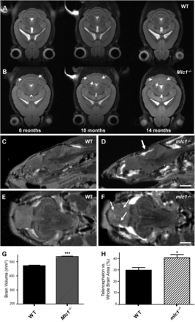
Figure 6. MRI of Mlc1^{−/−} mice and mlc1^{−/−} zebrafish. (A and B) MRI of mice from different ages ...
Notes:
Figure 6. MRI of Mlc1−/− mice and mlc1−/− zebrafish. (A and B) MRI of mice from different ages show progressive presence of white matter lesions (arrows) in the cerebellum of Mlc1−/− animals (B), but not in wild-type mice (A). (C–F) MRI of adult zebrafish reveals the presence of small lesions in the mesencephalon (thick arrow in D) and telencephalon (arrows in F) in mlc1−/− zebrafish. Hyperintense signals in (D) and (F) may correspond to fat containing tissue in or around the brain. (C) and (E) correspond to images from wild-type zebrafish. Scale bars: 1 mm in (C) and (D), 500 μm in (E) and (F). (G) Brain volume is higher in Mlc1−/− mice. Brain volume was estimated by quantifying the area of consecutive MRI images using ImageJ. Data correspond to seven wild-type and seven Mlc1−/− mice (P < 0.0001). (H) Telencephalon appears bigger relative to the whole brain in mlc1−/− zebrafish (P < 0.05).
Unless provided in the caption above, the following copyright applies to the content of this slide: © The Author 2014. Published by Oxford University Press. All rights reserved. For Permissions, please email: journals.permissions@oup.com

Slide 7
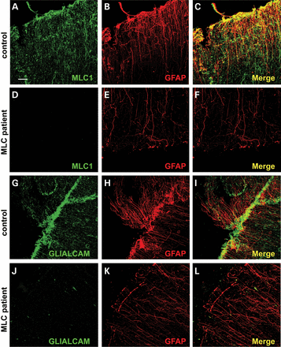
Figure 7. GLIALCAM is mislocalized in the cerebellum of a patient with a missense mutation in MLC1. (A–F) ...
Notes:
Figure 7. GLIALCAM is mislocalized in the cerebellum of a patient with a missense mutation in MLC1. (A–F) Immunofluorescence detection of MLC1 and GFAP proteins in the cerebellum of a control subject (A–C) and an MLC patient (D-F) carrying a homozygous mutation in MLC1 shows the absence of the MLC1 protein in the patient. Scale bar: 40 μm. (G–L) Immunofluorescence detection of GLIALCAM and GFAP proteins in the cerebellum of a control subject (G–I) and an MLC patient (J–L) carrying a homozygous mutation in MLC1 shows the diffuse signal for GLIALCAM in the absence of MLC1.
Unless provided in the caption above, the following copyright applies to the content of this slide: © The Author 2014. Published by Oxford University Press. All rights reserved. For Permissions, please email: journals.permissions@oup.com

Slide 8
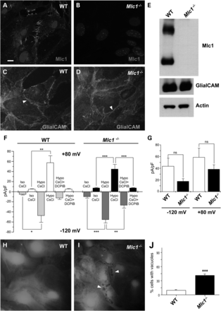
Figure 8. Cultured Mlc1^{−/−} astrocytes do not show mislocalization of Glialcam and still present a VRAC ...
Notes:
Figure 8. Cultured Mlc1−/− astrocytes do not show mislocalization of Glialcam and still present a VRAC response. (A and B) Immunofluorescence detection of Mlc1 in cultured astrocytes from newborn pups confirms the absence of the Mlc1 protein in Mlc1−/− mice. (C and D) Immunofluorescence detection of Glialcam in cultured astrocytes from newborn pups shows that Glialcam protein is present in cell junctions in Mlc1−/− mice, unlike it is seen in vivo. Scale bar: 10 μm. (E) Western blot of brain extracts show no difference in Glialcam protein levels between wild-type and Mlc1−/− mice. (F and G) Depression of the hypotonicity-evoked chloride current with the Volume Regulated Anion Channel (VRAC) inhibitor DCPIB in wild-type (WT) and Mlc1−/− mouse cultured astrocytes. (F) Bar graph of membrane current densities (mean ± SEM) at +80 mV (upper bars) and −120 mV (lower bars) measured in isotonic (Iso CsCl) and hypotonic conditions (Hypo CsCl) and after addition of DCPIB (10 μm) to the hypotonic solution (Hypo CsCl + DCPIB) in wild-type (n = 9) and Mlc1−/− (n = 17) astrocytes. Statistical significance was calculated using paired two-tailed Student's t-test; *P < 0.05, **P < 0.01, ***P < 0.001. (G) Bar graph of DCPIB-sensitive currents (mean ± SEM) induced by hypotonic challenge at −120 and +80 mV in wild-type (n = 7) and Mlc1−/− (n = 7) mouse astrocytes. Differences in current densities were not significant (ns). (H and I) Typical pictures of astrocytes obtained from wild-type (H) and Mlc1−/− (I) mice. Arrowheads point to vacuoles observed mostly in Mlc1−/− astrocytes. (J) Quantification of the number of cells containing vacuoles. A cell was positive for vacuolation if have at least three vacuoles of a size bigger than 0.5 μm. Scale bar: 10 μm.
Unless provided in the caption above, the following copyright applies to the content of this slide: © The Author 2014. Published by Oxford University Press. All rights reserved. For Permissions, please email: journals.permissions@oup.com

Slide 9
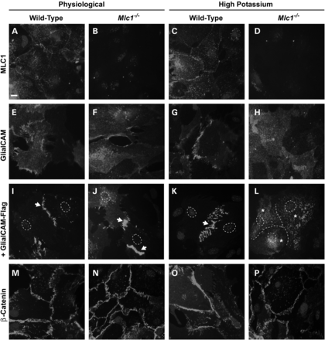
Figure 9. Glialcam localization to astrocyte junctions depends on Mlc1 and the presence of high extracellular potassium ...
Notes:
Figure 9. Glialcam localization to astrocyte junctions depends on Mlc1 and the presence of high extracellular potassium concentration. (A–D) Mlc1 localization in cell junctions in cultured mouse astrocytes do not change between physiological conditions or high extracellular potassium exposure. Scale bar: 10 μm. (E–H) Glialcam localization in cell junctions in cultured mouse astrocytes is lost when Mlc1−/− astrocytes are subjected to 6 h treatment with high extracellular potassium. Four independent experiments gave similar results. (I–L) Adenoviral-mediated expression of human Flag-tagged GLIALCAM in wild-type and Mlc1−/− cultured mouse astrocytes confirms the effect of the high extracellular potassium concentration on GlialCAM localization in cell junctions (arrows) in the absence of Mlc1, when it is found almost exclusively in the cytoplasm (asterisks). Dotted line in (L) labels the junctions between three adjacent astrocytes. Four independent experiments gave similar results. (M–P) High extracellular potassium concentration does not alter of the localization of a control junctional protein (β-catenin) in cultured mouse astrocytes.
Unless provided in the caption above, the following copyright applies to the content of this slide: © The Author 2014. Published by Oxford University Press. All rights reserved. For Permissions, please email: journals.permissions@oup.com

