Slide 1
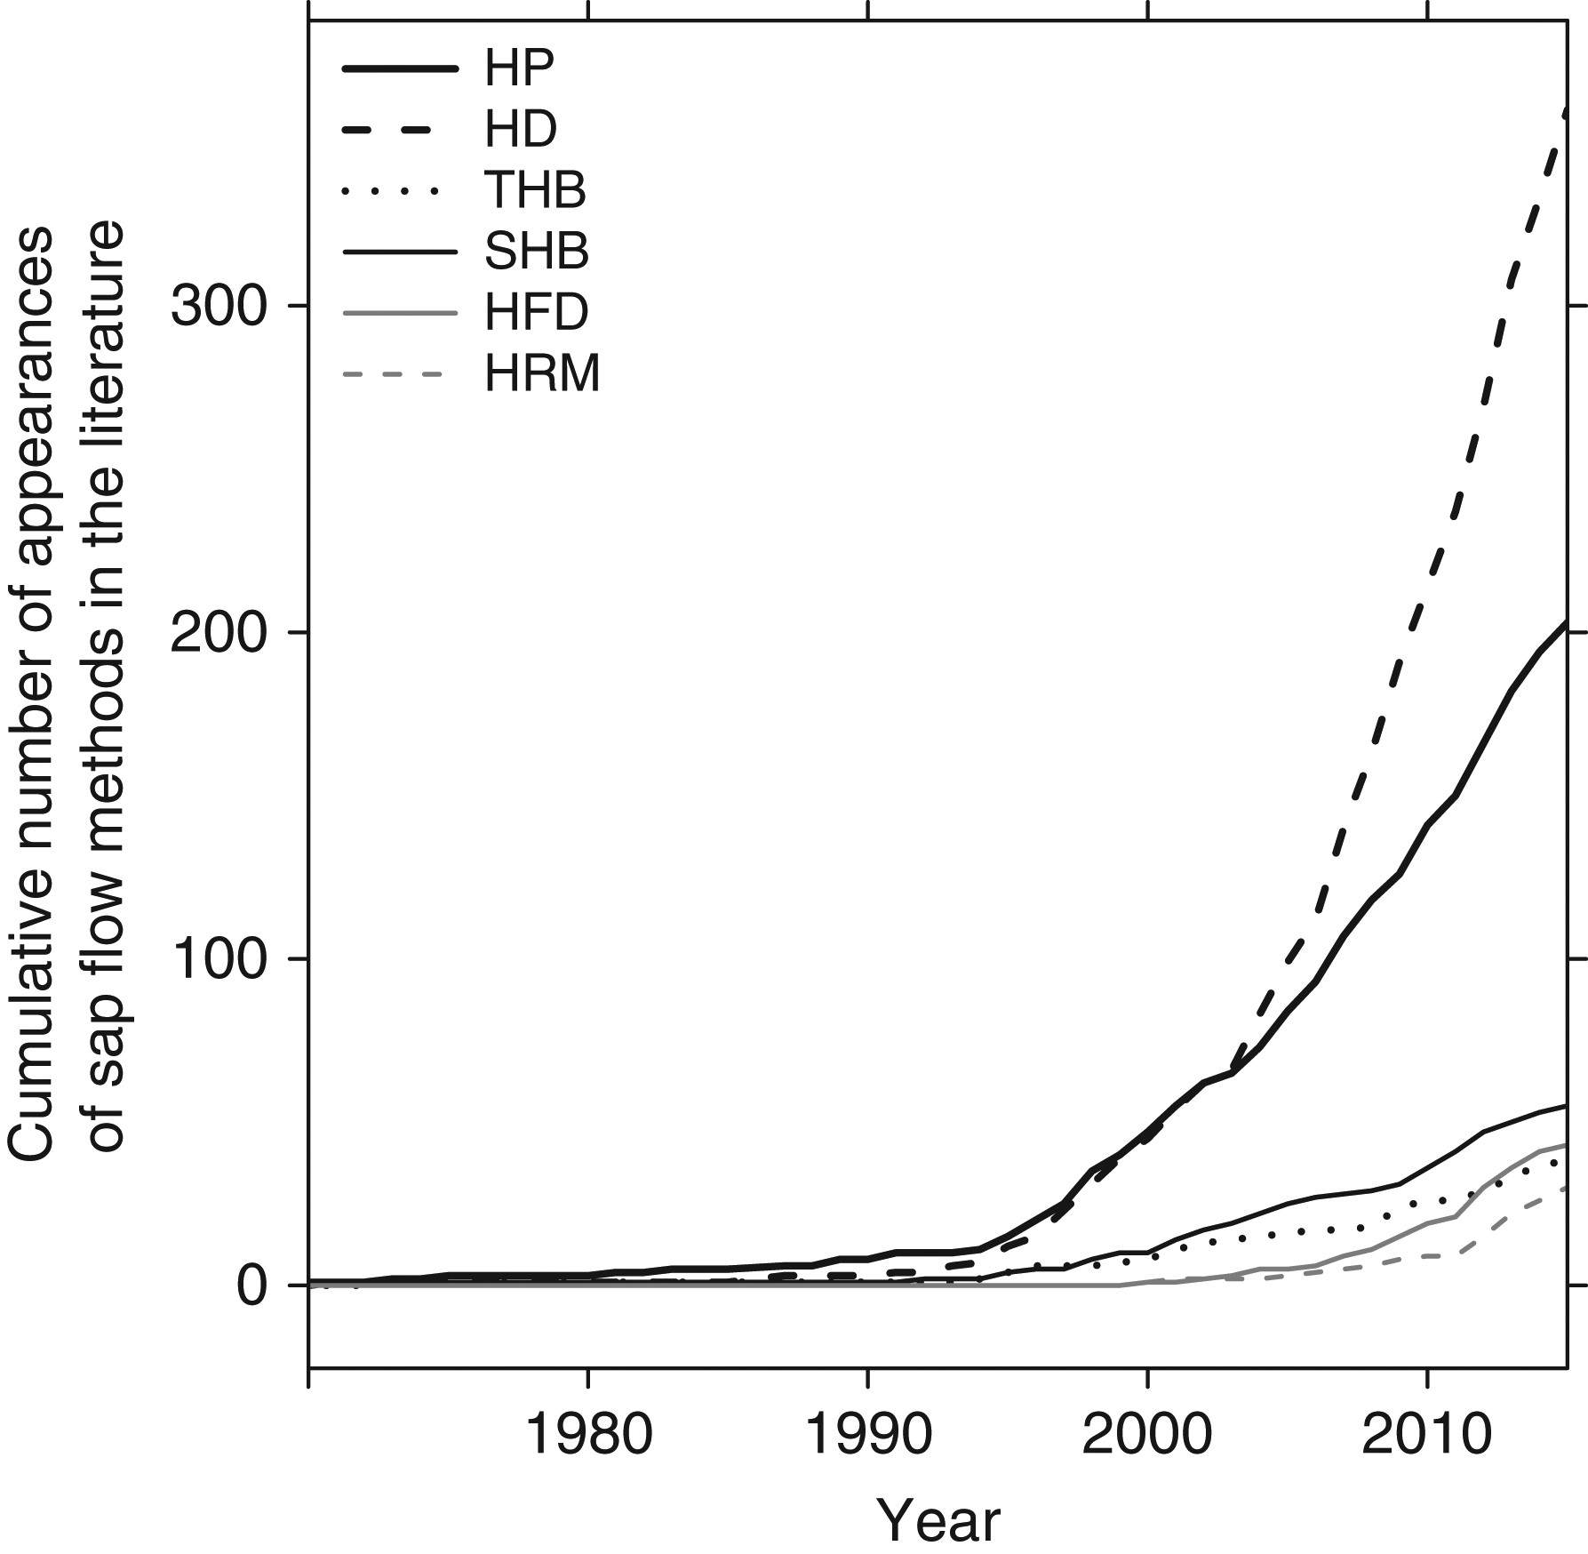
Figure 1. Cumulative count of appearances of different sap flow methods in a Scopus search of sap flow-related ...
Notes:
Figure 1. Cumulative count of appearances of different sap flow methods in a Scopus search of sap flow-related literature (‘sap flow’ OR ‘sapflow’ OR ‘sap flux’ OR ‘sapflux’ in title, abstract or keywords). Note that counts represent individual appearances of each method, not papers (e.g., a paper can have multiple methods). HP, heat pulse methods, including Compensation Heat Pulse, Tmax Method, Calibrated Average Gradient and Sapflow+; HD, heat dissipation; THB, tissue heat balance; SHB, stem heat balance; HFD, heat field deformation; HRM, heat ratio method.
Unless provided in the caption above, the following copyright applies to the content of this slide: © The Author 2016. Published by Oxford University Press. All rights reserved. For permissions, please e-mail: journals.permissions@oup.com

Slide 2
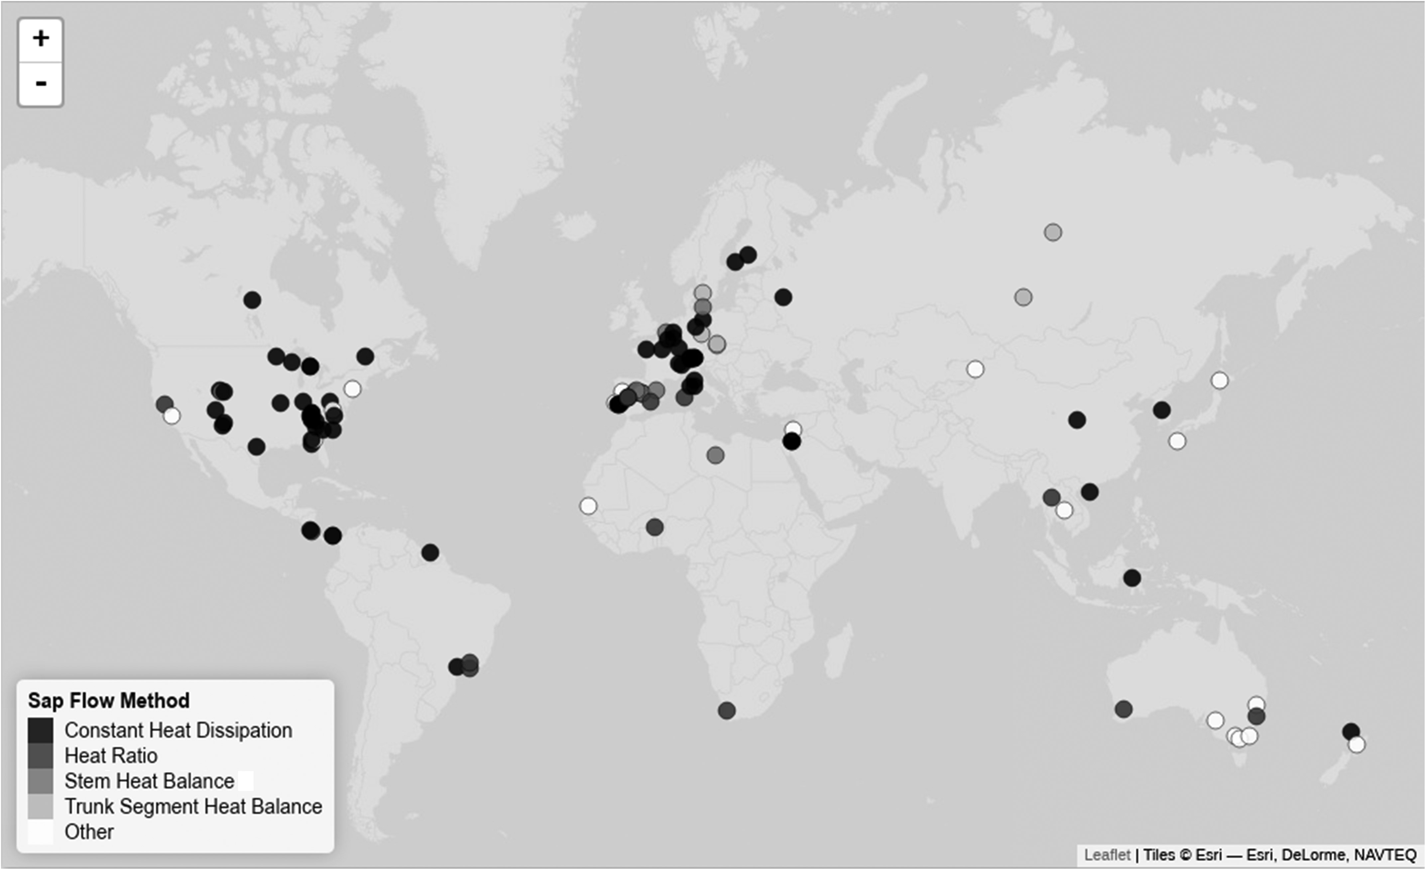
Figure 2. Geographic distribution of potential sap flow data sources, coded by sap flow method, based on a preliminary ...
Notes:
Figure 2. Geographic distribution of potential sap flow data sources, coded by sap flow method, based on a preliminary survey. An interactive summary of this preliminary survey, with further information on the growth condition of the stand, the number of species and trees can be found at http://sapfluxnet.creaf.cat/shiny/preliminary_dashboard/.
Unless provided in the caption above, the following copyright applies to the content of this slide: © The Author 2016. Published by Oxford University Press. All rights reserved. For permissions, please e-mail: journals.permissions@oup.com

Slide 3
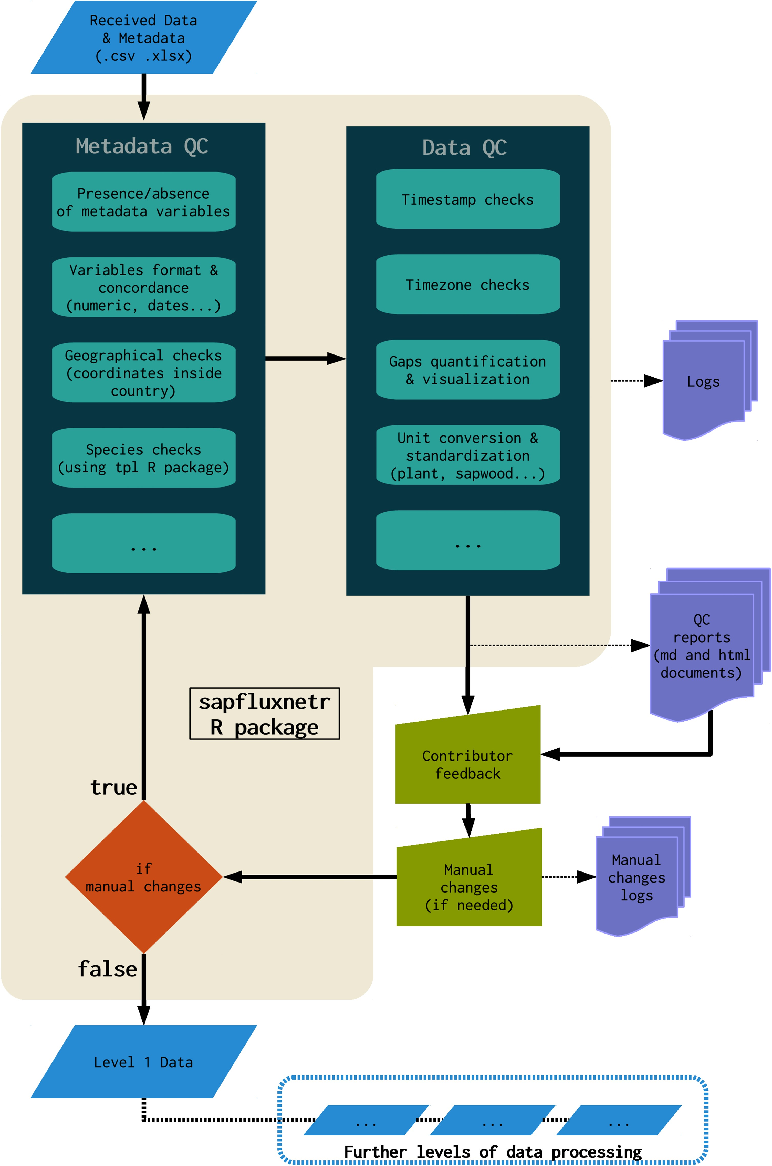
Figure 3. Data flow from reception to production of Level 1 data sets. Initial data and metadata quality control is ...
Notes:
Figure 3. Data flow from reception to production of Level 1 data sets. Initial data and metadata quality control is encapsulated in an R package under continuous development. This semi-automated procedure generates interactive quality control (QC) reports that are shared with data contributors to resolve any issues with the data. All the individual steps in this procedure and any manual changes on the data sets are traceable because they are logged in structured text files. Beyond Level 1, data processing is under implementation, as depicted by discontinuous lines.
Unless provided in the caption above, the following copyright applies to the content of this slide: © The Author 2016. Published by Oxford University Press. All rights reserved. For permissions, please e-mail: journals.permissions@oup.com

