Slide 1
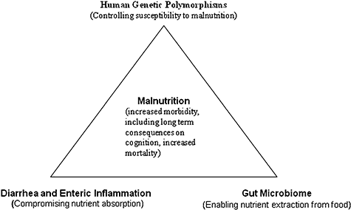
Figure 1 Interaction of human genetic polymorphisms, enteric infections, and gut microbiome in malnutrition.
Notes:
Figure 1 Interaction of human genetic polymorphisms, enteric infections, and gut microbiome in malnutrition.
Unless provided in the caption above, the following copyright applies to the content of this slide: © 2009 International Life Sciences Institute

