Slide 1
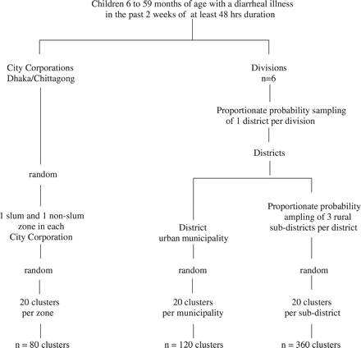
Figure 1 Summary of sampling frame for cluster selection
Notes:
Figure 1 Summary of sampling frame for cluster selection
Unless provided in the caption above, the following copyright applies to the content of this slide: Published by Oxford University Press on behalf of the International Epidemiological Association © The Author 2006; all rights reserved.

