Slide 1
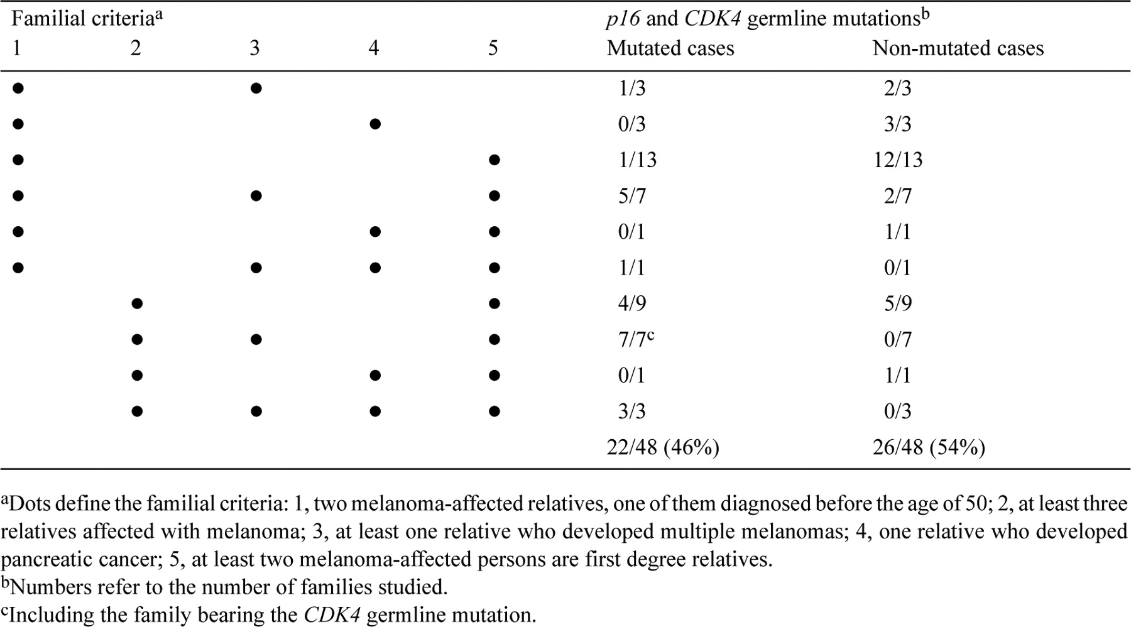
Table 1 Frequency of p16 and CDK4 germline mutations in relation to familial selection criteria
Notes:
Table 1 Frequency of p16 and CDK4 germline mutations in relation to familial selection criteria
Unless provided in the caption above, the following copyright applies to the content of this slide: © 1998 Oxford University Press

Slide 2
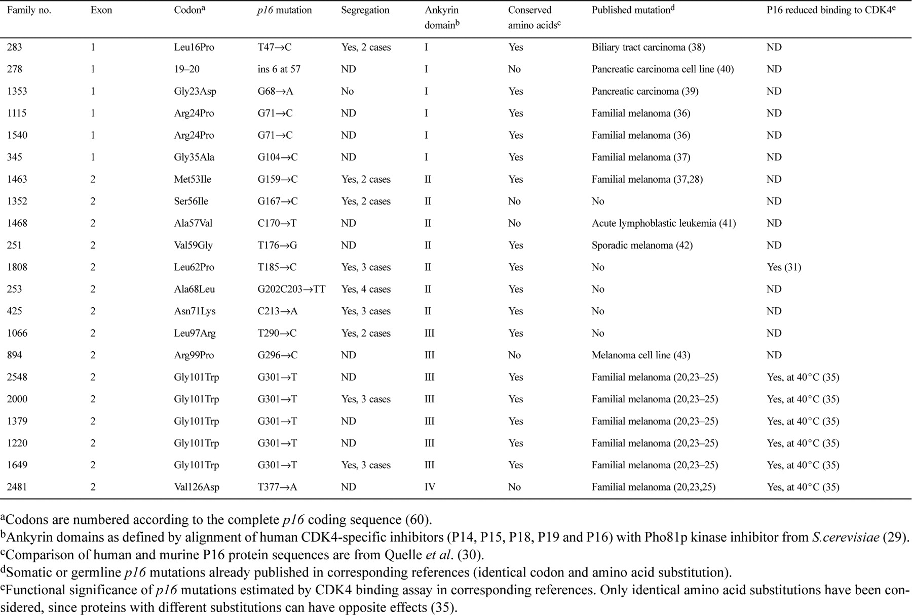
Table 2 p16 germline mutations in 48 melanoma-prone families
Notes:
Table 2 p16 germline mutations in 48 melanoma-prone families
Unless provided in the caption above, the following copyright applies to the content of this slide: © 1998 Oxford University Press

Slide 3
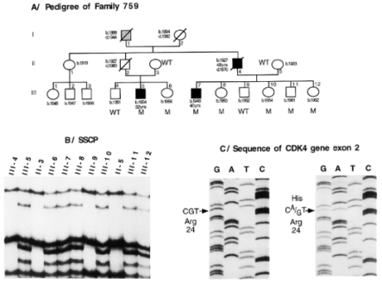
Figure 1 (A) Pedigree structure of kindred 759. Symbol definition is as follows: filled for melanoma; dotted for ...
Notes:
Figure 1 (A) Pedigree structure of kindred 759. Symbol definition is as follows: filled for melanoma; dotted for pyloric cancer. Years of birth and death and ages of melanoma onset are shown beneath each symbol. CDK4 germline mutation status is indicated as M (carrier of the Arg24His mutation) or WT (wild-type sequence). (B) SSCP analysis of PCR products for CDK4 gene exon 2 on DNA extracted from blood of 11 family 759 members. Numbers refer to individuals identified in (A). An abnormal migrating band corresponding to the mutated allele is detected for patients III-5, III-6, III-7, III-8, III-10, and III-12. (C) Sequence analysis of CDK4 gene exon 2. On the left is a wild-type control sequence, while on the right is a heterozygous mutant sequence of constitutional DNA from patient III-7. The arrow indicates the A→G mutation in the CDK4 gene responsible for the Arg24His substitution.
Unless provided in the caption above, the following copyright applies to the content of this slide: © 1998 Oxford University Press

