Slide 1
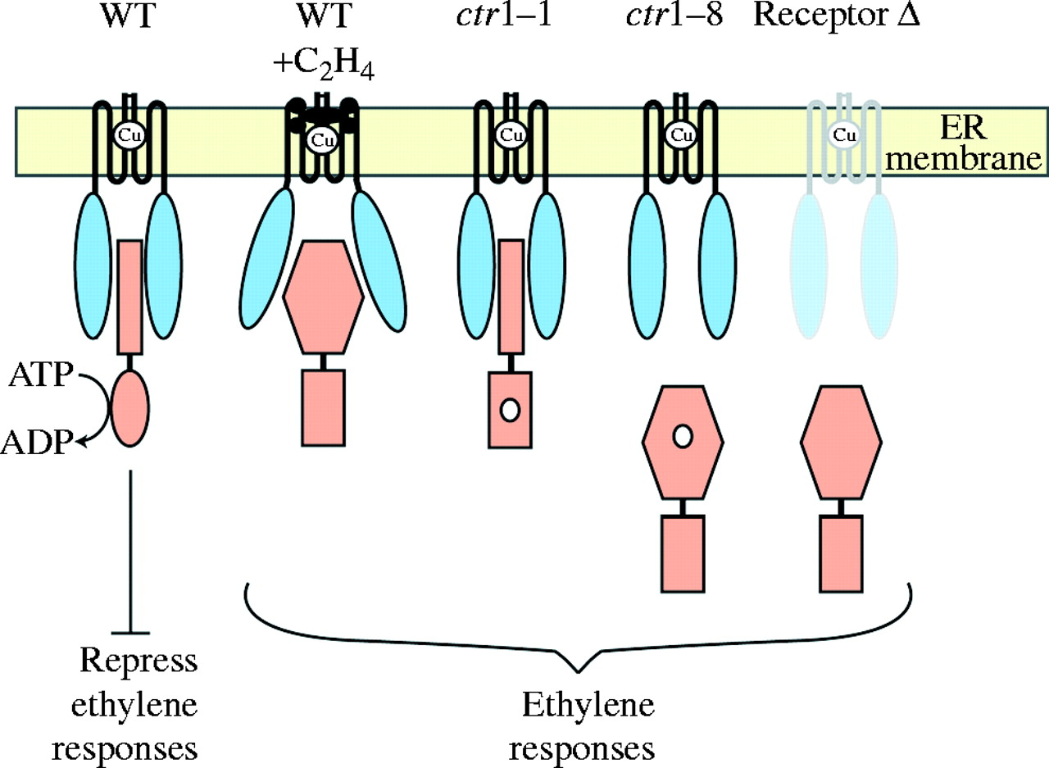
Fig. 3. Model for signalling by the ethylene receptor–CTR1 protein complex. The ethylene receptor (blue) contains one ...
Notes:
Fig. 3. Model for signalling by the ethylene receptor–CTR1 protein complex. The ethylene receptor (blue) contains one ethylene-binding site per homodimer, with ethylene binding mediated by a single copper ion (Cu) present in the ethylene-binding site. CTR1 (shown in orange) interacts with the soluble domain of the receptor and as a result of this interaction is localized to the ER. In air, the kinase domain of CTR1 actively represses ethylene responses. Binding of ethylene by the receptor leads to a conformational change in CTR1 that reduces its kinase activity, thereby relieving repression of the ethylene response pathway. Mutations in CTR1 (indicated by a white circle) can result in an ethylene-like response in air by two different mechanisms. Mutations such as ctr1-1 eliminate the kinase activity of CTR1 so that CTR1 is unable to repress the ethylene responses. Mutations such as ctr1-8 disrupt the interaction of CTR1 with the receptor, resulting in mis-localization of CTR1 to the cytosol. Loss-of-function mutations that eliminate multiple members of the ethylene receptor family (receptor Δ) also result in mis-localization of CTR1 to the cytosol. In the cytosol, CTR1 may adapt a kinase-inactive conformation (as shown here) or may not be proximate to the appropriate phosphorylation substrate (figure adapted from Gao et al., 2003).
Unless provided in the caption above, the following copyright applies to the content of this slide: © The Author 2005. Published by Oxford University Press on behalf of the Annals of Botany Company. All rights reserved. For Permissions, please email: journals.permissions@oupjournals.org

Slide 2
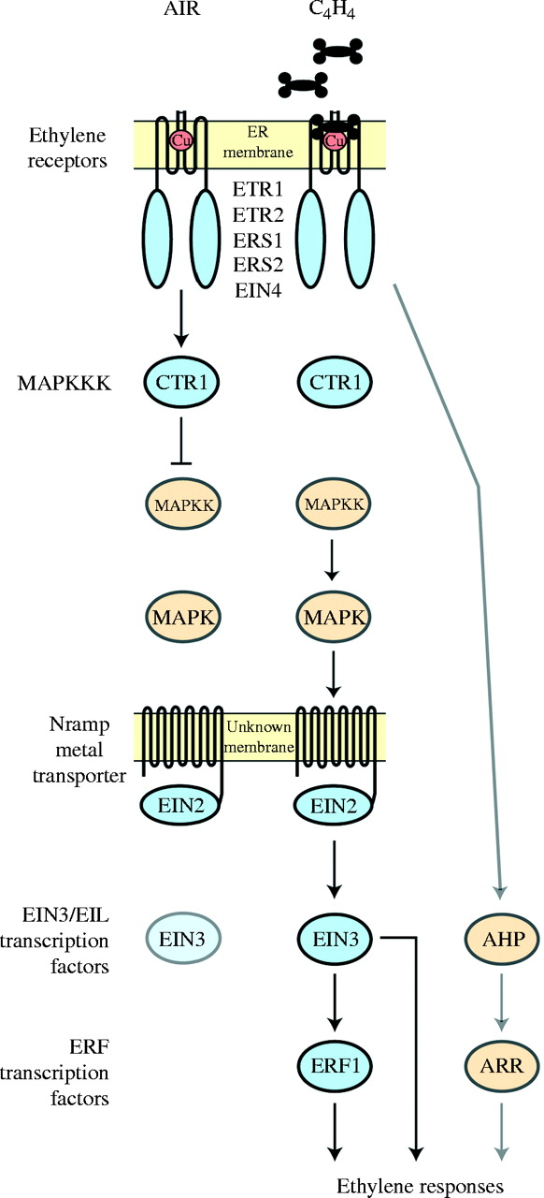
Fig. 2. Model for ethylene signal transduction that incorporates biochemical features of the pathway components. ...
Notes:
Fig. 2. Model for ethylene signal transduction that incorporates biochemical features of the pathway components. Soluble protein domains are shown as circles and predicting transmembrane structures are shown as lines. Confirmed components of the pathway are shown in blue; more recently proposed components are shown in orange. In air, ethylene receptors maintain CTR1 in an active state that serves to repress ethylene responses. In ethylene, the repression is relieved. Binding of ethylene inactivates the receptors, thereby inactivating CTR1. As a result, EIN2 is activated and a transcriptional cascade involving the EIN3/EIL and ERF transcription factors is initiated. Both families of transcription factors are involved in regulating ethylene responses. The protein level of EIN3 is lower in the absence of ethylene than in the presence of ethylene, due to degradation by the ubiquitin-proteasome pathway. The figure also incorporates components about which conflicting data has been reported, namely a MAPK module operating downstream of CTR1, and a two-component signalling pathway (AHP and ARR) functioning independently of the CTR1-mediated pathway.
Unless provided in the caption above, the following copyright applies to the content of this slide: © The Author 2005. Published by Oxford University Press on behalf of the Annals of Botany Company. All rights reserved. For Permissions, please email: journals.permissions@oupjournals.org

Slide 3
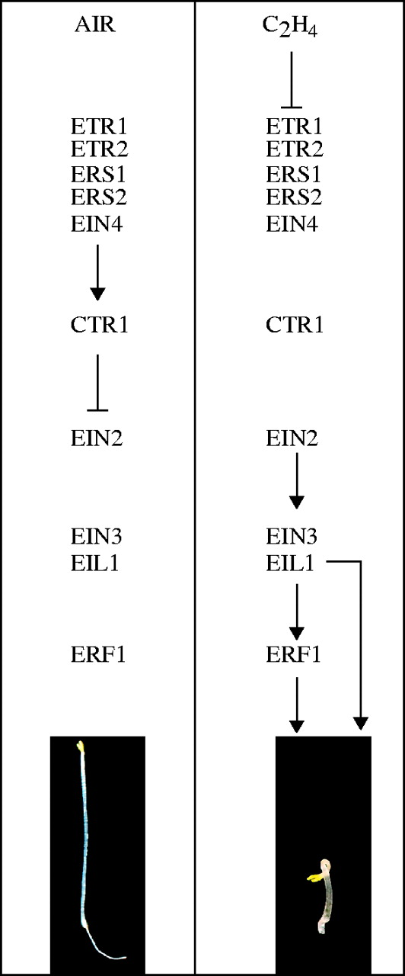
Fig. 1. Pathway for ethylene signal transduction based on genetic analysis. Key pathway components are shown. In air, ...
Notes:
Fig. 1. Pathway for ethylene signal transduction based on genetic analysis. Key pathway components are shown. In air, the negative regulator CTR1 suppresses the pathway so that downstream positive regulators are inactive, thereby resulting in seedlings that show an air-grown phenotype. Binding of ethylene serves to inactivate CTR1, so that the downstream positive regulators are now active. Activation of ethylene responses results in seedlings that show the triple-response phenotype.
Unless provided in the caption above, the following copyright applies to the content of this slide: © The Author 2005. Published by Oxford University Press on behalf of the Annals of Botany Company. All rights reserved. For Permissions, please email: journals.permissions@oupjournals.org

